Slide 1

SYMBOL TABLE, ABSTRACT SYNTAX TREE, INTERMEDIATE CODE GENERATOR FOR PYTHON LANGUAGE
19AIE313 – INTRODUCTION TO MODERN COMPILER DESIGN
Project Advisor: Ms. Kavitha C.R. / CSE
TEAM ID: 4 - INFINITY
AIE - “A”
APOORVA M - BL.EN.U4AIE19007
TANUJ M - BL.EN.U4AIE19041
AISHWARYA V - BL.EN.U4AIE19068

Slide 2
PROBLEM STATEMENT
To implement few of the phases of a compiler which has been made for the Python language using C language.
Compiler phases implemented:
Symbol table
Abstract syntax tree
Intermediate code generation
The constructs that have been focused on are ‘if-else’ and ‘while’ statements.
Syntax and semantic errors have been displayed if present.

Slide 3
ARCHITECTURE OF LANGUAGE
The following aspects of the Python language syntax have been covered:
Constructs like ‘if-else’ and ‘while’ and the required indentation for these loops.
Integer and float data types
Software Requirements (Languages used to develop this project):
C
YACC
LEX

Slide 4
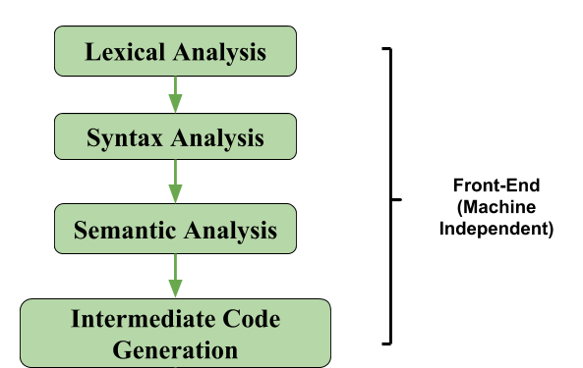
SYSTEM ARCHITECTURE

Slide 5
DIFFERENT MODULES OF PROJECT
DIFFERENT FOLDERS:
1. Token_And Symbol_Table: This folder contains the code that outputs the tokens and the symbol table.
2. Abstract_Syntax_Tree: This folder contains the code that displays the abstract syntax tree.
3. Intermediate_Code_Generation: This folder contains the code that generates the symbol table before optimisations and the intermediate code.

Slide 6
DIFFERENT MODULES OF PROJECT
DIFFERENT FILES:
1. proj.l: It is the Lexical analyser file which defines all the terminals of the productions stated in the yacc file. It contains regular expressions.
2. proj1.y: Yacc file is where the productions for the conditional statements like if-else and while and expressions are mentioned. This file also contains the semantic rules defined against every production necessary. Rules for producing three address code is also present.
3. inp.py: The input python code which will be parsed and checked for syntax and semantic errors by executing the lex and yacc files along with it.

Slide 7
DESIGN STRATEGY
1. SYMBOL TABLE CREATION
Linked list is being used to create the symbol table. The final output shows the label, value, scope, line number and type. We have created three functions to generate the symbol table. They are:
Insert: It pushes the node onto the linked list.
Display: It displays the symbol table.
Search: It searches for a particular label in the linked list.

Slide 8
2. ABSTRACT SYNTAX TREE
This is being implemented using a structure that has three members which hold the data, left pointer and right pointer respectively. The functions that aid in creating and displaying this tree are:
BuildTree: It is used to create a node of this structure and add it to the existing tree.
printTree: This function displays the abstract syntax tree using pre-order traversal.
3. INTERMEDIATE CODE GENERATION
We have used the stack data structure to generate the intermediate code that uses some functions, which are called based on some conditions.

Slide 9
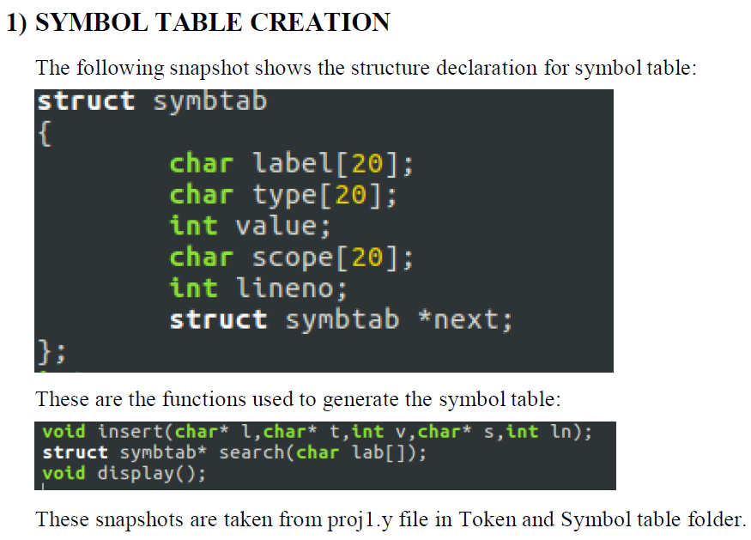
IMPLEMENTATION DETAILS

Slide 10
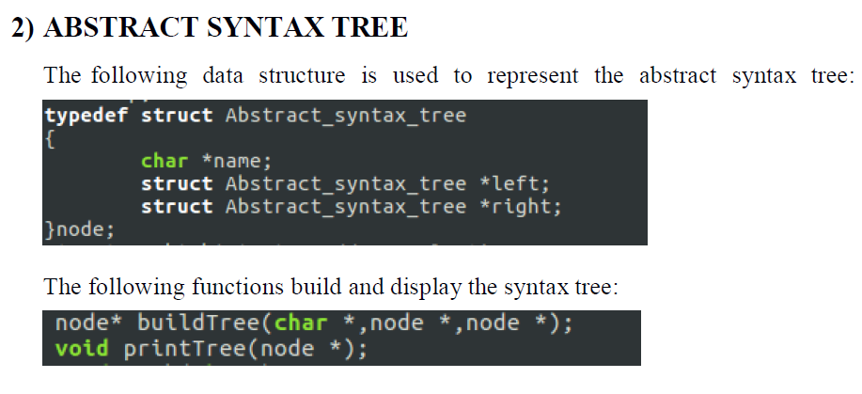
IMPLEMENTATION DETAILS

Slide 11
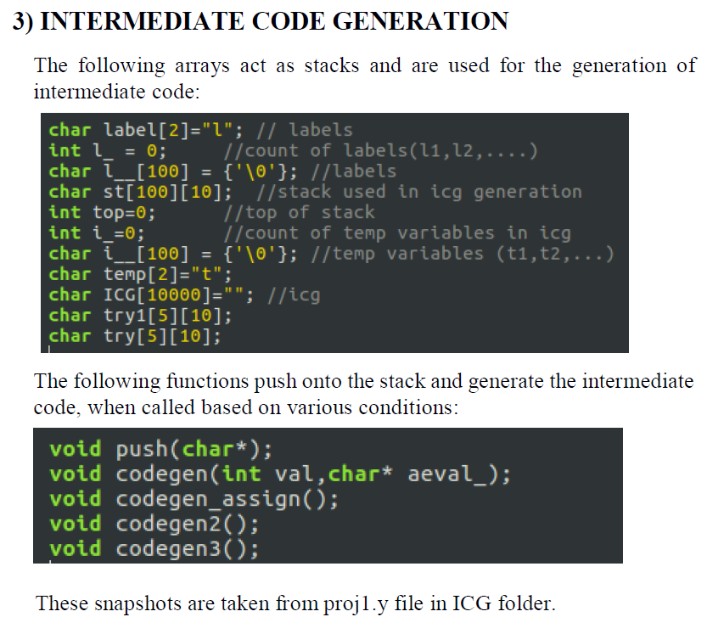
IMPLEMENTATION DETAILS

Slide 12
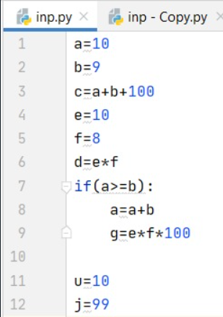
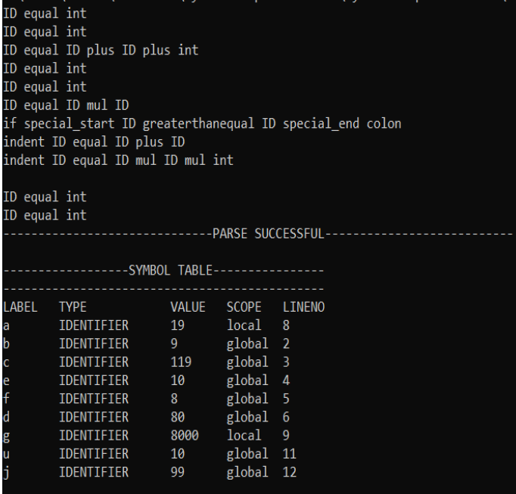
RESULT SNAPSHOTS (if-else)
TEST CASE 1
TOKEN & SYMBOL TABLE

Slide 13
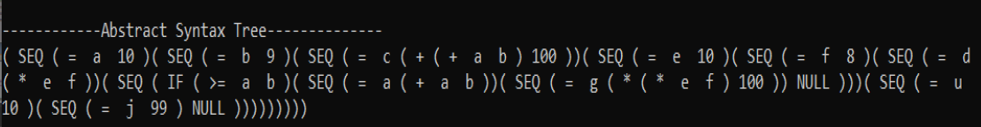
Abstract Syntax Tree:

Slide 14
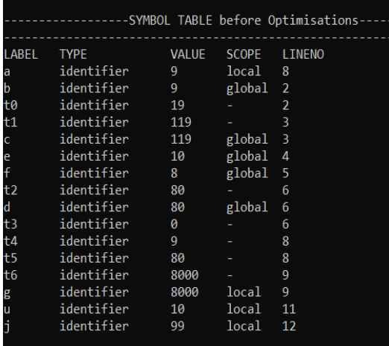
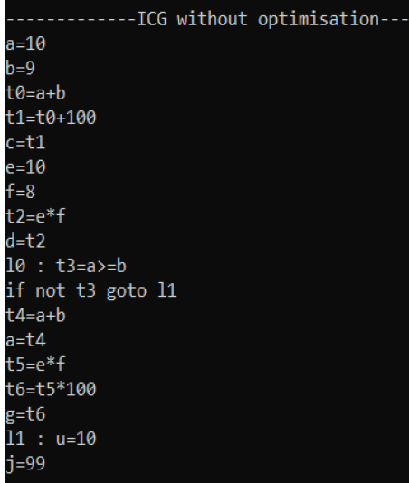
Symbol Table & Intermediate Code:

Slide 15
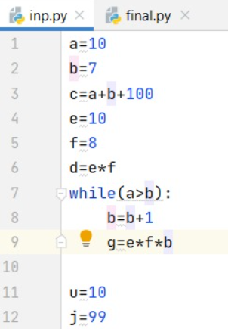
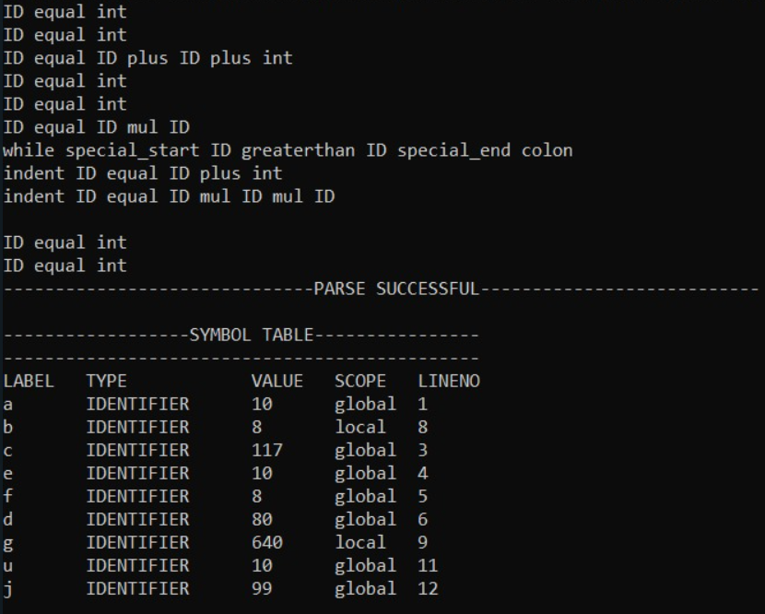
RESULT SNAPSHOTS (while)
TEST CASE 2
TOKEN & SYMBOL TABLE

Slide 16
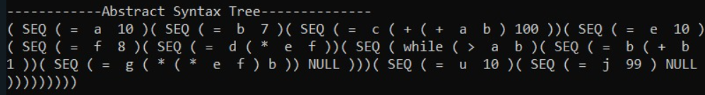
Abstract Syntax Tree:

Slide 17
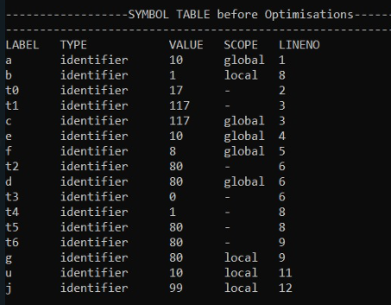
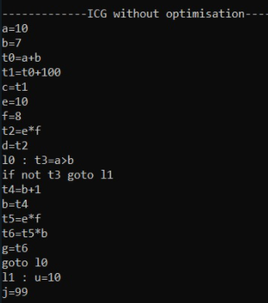
Symbol Table & Intermediate Code:

Slide 18
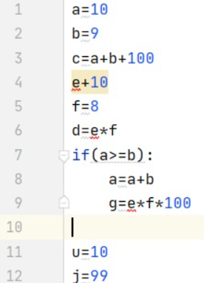
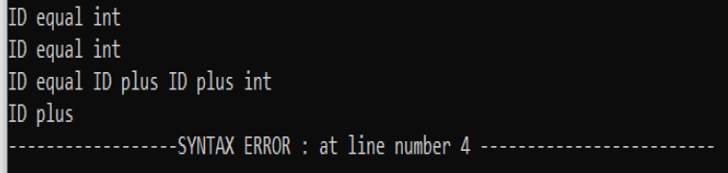
RESULT SNAPSHOTS
TEST CASE 2 (Syntax Error)
OUTPUT

Slide 19
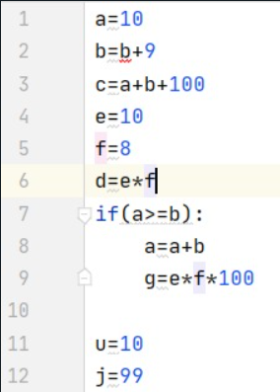
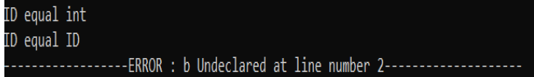
RESULT SNAPSHOTS
TEST CASE 3 (Semantic Error)
OUTPUT

Slide 20
CONCLUSION
This is a partial implementation of mini-compiler for python which contains the first three phases using lex and yacc files which takes in a python program as input and according to the context free grammar written, the program is validated.
Regular Expressions are written to generate the tokens.
Symbol table is created to store the information about the identifiers.
Abstract syntax tree is generated and displayed according to the pre-order tree traversal.
Intermediate code is generated and displayed.

Slide 21
FUTURE SCOPE
Our project has the following shortcomings:
User defined functions are not handled.
Importing libraries and calling library functions is not taken care of.
Data types other than integer and float, example strings, lists, tuples, dictionaries, etc have not been considered.
Constructs other than ‘while’ and ‘if-else’ have not been added in the compiler program.

Slide 22
REFERENCES
Lex and Yacc: http://cse.iitkgp.ac.in/~bivasm/notes/LexAndYaccTutorial.pdf
Introduction about Flex and Bison: http://dinosaur.compilertools.net/
Full Grammar Specification: https://docs.python.org/3/reference/grammar.html
Introduction to Yacc: https://www.inf.unibz.it/~artale/Compiler/intro-yacc.pdf
Intermediate Code Generation:
https://2k8618.blogspot.com/2011/06/intermediate-code-generator- for.html?m=0

Slide 23
THANK YOU

