Slide 1


TEAM 2 – INFINITY APOORVA.M BL.EN.U4AIE19007 TANUJ.M BL.EN.U4AIE19041 AISHWARYA.V BL.EN.U4AIE19068
19AIE302 – ADVANCED COMPUTER NETWORKS
GUIDED BY:
Mr. Rajesh M

Slide 2
PROBLEM STATEMENT
Implement the new routing protocol which modifies the existing AODV protocol.
The change required is in the packet format: An extra information: Packet number – a value assigned when a packet is send need to be included in the packet. Follow the steps mentioned in the document provided modifying AODV protocol.
To verify the working of modified protocol, simulate a wireless network consisting of 6 mobile nodes (n0 – n5). Use the modified routing protocol.

Slide 3
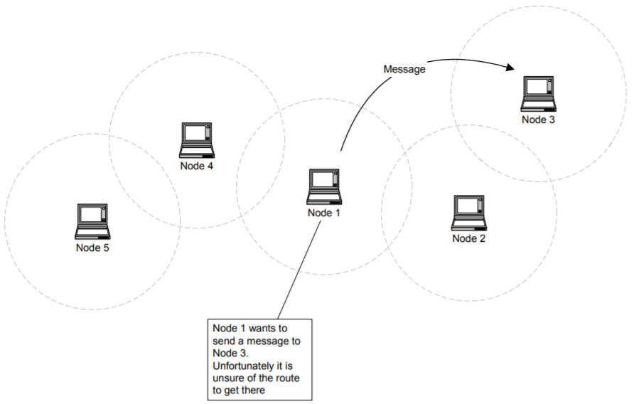
AODV PROTOCOL

Slide 4
WORKING PROCESS
How to modify the AODV protocol as per small piece of algorithm?
Step 1: add a variable called as pkt_count as an integer in aodv.h
Step 2: Initialize pkt_count with a value 0 in aodv.cc
int pkt_count;
pkt_count = 0

Slide 5
WORKING PROCESS
Step 3: we are going to get the packet counts during the forwarding of packets, so code will be running inside the forward() function of aodv.cc
Step 4: Now recompile ns2 using the command ‘make’. Then, run wireless tcl script that has the routing protocol as AODV.
printf (“Packet number %d and from node number %d /n", pkt_count++, index);
ns AODV.tcl

Slide 6
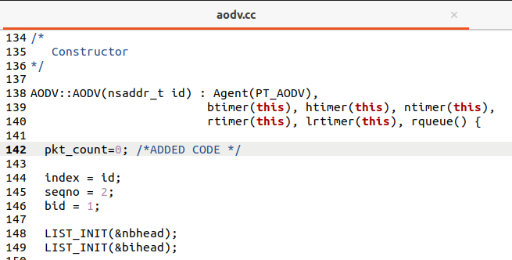
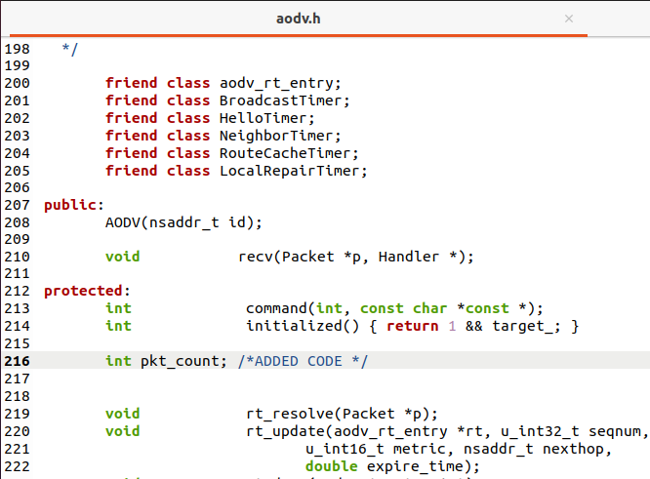
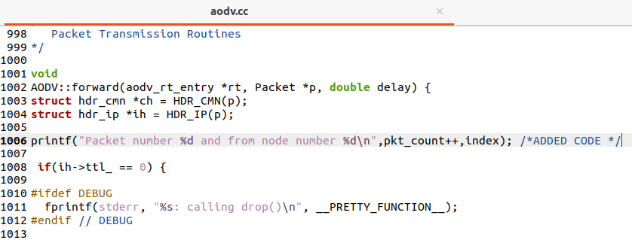
CODE

Slide 7
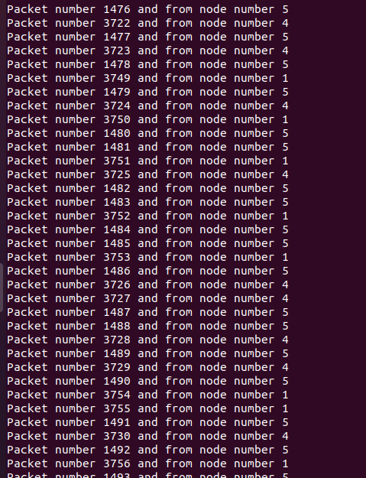
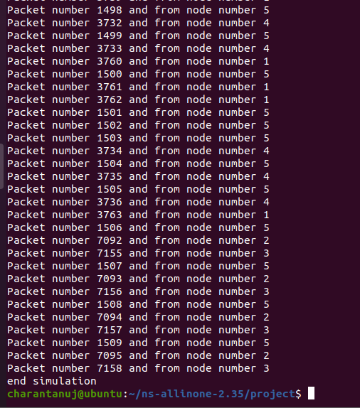
RESULTS

Slide 8
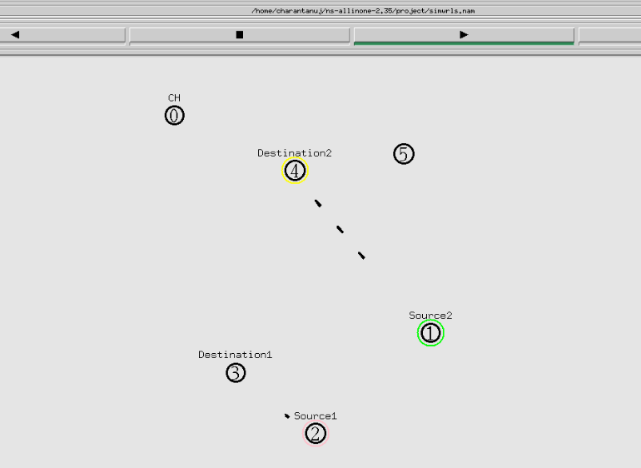
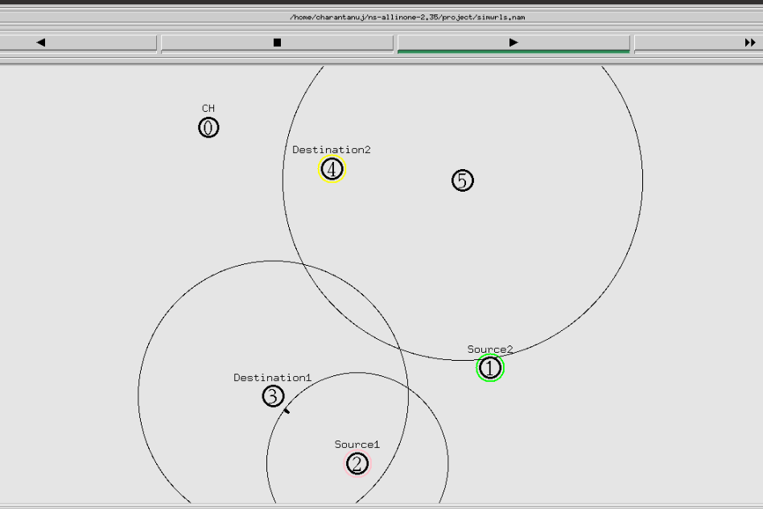
RESULTS

Slide 9

THANK YOU

