Slide 1

PAC-MAN GAME USING FINITE AUTOMATA
19AIE301 – FORMAL LANGUAGE AUTOMATA
TEAM INFINTY
APOORVA M AIE19007
TANUJ M AIE19041
AISHWARYA V AIE19068

Slide 2

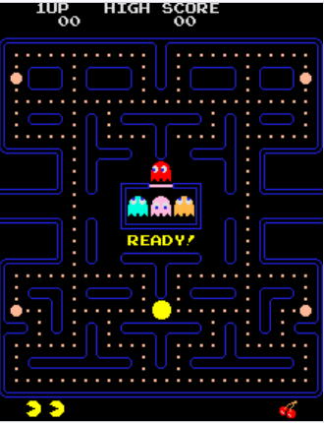
INTRODUCTION
PAC-MAN GAME!
Japanese Arcade Game - 1980
Pacman – player character
Ghost – Enemies: Blinky, Inky, Clyde, Pinky
Pac-dots
Power Pellets
IMPLEMENTATION: JFLAP+ SCRATCH

Slide 3
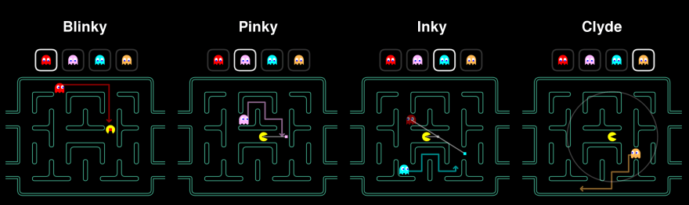
CHASE
The ghosts are trying to find and capture Pac-Man.
Blinky - very aggressive
Pinky - ambush Pac-Man
Inky – patrol, not very predictable
Clyde - random fashion

Slide 4

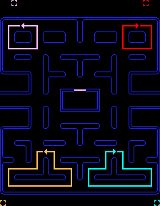
SCATTER
In scatter mode the ghosts stop chasing pacman
Each ghost moves in a unique way in scatter mode
The scatter mode lasts only for a few seconds, chase mode is restored after that.

Slide 5

FRIGHTENED
The Ghosts get frightened when Pacman acquires a power pellet
They turn blue and become vulnerable.
Pac-man cannot be killed during this time.

Slide 6
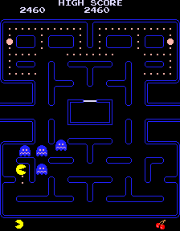
POWER PELLETS
Power pellets are special power that the pacman can acquire.
Eating more number of dots in a level will cause a bonus item, this is a special power to appear in the maze.
The power pellets are time bound.

Slide 7
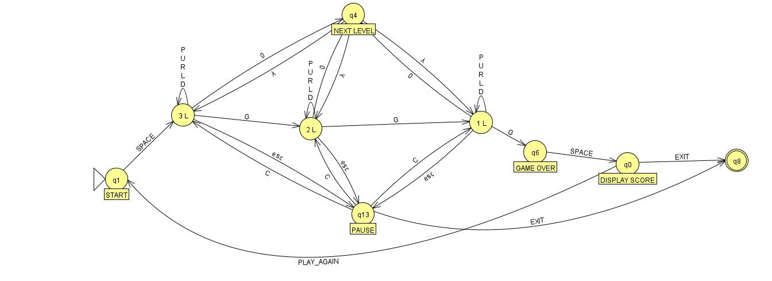
IMPLEMENTATION

Slide 8
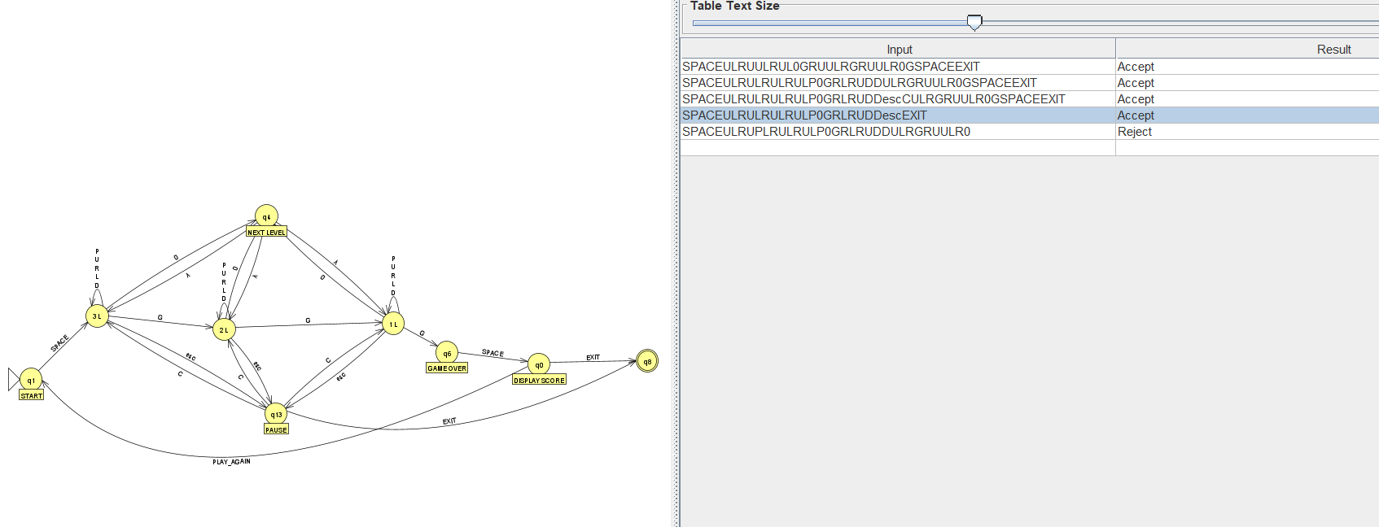

Slide 9
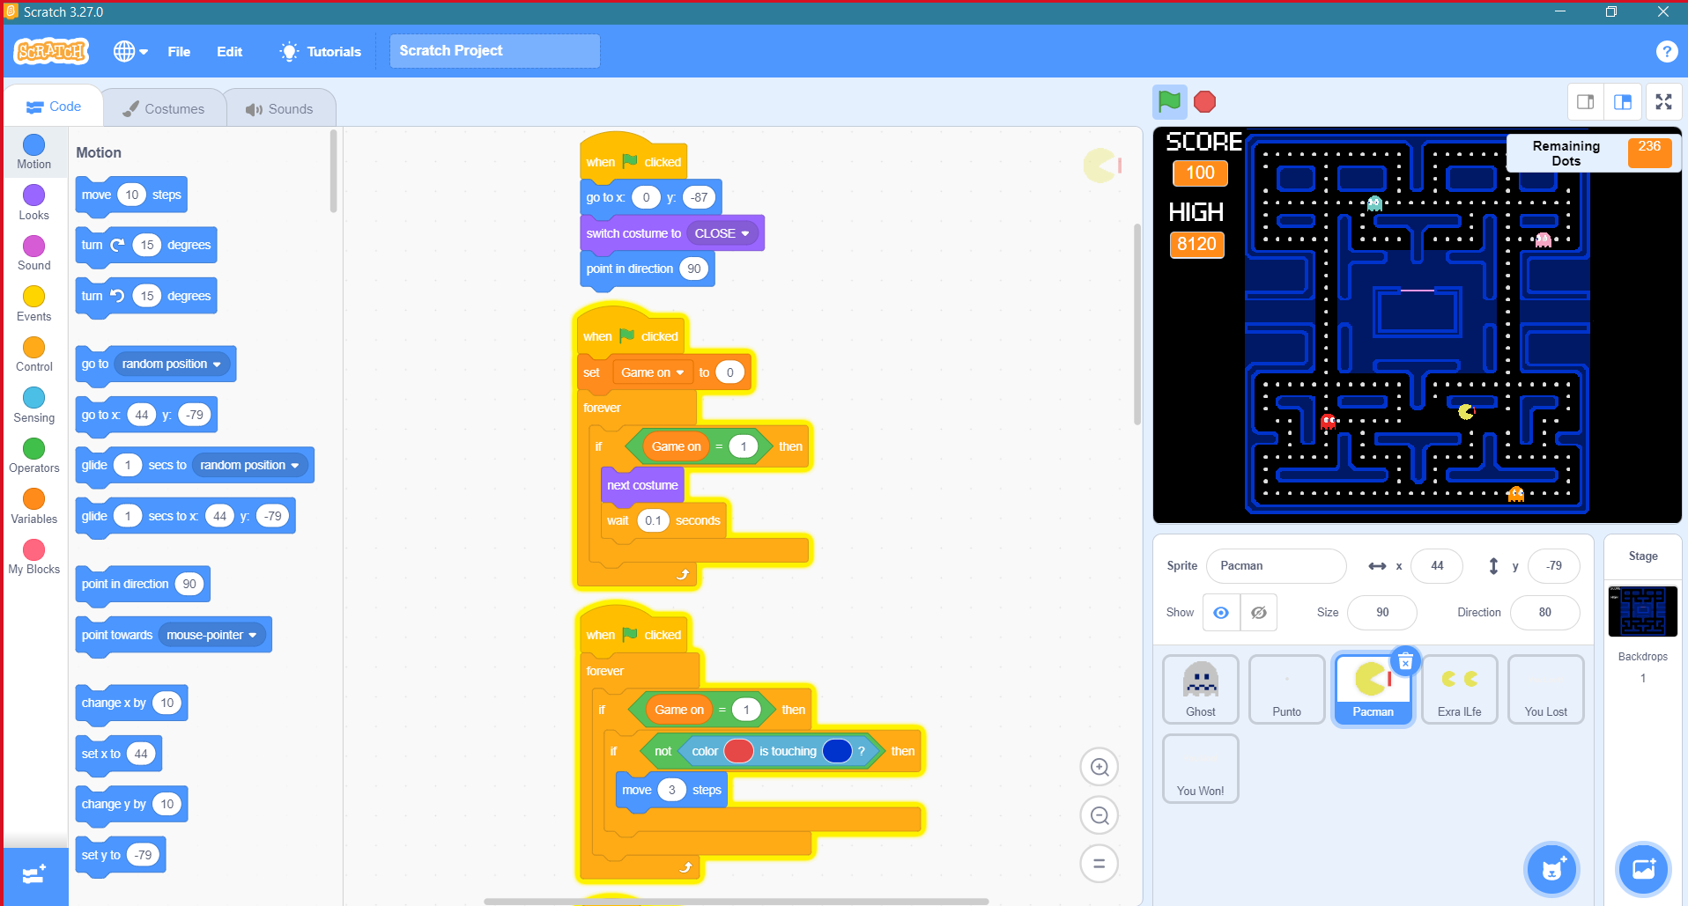
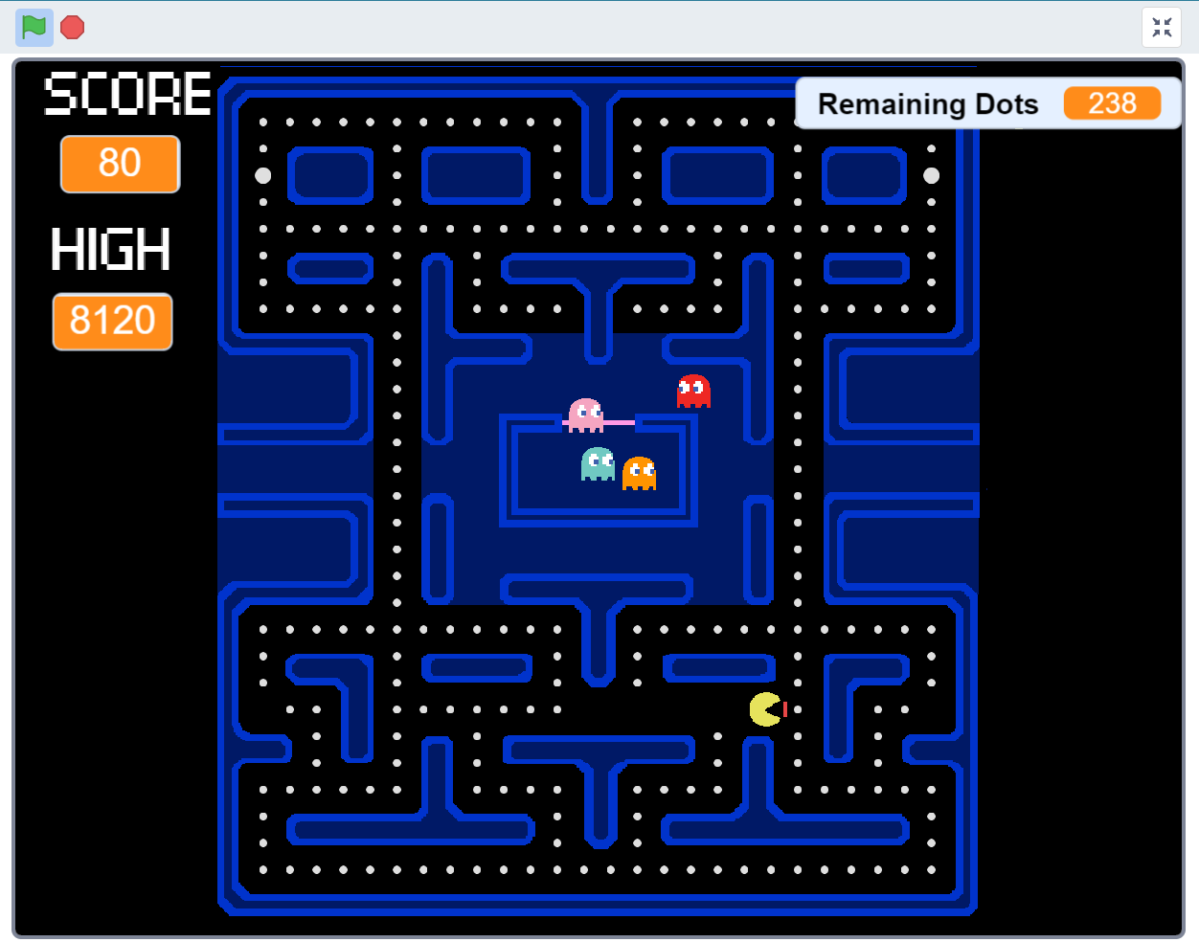
GUI IN SCRATCH

Slide 10
CONCLUSION
The proposed design of the Pacman game has been implemented by utilizing finite-state machines .
We found that designing a game using Automata is the best practice
Finite machines helps the coding process to be more systematic and organized.
In further work, we are planning to incorporate more special powers for both the ghosts and the Pacman.

Slide 11

THANK YOU

