Slide 1
Speech Emotion recognition
Team Thunders
Mamatha Gorantla - 16353839
Tanuj Maturi - 163354141
Jithendra Pavuluri - 16343746
Sreeharini Thamballa - 16353071

Slide 2
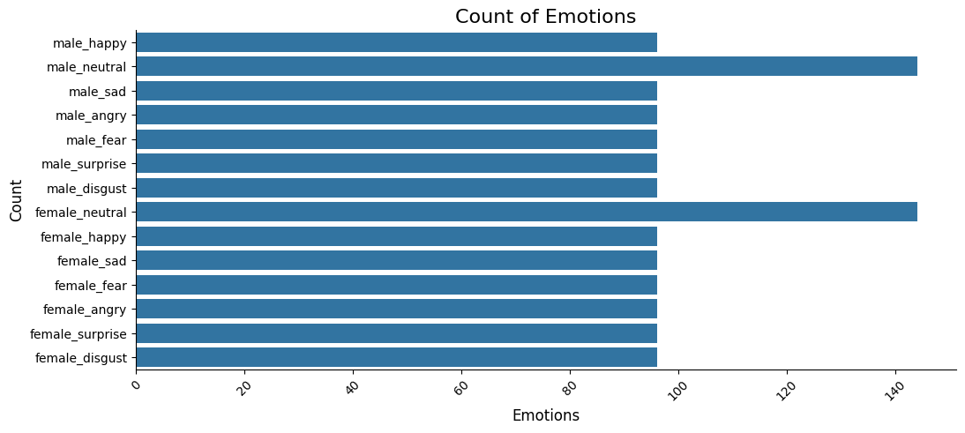
Exploratory Data Analysis
It includes audio files annotated with emotional labels like happiness, sadness, and anger.

Slide 3
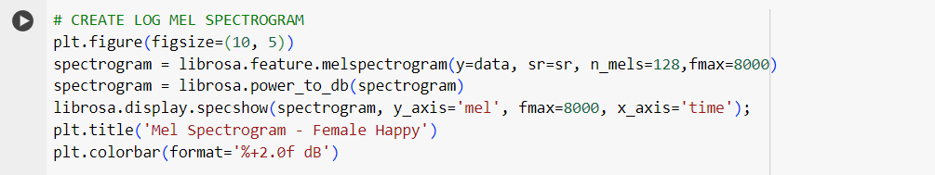
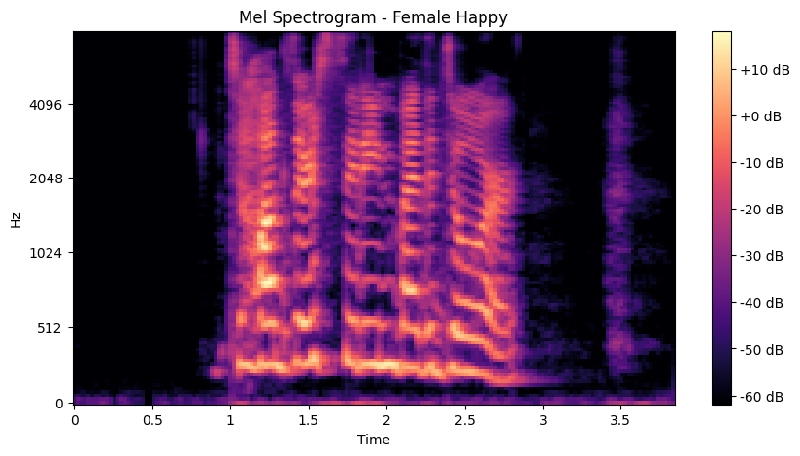
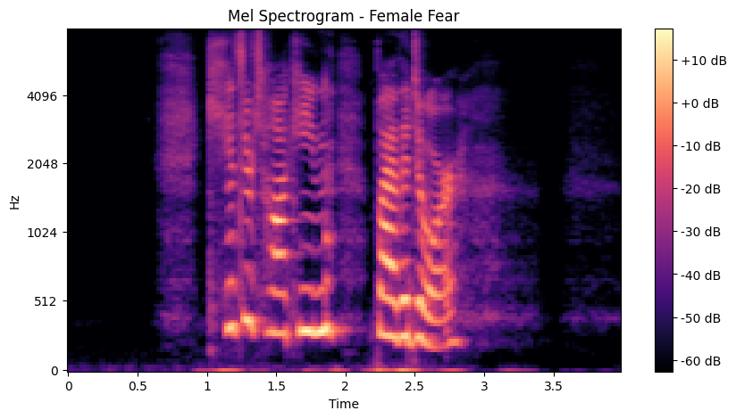
Creating the log Mel spectrogram for preprocessing

Slide 4
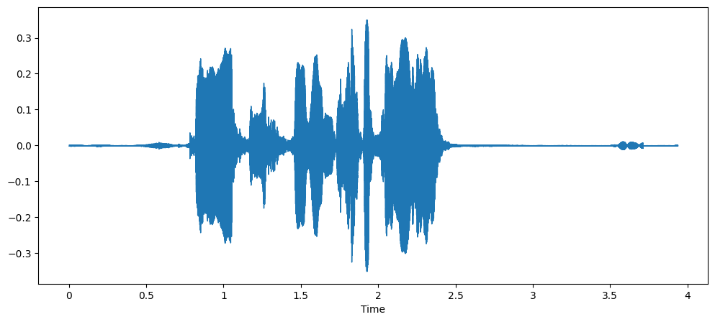
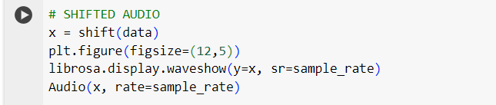
Data Augmentation

Slide 5
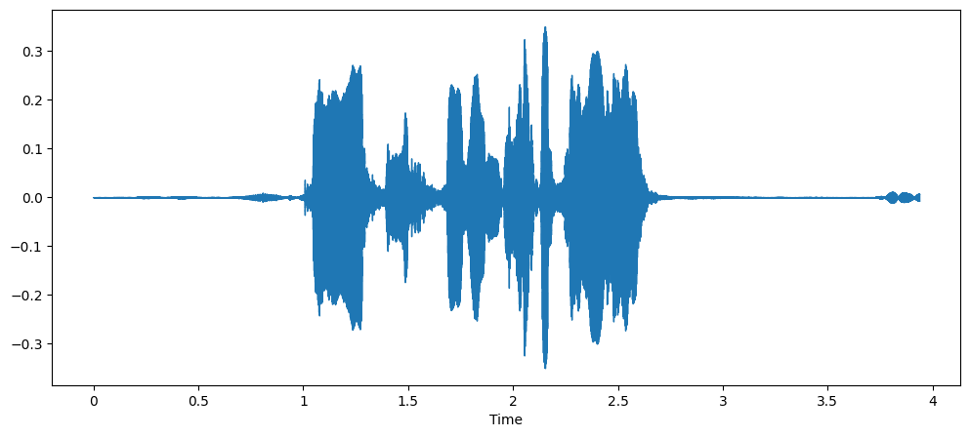
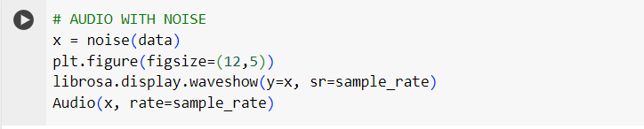

Slide 6

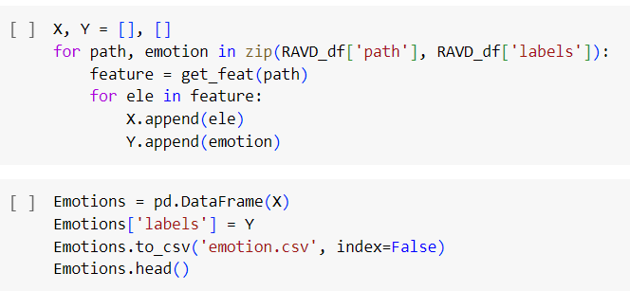
Feature Extraction
MFCC features extracted from audio signals, along with emotion labels in the format 'gender_emotion', comprise a data frame suitable for training speech emotion recognition models.

Slide 7
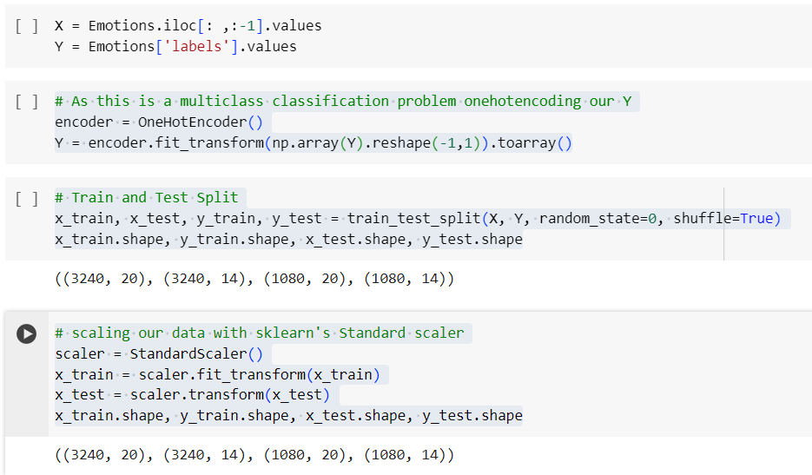
Data Preprocessing
This code preprocesses the data, splits it into training and testing sets, and standardizes the features, preparing them for training a machine learning model for multiclass classification.

Slide 8
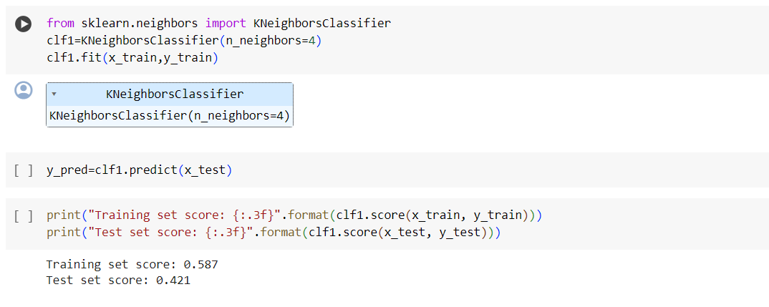
Deploying ML Models
KNN

Slide 9
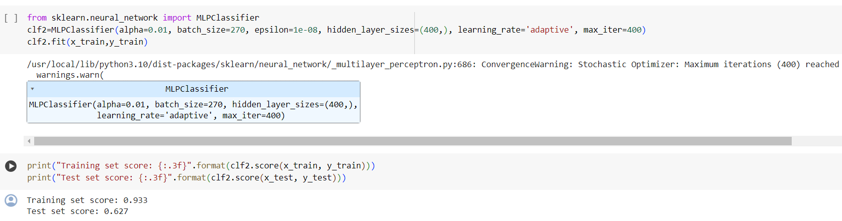
MLP

Slide 10
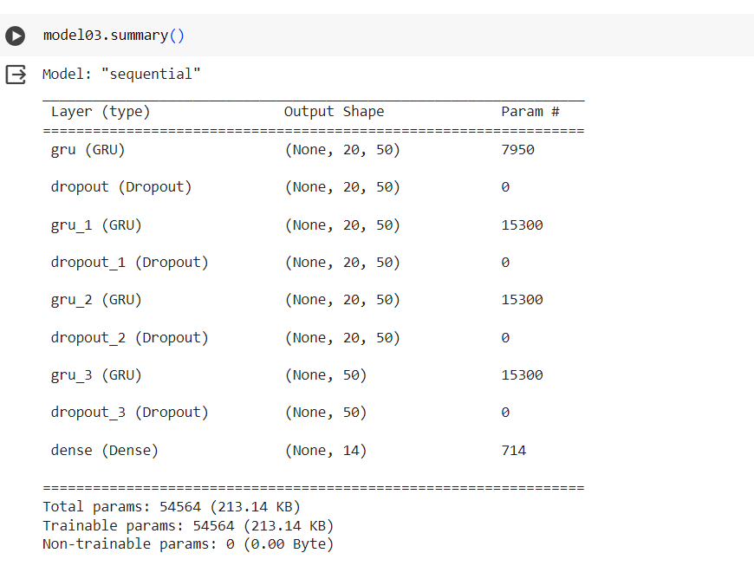
Deep Learning Models
GRU
The GRU model utilizes multiple GRU layers with 50 units each to capture temporal patterns in speech signals for emotion recognition.
The integration of return sequences and dropout layers allows the model to preserve temporal information and reduce overfitting, improving generalizability.

Slide 11
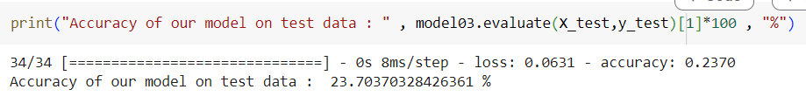
The GRU model achieved an accuracy of 23.70% on the test data, indicating room for improvement in its ability to accurately classify emotions from voice data.

Slide 12
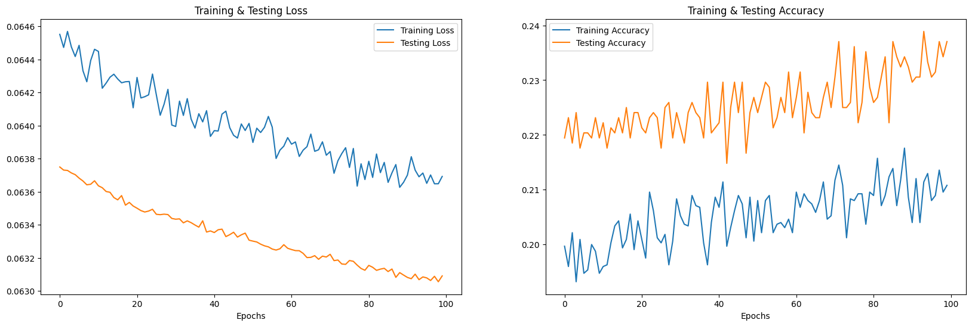
Training & Testing Loss, Accuracy
Training accuracy stabilizes at 21%, while testing accuracy varies around 23.9%, suggesting potential overfitting and challenges in generalization. Training loss declines steadily, unlike testing loss.

Slide 13
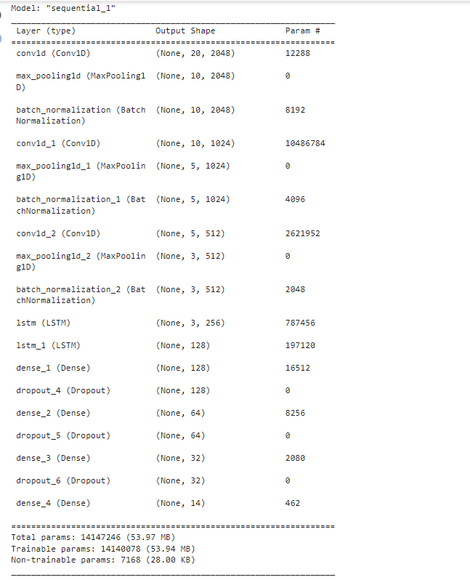
CNN
Convolutional Neural Network (CNN) architecture consisting of multiple convolutional and pooling layers followed by LSTM layers and dense layers, aiming to classify data sequences.

Slide 14
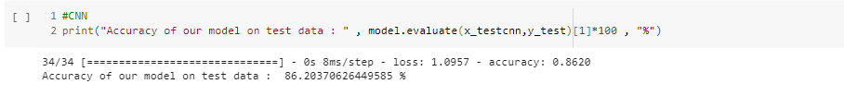
The CNN-based model achieved an accuracy of approximately 86.20% on the test data.

Slide 15
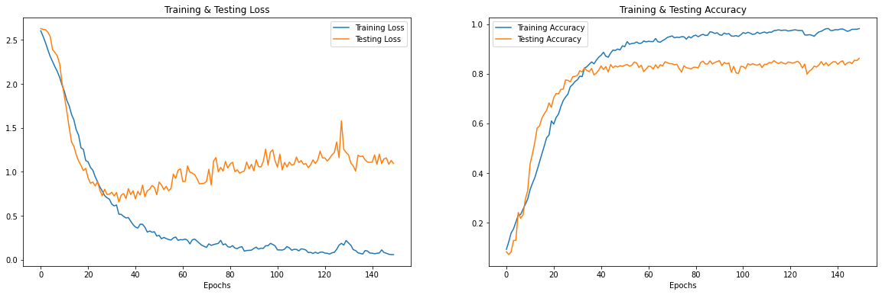
The model achieved an impressive 98.15% training accuracy and 86.2% testing accuracy over 150 epochs, demonstrating strong learning capability and generalization performance.

Slide 16
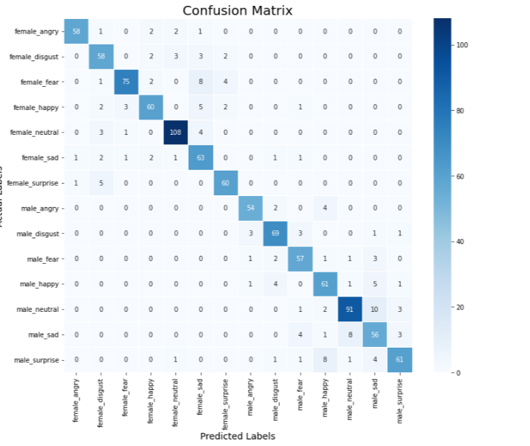
The confusion matrix shows that the speech emotion recognition model correctly classifies a high number of instances for classes 0 (58), 2 (60), and 1 (75), but struggles with differentiating classes like 6 from 0, as indicated by the high off-diagonal value of 60.

Slide 17
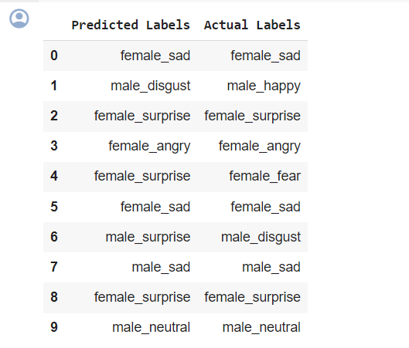
The output shows the first 10 rows comparing the predicted emotion labels from a speech emotion recognition CNN model to the actual emotion labels in the test data, highlighting instances of correct predictions (e.g., rows 0, 2, 3, 5, 7, 8, 9) and misclassifications (e.g., rows 1, 4, 6).

Slide 18
Conclusion
The CNN model achieved the highest accuracy of 86.20% on the test data, demonstrating its superiority over MLP, KNN, and GRU models, attributed to its ability to automatically extract features from spatial data.

Slide 19
Thankyou

