Slide 1

STOCK FORECASTING USING HMM AND SVR
19MAT301 – MIS 5
GUIDED BY:
Dr Subramani R
TEAM MEMBERS:
Tanuj M
Aishwarya V
Apoorva M

Slide 2



What is Stock & Stock Forecasting
Stocks are a type of investment.
Stocks Trade values – OPEN, HIGH, LOW & CLOSE
Stock forecast is an attempt to predict the future value of an individual stock.

Slide 3
PROJECT INSIGHT
Research Gap Of Your Project
Existing Work Carried Out For That Field
Motivation
Comparative Study

Slide 4
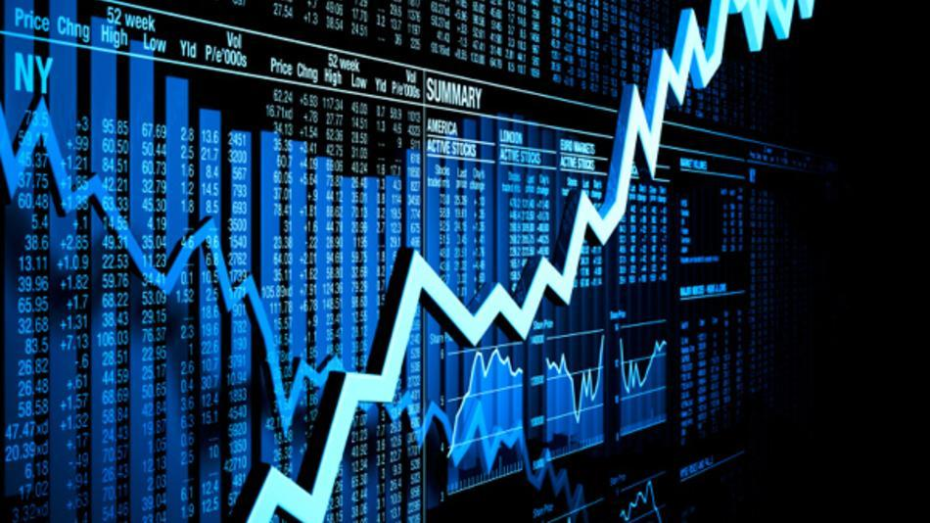
PROPOSED SOLUTION
Use probabilistic model – Hidden Markov Models
Train the model using the historical data
Predict next day’s prices
Use non-probabilistic model – Support Vector Regression
Train the model using the historical data
Predict next day’s prices
Compare the results with the results obtained using HMM

Slide 5
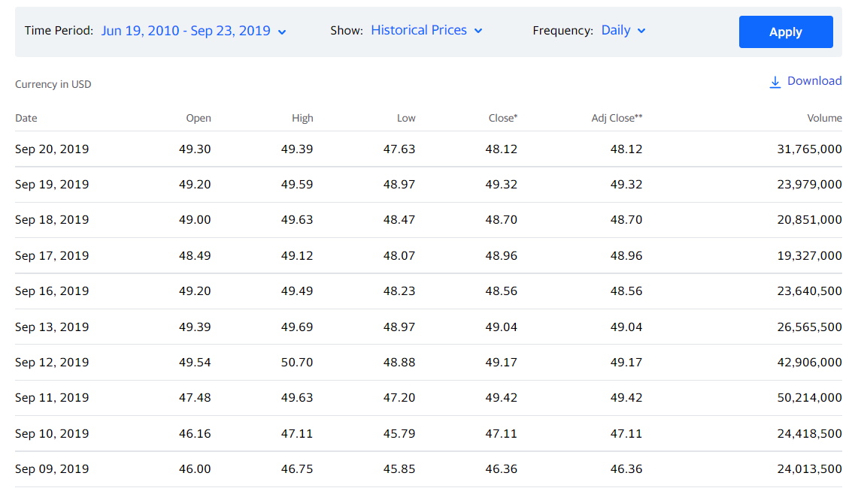

Slide 6
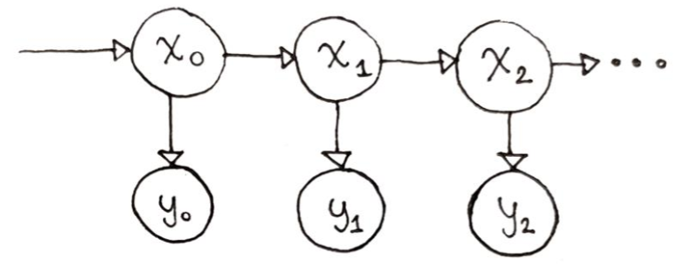
HIDDEN MARKOV MODEL
A Hidden Markov Model deals with inferring the state of a system given some unreliable or ambiguous observations from that system.
Flexible and computationally more efficient.

Slide 7
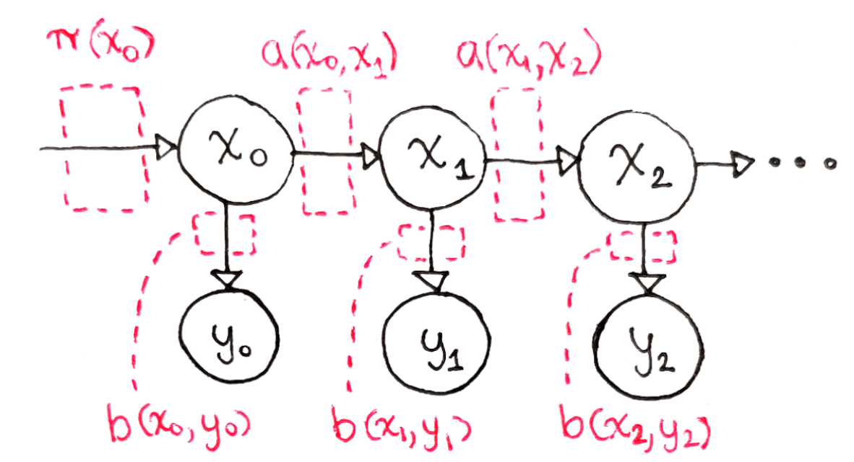
parameters explaining how the HMM behaves over time:
1. Initial State Probabilities
2. State Transition Matrix
3. Observation Probability Matrix

Slide 8
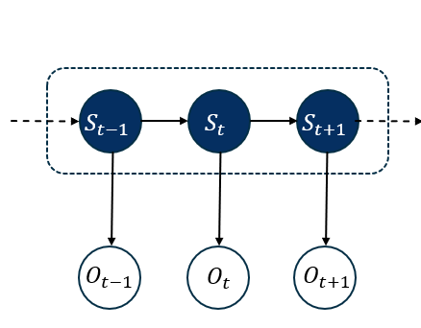
STOCKS AS HIDDEN MARKOV MODEL
There are underlying ‘hidden’ states which drive the stock prices.
Investor can observe only the stock prices.
States and the transition probabilities are unknown.
Observations are continuous vector- Open Price, Closing Price, High and Low.
Emission probabilities are PDF and assumed to be multivariate Gaussian distribution.

Slide 9
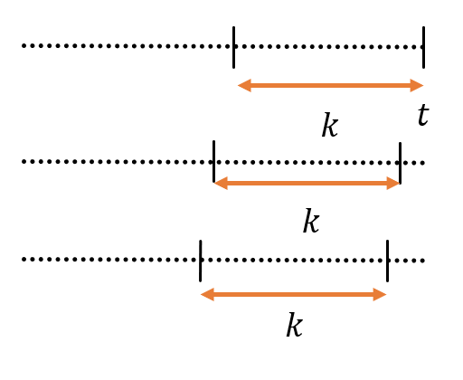

PREDICTION OF STOCKS PRICES
Take windows of k previous observations from today
Calculate log-liklihood for the given model
Compare it with the log-likelyhood of the previous sub-sequences of the same size by shifting the window by one day in the direction of past data
Calculating the difference in prices for prediction:

Slide 10
PREDICTION USING NON-PROBABILISTIC MODEL-SVR
SVR is a supervised learning algorithm .
Support vector Regression is similar to Support Vector Machines.
In SVM, the model tries to separate as much as possible the different classes by forming an hyper plane.
In SVR, the model tries to form a surface by fitting the data points as much as possible and predicts a value from a continuous set.
Here the data points are mapped into higher dimensional space where SVR – RBF kernel is applied.

Slide 11
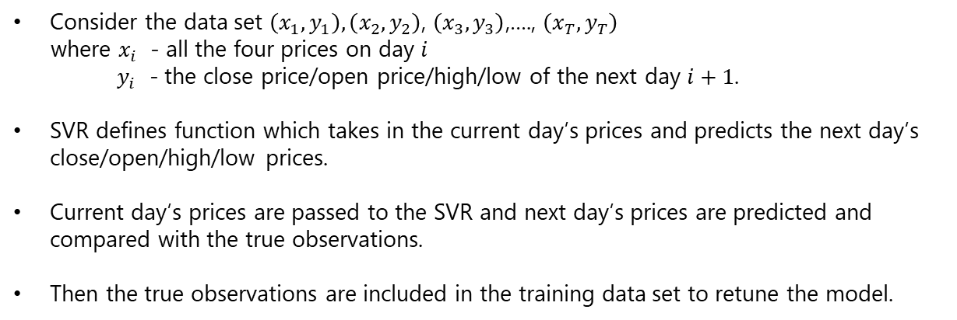
IMPLEMENTATION USING SVR
Consider the data set $\left(x_{1},y_{1}\right),\left(x_{2},y_{2}\right)$, $\left(x_{3},y_{3}\right)$,…., $\left(x_{T},y_{T}\right)$
where $x_{i}$ - all the four prices on day $i$
${ y}_{i}$ - the close price/open price/high/low of the next day $i+1$.
SVR defines function which takes in the current day’s prices and predicts the next day’s close/open/high/low prices.
Current day’s prices are passed to the SVR and next day’s prices are predicted and compared with the true observations.
Then the true observations are included in the training data set to retune the model.

Slide 12
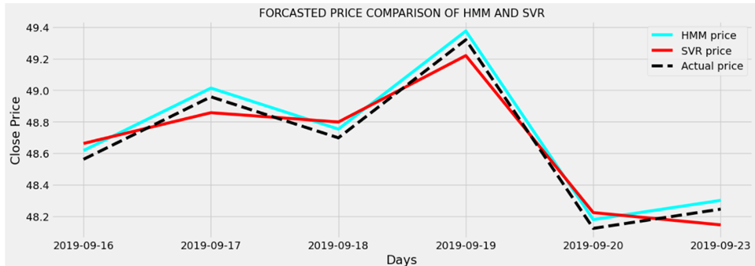
RESULT

Slide 13
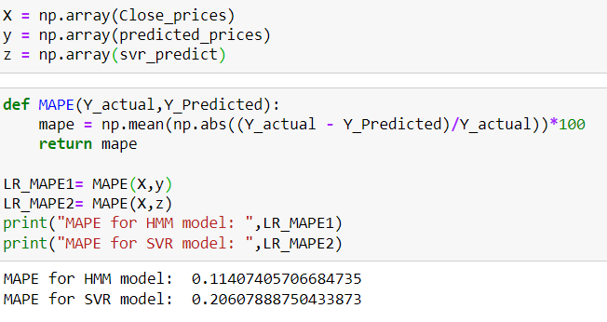
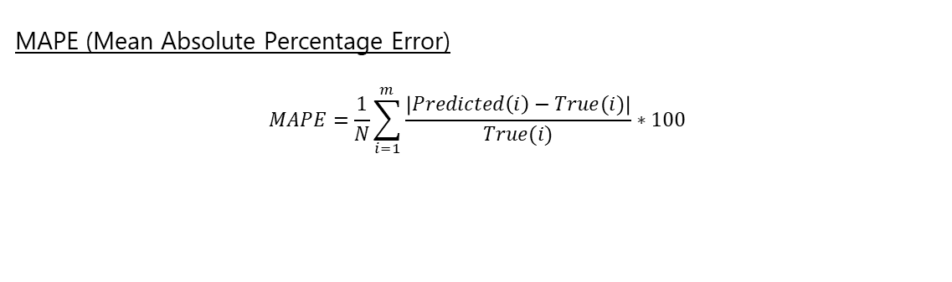
PERFORMANCE (ERROR RATE)
MAPE (Mean Absolute Percentage Error)
$$MAPE=\frac{1}{N}\sum_{i=1}^{m}{\frac{\left|Predicted\left(i\right)−True(i)\right|}{True(i)}}∗100$$

Slide 14
CONCLUSION
Both HMM and SVR models give similar accuracy.
The predictions diverge when prices are predicted for more than one day.
HMM captures the voltaility of the stock prices while SVR gives more stable predictions.

Slide 15

THANK YOU

