Slide 1


TICKET RESERVATION SYSTEM USING SCHEDULING ALGORITHMS
TEAM TYRANT
M.TANUJ AIE19041
P.AKHIL AIE19049
V.AISHWARYA AIE19068

Slide 2
OBJECTIVE
Implementation of ticket reservation system
FCFS scheduling
Priority scheduling

Slide 3
SCHEDULING
The process scheduling is the activity of the process manager that handles the removal of the running process from the CPU and the selection of another process on the basis of a particular strategy.
Process scheduling is an essential part of a Multiprogramming operating systems.
The Scheduling algorithms are
First-Come, First-Served (FCFS) Scheduling.
Shortest-Job-Next (SJN) Scheduling.
Priority Scheduling.
Shortest Remaining Time. Round Robin(RR) Scheduling.
Multiple-Level Queues Scheduling.

Slide 4
Types of Scheduling schemes
Non-Preemptive
Preemptive

Slide 5
FCFS SCHEDULING
It is an operating system scheduling algorithm that automatically completes queued calls and processes in order of their arrival.
It is the at ease and simplest CPU scheduling algorithm. In this type of algorithm, processes which requests the CPU at the outset get the CPU allocation first.
In this scheduling algorithm, an individual is served according to the queue manner. The person who arrives first place in the queue first buys the ticket and then the next one. This will continue as long as the last person in the queue purchases the ticket. Utilizing this algorithm, the CPU process works in a similar way.

Slide 6
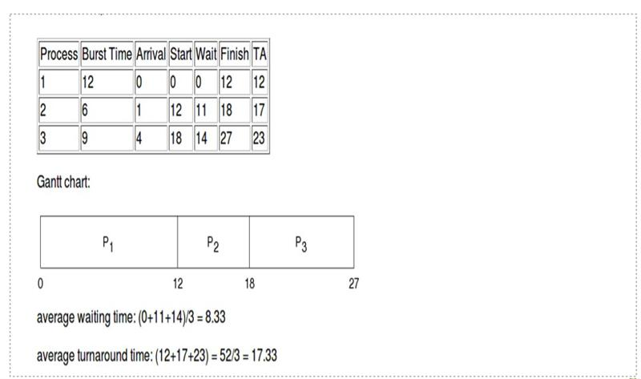

Slide 7
PRIORITY SCHEDULING
It is a method of scheduling processes which is based on priority. In this algorithm, the scheduler chooses the tasks to work in accordance with the priority.
Priority will vary depending on the memory requirements, time requirements, etc.
In this scheduling algorithm, first arrived process is processed first.
But for similar arrival times, we compare the priorities.
This process is repeated while all the process get executed.

Slide 8
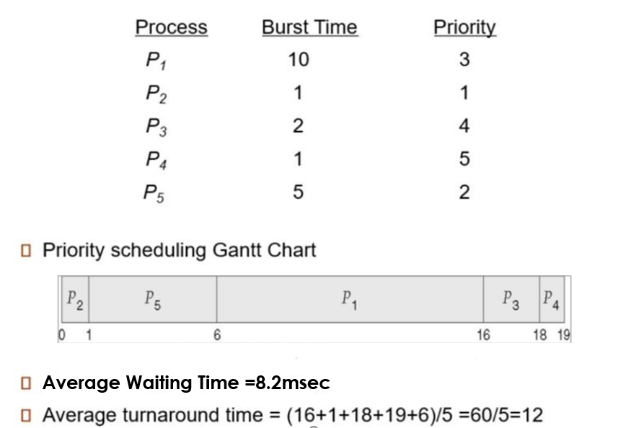
Here, Lower priority – more important

Slide 9
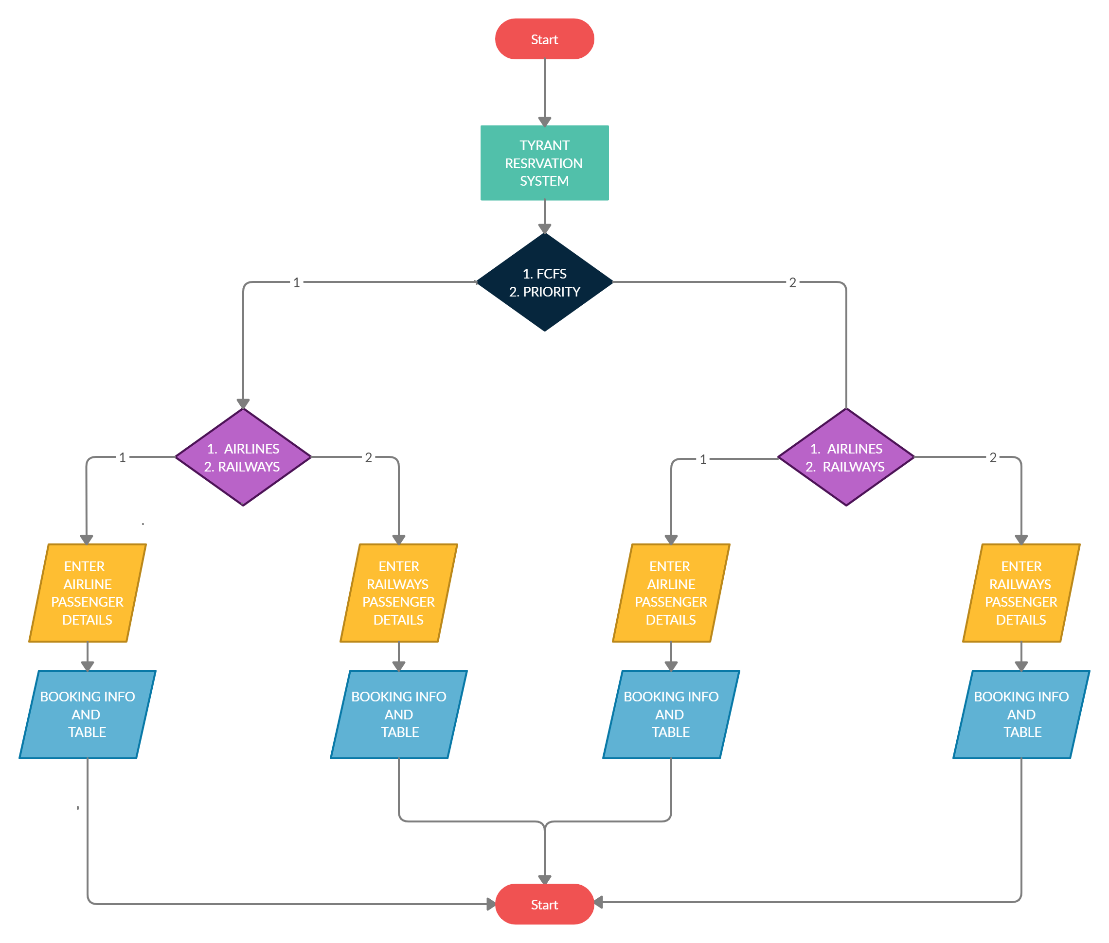
DESIGN

Slide 10
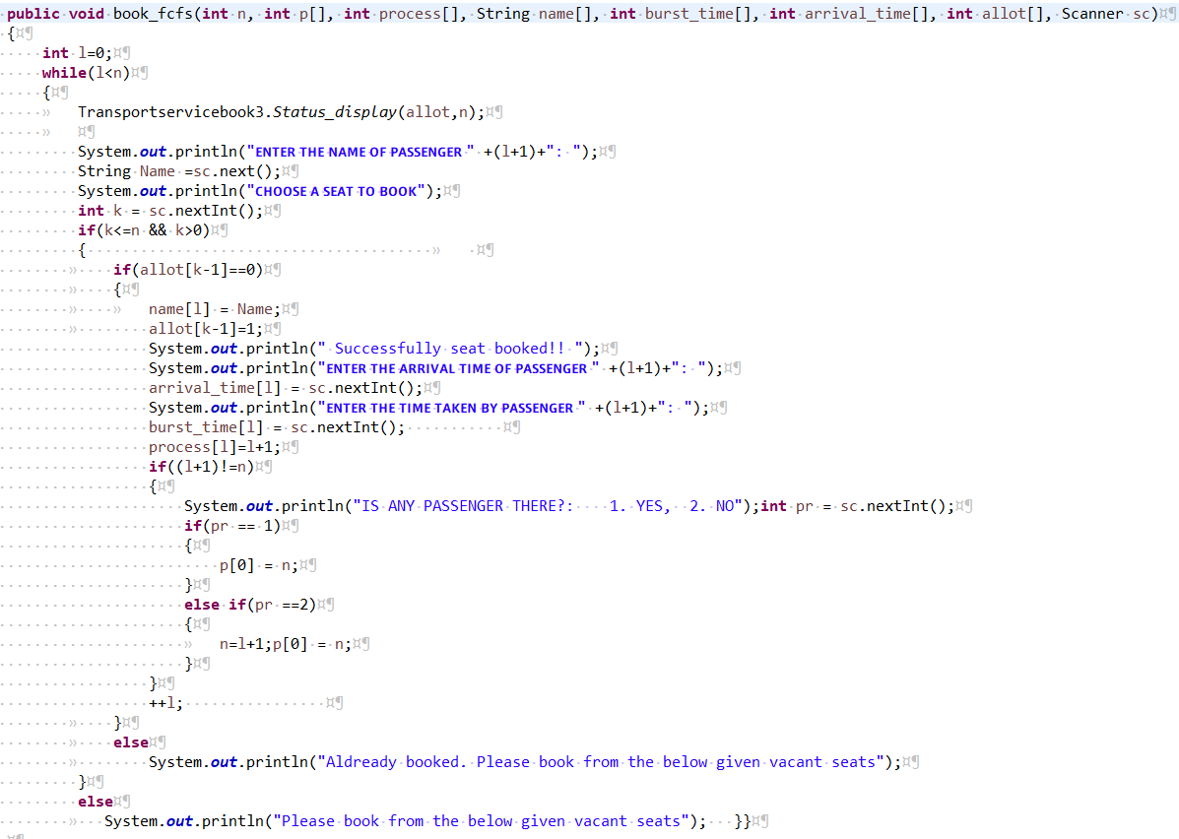
Implementation

Slide 11
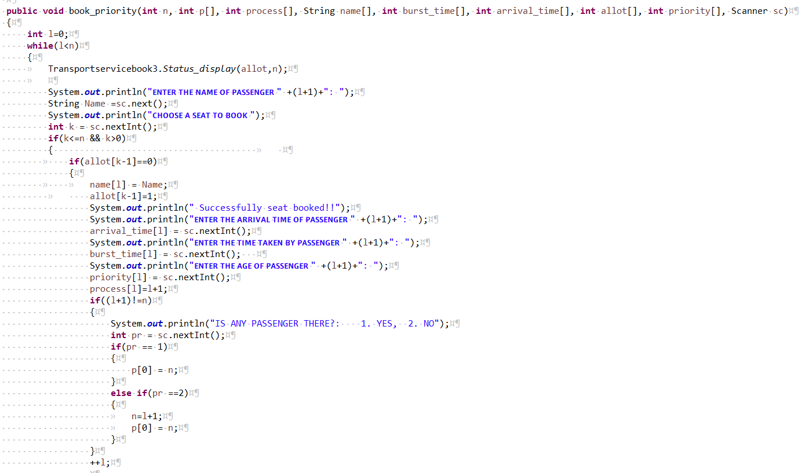

Slide 12
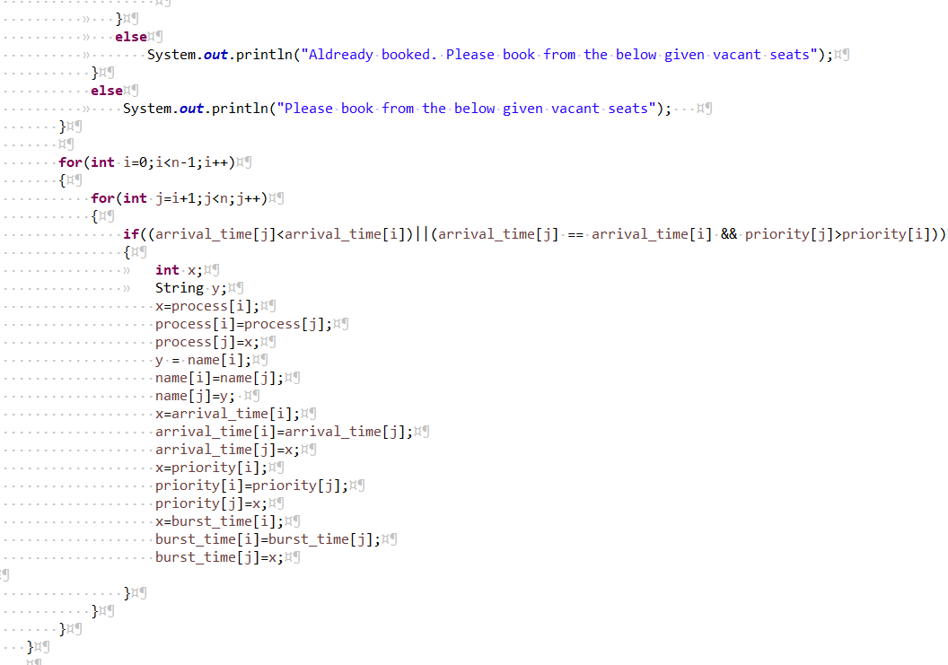

Slide 13
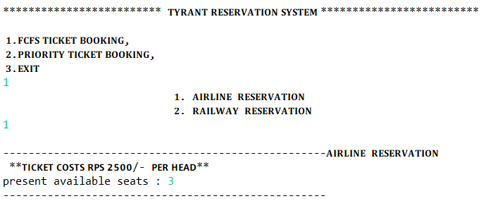
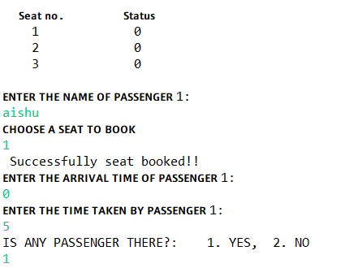
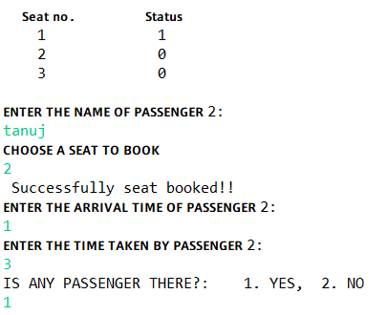
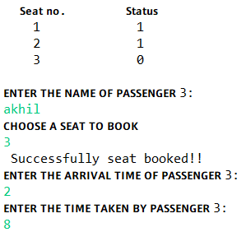
results

Slide 14
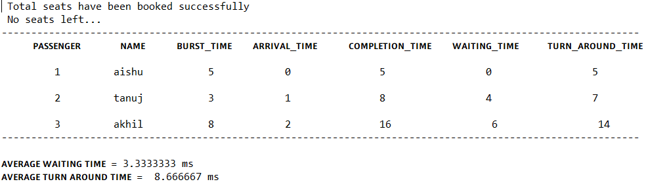

Slide 15
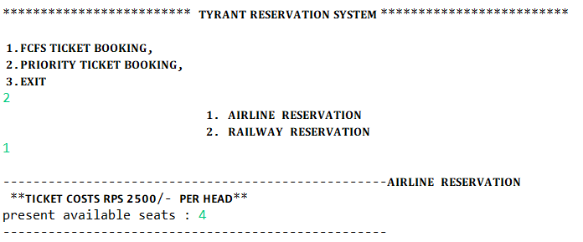
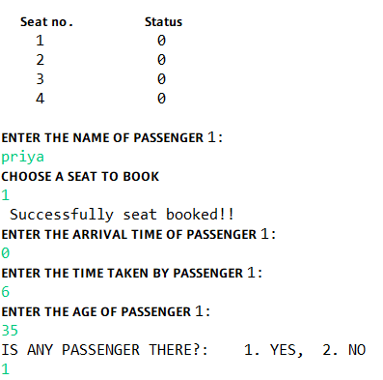
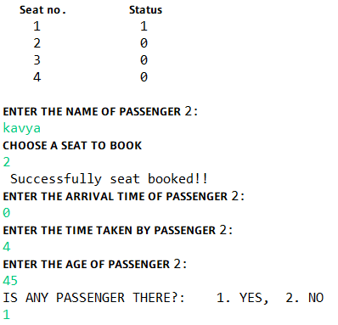
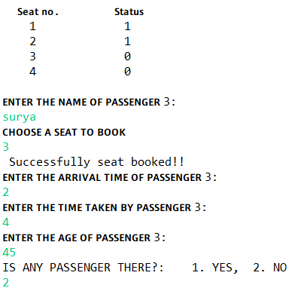

Slide 16
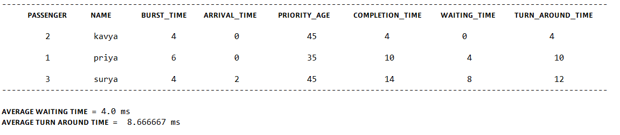

Slide 17
Thank You

