Slide 1



19AIE304-BDDBMS
USED CAR DATA ANALYTICS
TEAM INFINITY
APOORVA.M AIE19007
TANUJ.M AIE19041
AISHWARYA.V AIE19068

Slide 2


PROBLEM STATEMENT
Analyzing Used car data Using SparkSQL , Dataframes
Streaming Used car data and performing Queries
Visualization of Used car Dataset

Slide 3
DATASET DESCRIPTION
Dataset Size of 9.98 GB from Kaggle
30,000,209 unique IDS (rows)
66 attributes(columns)

Slide 4
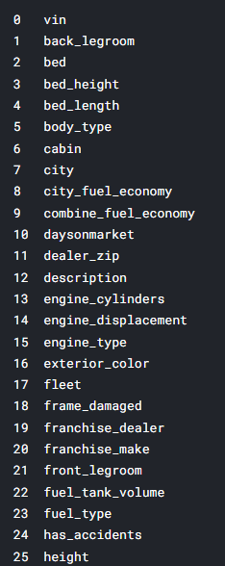
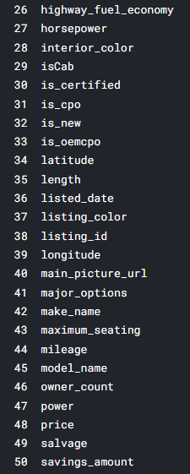
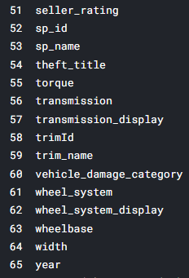
DATASET ATTRIBUTES

Slide 5
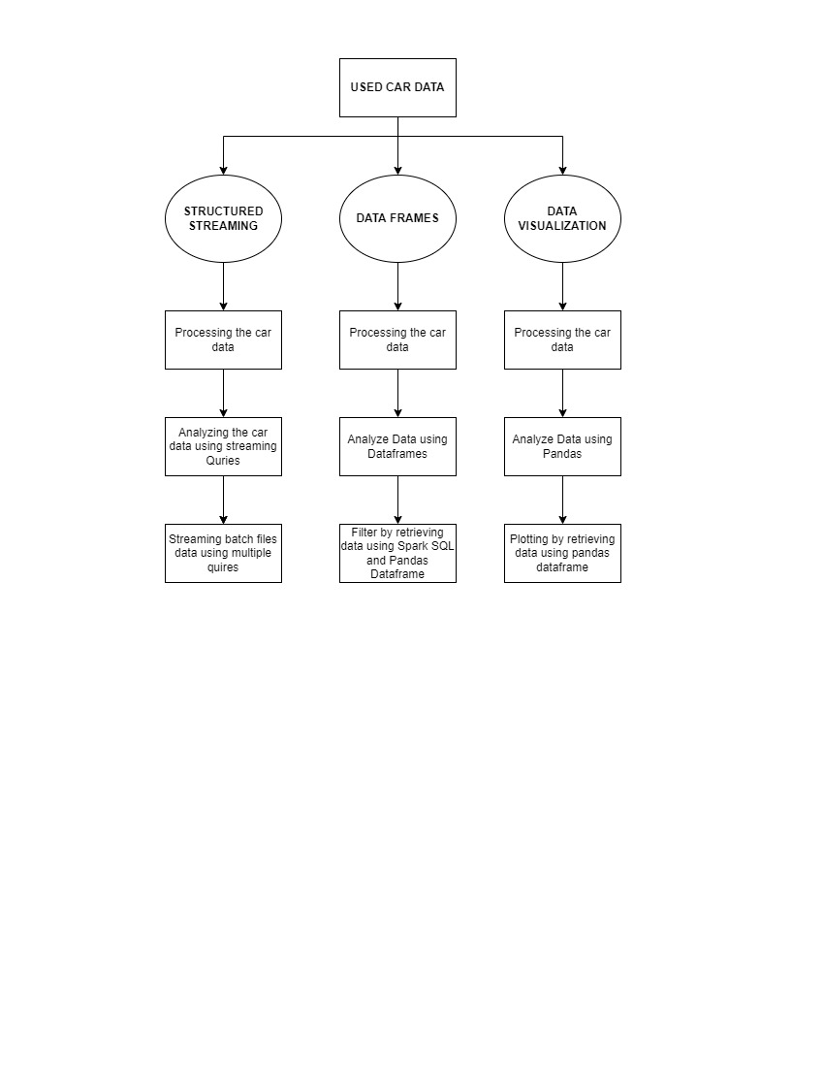
PROPOSED SYSTEM ARCHITECTURE

Slide 6
THANK YOU

