Slide 1





19AIE213 -ROBOT OPERATING SYSTEM AND ROBOT SIMULATION
PROJECT -VACUUM CLEANER
FACULTY:
A A NIPPUN KUMAAR SIR
DEPARTMENT OF CSE

Slide 2


PROBLEM STATEMENT
Design and implement a vacuum cleaning robot using a custom-built differential drive robot. The robot should traverse to all the locations of the environment, the boundaries of the environment should not be exclusively available it can be indicated by walls indirectly, also assume some static objects placed in the environments. The type of sensors can be team’s choice but the reason to use the sensor should be clear in the report and the presentation

Slide 3
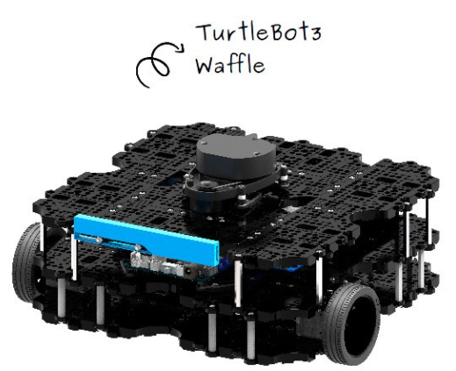
BOT
Differential Drive bot
Lidar Sensor is enabled for this project

Slide 4

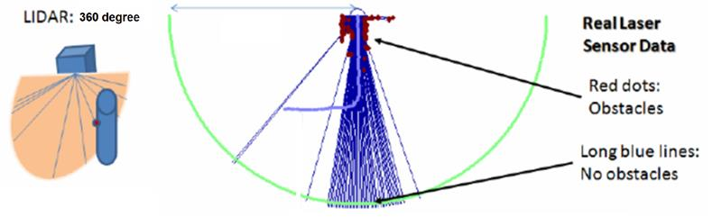
SENSOR USED
LIDAR SENSOR

Slide 5

PATH PLANNING
Path planning and path tracking strategies for mobile robot navigation are highly dependent on the target application.
Among those floor cleaning in extended public or industrial areas raise very interesting research challenges when required to be autonomously covered by mobile robots.

Slide 6
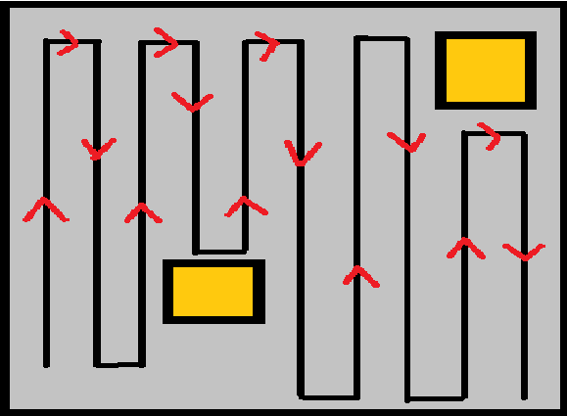
PROPOSED SYSTEM
U-TURN ALGORITHM
Default movement: Forward
When it encounters an obstacle, the bot should take a U-turn

Slide 7
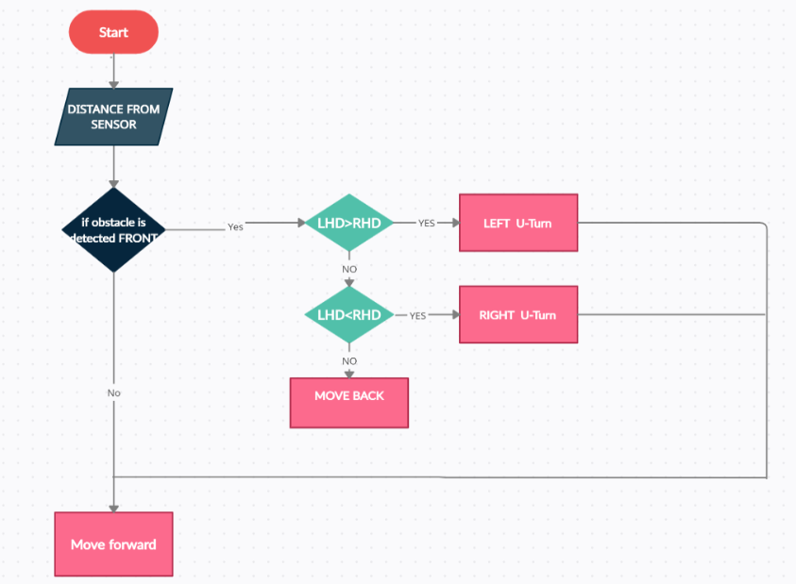
FLOW CHART

Slide 8
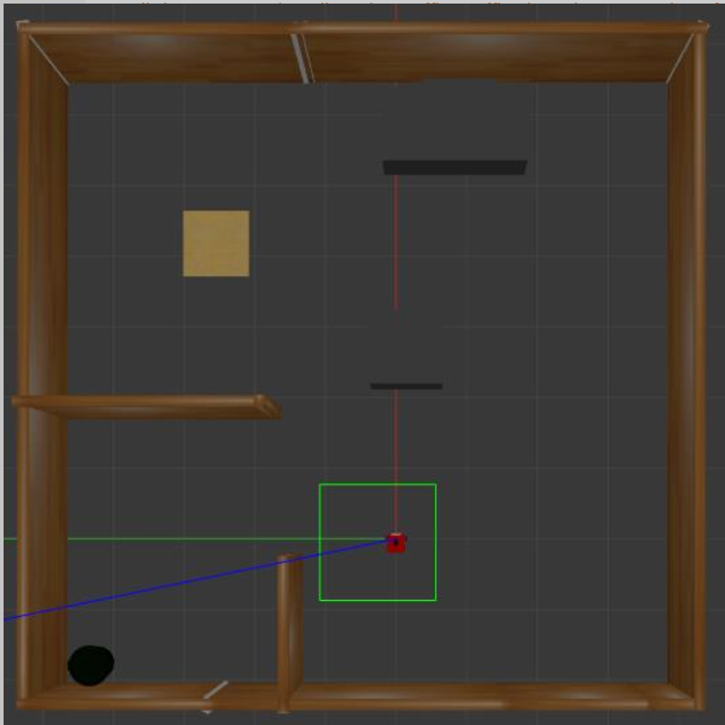
ENVIRONMENT

Slide 9
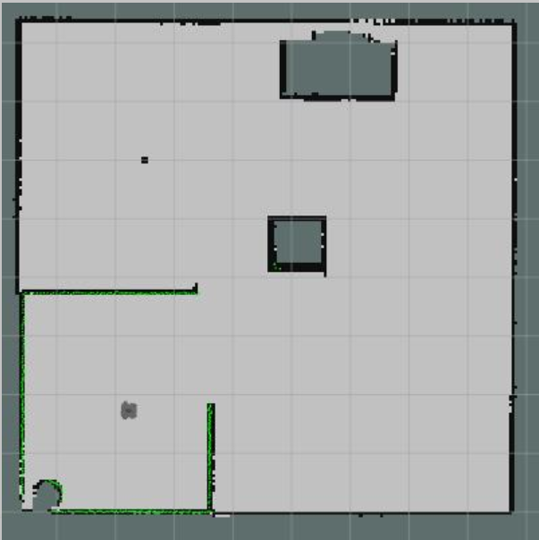
VISUALIZATION IN RVIZ

Slide 10

THANK YOU

