Slide 1

Amazon Store Sales Performance: Dashboard Insights
Presented by: D.Charan Teja | Date: July 10, 2025

Slide 2
Snapshot of Our Performance
A quick look at our key performance indicators reveals a robust sales volume, but highlights areas for profit optimisation.
$1.57M
$0.18M
5901
5901
Total Sales
Total Profit
Total Orders
Products Sold
Reflecting strong customer engagement across categories.
Indicates areas for margin improvement despite high sales.
Demonstrating consistent order volume.
Suggests efficiency in product distribution per order.

Slide 3


Who's Buying & How We're Shipping
Sales by Customer Segment
Product by Shipping Mode
Standard Class
Second Class
First Class
Same Day
Consumer
Corporate
Home Office
Consumers represent our largest customer base, accounting for nearly half of all sales.
Standard Class remains the most frequently used shipping method, highlighting cost-effective delivery preferences.

Slide 4
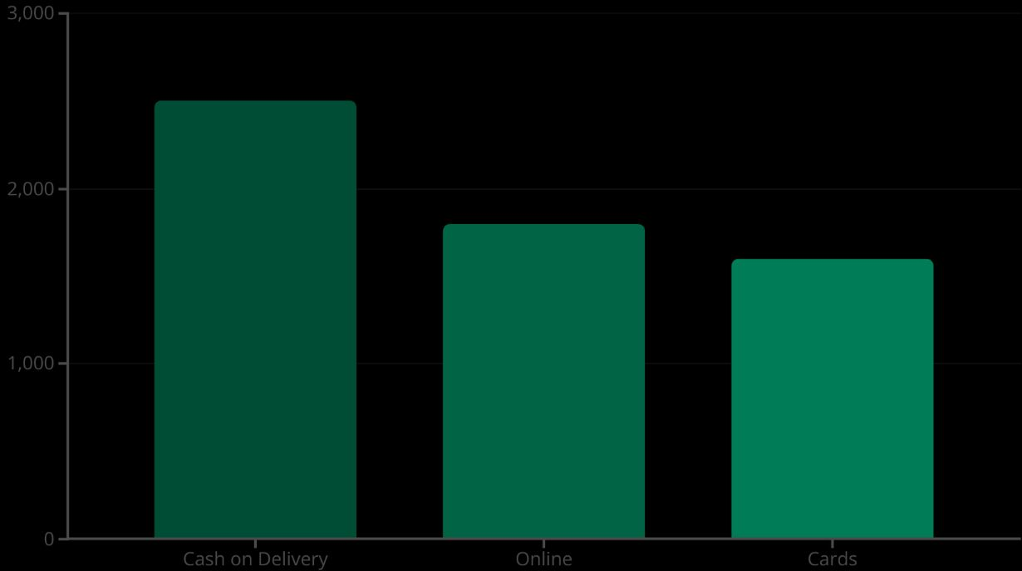

Order Trends: Payment & Returns
Payment Mode Distribution
Return Status
No Returns
Returned
Cash on Delivery continues to be our customers' preferred payment method.
Our low return rate indicates high customer satisfaction and product quality, which is a positive indicator.

Slide 5
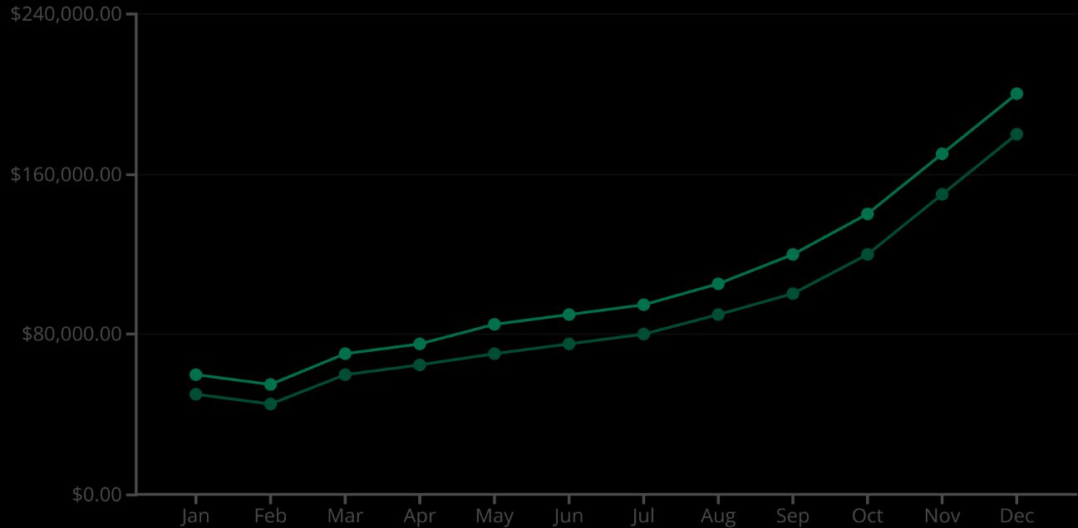

Monthly Performance & Geographic Footprint
Monthly Sales Trend (2019 vs. 2020)
Geographic Distribution
2019 Sales
2020 Sales
Sales consistently show a strong seasonal uplift, with Q3 and Q4 leading the way, and 2020 outpacing 2019.
Sales are primarily concentrated in key urban and coastal areas, identifying our strongest regional markets.

Slide 6
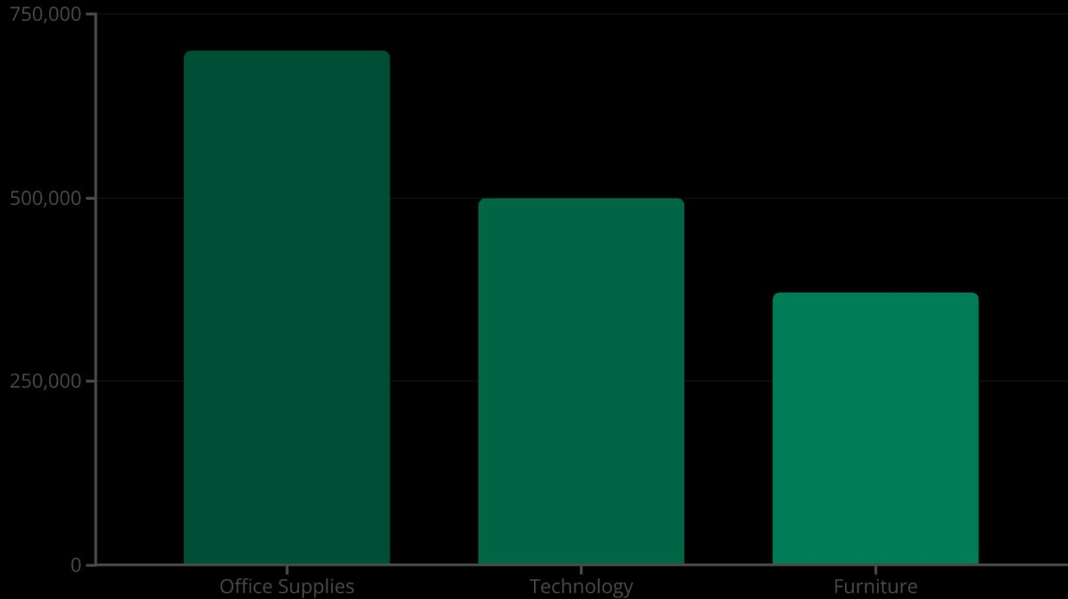
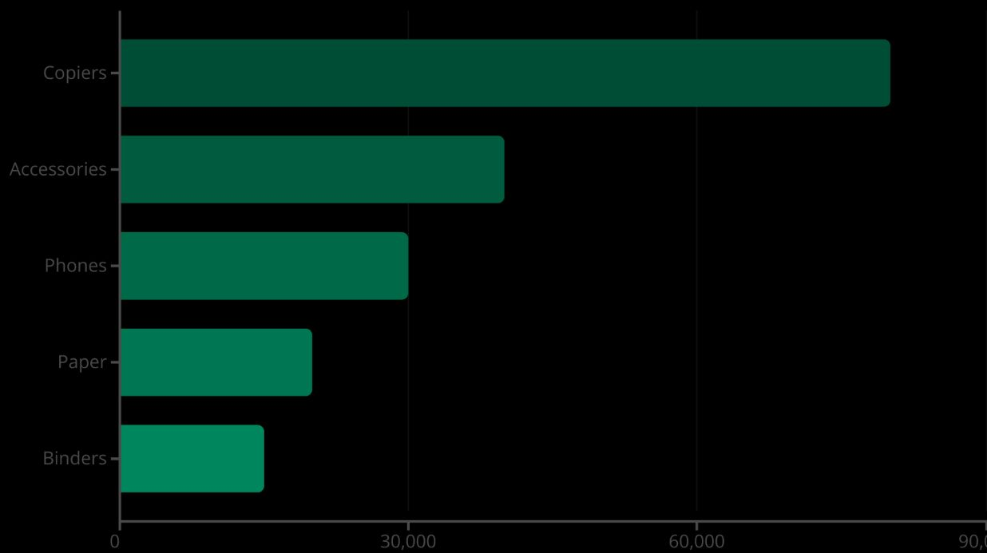
Deep Dive: What's Selling & What's Profitable?
Sales by Category
Profit by Sub-Category
Office Supplies dominate sales volume, followed by Technology and Furniture.
Copiers lead in profitability, with Accessories, Phones, Paper, and Binders also contributing significantly.

Slide 7
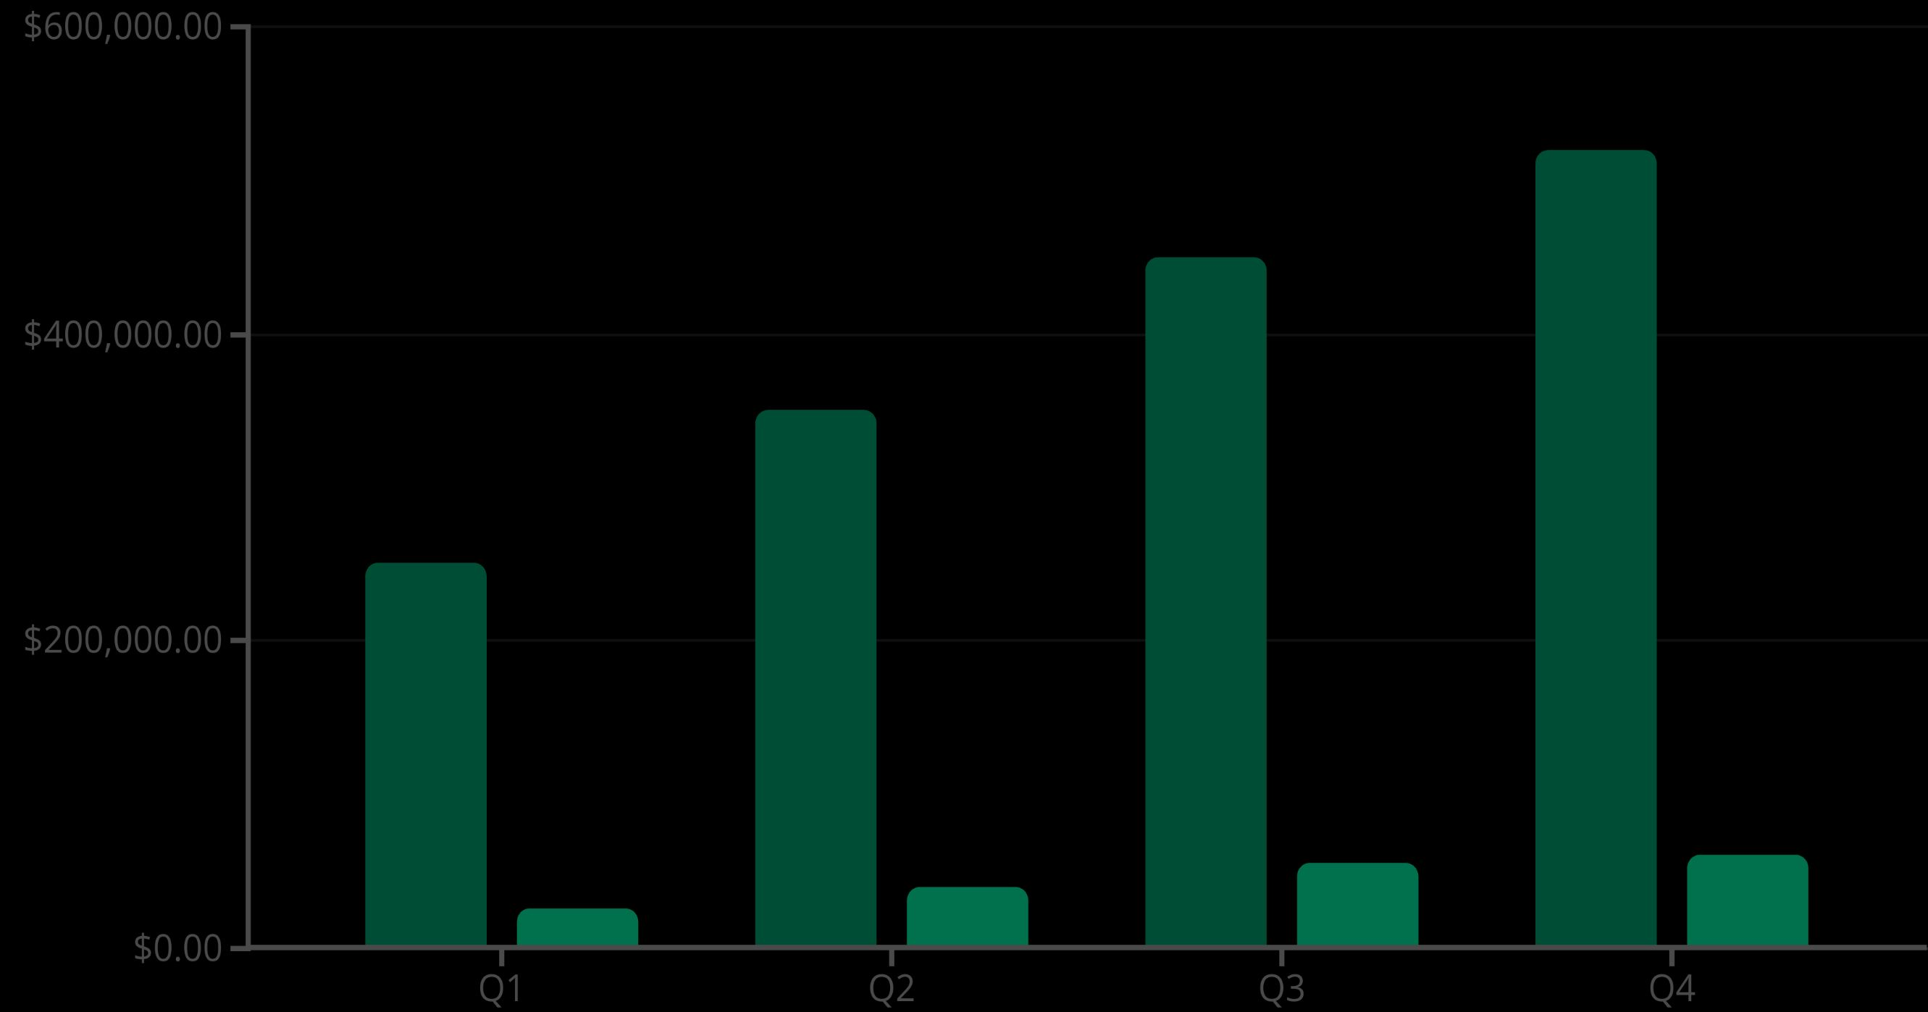
Quarterly Growth: Sales vs. Profit
Sales
Profit
Both sales and profit consistently increase across quarters, with Q4 demonstrating the strongest performance, likely due to holiday seasonality.

Slide 8
Driving Growth: Key Insights & Actions
Optimise Profit Margins
Capitalise on Q4 Trends
Enhance Geographic Focus
Address categories with low profitability, such as Furniture, Tables, Supplies, and Bookcases, by analysing cost structures.
Implement targeted marketing campaigns and optimise inventory management to leverage strong end-of-year sales.
Study high-performing regions for replication strategies and identify underperforming areas for corrective action.
Improve Customer Experience
Promote High-Profit Products
Refine COD and Standard Class delivery processes to improve customer satisfaction and operational efficiency.
Increase focus on marketing and sales of high-profit sub-categories like Copiers and Accessories.

Slide 9




Moving Forward: Strategic Next Steps
Profitability Deep Dive
Conduct granular analysis of specific products within underperforming sub-categories to identify precise areas for improvement.
Demographic & Behavioural Analysis
Analyse customer demographics and purchasing behaviours across high-profit and low-profit regions to inform localised strategies.
Shipping Optimisation
Explore new strategies to reduce shipping costs and improve delivery times, enhancing overall logistics efficiency.
AI for Predictive Forecasting
Integrate advanced AI tools to enhance predictive forecasting of sales and demand, ensuring better inventory and resource allocation.

Slide 10

Thank You
We appreciate your time and engagement. We look forward to discussing these insights further.

