Slide 1



AIEVCompass - AI-Powered EV Consultant
Sampath Magapu
sampathmagapu11@gmail.com

Slide 2

Learning Objectives
The objective of this project is to understand how Hybrid AI can be used to solve EV-related prediction problems by combining Machine Learning models with Conversational AI. Through this project, we learn how to clean datasets, perform advanced feature engineering, and train ML algorithms such as Random Forest, XGBoost, and Gradient Boosting for price and range prediction. We also learn how to integrate a Generative AI chatbot (DialoGPT) with traditional ML models, enabling an intelligent system that collects user inputs through natural language and generates reliable predictions. Additionally, the project teaches how to build a complete end-to-end application using Streamlit.
GOAL
Source :
www.freepik.com/

Slide 3
Tools and Technology used
AIEVCompass is built using Python as the core development language along with powerful data science libraries like NumPy, Pandas, and Scikit-Learn for processing, modeling, and analysis. The system integrates the DialoGPT-small language model using HuggingFace Transformers and PyTorch, enabling smooth, human-like conversational interactions. Streamlit is used to create a modern, responsive, and simple graphical interface that users can interact with in real time. Development work, experiments, and visualizations were carried out using Jupyter Notebook, Matplotlib, and Seaborn. This combination of tools made it possible to prototype, integrate, test, and deploy a complete AI system efficiently.
Python • NumPy • Pandas • Scikit-Learn • Random Forest • XGBoost • Gradient BoostingDialoGPT-small • HuggingFace Transformers • PyTorch (CPU)Streamlit • Jupyter Notebook • Matplotlib • Seaborn

Slide 4
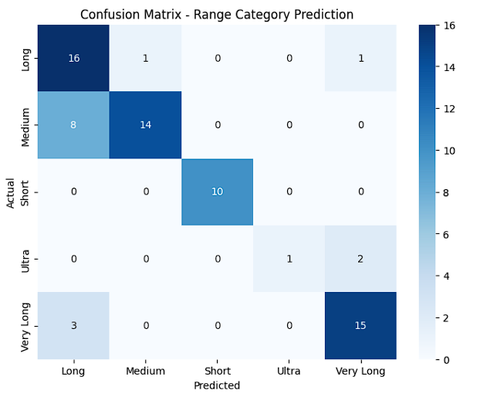
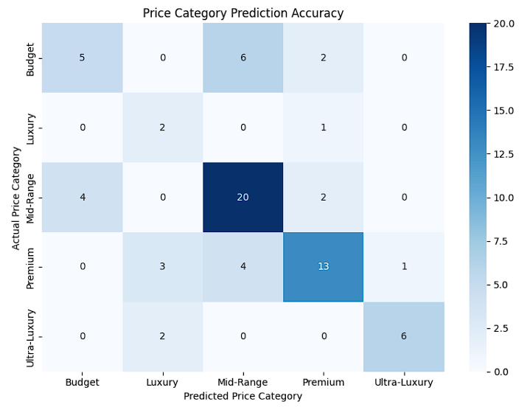
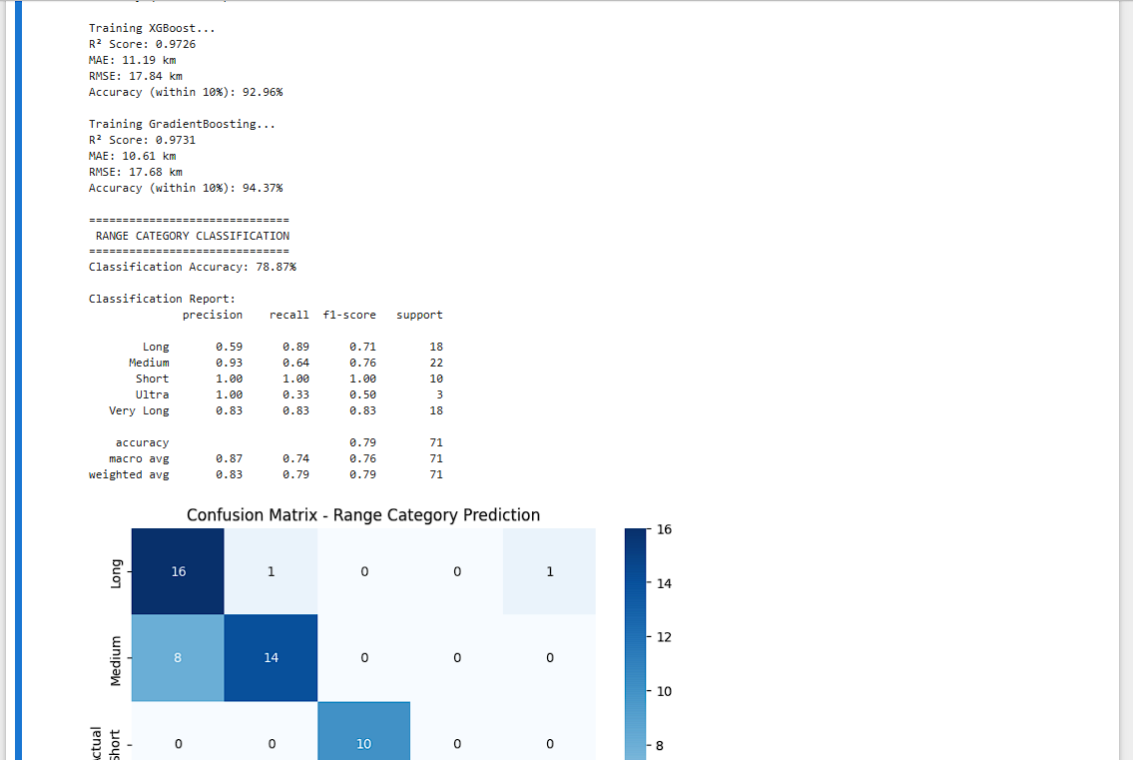
Methodology
The methodology begins with dataset cleaning, preprocessing, and extracting meaningful EV-related features. ML models such as Random Forest, Gradient Boosting, and XGBoost were trained using engineered features for predicting price and range with high accuracy. The conversational system was built using DialoGPT-small, which extracts user-provided details through natural language input. These extracted features are fed into the ML models for accurate prediction. The final solution integrates all components into a cohesive Streamlit application, enabling real-time hybrid AI interaction, where the chatbot handles conversation and the ML models handle prediction.

Slide 5
Problem Statement:
Consumers struggle to estimate the fair price or range of an electric vehicle due to the many technical and performance factors involved. Manufacturers also require tools to analyze potential EV configurations early in development. Existing solutions do not combine machine learning models with natural language conversation, making them either too technical or difficult for general users. There is a need for a user-friendly hybrid AI platform that merges Gen AI conversational capability with traditional ML prediction accuracy.

Slide 6
Solution:
Hybrid AI Architecture
AIEVCompass solves the problems by integrating a Generative AI chatbot with trained ML prediction models. The chatbot collects all the user and company inputs via natural conversation. These inputs are processed and fed into machine learning models such as Random Forest, XGBoost, and Gradient Boosting to produce accurate predictions for EV price, range, and segment classification. This hybrid approach ensures a smart, guided, and highly accurate EV consulting experience where Gen AI handles conversation and ML handles prediction.

Slide 7
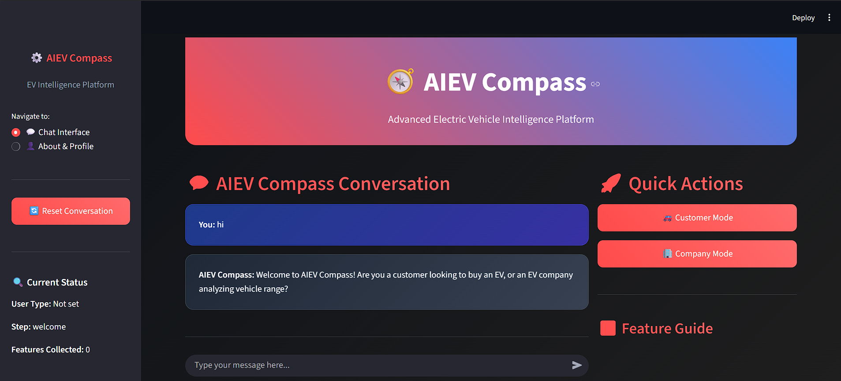
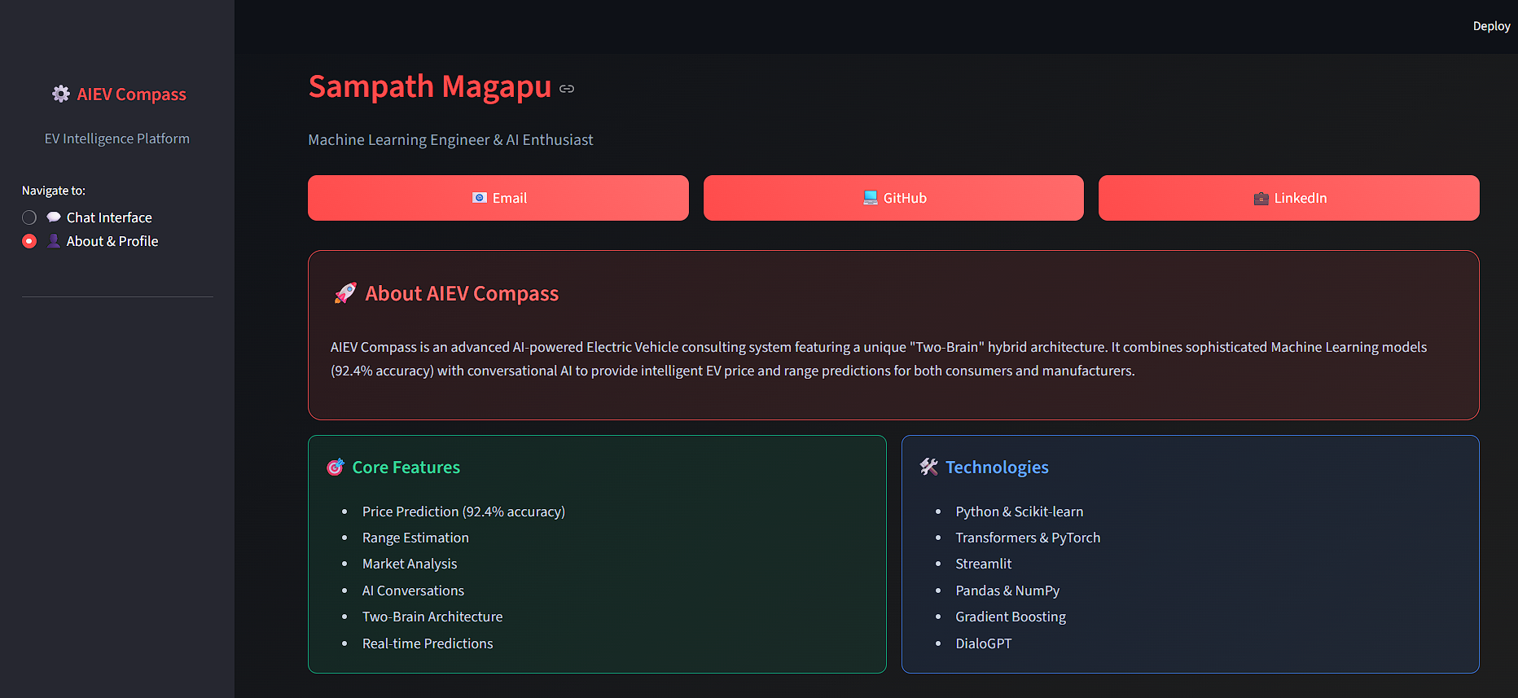
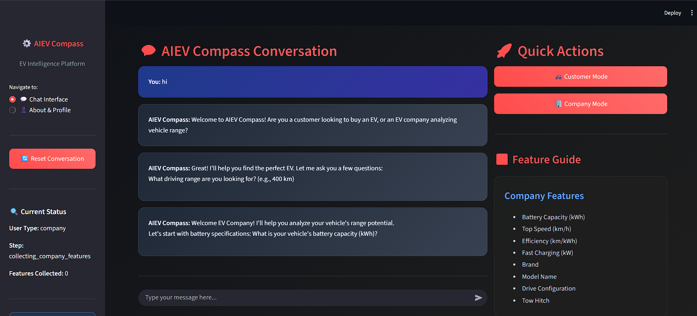
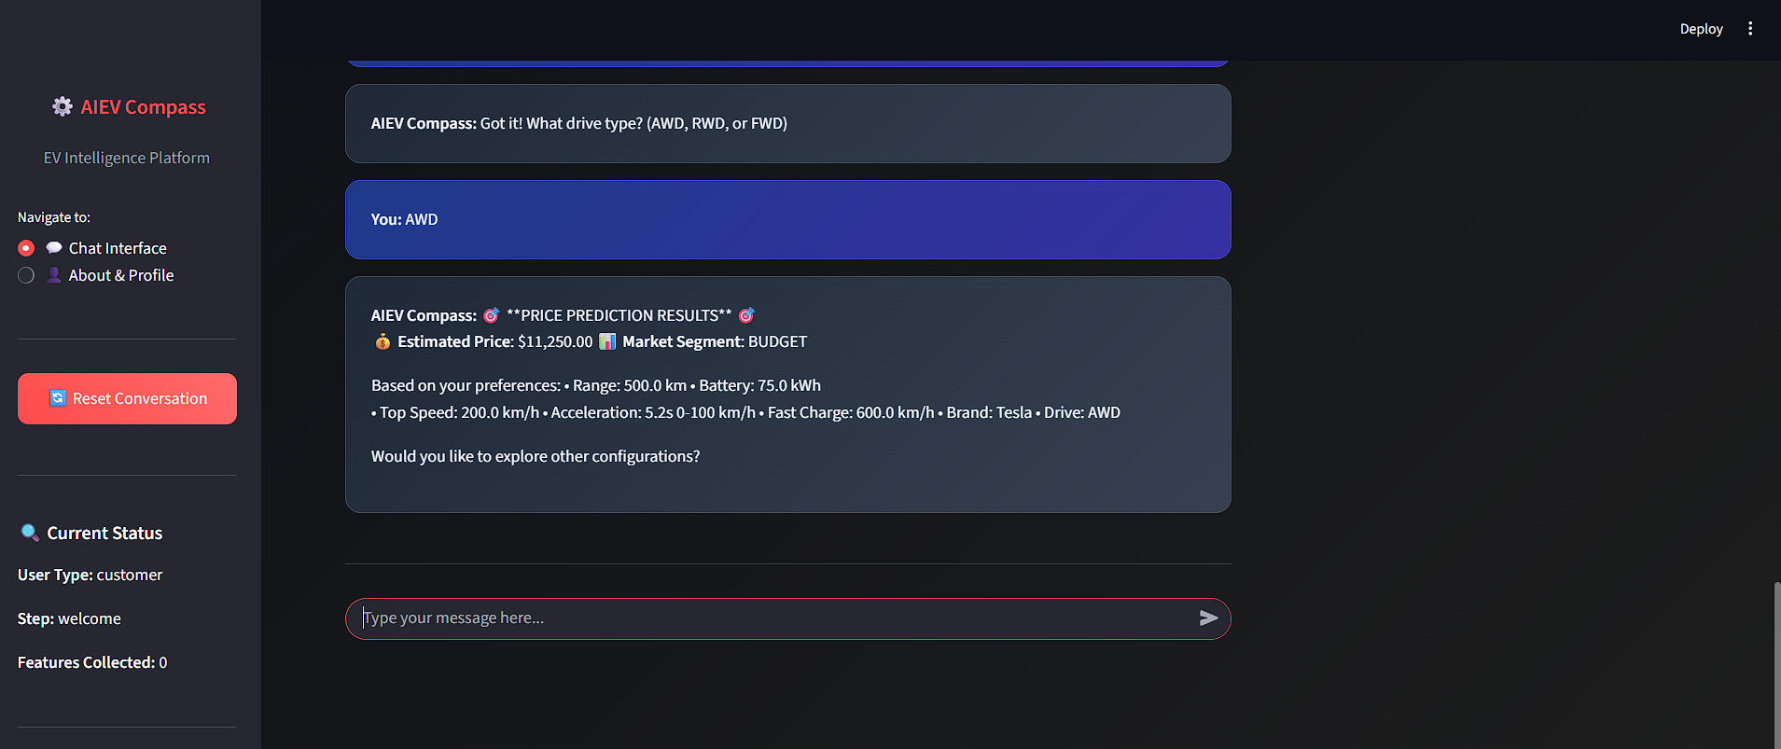
Screenshot of Output:

Slide 8
Conclusion:
AIEVCompass demonstrates how combining Machine Learning models with Generative AI can produce a powerful and user-friendly EV analytics system. The ML models provide accurate mathematical predictions using advanced algorithms like Random Forest and XGBoost, while the DialoGPT chatbot ensures that users can interact effortlessly through natural language. This hybrid AI design achieves both precision and accessibility, making AIEVCompass a strong example of practical, real-world AI integration.
Thank You!

