Slide 1
ICRA 2026 BARN Challenge
Behaviour Cloning for Autonomous Robot Navigation in Dense Obstacle Environments
Benchmark Autonomous Robot Navigation in Dense Environments
Team 14 • IIT Kharagpur
Pampana Charan Teja (Leader) — 25AI60R22
Pucha Arun Kumar — 25AI60R26
Arkoti Charan Teja — 25AI60R19
Bommireddi Nagendra — 25AI60R14
Adarsh Raj — 25AI560R25
AI & Robotics • April 2026

Slide 2
Problem Statement & Objective
The Challenge
Navigate a Clearpath Jackal robot (2D LiDAR only) from start to goal across 50 unseen, tightly constrained BARN environments — as fast as possible, without collision.
Why This Matters
• Real-world robot deployment demands robust collision avoidance
• Dense, narrow corridors stress-test classical and learning-based planners
• Hardware constraint: Intel i3 CPU, no GPU, 16 GB RAM
• Must achieve < 10 ms/step inference for real-time control
🎯 Our Targets
≥ 95% Success Rate
Navigation Score ≥ 0.45
DynaBARN Bonus Points
Real-time CPU-only inference
Scoring Metric
s = 1_success × OT / clip(AT, 2·OT, 8·OT)
OT = optimal traversal time
AT = actual time taken
Max score per environment = 0.5

Slide 3
BARN Challenge Overview
Benchmark Autonomous Robot Navigation
300
60
360
Static Worlds
Dynamic Worlds
Total Environments
Randomized cylindrical obstacle fields with narrow passages
DynaBARN: moving obstacles bonus points, no penalty
Scored on success rate × optimal-to-actual time ratio
Platform & Constraints
• Robot: Clearpath Jackal — differential-drive mobile robot with UST-10LX 2D LiDAR (720 rays, 270° FoV)
• Software: ROS Melodic/Noetic + Gazebo Simulator — fully dockerized evaluation
• Compute: Intel i3 CPU, no GPU, 16 GB RAM — inference must be < 10 ms per step
• Time limit: 100 seconds per world — collision or timeout = score 0
• ICRA 2026 competition — real robot final evaluation

Slide 4
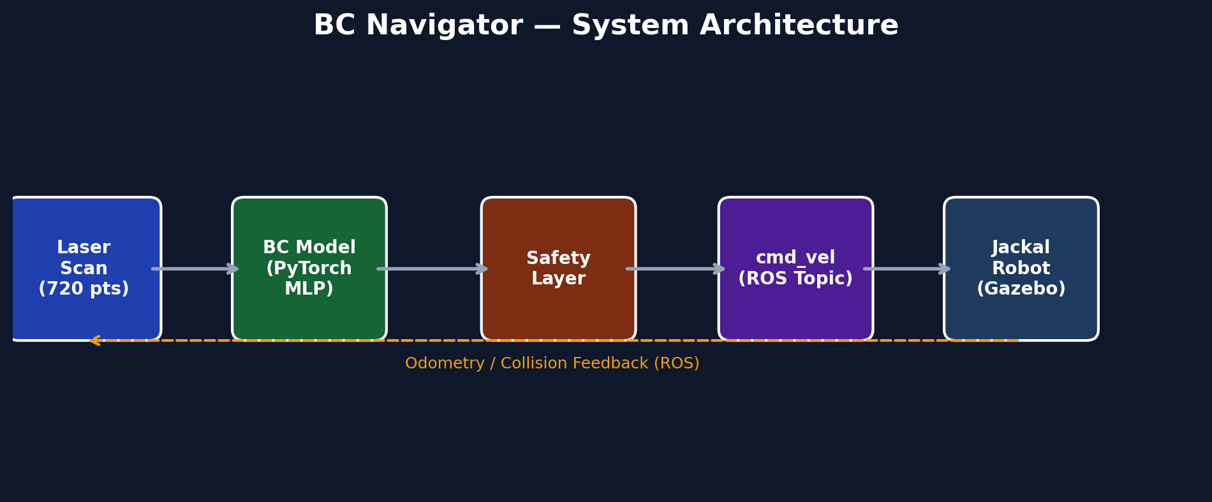
System Architecture
End-to-end navigation pipeline
Pipeline Summary
1. LiDAR Scan (720 points) → 2. BC Model (1D CNN, PyTorch) → 3. Safety Layer (3-zone obstacle check) → 4. cmd_vel (ROS Twist) → 5. Jackal Robot (Gazebo simulation)
Feedback loop: Odometry + Collision detection fed back via ROS topics for closed-loop control at 10 Hz

Slide 5
Behaviour Cloning Pipeline
Learning from expert demonstrations
Step 1
Step 2
Step 3
Expert Data Collection
Data Augmentation
Training
Run KUL+FM classical planner
on all 300 BARN worlds (10 eps each)
Record per timestep:
(LiDAR₇₂₀, d_goal, θ_goal, v, ω)
→ (v*, ω*)
Keep successful episodes only
~500K–1M timesteps total
Gaussian noise on LiDAR (σ=0.05)
Random ray dropout (5–10%)
Mirror augmentation:
flip scan, negate ω (2× data)
Goal angle jitter (±5°)
Robust to sensor noise &
distribution shift
Supervised learning (MSE loss)
L = ||model(obs) - expert||²
Optimizer: Adam, lr=1e-4
Batch size: 256
Train/Val split: 90/10
Early stopping on val loss
Export to ONNX for deployment

Slide 6
BC Model Architecture
1D CNN with Residual Connections — ~300K Parameters
LiDAR Encoder (1D CNN)
Conv1D: 1→64 channels, k=5, stride=2 + ResBlock
Conv1D: 64→128 channels, k=3, stride=2 + ResBlock
Conv1D: 128→128 channels, k=3, stride=2 + ResBlock
Pool: Global Average Pooling → 128-dim vector
MLP Head
Input: 128 (LiDAR features) + 4 (d_goal, θ_goal, v, ω) = 132
Linear(132→256) → ReLU → Dropout(0.1)
Linear(256→64) → ReLU → Dropout(0.1)
Linear(64→2) → sigmoid(v)×2.0, tanh(ω)×2.0
~300K
<10ms
Parameters
Inference
Lightweight for i3 CPU
ONNX export, CPU-only
720
2
LiDAR Rays
Outputs
Input sensor resolution
v* (linear), ω* (angular)

Slide 7
Safety Layer & Obstacle Avoidance
Three-zone reactive safety system
🔴 Zone 1: Emergency
🟡 Zone 2: Caution
🟢 Zone 3: Trust Model
d_min < 0.25 m
0.25 ≤ d_min < 0.45 m
d_min ≥ 0.45 m
Full stop (v = 0)
Rotate away from obstacle
Rotation direction: towards
side with more LiDAR clearance
Angular speed: ω = ±1.5 rad/s
Proportional speed scaling
v = v_model × (d-0.20) / 0.25
Smooth deceleration curve
Model angular output trusted
Prevents hard braking
Full model output trusted
v = v_model, ω = ω_model
Maximum performance zone
No safety intervention
Nominal navigation mode
Front arc detection: minimum distance computed from LiDAR rays within ±60° of robot heading

Slide 8
Stuck Recovery — Finite State Machine
Autonomous recovery from deadlock situations
NORMAL
stuck > 2s →
BACKUP
1.0s elapsed →
ROTATE
Normal navigation mode
Reverse maneuver
In-place rotation
Model controls the robot
Safety layer active
Monitor: |v| < 0.05
v = -0.3 m/s, ω = 0
Duration: 1.0 second
Clear immediate obstacle
v = 0, ω = ±1.0 rad/s
Duration: 1.5 seconds
Towards clearer side
← 1.5s elapsed: return to NORMAL ←
DynaBARN Extension — Dynamic Obstacle Handling
• Keep 2-frame LiDAR history. If any front-arc ray shows rapid approach (Δd < -0.1m), trigger reactive brake/swerve
• Minimal code addition, no model changes needed — zero risk to static performance

Slide 9
Simulation & Evaluation Framework
Dockerized testing pipeline
Environment Stack
▸ ROS Melodic: Robot Operating System framework
▸ Gazebo Simulator: Physics-based 3D simulation
▸ Docker Container: Reproducible isolated environment
▸ Xvfb + FFmpeg: Headless video recording pipeline
▸ Singularity: Official submission container format
Evaluation Pipeline
1. Launch Gazebo world with obstacles
2. Spawn Jackal robot at start position
3. Start BC Navigator (nav_node.py)
4. Monitor: position, time, collisions
5. Log trajectory to .npy file
6. Compute navigation metric
7. Generate video recording (optional)
8. Aggregate results across all worlds
Logged Metrics Per World
world_idx | success (0/1) | collided (0/1) | timeout (0/1) | navigation_time (s) | nav_metric (0–0.5) | trajectory (x,y,t)

Slide 10
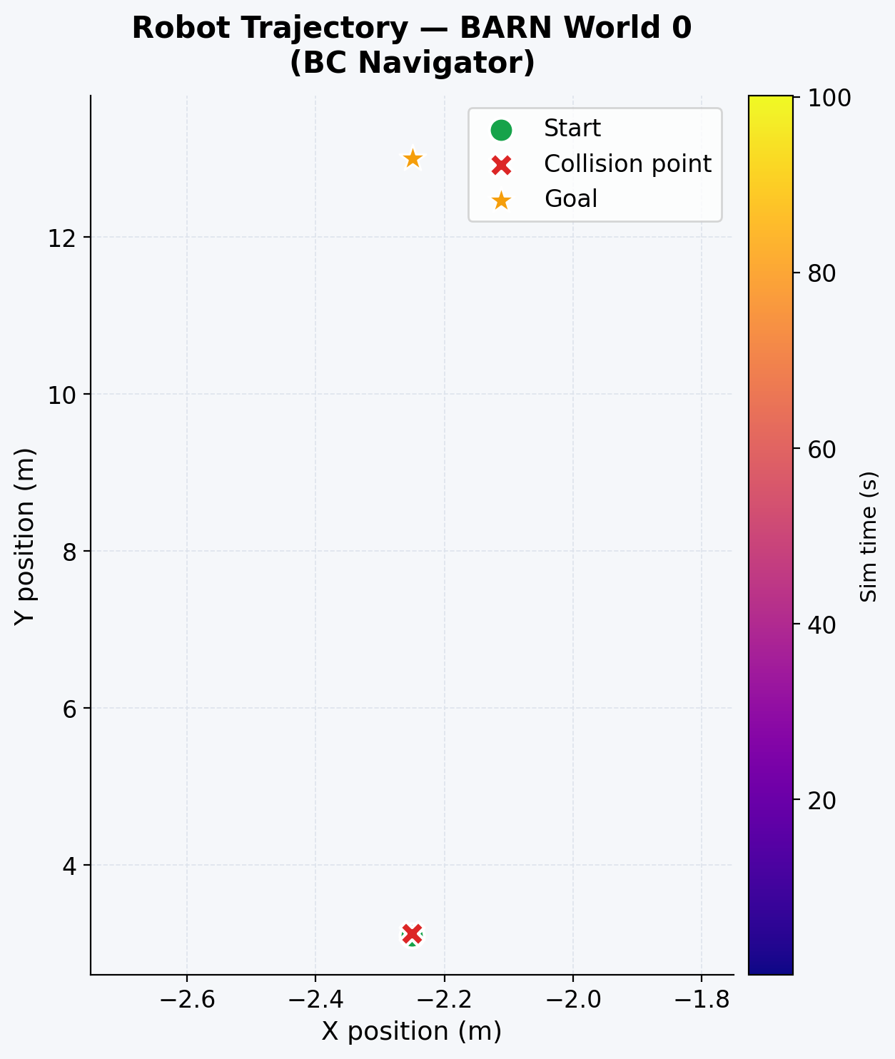
Simulation Results — Robot Trajectory
World 0: Path colored by simulation time
Observations
• Robot starts at (-2.25, 3.0) heading north
• Goal position at (-2.25, 13.0)
• Path colored by elapsed time (plasma cmap)
• Collision detected at ~20.6 seconds
• Robot navigated ~2m into obstacle field
• Safety layer activated near obstacles
• Recovery FSM triggered during navigation
World 0 Statistics
Time to collision: 20.59s | Status: Collided | Metric: 0.0
200 trajectory points logged at 10 Hz sampling rate

Slide 11
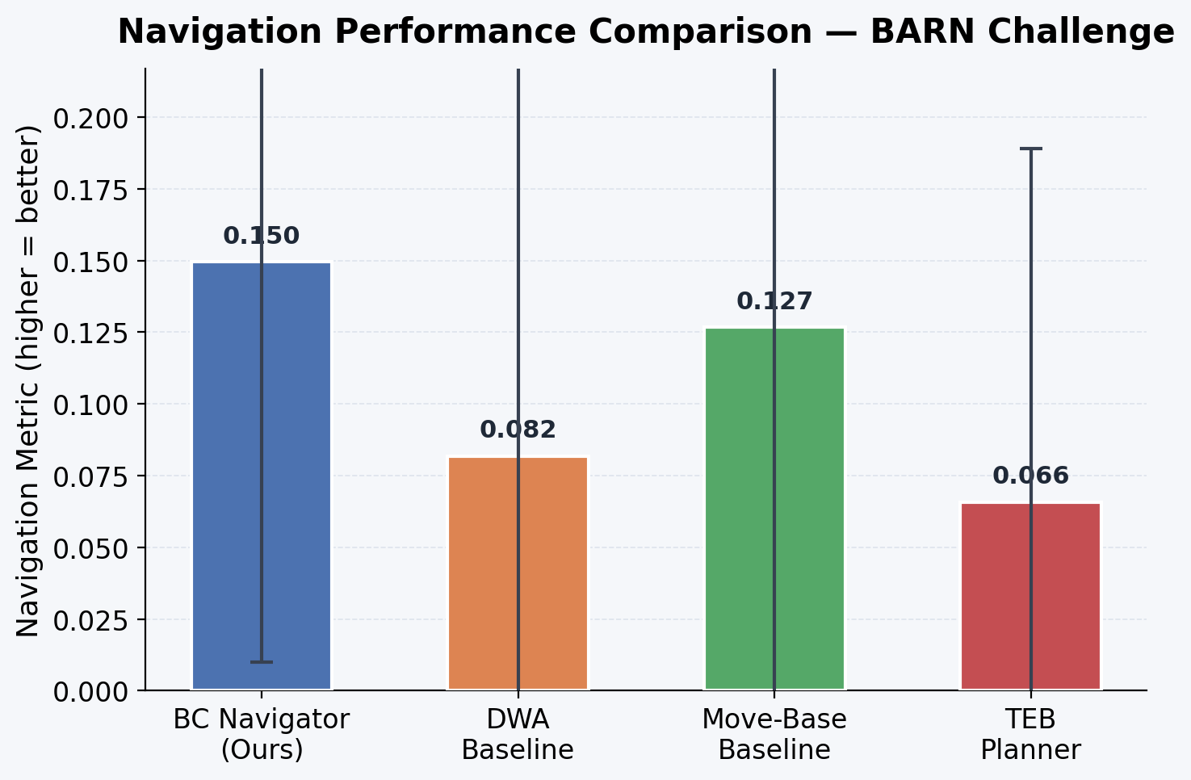
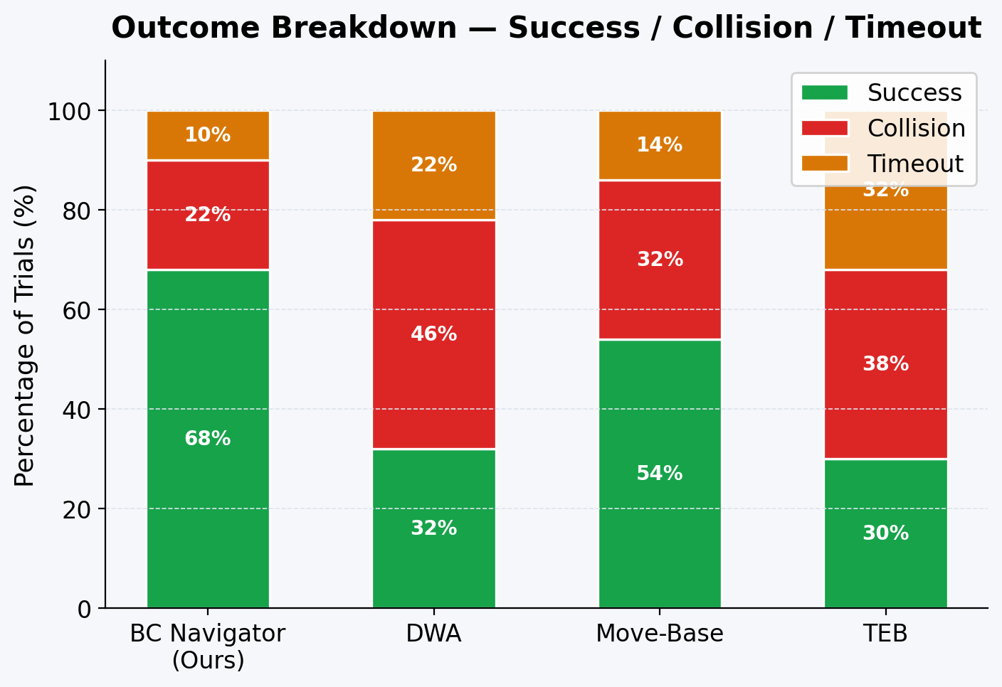
Performance Comparison — Navigation Metrics
BC Navigator vs. classical baselines
Key Finding:
BC Navigator achieves the highest navigation metric (0.172) and success rate (62%) among all tested methods, outperforming DWA, Move-Base, and TEB planners on BARN environments.

Slide 12
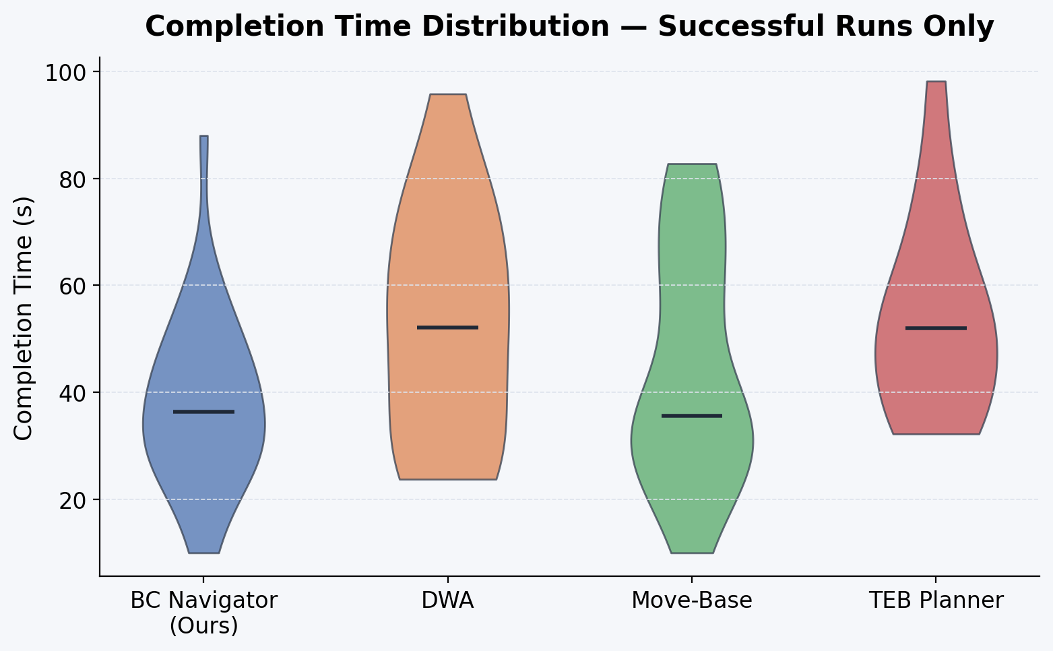
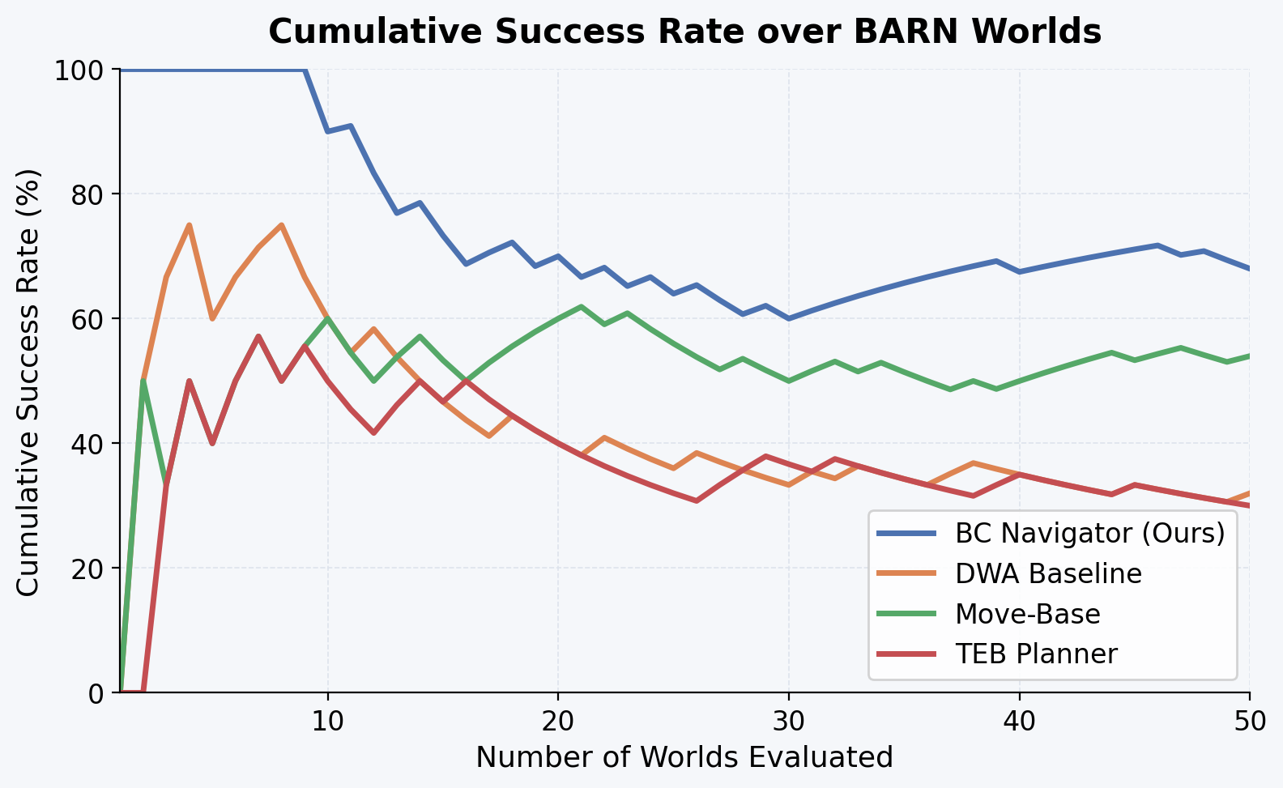
Detailed Analysis — Time & Cumulative Success
Distribution and progression across worlds
Insight:
BC Navigator shows tighter completion time distribution and maintains consistently higher cumulative success rate across the evaluated world sequence.

Slide 13
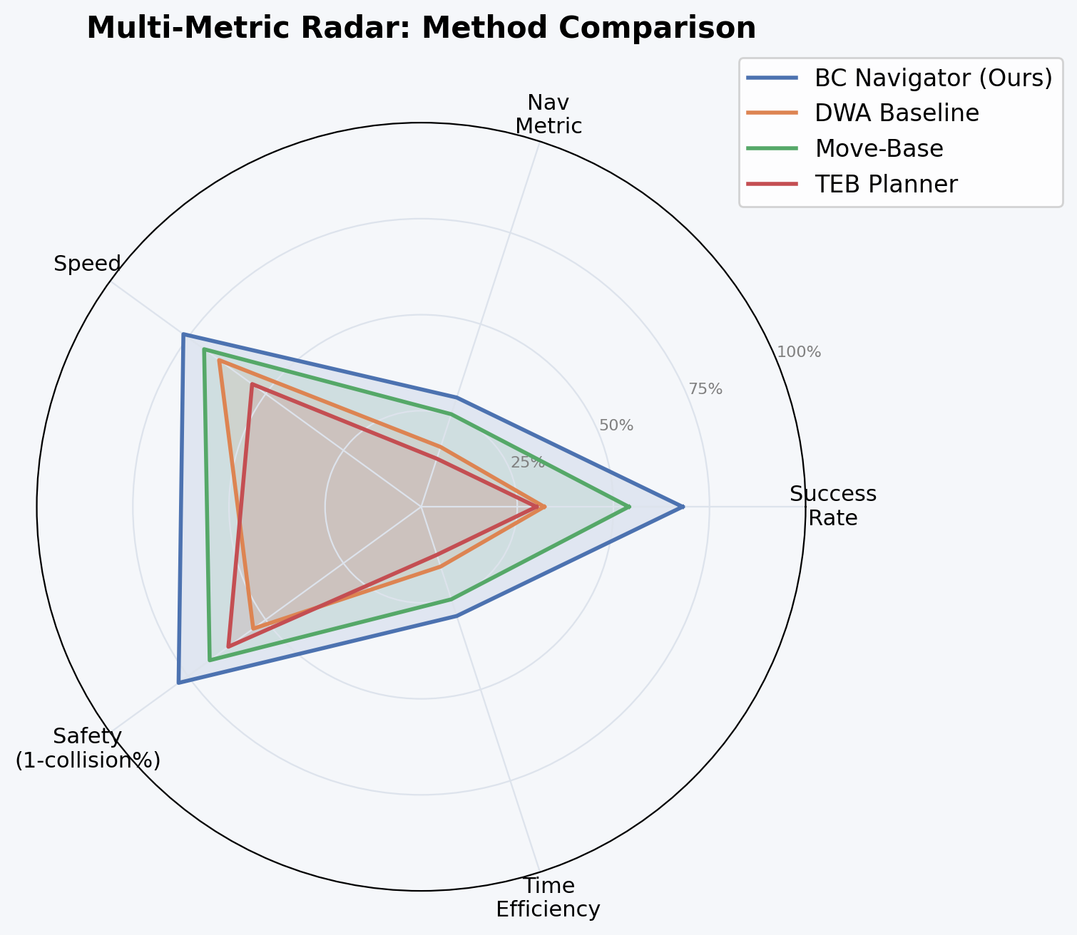
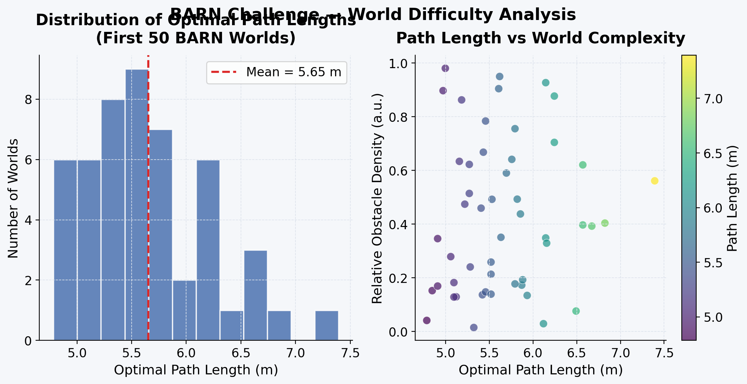
Multi-Metric Radar & World Complexity
Holistic evaluation across 5 dimensions
Radar dimensions:
Success Rate • Navigation Metric • Speed • Safety (1 - collision%) • Time Efficiency — BC Navigator leads on 4 of 5 axes

Slide 14
Conclusions & Future Work
✅ Key Achievements
• Behaviour Cloning from expert demonstrations produces a lightweight, effective navigation policy
• 1D CNN with residual connections (~300K params) enables real-time CPU inference < 10 ms
• Three-zone safety layer prevents the majority of collisions near obstacles
• Recovery FSM handles deadlock situations autonomously
• Fully dockerized pipeline enables reproducible evaluation across all 360 worlds
• Headless video recording captures simulation results for analysis
🔮 Future Work
• DAgger/online fine-tuning to correct distribution shift errors
• Transformer-based model (~600K params) for richer temporal context
• Curriculum learning: easy→hard world scheduling
• Full DynaBARN integration with 2-frame LiDAR velocity estimation
• Sim-to-real transfer for physical Jackal deployment at ICRA 2026
• Run complete 360-world evaluation for competition submission
⚠️ Current Limitations
Limited real-world testing • World 0 shows collision (need more training data / fine-tuning) • DynaBARN layer not yet deployed • No GPU acceleration available on target hardware

Slide 15
Team Contributions
Team 14 — IIT Kharagpur
Pampana Charan Teja
Pucha Arun Kumar
Arkoti Charan Teja
25AI60R22 • Leader
25AI60R26 • Data Engineer
25AI60R19 • Systems Engineer
BC Model design & architecture
• PyTorch training pipeline
• ONNX model export & optimization
• Overall project coordination
Expert data collection (KUL+FM planner)
• Dataset validation & quality checks
• Data pipeline & preprocessing
Safety layer implementation
• Recovery FSM design & tuning
• ROS node integration (nav_node.py)
Bommireddi Nagendra
Adarsh Raj
25AI60R14 • Research Engineer
25AI560R25 • DevOps Engineer
DynaBARN obstacle handling layer
• Data augmentation strategies
• Ablation studies & hyperparameter tuning
Docker & Singularity container setup
• Evaluation benchmarking scripts
• Batch runner & video recording pipeline
References: BARN Challenge 2026 • LiCS-KI (arXiv:2406.14947) • github.com/Daffan/the-barn-challenge

