Slide 1
ACADEMIC PROJECT PRESENTATION
CareerNify
STUDENT JOURNEY
Career Guidance & Placement Platform
01
Discover your direction. Build skills. Prepare for opportunity.
EXPLORE
02
DEVELOP
03
PRESENTED BY
[Student Name] | Roll No. [Roll Number]
PREPARE
[Department] | [College Name] | Academic Year [20XX–20XX]
PROJECT REVIEW
01 / 09
Notes:
Good morning. My project is CareerNify, a career guidance and placement platform for students. It brings together career exploration, skill tracking, learning, interview practice and job discovery. I have left the personal academic details as placeholders so I can fill in my name, roll number, department, college and academic year before presenting.

Slide 2
PROJECT INTRODUCTION & MOTIVE
A clearer route from student goals to career preparation
CareerNify is a student-facing web app that organizes career and placement preparation in one place.
EXPLORE
DEVELOP
PREPARE
DISCOVER
Career options
Skills & learning
Interview practice
Jobs & drives
Why this project?
Who benefits?
Career information, skill-building and placement preparation can be scattered across separate tools. Students need a visible path from a goal to practical next actions.
Students can explore roles, see learning and preparation pages, and find opportunities. Administrators have dedicated pages for managing platform content.
MOTIVE | Make career preparation more organized, visible and actionable for students.
CAREERNIFY / COLLEGE PROJECT REVIEW
02 / 09
Notes:
The motive is to reduce fragmentation during career preparation. CareerNify links role discovery with skills, learning resources, practice and opportunity listings. It is designed for students and also includes administrator pages. This describes the project goal, not a measured claim about employment outcomes.

Slide 3
PROBLEM STATEMENT & OBJECTIVES
From scattered preparation to a connected student workspace
THE CURRENT CHALLENGE
Career planning, skill development and job preparation often happen in separate places.
PROJECT OBJECTIVES
1
Explore career roles and recommendations
Scattered tools
Hard to see the next step.
2
Show student skills and areas to improve
Unclear skill gaps
Role requirements can feel abstract.
3
Organize role-oriented learning resources
Limited practice
Preparation needs a place to rehearse.
4
Offer assessment and interview-practice screens
Fragmented progress
Learning and opportunity details are separate.
5
Bring jobs and placement drives into the journey
EXISTING APPROACH
separate tools / manual tracking
PROPOSED
connected CareerNify modules
CAREERNIFY / COLLEGE PROJECT REVIEW
03 / 09
Notes:
This contrasts fragmented preparation with the project’s proposed connected workspace. The objectives match pages present in the source: career intelligence, skill analysis, learning paths, mock interviews, assessments, jobs and placement drives. This is a design comparison, not a measured comparison study.

Slide 4
TOOLS & TECHNOLOGIES USED
A lightweight web stack with Supabase services
HTML
HTML5
CSS
CSS3
Page structure: semantic content, forms and navigation.
Visual design: layout, shared styles and responsive rules.
BUILD & RUN
Visual Studio Code
Project code editor
JS
JavaScript
SB
Supabase
Client behavior and Supabase integration modules.
Auth, Postgres data and private-storage integration in source.
Web browser
Microsoft Edge used for local review
STACK AT A GLANCE
HTML5
CSS3
JavaScript
Supabase
PostgreSQL
Git / GitHub are not listed: no Git repository is present in the provided workspace.
CAREERNIFY / COLLEGE PROJECT REVIEW
04 / 09
Notes:
The interface uses HTML, CSS and plain JavaScript modules. Supabase is used by the code for authentication and data services; SQL migrations define the schema and row-level security. Visual Studio Code is the development editor, and I used Microsoft Edge to run and capture pages. Git or GitHub is not claimed because the supplied folder is not a Git repository.

Slide 5
SYSTEM ARCHITECTURE & WORKFLOW
The browser UI calls Supabase; the database returns data
SIMPLIFIED REQUEST / RESPONSE FLOW
1 USER
2 WEB UI
3 JAVASCRIPT
4 SUPABASE
5 POSTGRES
Student / admin
HTML + CSS pages
Client-side modules
Auth + API + storage
Database
Response returns through JavaScript to update the page
Authentication
Database
File storage
Supabase Auth calls exist in JavaScript for sign-in, registration and password flows.
Client calls connect to Postgres tables; SQL migrations define schema and RLS.
Resume upload and private-bucket code is present; live storage needs backend configuration.
Integrations are described from source code; this review did not verify a live Supabase account or database.
CAREERNIFY / COLLEGE PROJECT REVIEW
05 / 09
Notes:
A user interacts with an HTML page styled by CSS. JavaScript handles the action and, where needed, sends a request through the Supabase client. Auth requests go to Supabase Auth; data operations use the database API; resume files use Storage in the implemented flow. Supabase returns a response that client code uses to update the page. These integrations exist in source, but I did not run live requests against a verified project account for this review.

Slide 6
MODULES & IMPLEMENTATION
Student and admin modules share one consistent interface
Career planning
Skill development
Practice
Career intelligence, recommendations and profile context.
Skill analysis, progress visuals and learning paths.
Mock interview questions and assessment pages.
Opportunities
Student services
Administration
Job recommendations and placement-drive pages.
Dashboard, profile, certificates, notifications and support.
Admin dashboard plus student, content, jobs, drives and assessment pages.
IMPLEMENTATION PATH
HTML
page structure
CSS
responsive style
JavaScript
events + client
Supabase
auth + data
Resume review: browser text extraction / keyword guidance + upload path (PDF, DOCX, TXT; 5 MB max).
CAREERNIFY / COLLEGE PROJECT REVIEW
06 / 09
Notes:
These are the modules visible in the project pages and navigation. The frontend is split into HTML pages, shared CSS, and JavaScript modules. Supabase client code handles authentication and data actions where implemented. Resume analysis extracts text in the browser, provides keyword-based guidance and includes code for private storage. It is guidance, not a guarantee of career fit or hiring.

Slide 7
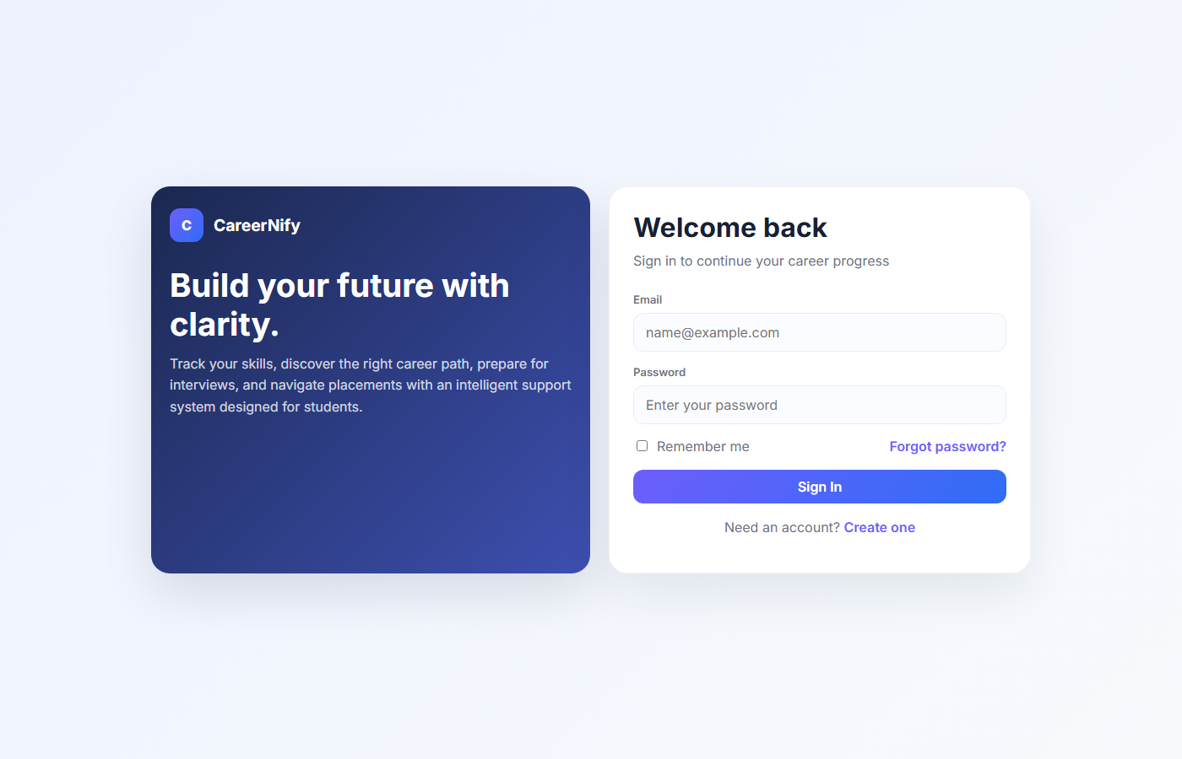
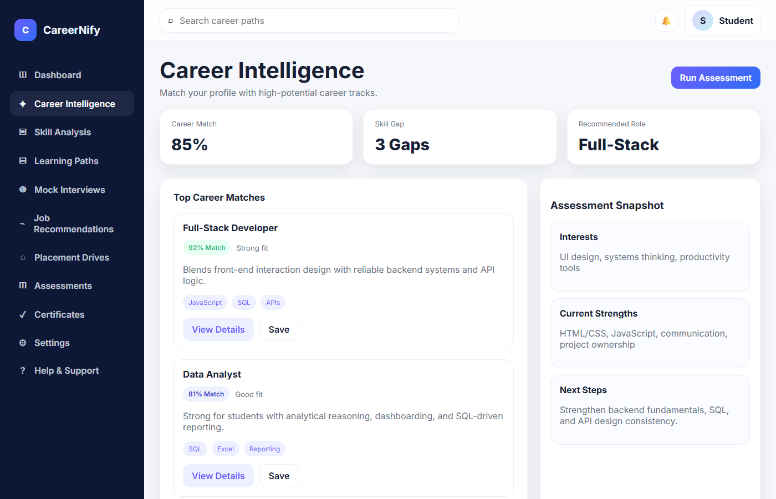
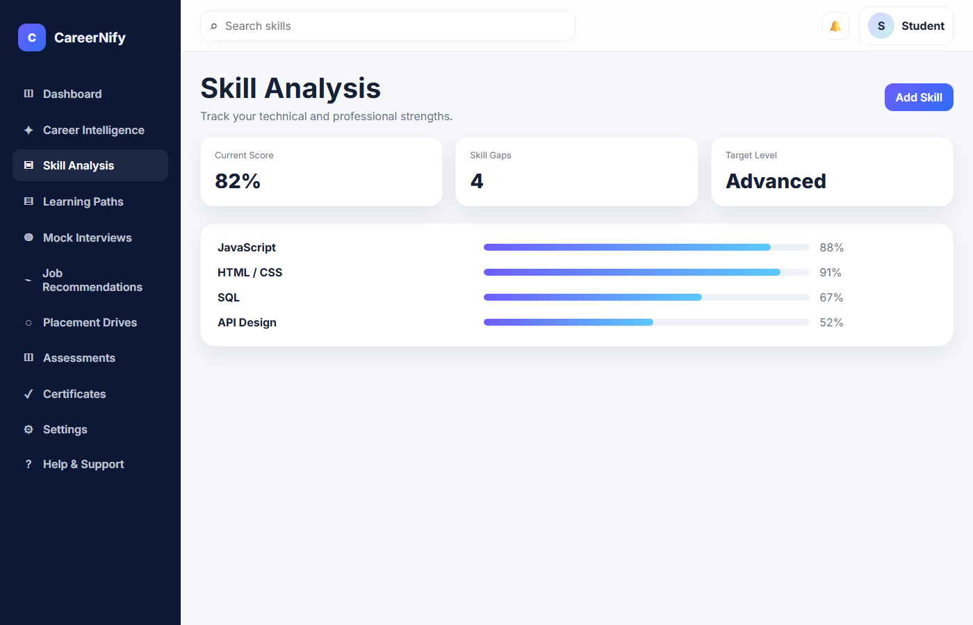
PROJECT OUTPUT | SCREENSHOTS
Actual browser output from the running CareerNify project
Screenshots captured from the local project in Microsoft Edge | UI values shown are sample/demo content
1
1
1
SIGN-IN / HOME
CAREER INTELLIGENCE
SKILL ANALYSIS
OUTPUT: CareerNify welcome panel, email/password fields, sign-in button and account links.
OUTPUT: 85% match, 3 gaps; Full-Stack 92% and Data Analyst 81% are shown as top roles. (Sample UI)
OUTPUT: Score 82%, 4 gaps; JavaScript 88%, HTML/CSS 91%, SQL 67%, API Design 52%. (Sample UI)
Career-match and skill percentages are static example UI values, not measured student results.
CAREERNIFY / COLLEGE PROJECT REVIEW
07 / 09
Notes:
These are actual screenshots captured from the running local site. The sign-in view shows the welcome panel, email and password inputs, sign-in button and account links. Career Intelligence visibly presents a match score, skill-gap count, role recommendation, and career-match cards. Skill Analysis presents a current score, skill-gap count and progress values. Career and skill figures are static example UI values, not measured results. Using the sign-in form requires a configured live Supabase account.

Slide 8
RESULTS, TESTING & BENEFITS
What was verified locally—and what still needs testing
LOCAL CHECKS
TEST CASE
EXPECTED
ACTUAL RESULT
STATUS
Home / sign-in page
Page serves in browser
HTTP 200
PASS
Career + skill pages
Module pages serve
Both HTTP 200
PASS
Supabase sign-in / data
Authenticated response
Not tested: no verified test account / live DB check
NOT TESTED
Project benefits
Limitations
Career, learning and placement pages are grouped together. Responsive styling is included. Resume text analysis runs in the browser.
Some screens show static sample content. Live Supabase workflows need setup and end-to-end tests. No accessibility metrics are claimed.
Verified here: six routes returned HTTP 200; three pages were captured. Backend functionality remains unverified.
CAREERNIFY / COLLEGE PROJECT REVIEW
08 / 09
Notes:
I checked local home, career, skill, learning, mock-interview and admin routes; all returned HTTP 200. I also captured actual browser views. This confirms pages are served, not that every button or backend workflow works. I did not authenticate with a test account or verify live Supabase responses, so that test is marked not tested. Some screens contain static sample data, and no automated suite or accessibility metrics are claimed.

Slide 9
CONCLUSION
One platform. A more connected
student career journey.
C
CareerNify brings career exploration, skill development, preparation and placement pages together in a single web application.
CAREERNIFY
FUTURE ENHANCEMENTS
1
Validate
Configure Supabase and run end-to-end auth / data tests.
2
Improve
Refine sample-to-live data flows and verify role-based screens.
3
Evaluate
Run student usability and accessibility checks; iterate from feedback.
THANK YOU | QUESTIONS & ANSWERS
09 / 09
Notes:
To conclude, CareerNify provides a connected set of student career and placement-preparation pages using HTML, CSS, JavaScript and Supabase services. The local interface is available; live workflows and data still need end-to-end verification. Future work is to complete backend setup, test authentication and data flows, and evaluate usability and accessibility with students. Thank you. I am happy to take questions.

