Slide 1
C
CareerNify
Build your future with clarity
A web application for student career exploration, skill development, interview practice and job opportunities

Slide 2
Project Overview
CareerNify brings everything a student needs for a career journey into one web application.
Students often use separate tools for career guidance, skill tracking, courses, interview prep and job search.
CareerNify unifies these into a single dashboard with an intelligent support system.
Goal: help students track skills, find the right career path, prepare for interviews and navigate placements.
Career exploration
Skill development
Learning resources
Interview practice
Job opportunities
CareerNify | 2

Slide 3
Main Users and Modules
Students
Administrators
Sign in, take career assessments, analyse skills, follow learning paths, practise mock interviews, view job recommendations and placement drives.
Manage users and platform content such as learning paths, jobs, placement drives and assessments.
Modules in the sidebar
Dashboard
Career Intelligence
Skill Analysis
Learning Paths
Mock Interviews
Job Recommendations
Placement Drives
Assessments
Certificates
CareerNify | 3

Slide 4
Technologies Used
HTML5
CSS3
JavaScript
Page structure: forms, sections, semantic layout
Styling: responsive cards, sidebar, gradients, badges
Interactivity, page logic and calls to Supabase
Supabase
SQL
Auth, hosted database and file storage
Tables, queries and relationships for user data
CareerNify | 4

Slide 5
System Architecture
Browser
Supabase Auth
Supabase Database
Supabase Storage
→
→
→
HTML5 + CSS3 + JavaScript UI
Sign up, sign in, sessions
SQL tables for users, skills, jobs, paths
Files such as certificates
The user logs in through Supabase Auth; the session decides which data and pages are available.
JavaScript reads and writes data through the Supabase client, backed by SQL tables.
Storage holds uploaded files, keeping the app serverless and simple to deploy.
CareerNify | 5

Slide 6
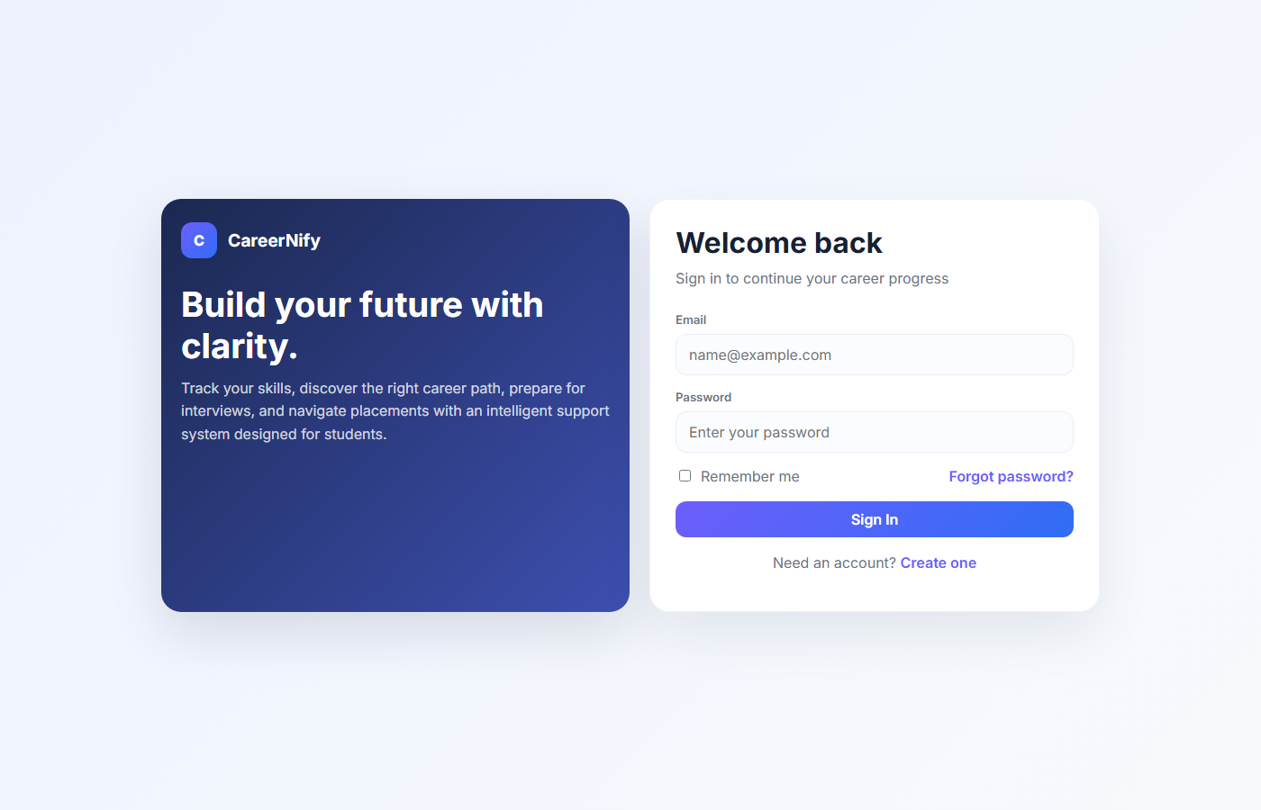
Output 1: Login Page
Split layout: CareerNify branding on the left, sign-in form on the right.
Email and password fields with Remember me and Forgot password.
Create one link for new account sign-up.
Authentication is handled by Supabase Auth.
CareerNify | 6

Slide 7
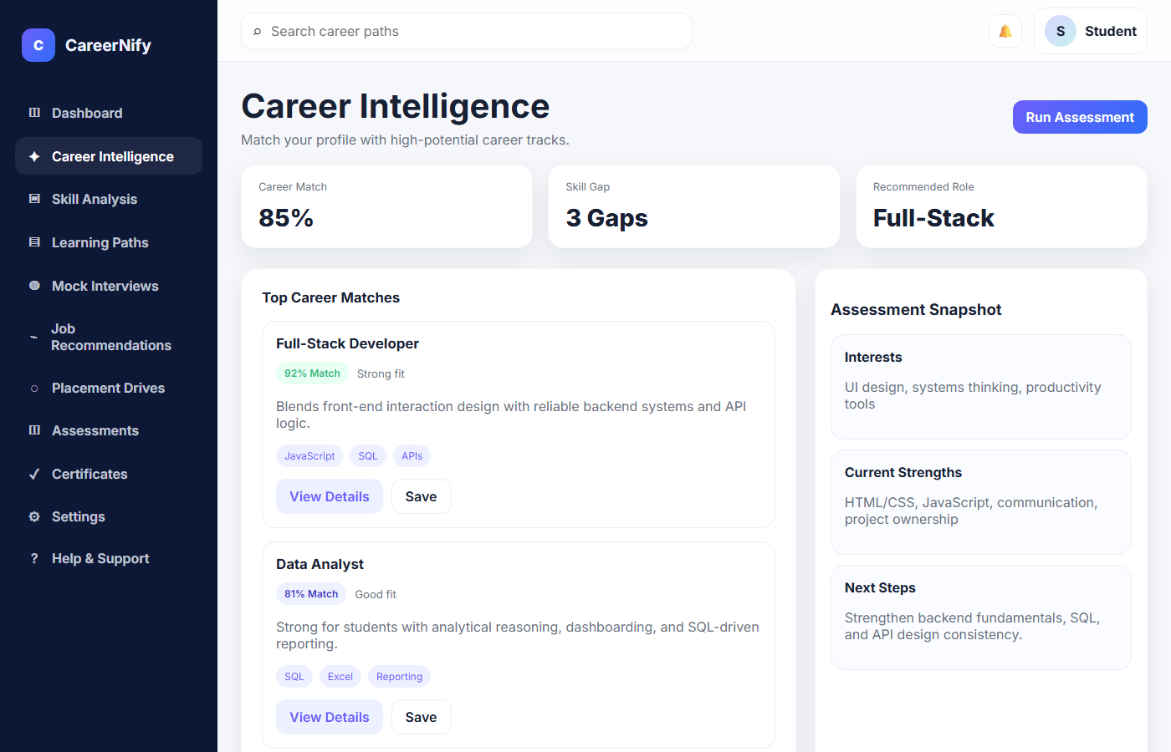
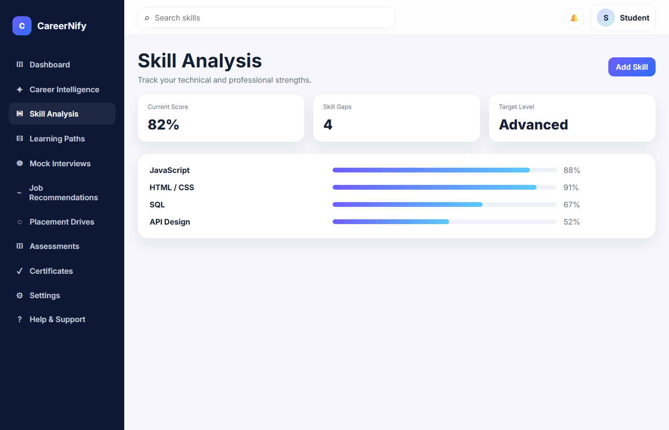
Output 2: Career Intelligence and Skill Analysis
Career match 85%, 3 skill gaps, recommended role Full-Stack.
Top matches: Full-Stack Developer 92%, Data Analyst 81%.
Snapshot of interests, strengths and next steps.
Score 82%, 4 skill gaps, target level Advanced.
Progress bars: JavaScript 88%, HTML/CSS 91%, SQL 67%, API Design 52%.
Weakest skills show where to focus next.
CareerNify | 7

Slide 8
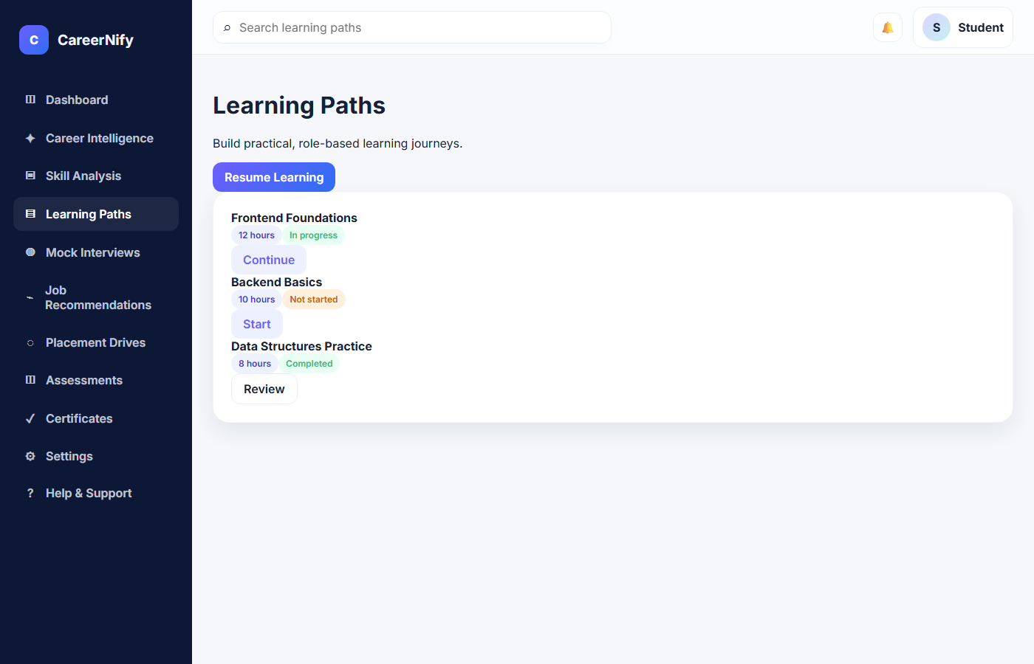
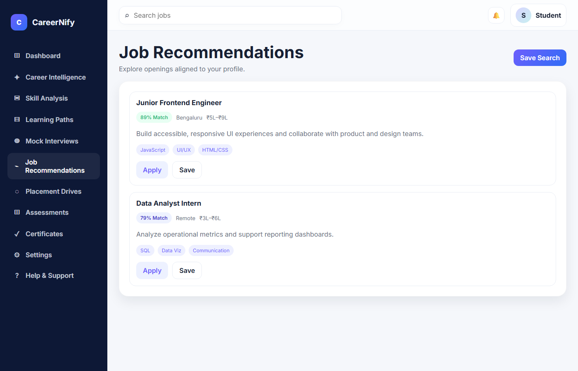
Output 3: Learning Paths and Job Recommendations
Role-based paths: Frontend Foundations (12 h, in progress), Backend Basics (10 h), Data Structures Practice (8 h, completed).
Continue, Start and Review buttons track status.
Jobs matched to the profile: Junior Frontend Engineer 89%, Data Analyst Intern 79%.
Location, salary range and skill tags with Apply and Save.
CareerNify | 8

Slide 9
Conclusion and Future Scope
Conclusion
Future Scope
CareerNify combines guidance, skill tracking, learning, interview practice and jobs in one place.
Built with HTML5, CSS3, JavaScript, Supabase and SQL.
Gives students clear direction and a measurable path to placement.
Admin analytics for placement tracking.
AI-powered mock interview feedback.
Certificate verification and sharing.
Mobile app and notifications.
CareerNify | 9

