Slide 1
Data Science
Exploring Data Science

Slide 2

Understanding Data Science Fundamentals - Visual

Slide 3


Understanding Data Science Fundamentals
• Data Science combines statistical analysis, programming, and domain expertise to extract meaningful insights from structured and unstructured data.
• Modern data science emerged from the intersection of mathematics, computer science, and business analytics to solve complex real-world problems.

Slide 4

Core Components of Data Science - Visual

Slide 5
Core Components of Data Science
• Data collection and cleaning processes form the foundation of any data science project, typically consuming 60-80% of a data scientist's time.
• Statistical analysis and machine learning algorithms enable predictive modeling and pattern recognition in large datasets.
• Programming languages like Python and R provide the technical framework for implementing data science solutions.

Slide 6
The Data Science Pipeline - Visual

Slide 7

The Data Science Pipeline
• The data science workflow begins with problem definition and data acquisition, followed by preprocessing and exploratory data analysis.
• Feature engineering and model selection processes require careful consideration of dataset characteristics and business objectives.
• Model deployment and monitoring systems ensure continuous improvement and practical application of data science solutions.

Slide 8
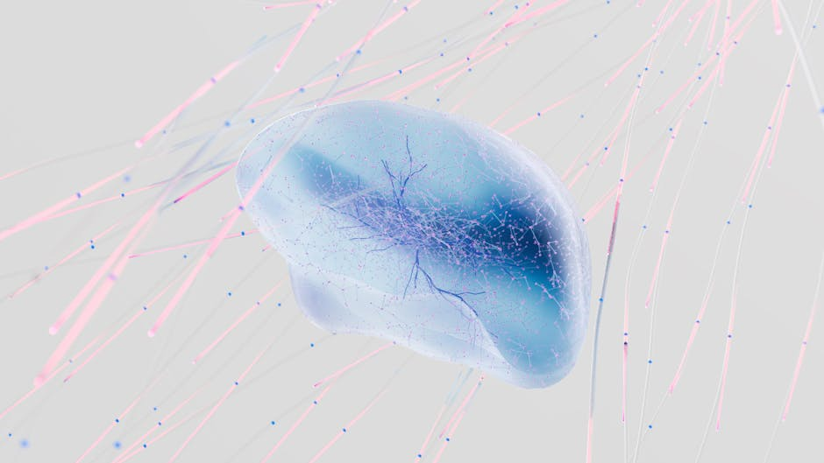
Applications and Impact - Visual

Slide 9
Applications and Impact
• Data science drives innovation across industries, from healthcare diagnostics to financial fraud detection and personalized marketing.
• Business intelligence and automated decision-making systems rely on data science to process vast amounts of information and generate actionable insights.
• The integration of data science with artificial intelligence continues to expand the boundaries of what's possible in predictive analytics and automation.

