Slide 1
Data Science
Exploring Data Science

Slide 2
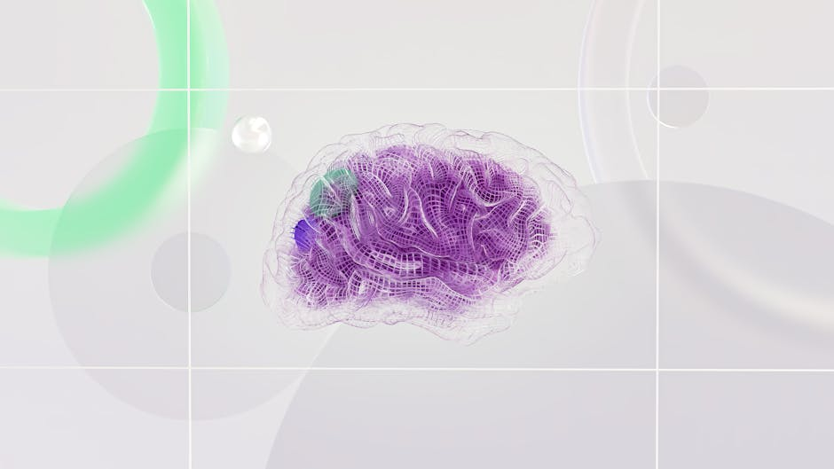
Introduction to Data Science - Visual

Slide 3


Introduction to Data Science
• Data science is a field that combines concepts from computer science, statistics, and domain-specific knowledge to analyze and interpret data.
• It involves using various techniques such as machine learning, deep learning, and data visualization to extract insights from data.

Slide 4
Applications of Data Science - Visual

Slide 5
Applications of Data Science
• Data science is used in a variety of industries, including healthcare, finance, marketing, and more.
• It helps organizations make informed decisions by analyzing and interpreting large datasets.

Slide 6

Data Science Workflow - Visual

Slide 7

Data Science Workflow
• The data science workflow typically involves data collection, data cleaning, data analysis, and data visualization.
• Each step of the workflow is crucial for extracting meaningful insights from data.

Slide 8
Future of Data Science - Visual

Slide 9
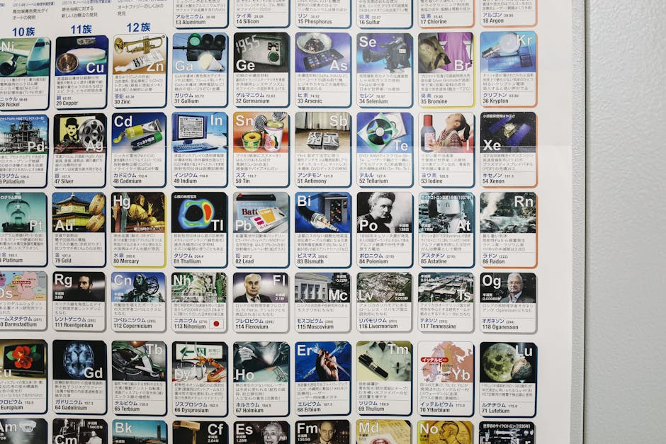
Future of Data Science
• As technology continues to advance, data science will become even more important in various industries.
• The field will continue to evolve and expand into new areas, such as augmented reality and virtual reality.

