Slide 1

Note: The data and information in this document is reflective of a hypothetical situation and client. This document is to be used for KPMG Virtual Internship purposes only.
Sprocket Central Pty Ltd
Data analytics approach
[Division Name] - [Engagement Manager], [Senior Consultant], [Junior Consultant]

Slide 2
Note: The data and information in this document is reflective of a hypothetical situation and client. This document is to be used for KPMG Virtual Internship purposes only.
Agenda
Introduction
Data Exploration
Model Development
Interpretation

Slide 3
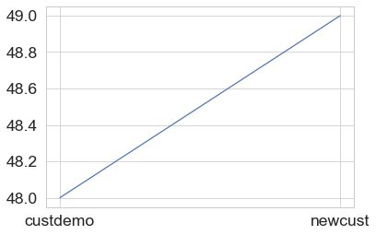
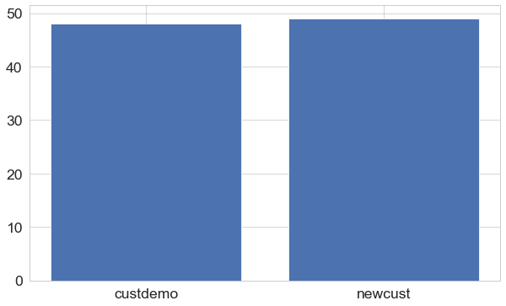
Note: The data and information in this document is reflective of a hypothetical situation and client. This document is to be used for KPMG Virtual Internship purposes only.
Introduction
We have been going through your company’s data which has been collected since 3 years and made some insights which helps you get better reach towards your customers
Growth: from 48 to 49 products per customer, no difference between products bought by old and new customers ,there is no growth in product per customer , so we must focus on selling new designs of products

Slide 4
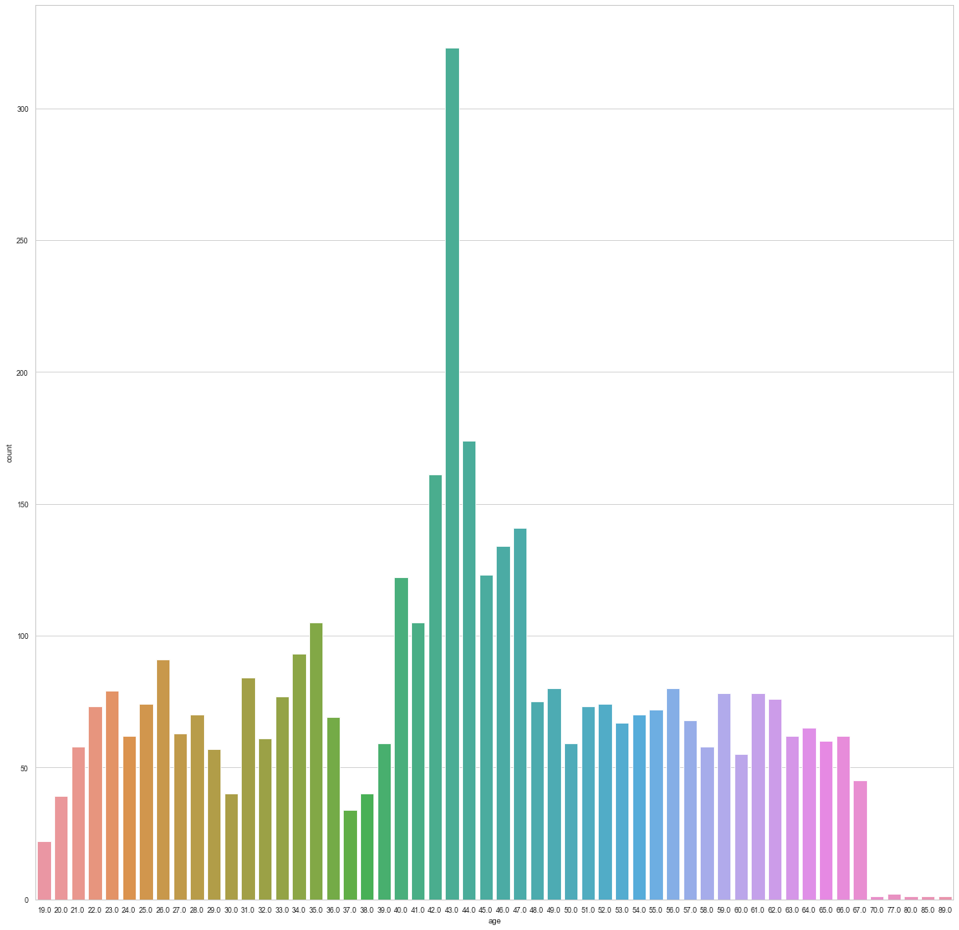
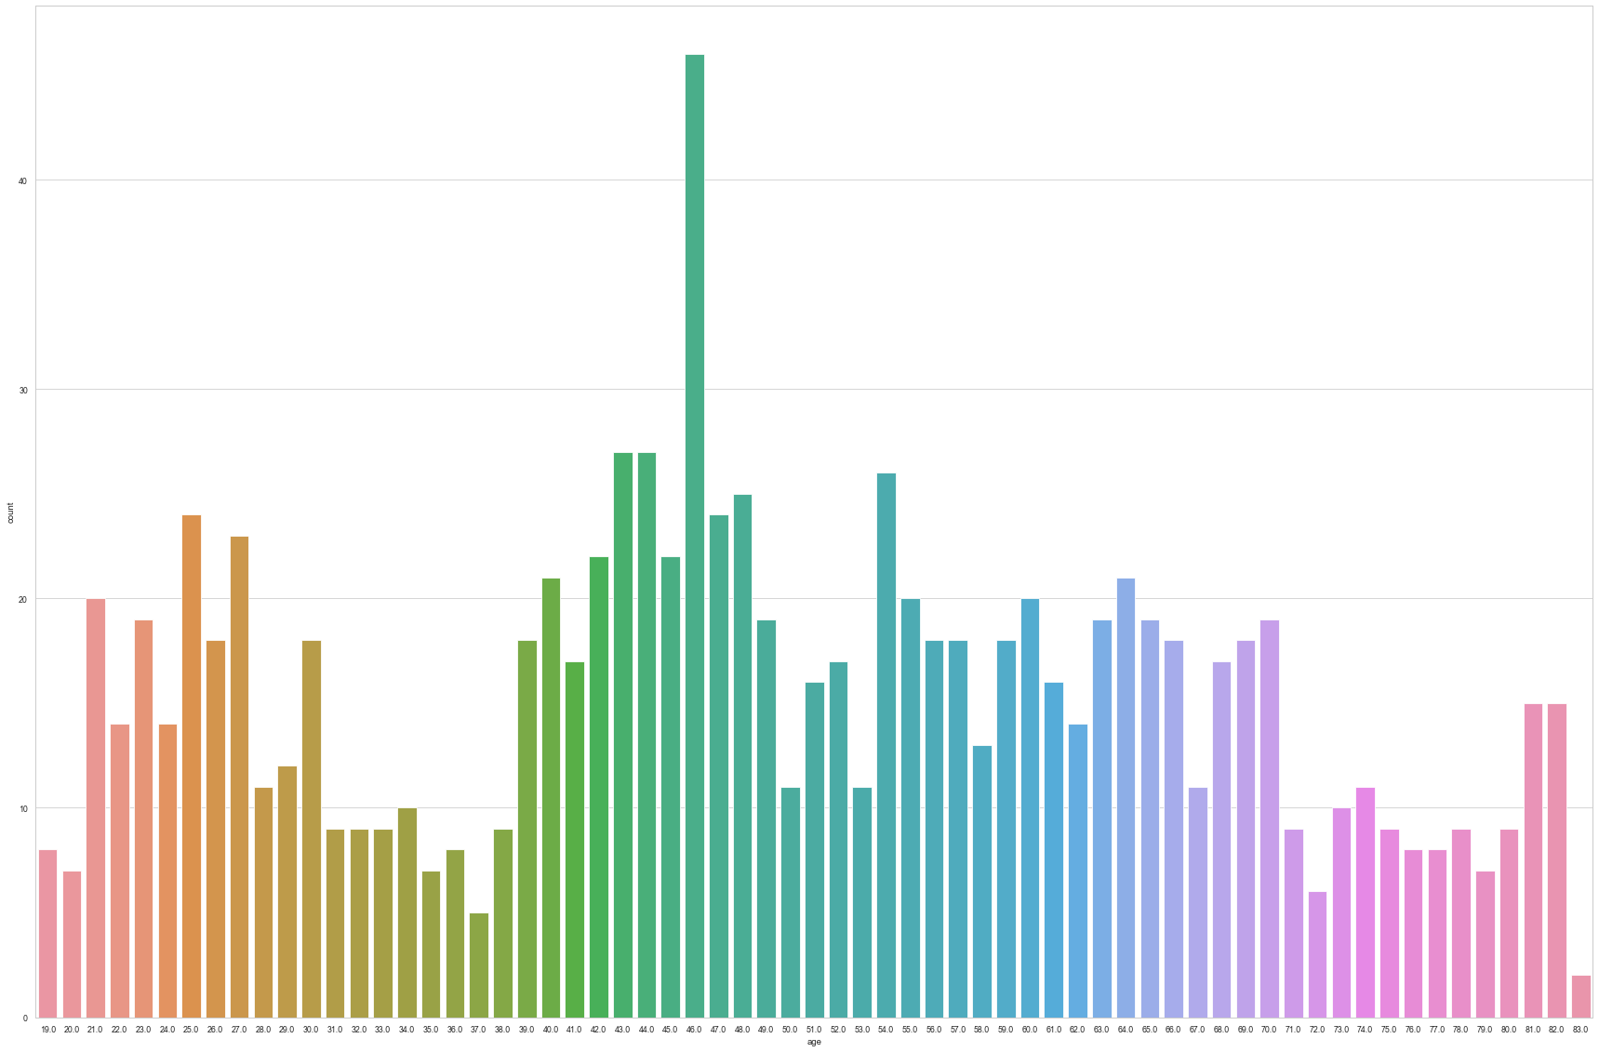
Note: The data and information in this document is reflective of a hypothetical situation and client. This document is to be used for KPMG Virtual Internship purposes only.
Data Exploration
Graph of old and new customers’ age vs their count, it helps us divide range of whole age class into groups
Old customers
New customers

Slide 5
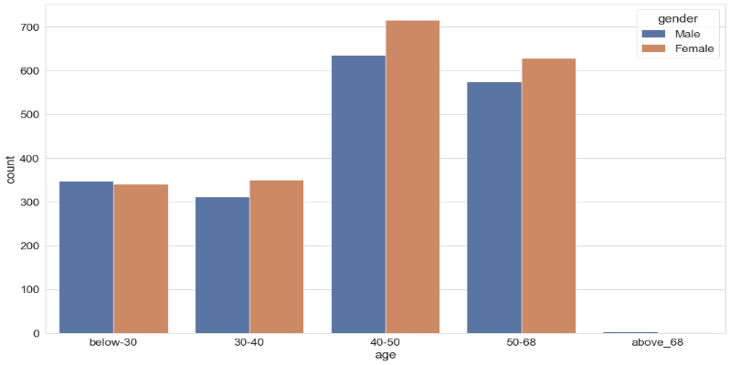
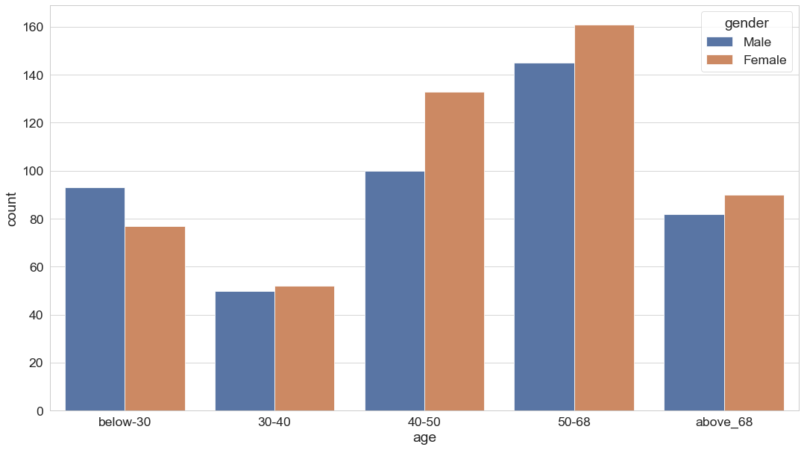
Note: The data and information in this document is reflective of a hypothetical situation and client. This document is to be used for KPMG Virtual Internship purposes only.
Data Exploration
Age
These insights shows that Female customers are greater than male customers
Regarding “Age” ,customers from age group from 50 to 68 are increasing , while old customer from age group 40 to 50 have decreased.
And people above age 68 showing interest in buying bikes .so we must focus more on customers from age 50+. Probably considering their health ,they must have started using bicycle for exercise purpose.
So selling more cycles which impress adults would grow income
And for people below 50 their count percentage haven’t changed much

Slide 6
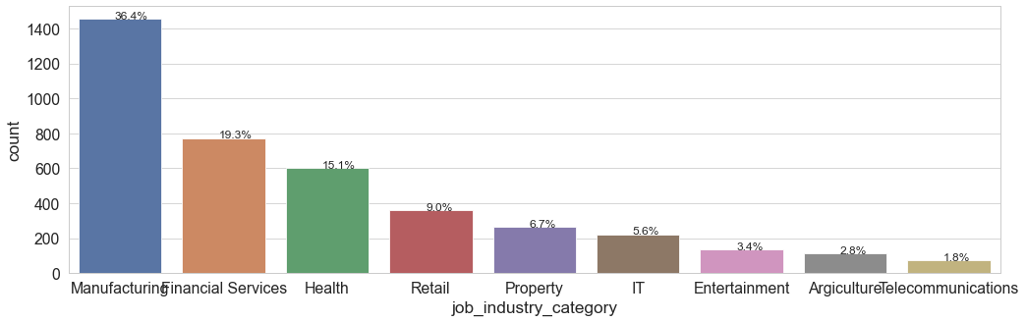
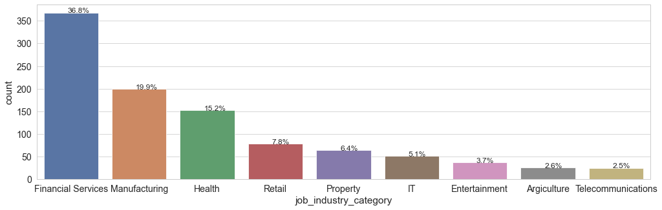
Note: The data and information in this document is reflective of a hypothetical situation and client. This document is to be used for KPMG Virtual Internship purposes only.
Data Exploration
Job industry category
Our new customers mostly are from Financial services but old ones are mostly from Manufacturing related jobs
Rest of the job aren’t must counted to max
So we should focus mostly on financial services then manufacturing related jobs

Slide 7


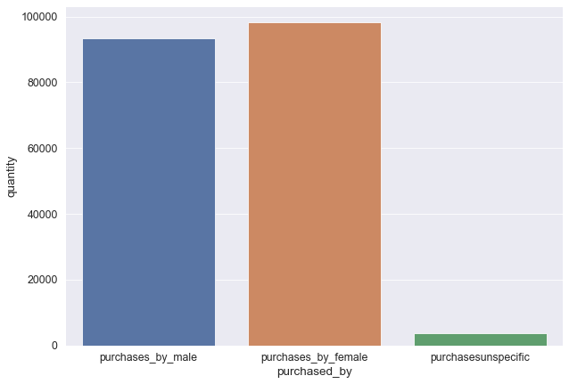
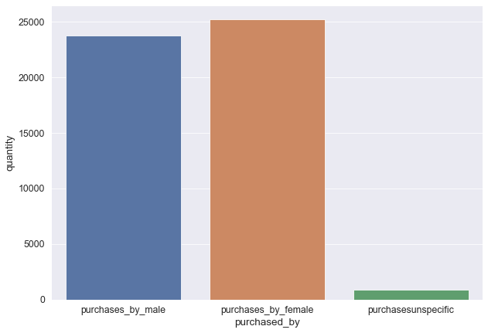
Note: The data and information in this document is reflective of a hypothetical situation and client. This document is to be used for KPMG Virtual Internship purposes only.
Data Exploration
Number of purchases
In past thee years from old customers as well as from new customers “Female ” customers are buying relatively more products
So selling more bikes which attract female customers would be helpful
New
Old

Slide 8
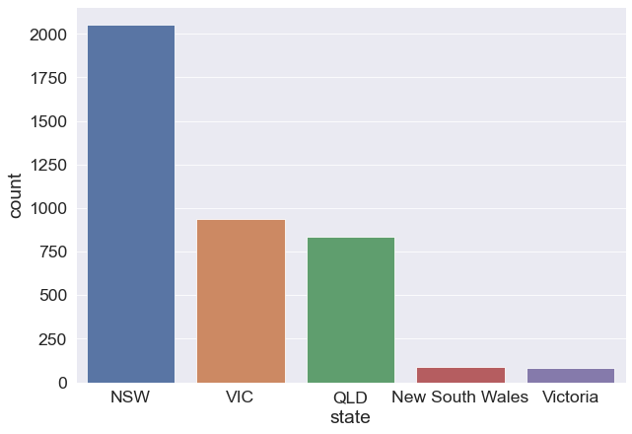
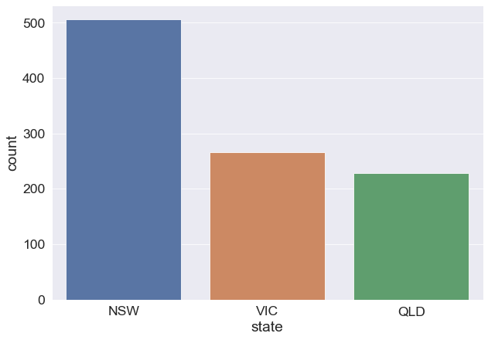
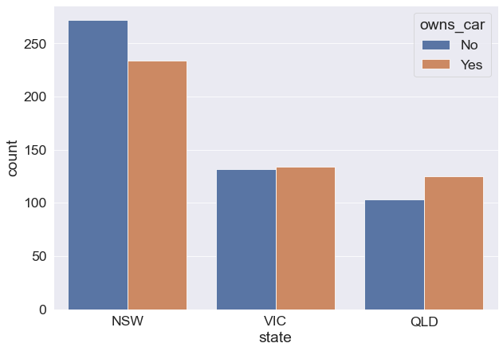
Note: The data and information in this document is reflective of a hypothetical situation and client. This document is to be used for KPMG Virtual Internship purposes only.
Data Exploration
States
Old customer states
new customer states
new customer states with car or without car
There were customers from new south wales and Victoria but from new customers no one are from those states , so we should advertise there more
From NSW more number of customers are coming
NSW should be considered the most since numbers of customers don’t own cars is significantly larger than that own.
VIC and QLD has more customers that own car that who don’t but we can try to have something so that those owns car will buy bikes.

Slide 9
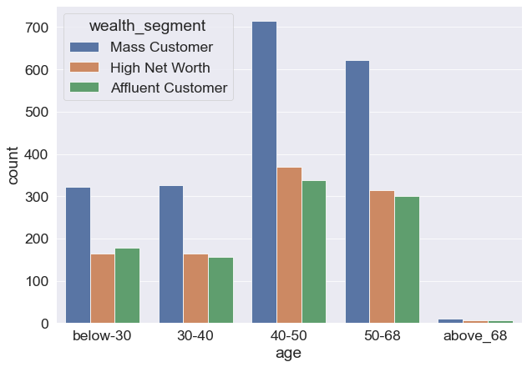
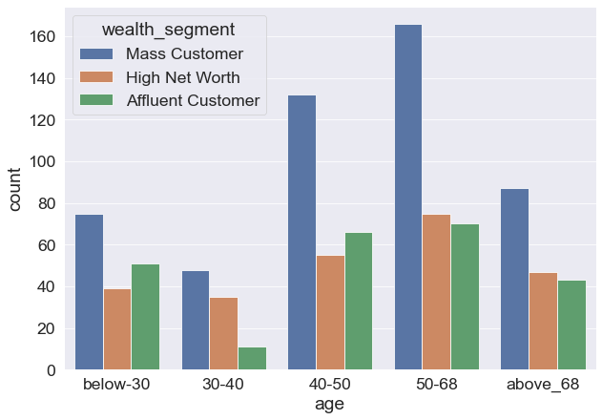
Note: The data and information in this document is reflective of a hypothetical situation and client. This document is to be used for KPMG Virtual Internship purposes only.
Data Exploration
In all ages, the number of Mass Customers is the highest so we should focus on this social class.
After that, we should focus on High Net Customer.
Then Affluent Customers but mostly from age 40 to 68

Slide 10
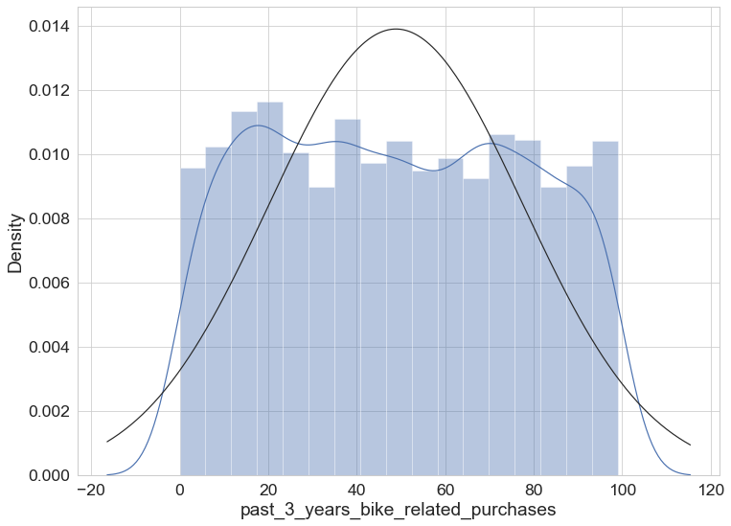
Note: The data and information in this document is reflective of a hypothetical situation and client. This document is to be used for KPMG Virtual Internship purposes only.
Model Development
Model should be predicting number of products bought by customers
Female and male are buying products with not much difference
Distribution of number of purchases We can see max is around 100 and people without buying anything also visiting store

Slide 11
Note: The data and information in this document is reflective of a hypothetical situation and client. This document is to be used for KPMG Virtual Internship purposes only.
Appendix

Slide 12
Note: The data and information in this document is reflective of a hypothetical situation and client. This document is to be used for KPMG Virtual Internship purposes only.
Appendix
Age group from 19 to 24 are really less in buying bicycles. Young people aren’t much attracted to the bikes your store is selling , so selling modern models could help in gaining more customers
From data we analyzed there are few errors regarding gender, knowing gender really helps in reaching good accuracy because men and women have different bike models.
Thankyou

