Slide 1

Analyzing Employee Attrition Patterns Using HR Data
Charan VR
AF05104385
ANP–D4856

Slide 2

Introduction
Employee attrition is a major challenge faced by many organizations. When employees leave frequently, it increases recruitment costs, reduces productivity, and affects team performance.
This project analyzes employee data to understand the patterns and f factors influencing employee attrition. Using data visualization and analytics in Power BI, the project aims to identify the key reasons employees leave and provide insights to help organizations improve employee retention.

Slide 3
Problem Statement
Identify employees who are more likely to leave the company.
Analyze factors contributing to employee attrition.
Provide insights to help HR teams take actions to improve employee retention and workplace satisfaction.

Slide 4
Dataset Description
Source : Kaggle
Dataset contains :
Employee ID
Age
Gender
Education
Department
Job Satisfaction
Work Life Balance
Overtime
Distance From Home km
Num Projects Last Year
Last Promotion Years Ago
Attrition
Role Name

Slide 5

Key DAX Measures
Total Emlpoyee
Active Employee
Total Attrition
Attrition %
Low Job Satisfaction
Work Life Balance
High Workload
Overtime
High Distance
No Promotion
Average Years Before leaving

Slide 6
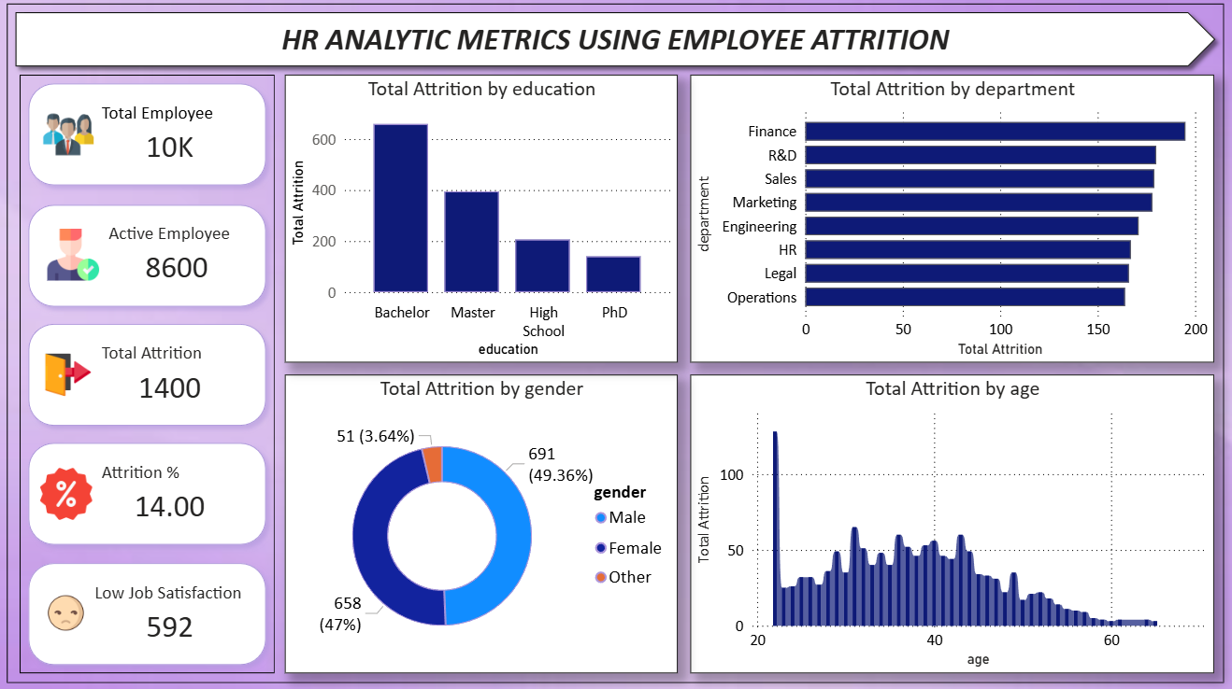
Dashboard Overview

Slide 7
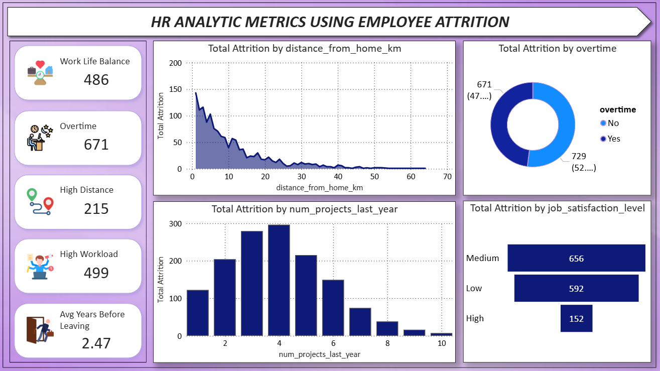
Dashboard Overview

Slide 8
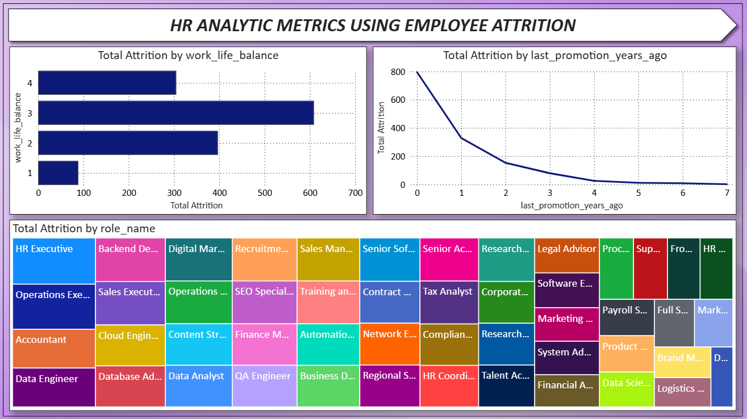
Dashboard Overview

Slide 9

Key Insights
Some departments show higher employee attrition compared to others.
Employees with low job satisfaction are more likely to leave the company.
Frequent overtime is associated with higher attrition rates.
Lack of promotions and career growth increases employee turnover.
Employees handling a higher number of projects may experience workload stress, leading to higher attrition.
Employees living far from the workplace tend to leave more often.

Slide 10

Recommendations
Improve job satisfaction by creating a positive and supportive work environment.
Reduce excessive overtime to help employees maintain a better work-life balance.
Provide regular promotions and career growth opportunities to retain talented employees.
Manage project workload effectively to prevent employee stress and burnout.
Support employees with long commuting distances through flexible work options or transportation support.

Slide 11
Conclusion
This project analyzed employee data to understand the key factors influencing employee attrition. The analysis showed that factors such as job satisfaction, overtime, workload, work-life balance, promotions, and commuting distance play an important role in employee turnover. By using Power BI dashboards and data analysis, organizations can identify employees at risk of leaving and take proactive steps to improve employee satisfaction and retention. This helps companies reduce attrition, improve productivity, and create a more stable workforce.

Slide 12
Thank You

