Slide 1
Real-Time RAG for Movie Reviews
GitHub Repository:
https://github.com/charara-telecom/ds-project
Ali Charara & Rémy Sader
January 2025

Slide 2
Introduction
RAG systems combine large language models with external knowledge for context-aware responses.
Most RAG systems work on static datasets, but real-time applications require continuous streaming data.
Real-time challenges:
High-throughput ingestion
Low-latency retrieval
This project: Build a real-time RAG system to analyze public opinions on new movie releases.

Slide 3
Goal of the Project
Build a real-time RAG system for analyzing public movie opinions.
Provide context-aware summaries of live movie reviews.
Handle continuously streaming data efficiently.

Slide 4
Key Objectives
Kafka pipeline for ingesting live movie reviews.
Generate embeddings and store in a vector database.
Retrieve the most relevant reviews for user queries.
Demonstrate real-time operation of a RAG system.

Slide 5
System Architecture
Supports real-time retrieval and generation of movie review summaries.
Combines live streaming data with RAG-based summaries.
Key components:
Data Ingestion
Embeddings & Vector Database
RAG Query & Generation

Slide 6
From Live Reviews to Real-Time Summaries
Data Ingestion:
TMDB API feeds live reviews into Apache Kafka.
Kafka buffers and streams data continuously.
Processing & Embeddings:
Reviews cleaned and tokenized.
Converted into numerical embeddings for semantic search.
Vector Database:
Embeddings stored for fast similarity retrieval.
Continuously updated to keep reviews fresh.
RAG Query & Generation:
Retrieves relevant reviews from vector DB.
Generates up-to-date summaries.

Slide 7
Kafka and TMDB Overview
TMDB API provides real-time movie information and user reviews.
Apache Kafka is used to stream and buffer data continuously.
Two Kafka topics organize the data:
movie-details: metadata for each movie
movie-reviews: user reviews linked to movies
Ensures efficient, real-time ingestion for the RAG system

Slide 8
Kafka Producer Overview
Producer processes up to 50 movies per iteration to avoid flooding.
Movie details stored: ID, title, overview, release date, runtime, genres, rating, popularity
Reviews stored: author, content, timestamp, movie ID & title
Each review is enriched with metadata before entering Kafka → ensures accurate retrieval later

Slide 9
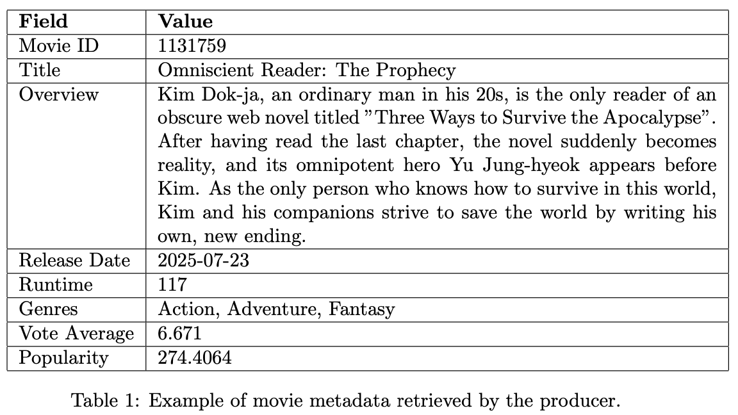
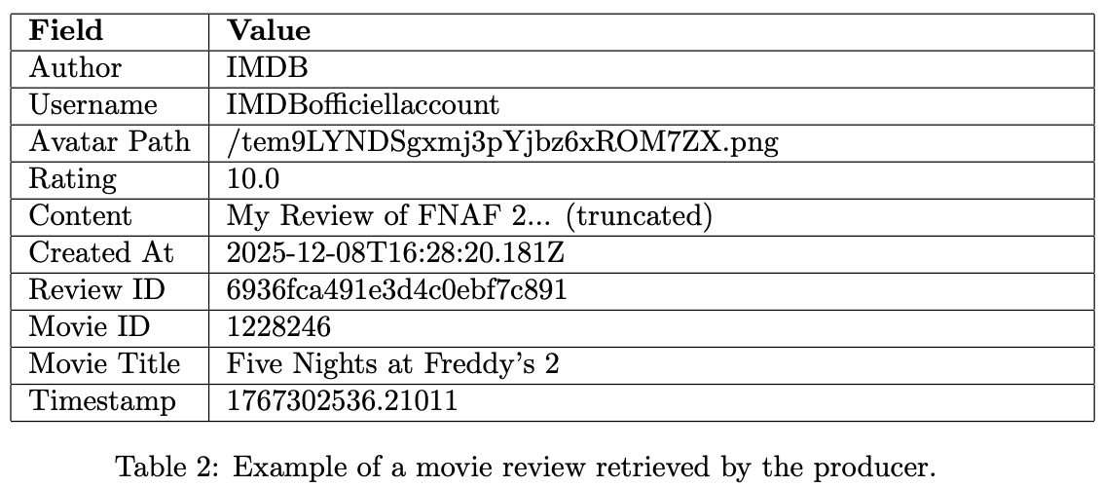
Sample Movie Metadata & Review

Slide 10
Kafka Consumer & Embedding Pipeline
Reads live reviews from the movie-reviews Kafka topic.
Prepares data for the vector database:
Assigns unique IDs to each review.
Normalizes metadata (movie title, author, rating, timestamps).
Converts review dates to numeric timestamps for filtering.
Generates embeddings using the Gemini model (text-embedding-004, 768 dimensions).
Stores processed data in ChromaDB (chroma_db_v2) for real-time RAG retrieval.

Slide 11
Vector Database & Gemini Embeddings
Vector Database (ChromaDB)
Stores processed reviews, embeddings, and essential metadata.
Acts as the knowledge base for real-time RAG retrieval.
Keeps storage efficient by including only relevant metadata (title, rating, timestamp).
Embedding Generation (Gemini)
Converts review text into 768-dimensional vector embeddings.
Captures semantic meaning for similarity-based retrieval.
Custom GeminiHelper handles:
API key rotation
Single/batch embeddings
Configurable parameters (task_type, dimensions)

Slide 12
Rag Pipeline Overview
Processes user queries with Gemini model for filter extraction.
Retrieves relevant reviews from ChromaDB via:
Semantic similarity (embeddings)
Metadata filtering (movie title, rating, date)
Formats retrieved documents for LLM answer generation.
Outputs the answer with movie references for debugging purposes.

Slide 13
User Interaction
Web app built with Streamlit.
Users ask questions about movies → system retrieves & summarizes reviews.
Features:
- Live feedback
- Metadata inspection
- User-friendly interface

Slide 14
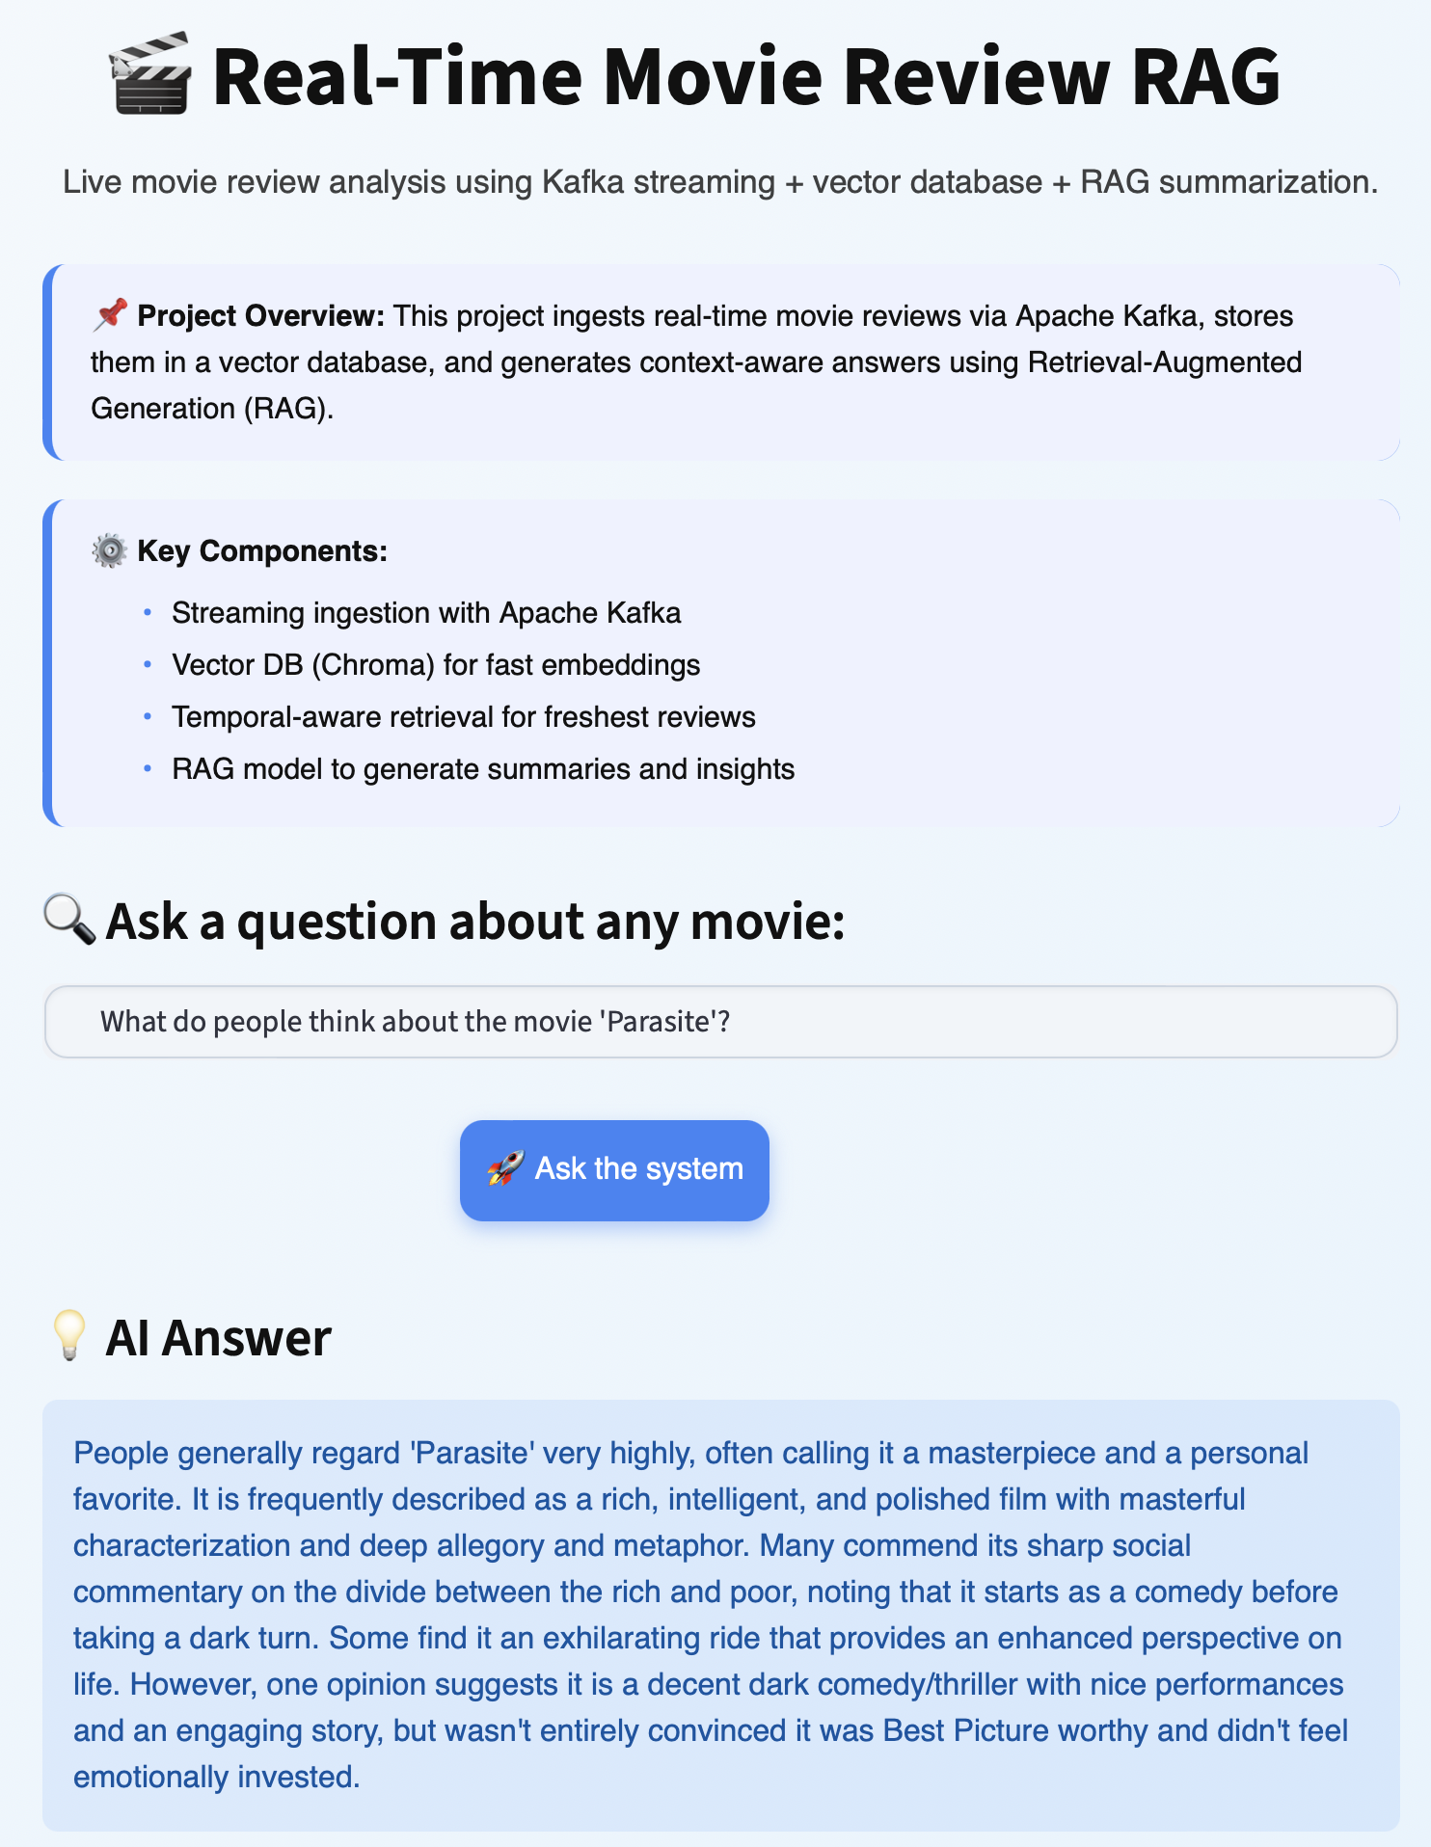
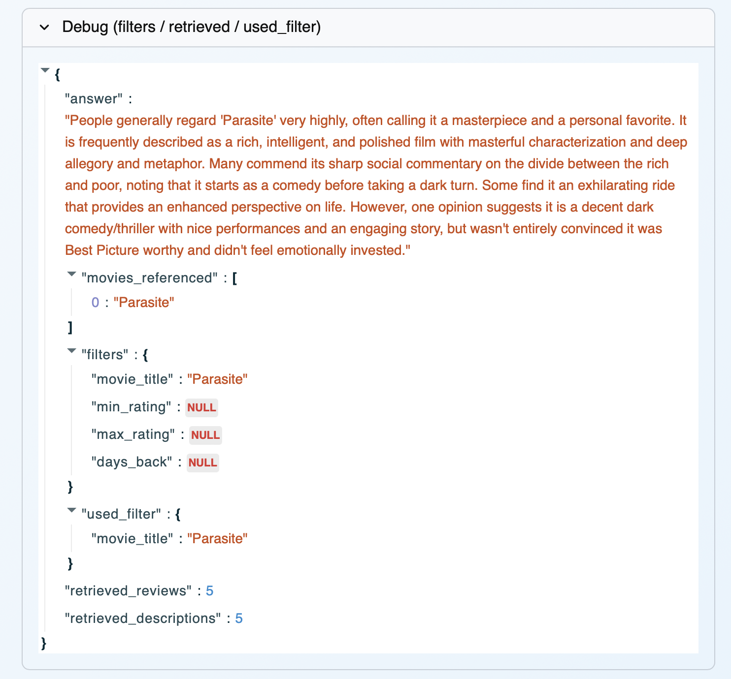
User Example Prompts & Responses (1/2)

Slide 15
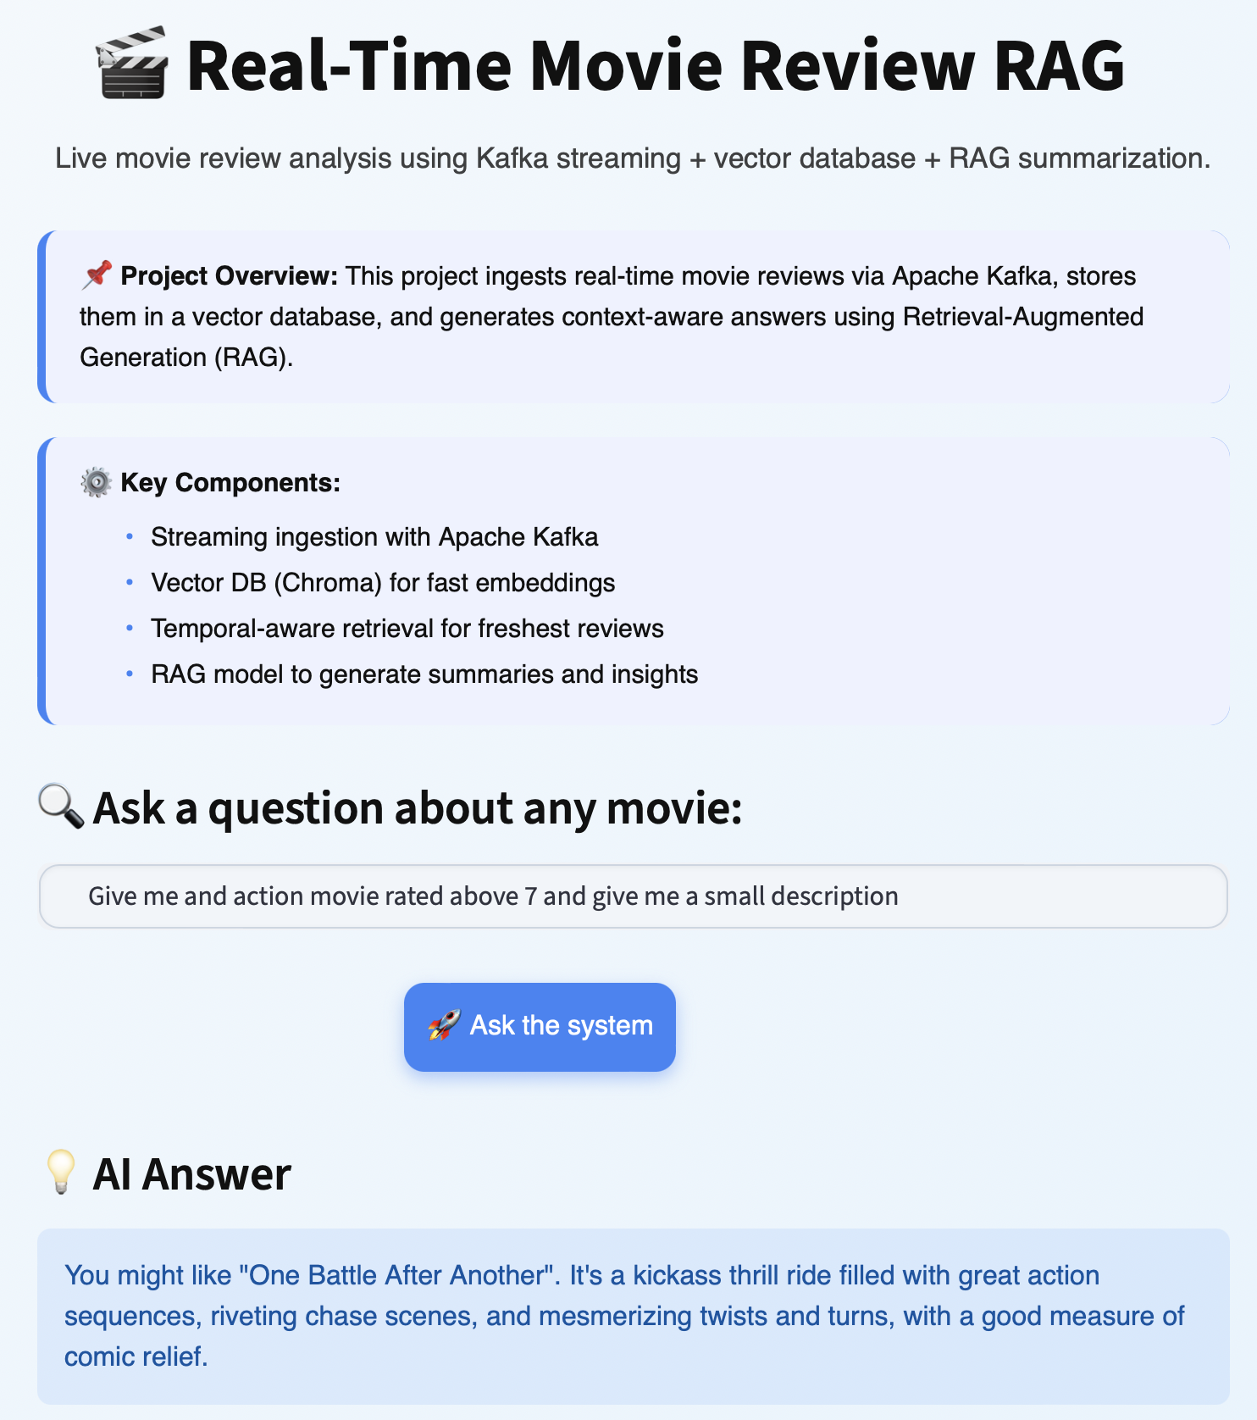
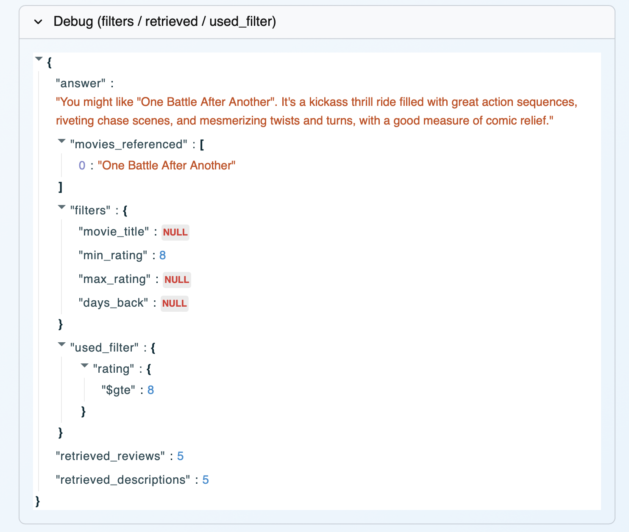
User Example Prompts & Responses (2/2)

Slide 16

Demo

