Slide 1

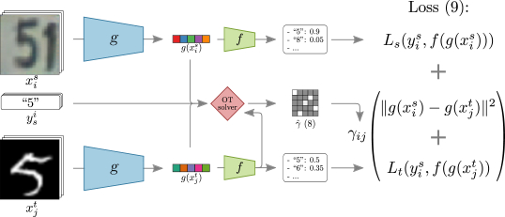
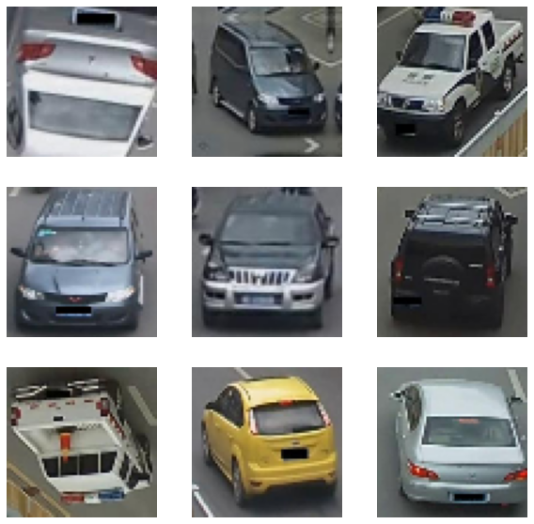
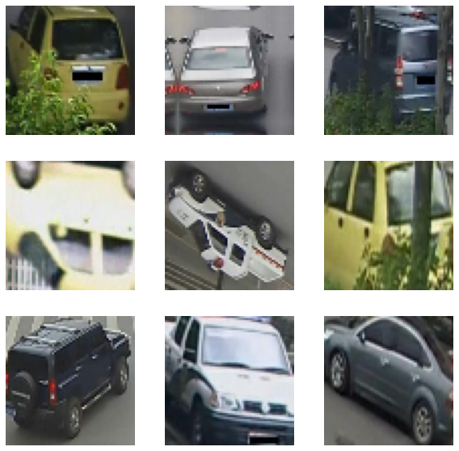
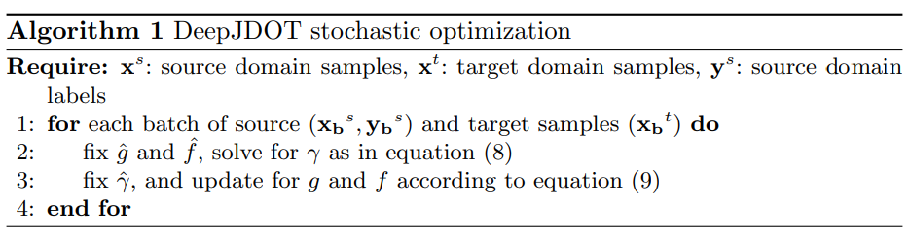
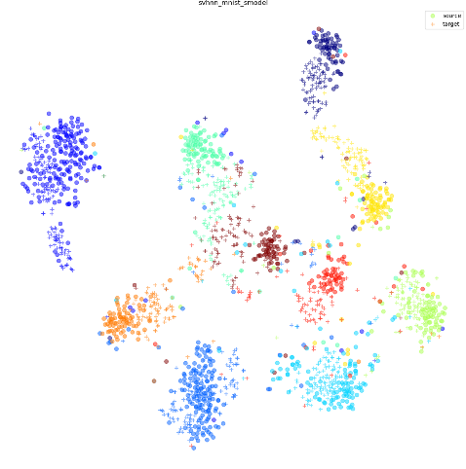
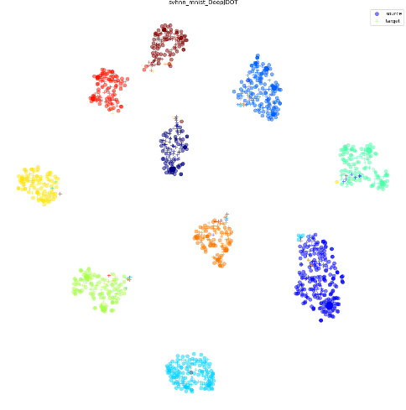
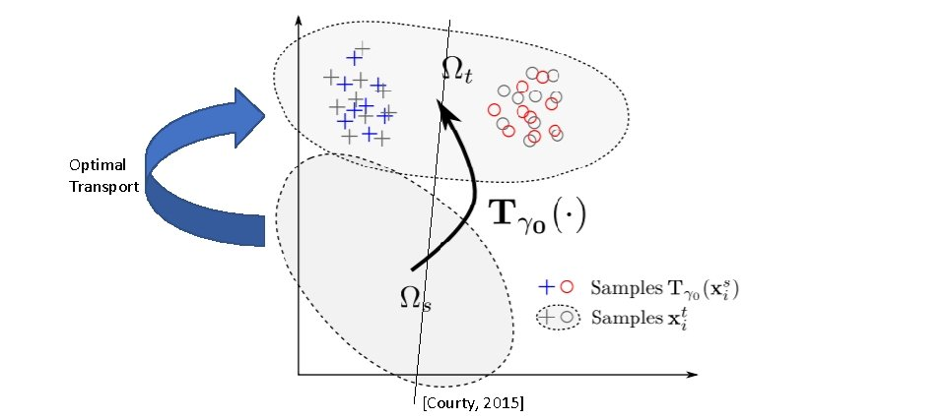
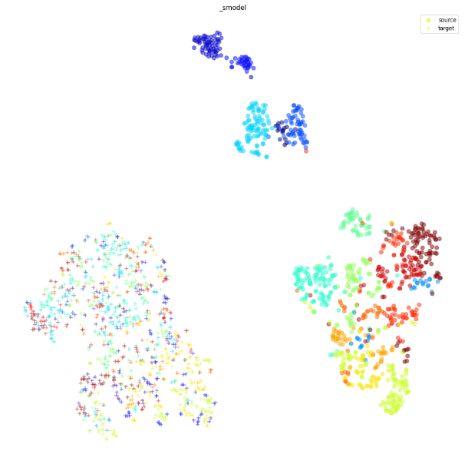
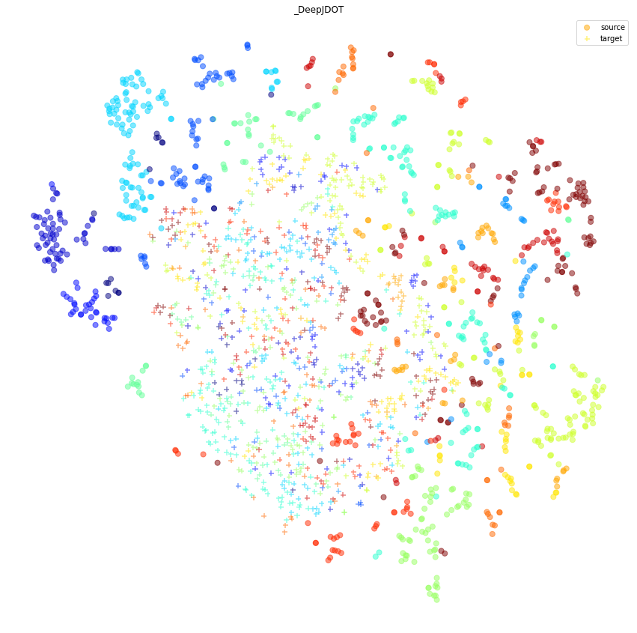
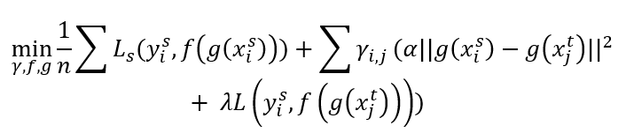
Deep Joint Distribution Optimal Transport for
Domain Adaptation, Vehicle Re-identification
Rizk Ralph
Directed by: Dr Hedi Tabia
I- Introduction
Vehicle re-identification objective is to identify the same vehicles even if it was captured from different angles and places. For example, if the model was trained to recognize the same vehicle from the front and rear view, it will fail to predict once the picture is taken from the side view. DeepJDOT was implemented to solve this problem.
Source Dataset Target Dataset
II- Optimal Transport for Domain Adaptation
Domain adaptation trains a model with labeled source data instances and unlabeled target data.
Align the data to each other and match the class of the target data from the source data that are already labeled.
Covers the transformations between the source and target.
Source data will be mapped using barycentric mapping, then we will train a new classifier on these transported source data.
OT compares the distributions probabilities in a geometrical way.
Domain Adaptation Approach
III- Deep Joint Distribution Optimal Transport
Deep Joint Distribution Optimal Transport used to prevent at first making the representation of the source adaptation then learning the classifier on these adapted features.
Optimization Function
DeepJDOT Approach
DeepJDOT Algorithm
IV- Initial test result
Applied on MNIST and SVHN dataset for testing.
V- Vehicle Re-identification result
t-distributed stochastic neighbor embedding
Unfortunately, the model was not enough to generalize on this dataset with different distribution. This could be mainly due to
Hyperparameters
CNN architecture
Complexity and inconsistency in the dataset where even with our eyes we couldn’t distinguish between these classes
Training/Data | Before DeepJDOT | After DeepJDOT
Source Data | 0.9437 | 0.9751
Target Data | 0.1064 | 0.2382
M1 E3A @ Université Paris-Saclay. Paris, France

