Slide 1
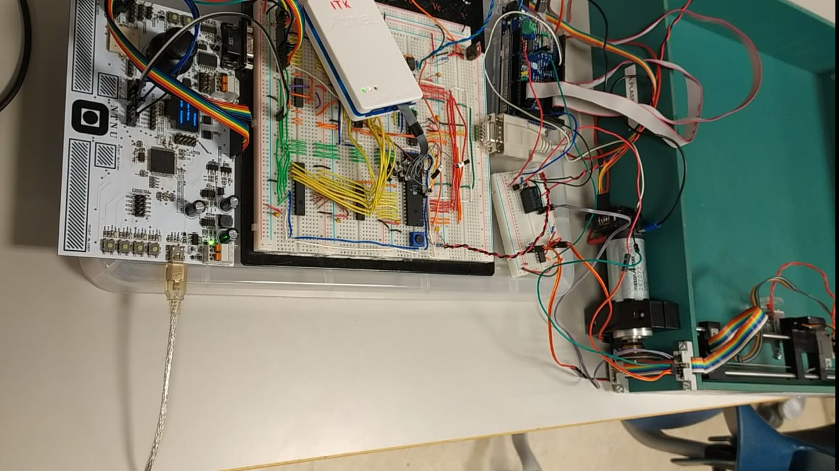

TTK4155 Ping Pong Project
Presented By: Charbel Badr, Harish Nagaruru Venkata, Ahmed Daraghma

Slide 2
Functional Requirements
Based on user input from multifunction board, control the system using Atmega162 and Atsam3x8e.
Use Voltage regulator to step down the voltage.
Initialize node 1 and node 2.
Activate external memory for SRAM.
Atmega162 should provide a frequency of 4.9152MHz.
NAND gates should be used in designing the address decoder for OLED, ADC, SRAM.
CAN is used for communication for different nodes using SPI commands with a Baud Rate of 250Kbps.
Generate/ Initialize a clock of 2.45MHz to the ADC using Atmega162.
Handle the direction of the game using servo motor by generating a PWM signal in Atsam3x8e.
Solenoid shall be used to hit the ball.
Control the motor speed and direction using a PI Controller.
The game is said to be over when the threshold of IR intensity has reduced.

Slide 3
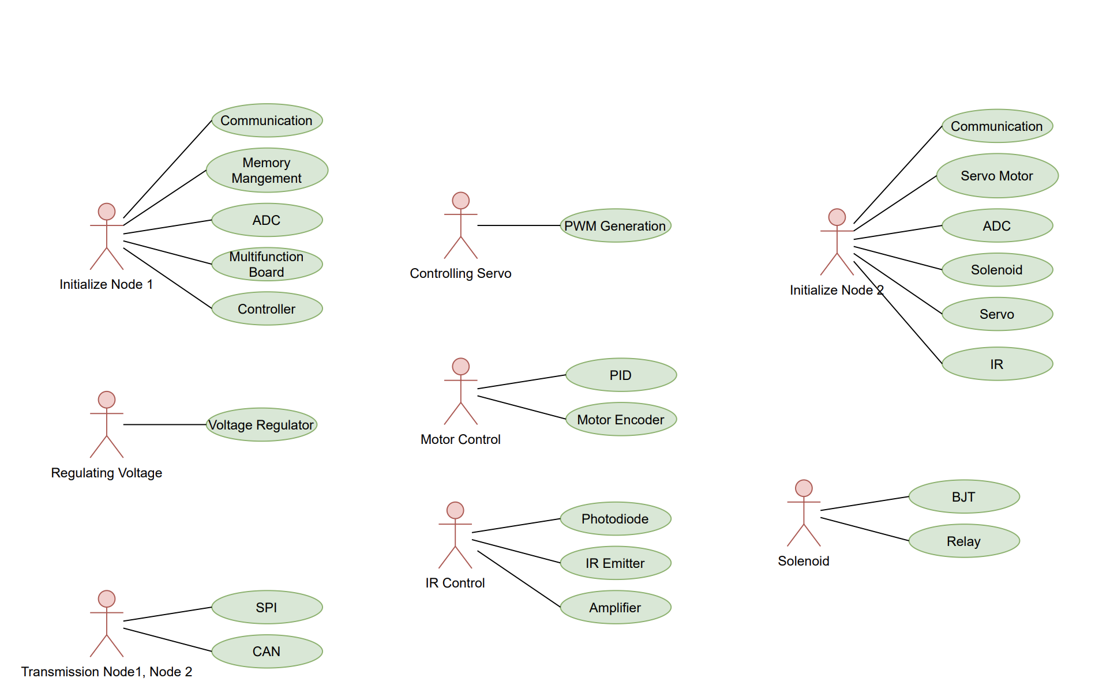
Use Case Diagrams

Slide 4
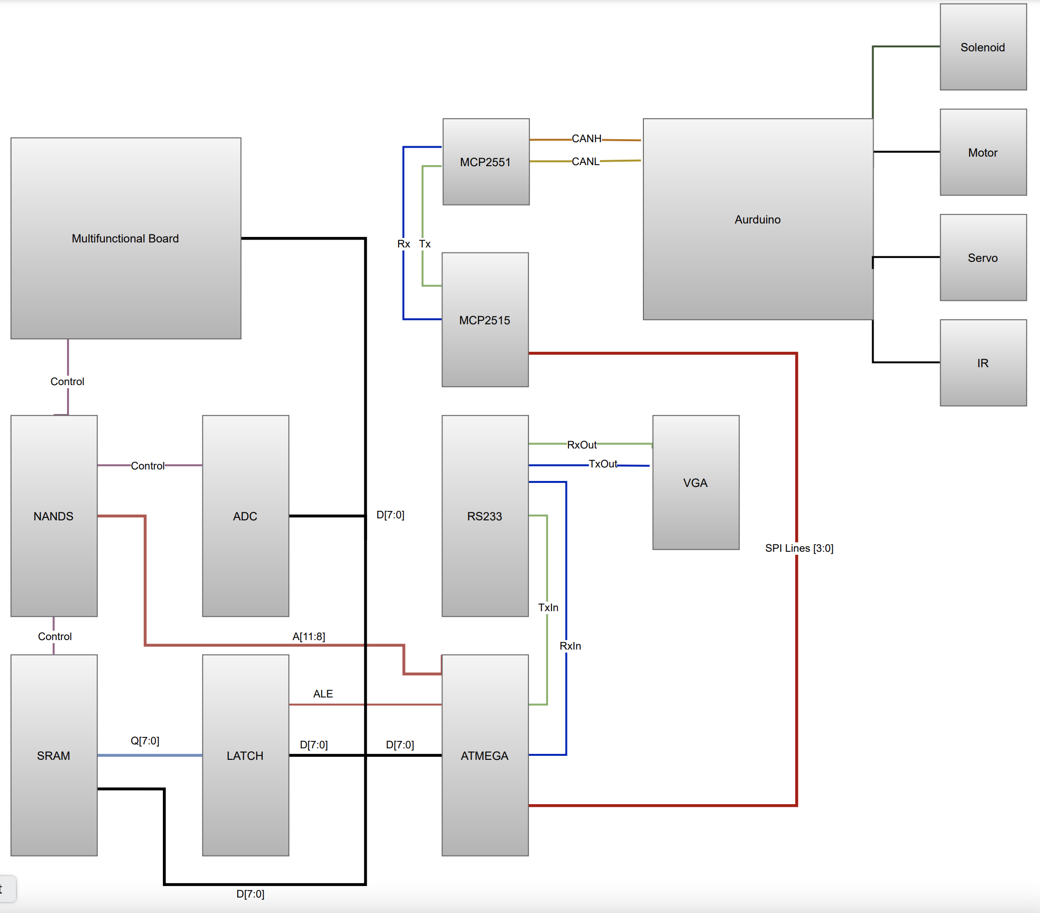
Block Diagram

Slide 5
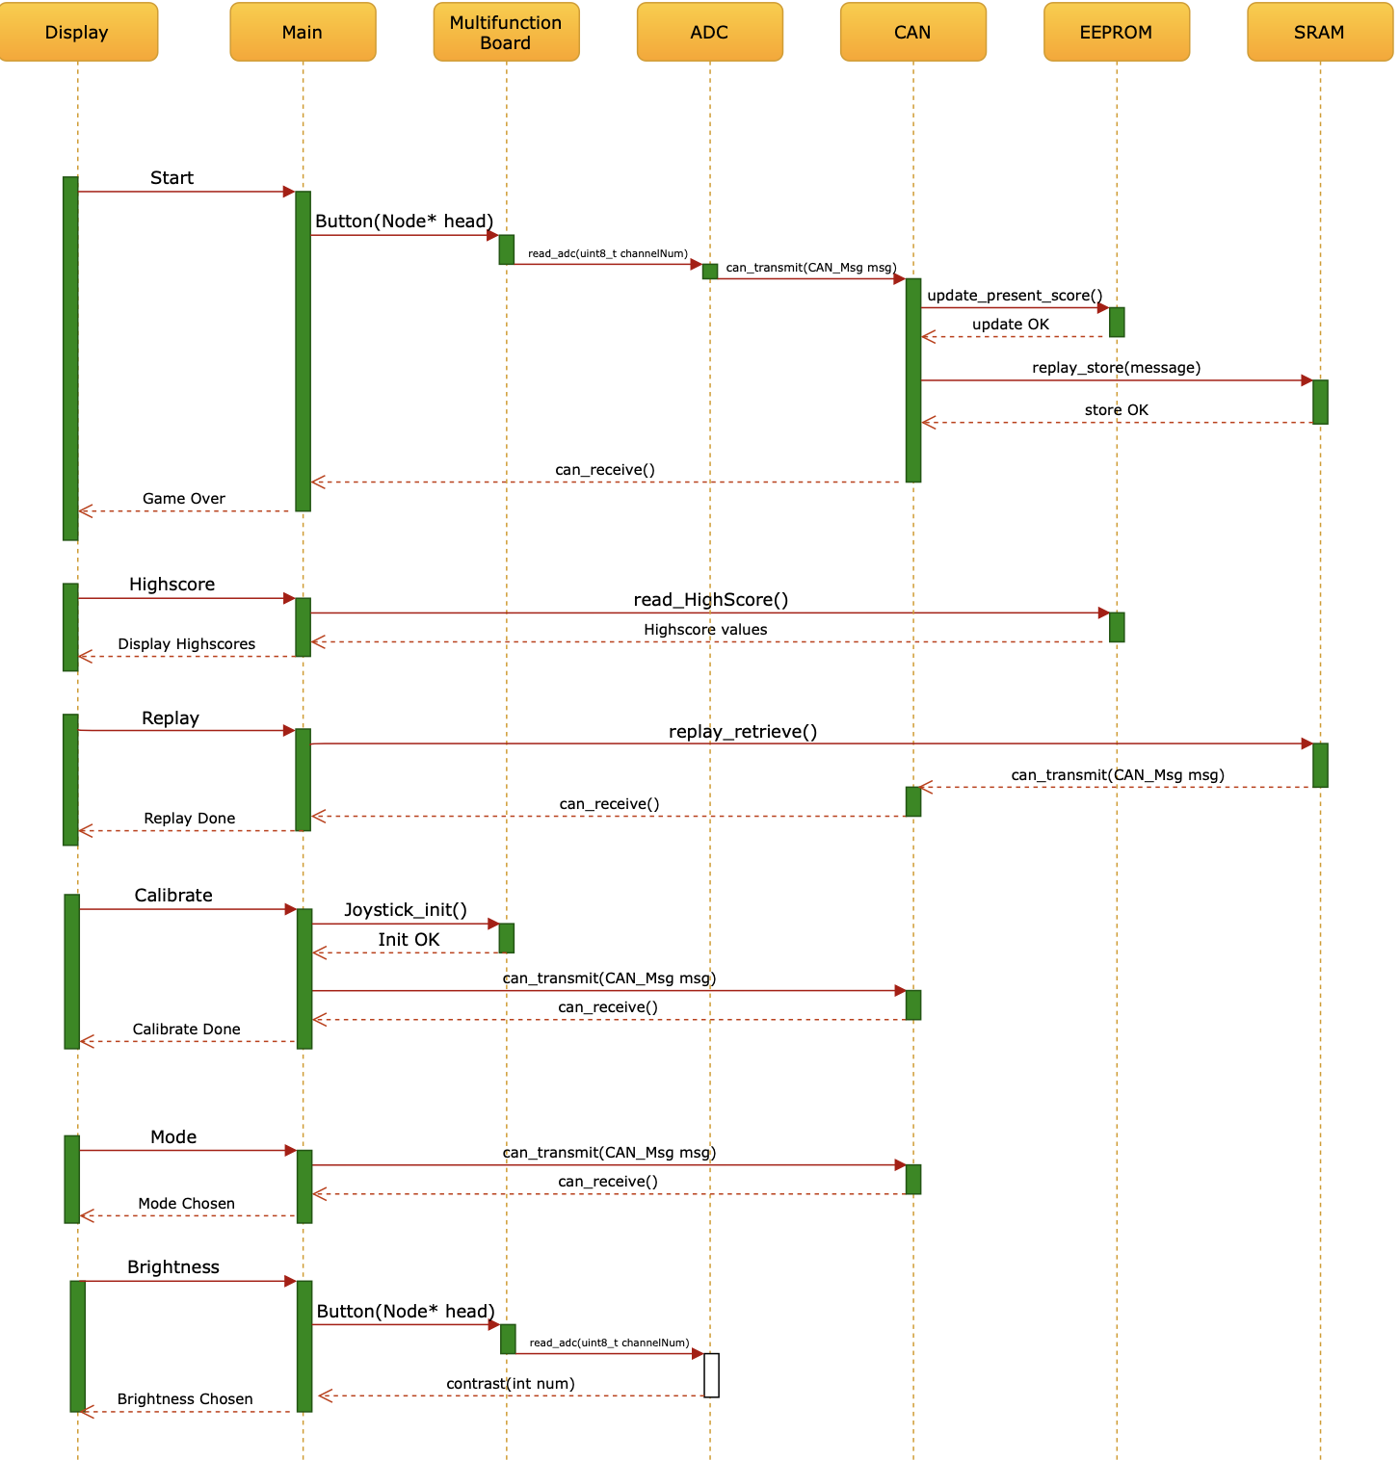
Sequence Diagram Node 1

Slide 6
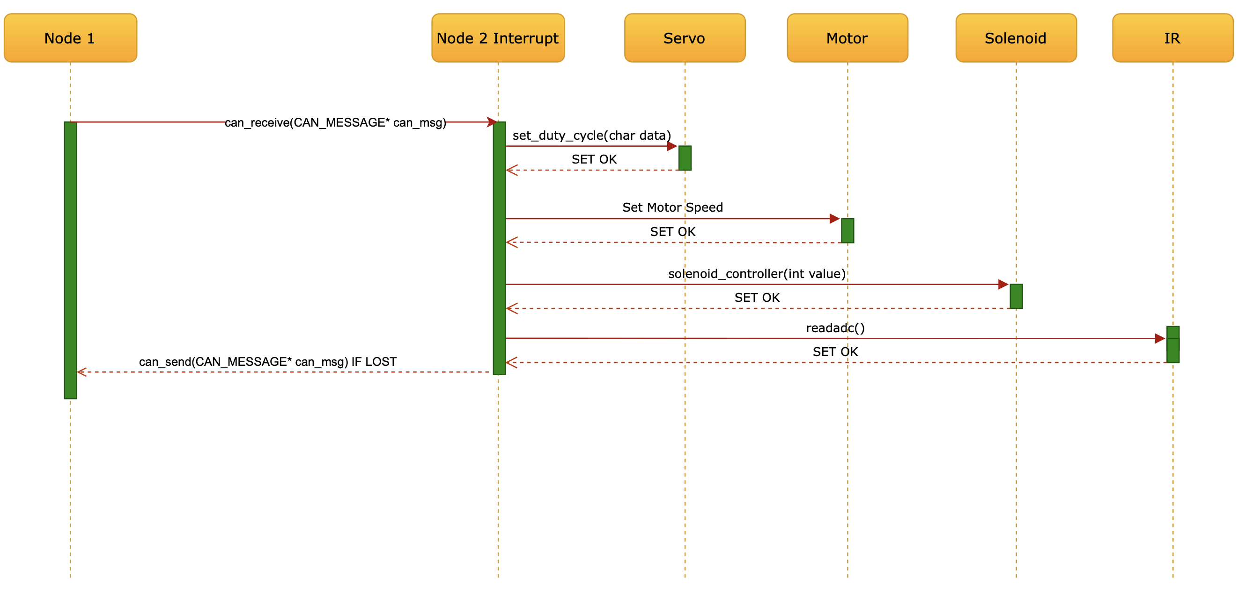
Sequence Diagram Node 2

Slide 7
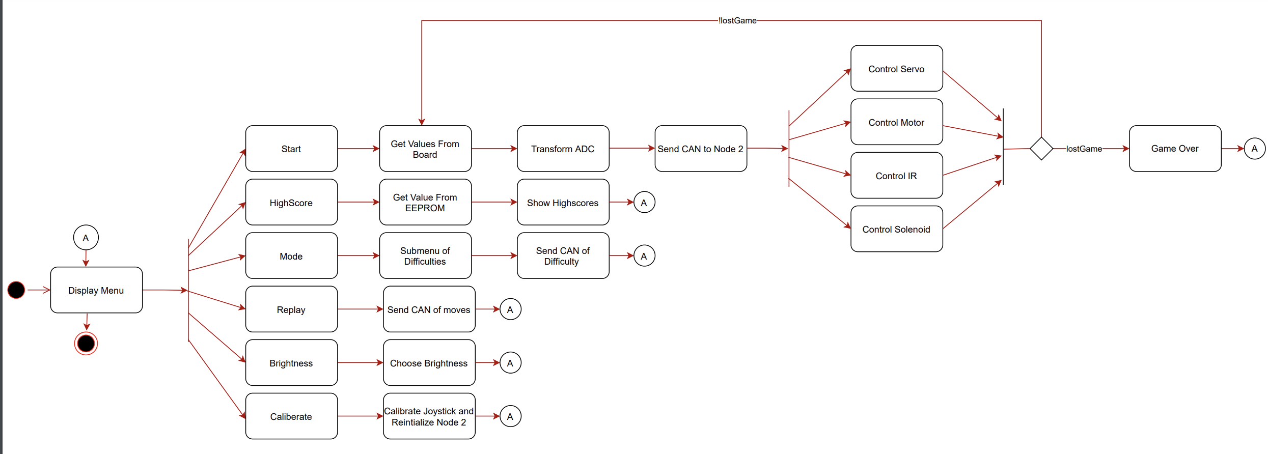
Process Diagram

Slide 8
Extras
Adding 2 Column Menu
Having SubMenus
Calibration Function
Replay Function
Showing Highscore
Control Brightness
Setting Difficulty (Easy, Hard)
UML Documentaion
Simple Animations

