Slide 1
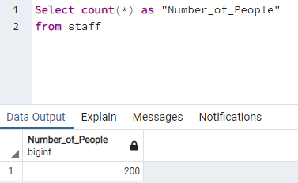
How many people work for this company?

Slide 2
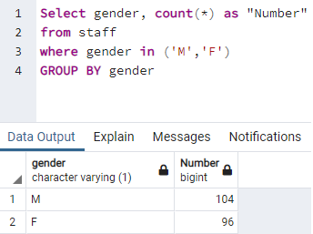
What is the female to male ratio?

Slide 3
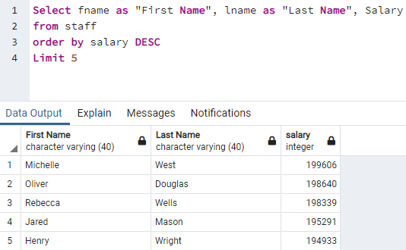
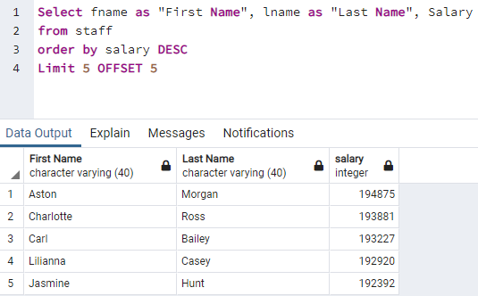
a)Highest paid 5? b)Highest paid 6-10? c)Compare?
a)
b)

Slide 4
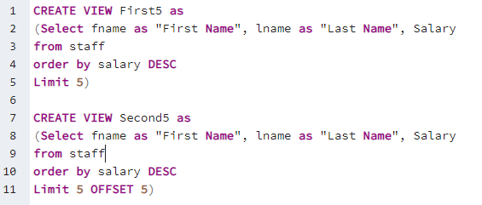
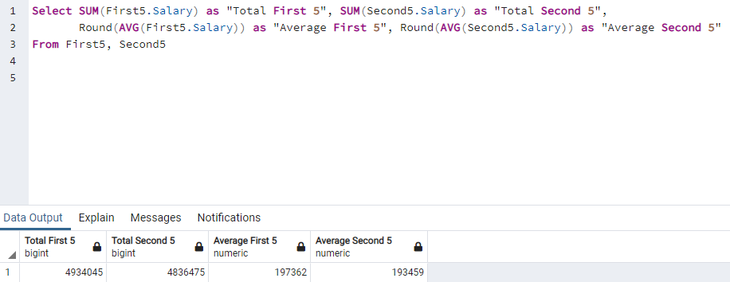
c)

Slide 5
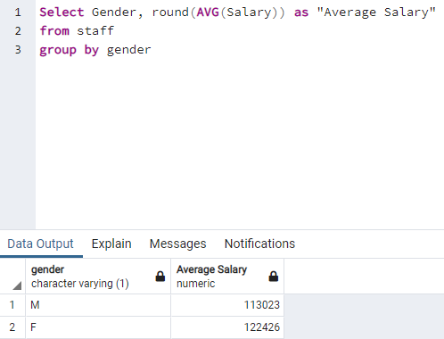
Average salary for men and women?

Slide 6
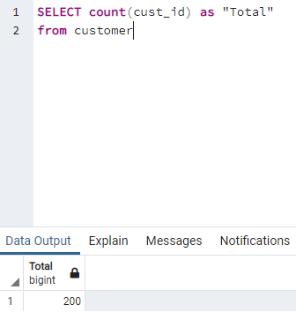
How many registered customers do we have?

Slide 7
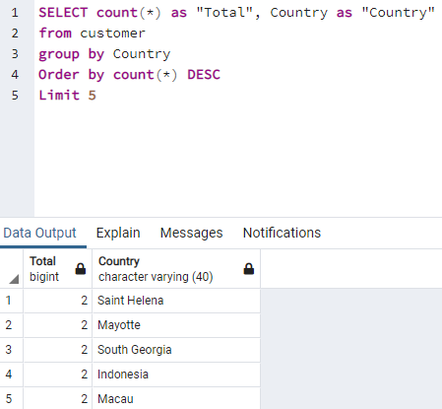
Top 5 countries with customer count?

Slide 8
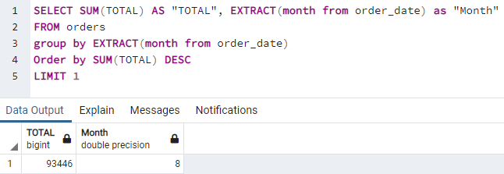
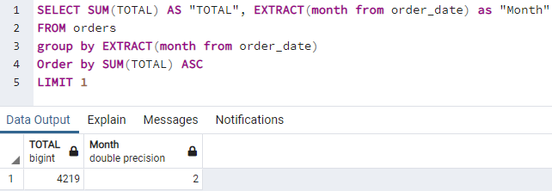
a) What is the busiest month? b) Worst month?
a)
b)

Slide 9
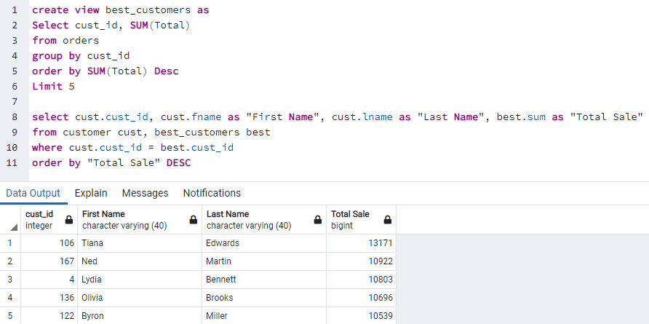
Who are our top 5 customers?

Slide 10
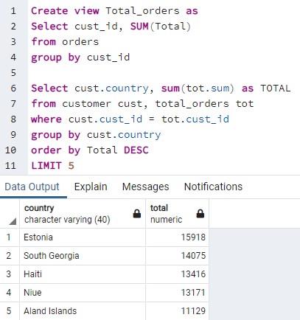
Best performing countries?

Slide 11
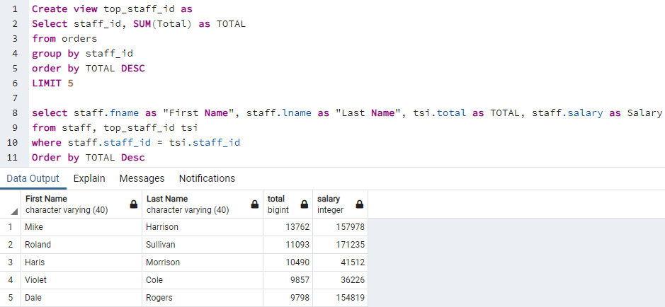
Best performing staff?

Slide 12
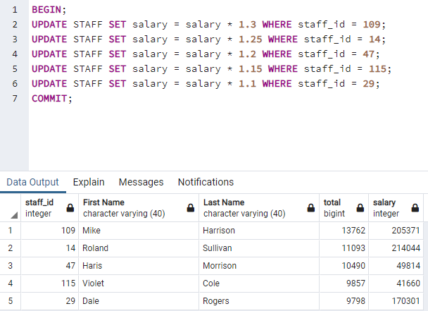
Give bonus to best performing staff? (30% for 1st, 25% for 2nd…)

Slide 13
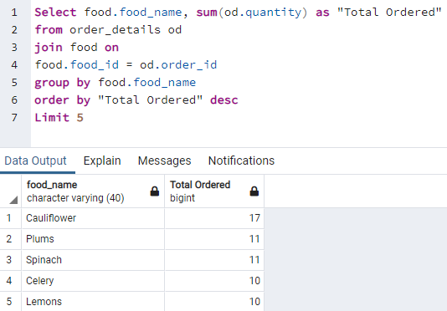
Most wanted food?

Slide 14
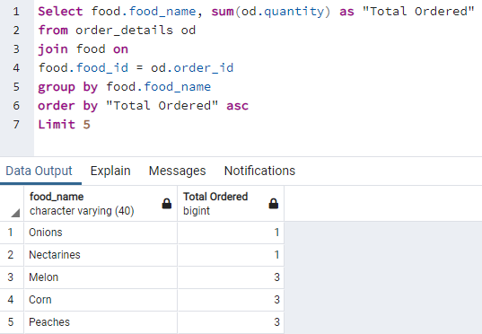
Least wanted food?

Slide 15
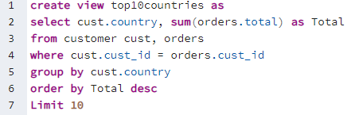
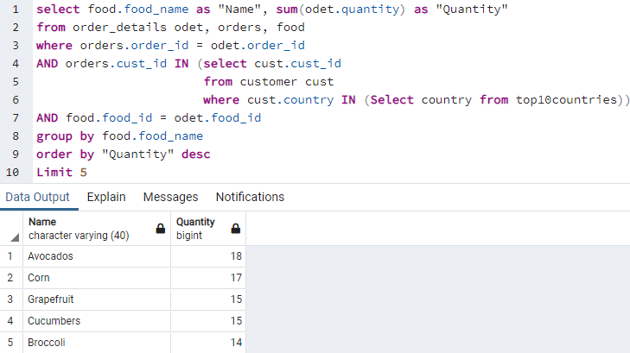
Most ordered food by top 10 countries?

Slide 16
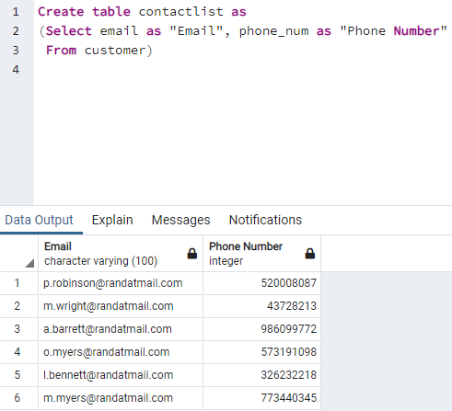
Get table with the emails and phone numbers?

