Slide 1
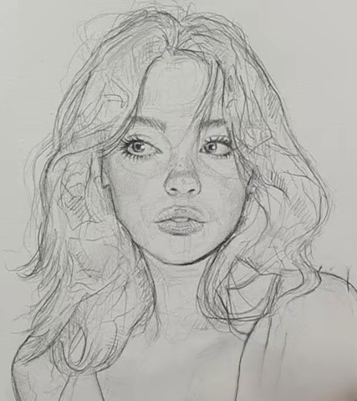
NST Studio
Neural Style Transfer From Classic Optimization to Real-Time Inference
Deep Learning Project · 2026
1 / 15
PyTorch 2.x
Flask 3.x
VGG-19
PatchGAN

Slide 2
What is Neural Style Transfer?
Neural Style Transfer (NST) blends the content of one image with the artistic style of another using a deep convolutional neural network — without any human-crafted filters.
📷
🎨
✨
Content Image
Style Image
Stylized Output
The photograph to preserve — objects, structure, composition
The artwork to borrow from — textures, colors, brushstrokes
A new image painted in the style while keeping the content
Result = f ( Content Image, Style Image )
• Originally proposed by Gatys, Ecker & Bethge (2016)
• No training required for classic NST — only an iterative optimization
• Later extended to real-time feed-forward networks by Johnson et al. (2016)
2 / 15

Slide 3
The Problem We're Solving
Classic NST produces great results but is painfully slow
⏱️
Speed
🖥️
Usability
Classic NST takes 5–15 minutes per image 300–1000 gradient steps through a 143M-param VGG-19
Command-line tools are inaccessible to non-technical users No visual feedback during generation
🎨
Flexibility
📦
Scale
Fixed style — changing it means rerunning the whole optimization No way to compare multiple styles instantly
Not practical for batch processing or real-time applications Every new image needs a fresh 10-minute run
✅ Our solution: a full-stack web app with Classic NST for quality + Fast NST for instant real-time inference
3 / 15

Slide 4
How Classic NST Works
1
Freeze VGG-19
VGG-19 Layers
Load ImageNet-pretrained VGG-19 — weights never update
relu1_2 ← style
2
Extract Features
Pass content & style images through VGG-19; save layer activations
relu2_2 ← style
3
Compute Gram Matrix
For each style layer: Gram(F) = F·Fᵀ ÷ (C·H·W) — captures texture statistics
relu3_3 ← style
4
Initialize Output
relu4_2 ← content
Start from the content image (or random noise)
5
Optimize Pixels
relu4_3 ← style
Minimize L_total = α·L_content + β·L_style using L-BFGS / Adam
relu5_3 ← style
6
Iterate
300–1000 steps — the image pixels are the only learned parameters
4 / 15

Slide 5
The Math: Loss Functions
Content Loss
Style Loss
L_content = ½ · Σ (F_ij − P_ij)² F = features of generated image P = features of content image Layer: relu4_2 (conv4_2)
L_style = Σ_l w_l · MSE( G_l, A_l ) G_l = Gram matrix of generated image at layer l A_l = Gram matrix of style image at layer l Gram(F) = F·Fᵀ ÷ (C·H·W)
L_total = α · L_content + β · L_style
α = content weight (e.g. 1e5) β = style weight (e.g. 1e10)
Why Gram Matrices?
The Gram matrix captures correlations between feature channels — not where features appear, but how they co-occur. This makes it position-invariant, exactly what we need for texture and style: the painting's brushstroke pattern is the same wherever you look.
5 / 15

Slide 6
VGG-19: Why It Works for Style Transfer
Why VGG-19?
• 19-layer deep CNN trained on 1.2M ImageNet images
• Learns a rich hierarchy: edges → textures → objects → semantics
• Early layers (relu1–2): low-level textures, colors, edges
• Middle layers (relu3–4): patterns, brushstrokes, material
• Deep layers (relu5): high-level objects and scene structure
Implementation Notes
• Weights loaded from torchvision (ImageNet pretrained)
• All parameters frozen — requires_grad = False
• Custom normalization layer prepended (mean/std of ImageNet)
• Content hooks at relu4_2
• Style hooks at relu1_2, relu2_2, relu3_3, relu4_3, relu5_3
• CRITICAL: must run in float32 — relu4+ activations exceed float16 max (65504)
FC 1-3
Conv 12-16
Conv 8-11
Conv 5-7
Conv 3-4
Conv 1-2
64ch
128ch
256ch
512ch
512ch
class
← low-level (style) high-level (content) →
6 / 15

Slide 7
System Architecture
🌐 Browser (HTML + CSS + JavaScript)
Drag-drop upload · Before/After slider · Gallery · Fullscreen viewer · Toast notifications
HTTP / SSE ▼
⚙️ Flask app.py
/upload · /progress/<id> · /fast-stylize · /gallery · /models · /sample-img
▼
▼
🔬 nst_core.py — Classic NST
⚡ fast_nst.py — Fast NST
• VGG-19 pixel optimization
• SSE progress streaming
• L-BFGS / Adam optimizer
• TransformerNet feed-forward
• Sub-second inference
• Pre-trained .pth models
💾 models/ .pth files
🖼️ static/outputs/ results
📊 runs/ TensorBoard logs
🎞️ samples/ training previews
7 / 15

Slide 8
Flask REST API Endpoints
POST
/upload
Upload content + style images, start Classic NST job, return job ID
GET
/progress/<id>
SSE stream — sends loss value and preview image every N iterations
POST
/fast-stylize
One-shot inference with a pre-trained Fast NST TransformerNet model
GET
/models
List available Fast NST .pth models with name, path and thumbnail
GET
/gallery
Return last 60 stylized outputs sorted by modification time
GET
/sample-img/<m>/<f>
Serve per-model training preview images saved during training
GET
/samples/<model>
List all training preview filenames for a given model
Built with Flask 3.x · Threaded job dict · JSON metadata · Pathlib for all paths
8 / 15

Slide 9
Classic NST — Core Implementation (nst_core.py)
Gram Matrix
Implementation Notes
• ContentLoss: MSE between generated and content features at relu4_2
• StyleLoss: MSE between Gram matrices at 5 style layers
• Normalization layer prepended so images stay in [0,1]
• Loss hooks injected into frozen VGG-19 graph
• L-BFGS optimizer acts directly on image tensor
• SSE streams loss + base64 preview every 50 steps to browser
• Final image decoded from float tensor → PIL → JPEG → disk
def gram_matrix(input): a, b, c, d = input.size() features = input.view(a * b, c * d) G = torch.mm(features, features.t()) return G.div(a * b * c * d)
Style Loss Module
class StyleLoss(nn.Module): def __init__(self, target_feature): super().__init__() self.target = gram_matrix( target_feature).detach() def forward(self, input): G = gram_matrix(input) self.loss = F.mse_loss(G, self.target) return input
9 / 15

Slide 10
Web UI Features
🖱️
Drag & Drop Upload
↔️
Before / After Slider
Drop content and style images anywhere — no file picker needed
CSS clip-path divider to compare original vs. stylized side-by-side
🖼️
Results Gallery
⛶
Fullscreen Viewer
Last 60 outputs with metadata — model name, style weights, timestamp
Click any image to expand full-screen, ESC to close
📊
Live SSE Progress
🔔
Toast Notifications
Loss value + preview image streamed live as Classic NST iterates
Non-blocking pop-ups for job complete, errors, and model selection
10 / 15

Slide 11
Dataset & Preprocessing
MS-COCO train2014
preprocess.py — Validation Pipeline
Total images
82,783
• 8 parallel workers via ThreadPoolExecutor
• Force-decode every pixel — catches truncated JPEGs
• Filter images smaller than 256px on either side
• Writes valid_images.txt manifest — ~2 min one-time cost
• Manifest used by DataLoader, skips re-validation on resume
Valid images
82,177
Removed (corrupt/small)
606
Dataset size
~13 GB
Min image size
256 × 256 px
Image format
JPEG
Training Transforms
RandomCrop(256) → ToTensor() → Normalize( mean=[0.485, 0.456, 0.406], std=[0.229, 0.224, 0.225] )
SeededSampler enables exact mid-epoch resume — same image order guaranteed across interruptions
11 / 15

Slide 12
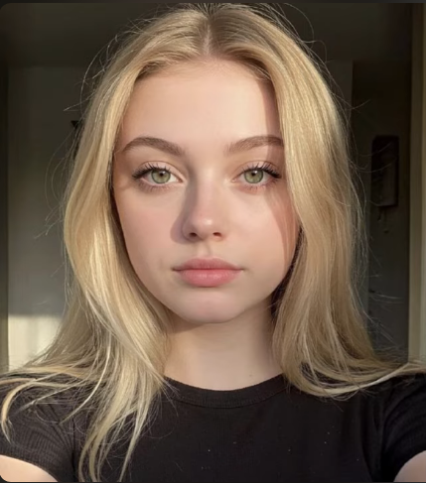
Style & Content Reference Images
Style Image — pencil_style_img1.jpg
Content Image — content_img1.png
⚙️ Full training in progress on MS-COCO train2014 (82,177 images, 2 epochs, batch 8) · Stylized result images will replace this placeholder after training completes.
12 / 15

Slide 13
Classic NST vs Fast NST — Comparison
Classic NST
Fast NST (ours)
Inference time
5–15 min
< 1 second
Training required
None
~4–5 hrs (once)
Quality
Very high
High (with improvements)
New style
Re-run optim.
Train new model
GPU memory
~2 GB
~4 GB (training)
Method
Pixel optim.
Feed-forward net
Batch processing
❌ Impractical
✅ Instant
Adversarial loss
❌ No
✅ PatchGAN
Best for
One-off art
Real-time / web
13 / 15

Slide 14
Future Work — Currently in Active Development
🚧 All features below are being actively built in this project
⚡ Fast NST Real-Time Inference
🎭 PatchGAN Adversarial Training
TransformerNet trained on MS-COCO — sub-second stylization. Replaces 15-minute Classic NST for live use.
70×70 PatchDiscriminator with spectral norm. Enforces micro-texture realism — sharper brushstrokes.
📐 8 Training Improvements
🗂️ Multi-Style Model Library
5-layer VGG loss · Multi-scale Gram · Feature stats loss Identity loss · Per-layer weights · AMP + cosine LR
train_all_styles.sh: one model per style image. Instant style switching from web UI dropdown.
📊 TensorBoard Dashboard
🖼️ Training Results in README
Live loss curves for all 5 loss components. Sample preview images saved every 500 training steps.
Before/After images will be added to README.md after the first full training run completes.
14 / 15

Slide 15
Thank You
NST Studio — Neural Style Transfer Web Application
• Classic NST: VGG-19 pixel optimization with live SSE streaming
• Full-stack Flask web app — drag-drop, gallery, comparison slider
• Fast NST in active development: < 1s inference per image
• PatchGAN adversarial training for texture realism
• Multi-style model library with one-command training scripts
• TensorBoard logging + sample previews every 500 training steps
github.com/charbelmezeraani0-star · 2026
15 / 15

