Slide 1
SMART FRIDGE
Chase Breeden, Carter Crews, and
Justin James
University of Tennessee – Martin

Slide 2
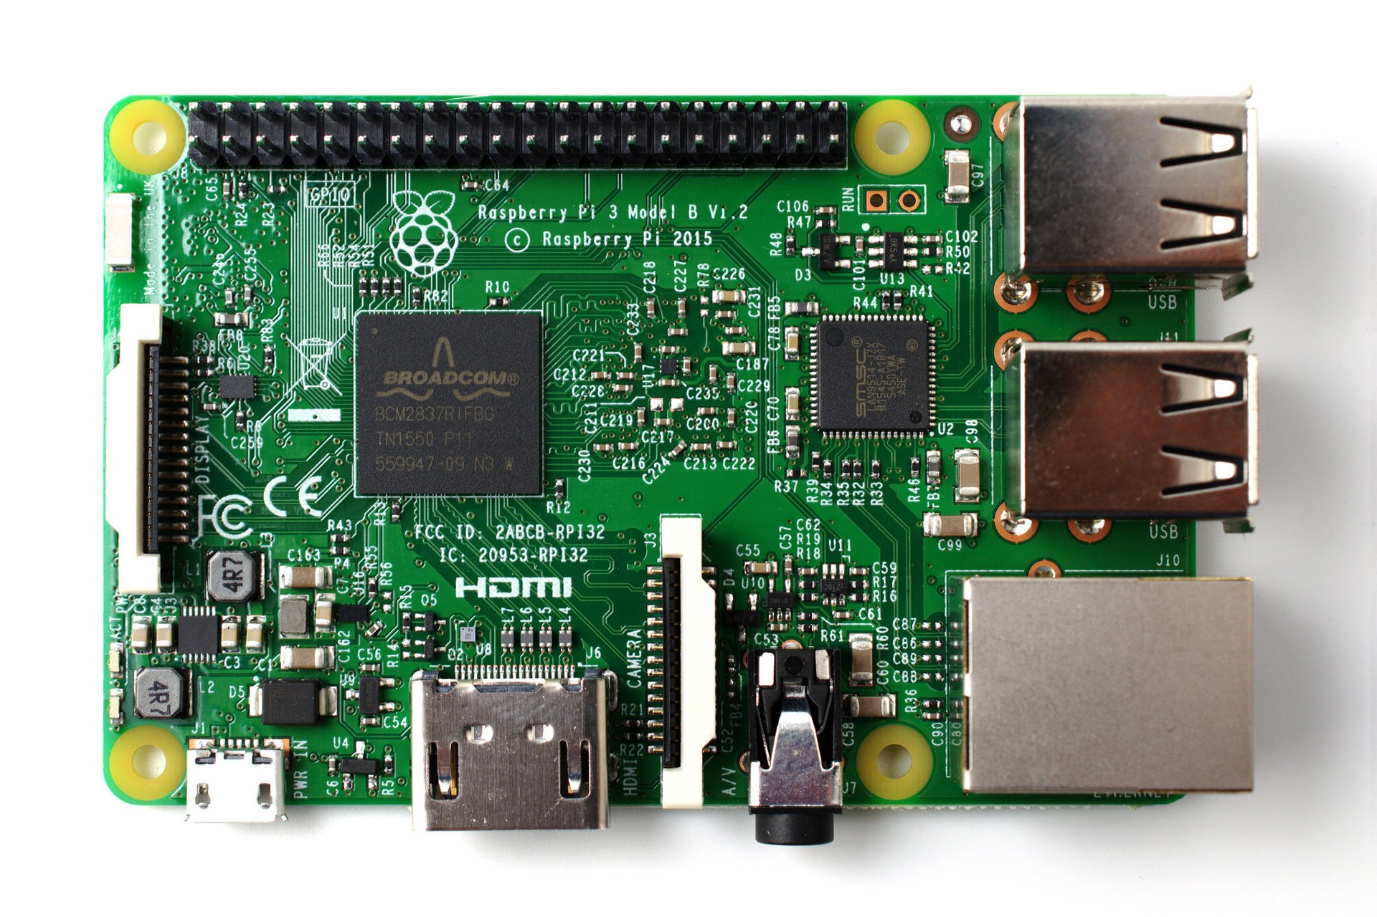
Raspberry pi
The Raspberry Pi is a credit card-sized computer that plugs into your TV and a keyboard. It is a capable little computer which can be used in electronics projects, and for many of the things that your desktop PC does, like spreadsheets, word processing, browsing the internet, and playing games.

Slide 3
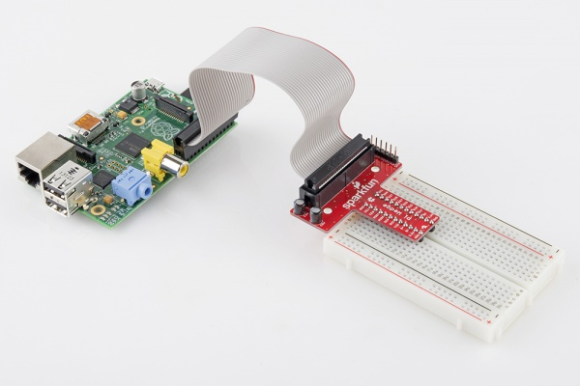
GPIO
The Pi has bi-directional Input/Output pins, which we used to attach our temperature and door sensors.

Slide 4
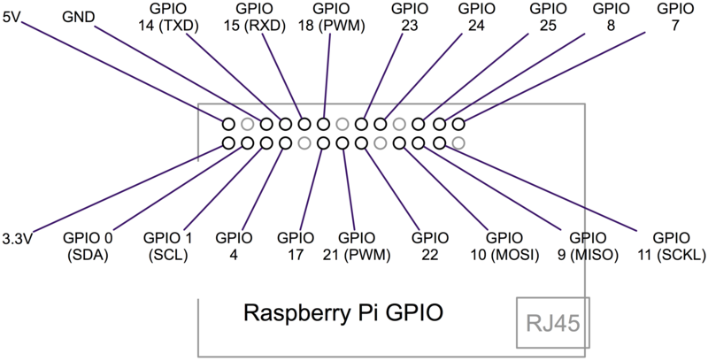
Gpio layout on pi

Slide 5
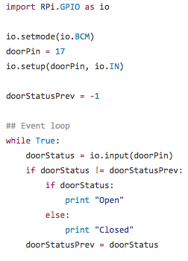
Sample python code using gpio

Slide 6

Amazon web services
Amazon Web Services (AWS) is a comprehensive, evolving cloud computing platform provided by Amazon.com. Web services are sometimes called cloud services or remote computing services.
AWS offers multiple services including: Storage, Dynamo Databases, and many services.

