Slide 1

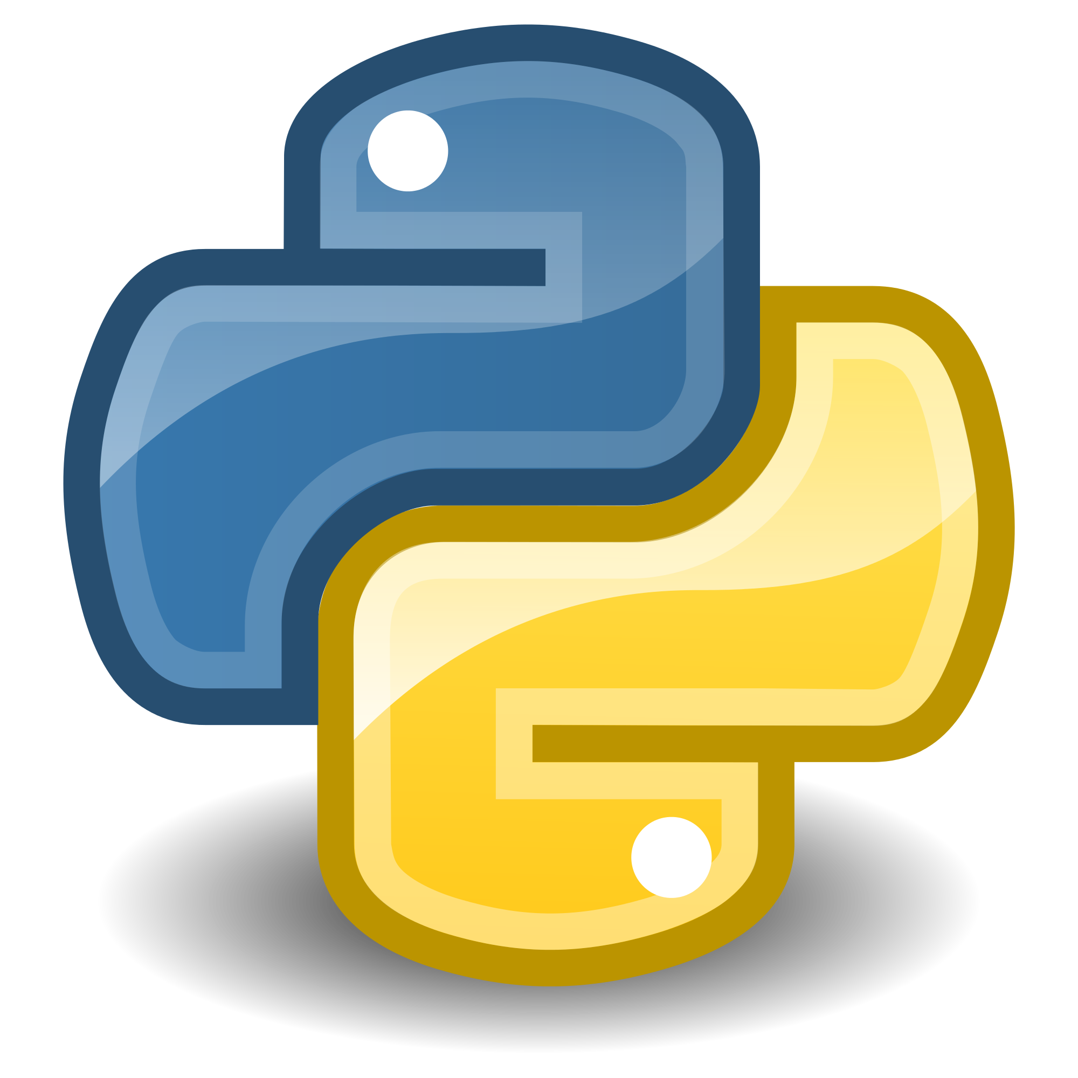



Smart Fridge
Fall 2016
Chase Breeden, Carter Crews, Justin James
Advisor: Bob Bradley
Goal
Requirements
Get text message notifications when alarm conditions occur.
Webpage to monitor status of all connected refrigerators.
To have the ability to monitor a refrigerator's operational status from anywhere.
Design Process
Loaded Raspberry Pi with Raspbian OS.
Attached temperature sensors and door sensor to Raspberry Pi.
Wrote Python 3 script to utilized and gather data from sensors.
Send data recorded to AWS and process rules on incoming data.
Send text message to user if temperature is above abnormal.
Send data to web page.
Components
Amazon Web Services – cloud computing platform provided by Amazon.com.
Raspberry Pi – hardware controller used to gather data.
Python 3 – Scripting language for the Raspberry Pi.
Raspbian – Operating System for Raspberry Pi.
Tempurature sensor - Sensor for gathering tempurature data.
Door Sensor – Magnetic sensor used to monitor door activity.
Conclusion
Accomplished Work:
- Successfully achieved goal of gathering data from sensors.
- Verified data was fully uploaded to AWS.
- Implemented ability to send SMS messages to user’s device.
Future Work:
- Add camera capability as a security feature.
- Add graph of temperature history.

