Slide 1


Arun Gopala Krishnan K R
Balaji Ashok Kumar
Jayalakshmi Tirupathi
Divya Lakshmi Anna Ganesh
Surendar Mohanraj
Venkata Sai Charan Amarthaluru

Slide 2
B-Team

Slide 3



Problem Statement & Solution
Problems
Flamingo
Flamingo - A Progressive Web App (PWA) which can be used by Warriors & Doctors in any devices like Mobile/Laptop/Desktop.
GitHub Link for the source code: https://github.com/dynamicbalaji/hack-for-pink-2020
ReadMe Direct Link: https://github.com/dynamicbalaji/hack-for-pink-2020/blob/master/README.md

Slide 4








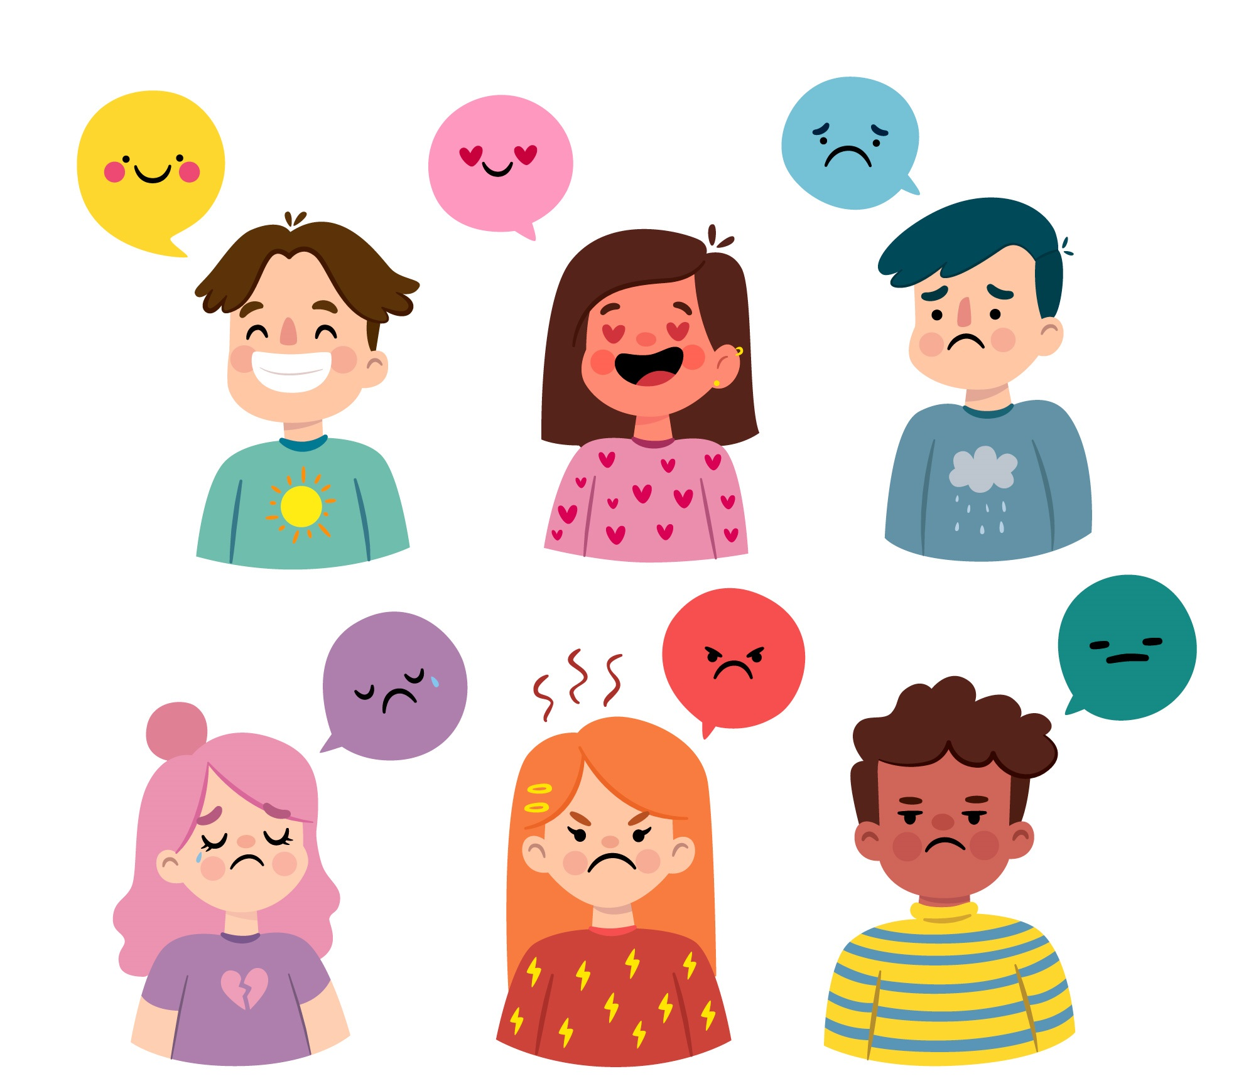



Social Media Login
Warrior Functionalities
Anonymous Login
Timeline View
Doc Scanning
Chatbot/Live Chat
Make-A-Wish
News Feed
Secure File Sharing
Mood Detection
Timely Reminder
Nearby Medical Centers
Doctor Appointment

Slide 5





Doctor/Psychiatrist Functionalities
Secure File Sharing
Live Chat
Appointment Management
Motivational Counseling
Sponsor Make-a-wish
Donation for Treatment
Angel Functionalities
News Feed
Sponsor Make-a-wish
Donation for Treatment

Slide 6
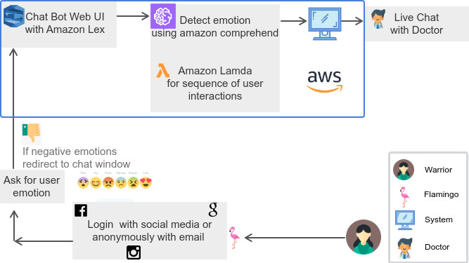
Mood Detection & Live Chat

Slide 7
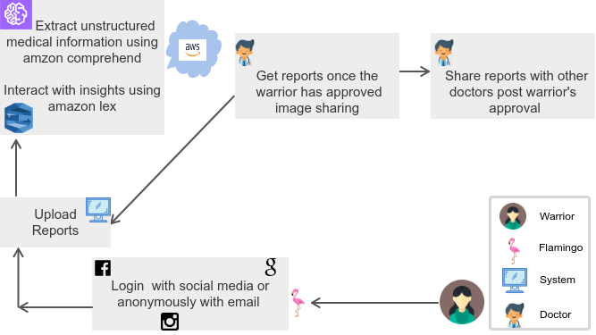
Anonymous Login, Image Analysis & Sharing

Slide 8
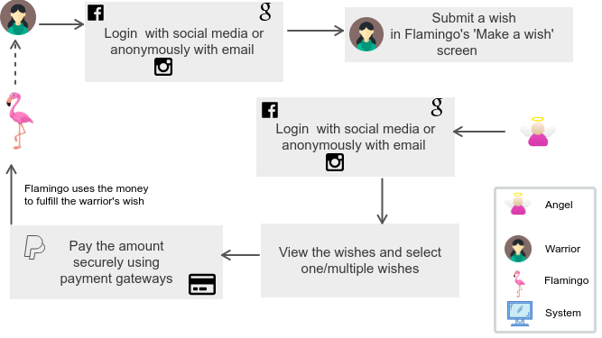
Make a Wish & Sponsor

Slide 9
Benefits, Future Enhancements & Tech Stack
Benefits
Tech Stack Used
Future Enhancements
Angular
Node JS
Material Design
MySQL DB
HTML 5
CSS3

Slide 10

Our Proposed Solution
Pleasantly DESIRABLE
Technologically FEASIBLE
Economically VIABLE

