Slide 1


Arun Gopala Krishnan K R
Balaji Ashok Kumar
Jayalakshmi Tirupathi
Divya Lakshmi Anna Ganesh
Surendar Mohanraj
Venkata Sai Charan Amarthaluru

Slide 2
Project Description
B-Team
Project Flamingo takes care of the needs and concerns of warriors, who fight against the daemon in them and the doctors, who do the noble cause in supporting the warriors both physically and mentally.
In this project, the privacy of the warriors is considered in all aspects of the application.
Angels in disguise can also use this application to grant the wishes of warriors thus bringing a hope and light to their life.
This project also brings in the latest and efficient technologies in market to achieve this noble cause.

Slide 3



Problem Statement & Solution
Problems
Flamingo
Flamingo - A Progressive Web App (PWA) which can be used by Warriors & Doctors in any devices like Mobile/Laptop/Desktop.
GitHub Link for the source code: https://github.com/dynamicbalaji/hack-for-pink-2020
ReadMe Direct Link: https://github.com/dynamicbalaji/hack-for-pink-2020/blob/master/README.md

Slide 4








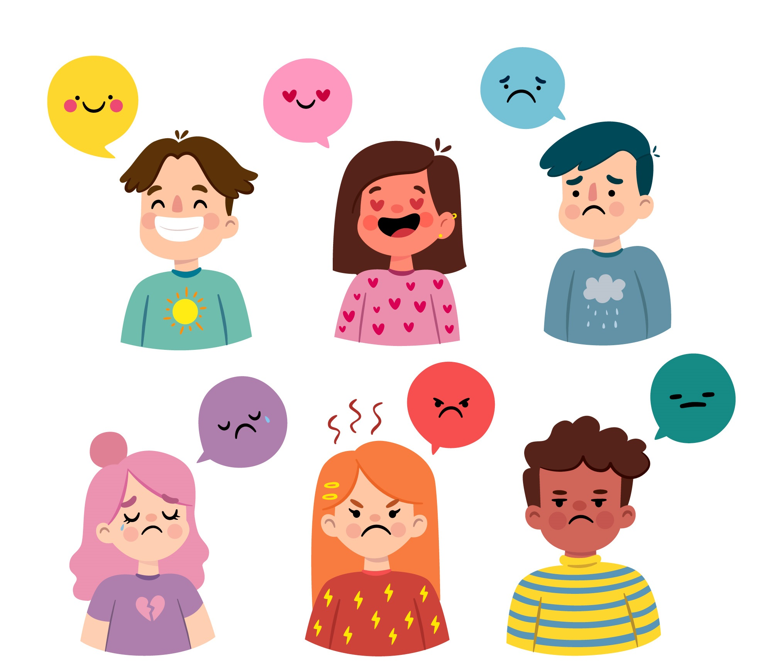



Social Media Login
Warrior Functionalities
Anonymous Login
Timeline View
Doc Scanning
Chatbot/Live Chat
Make-A-Wish
News Feed
Secure File Sharing
Mood Detection
Timely Reminder
Nearby Medical Centers
Doctor Appointment

Slide 5





Doctor/Psychiatrist Functionalities
Secure File Sharing
Live Chat
Appointment Management
Motivational Counseling
Sponsor Make-a-wish
Donation for Treatment
Angel Functionalities
News Feed
Sponsor Make-a-wish
Donation for Treatment

Slide 6
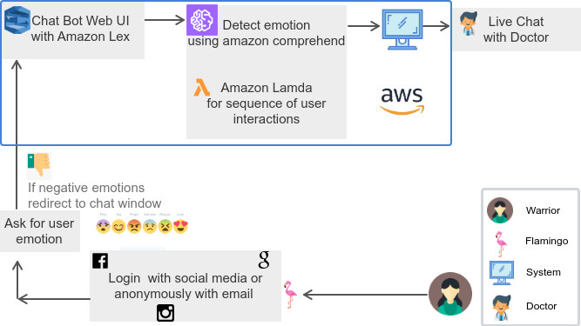
Mood Detection & Live Chat

Slide 7
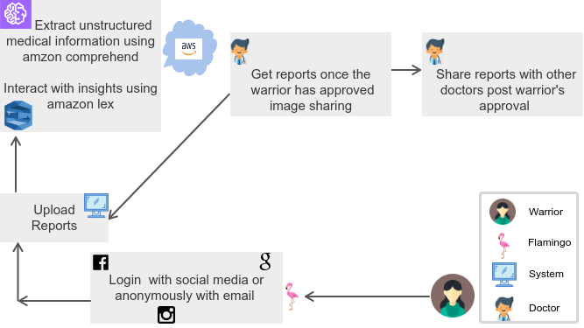
Anonymous Login, Image Analysis & Sharing

Slide 8
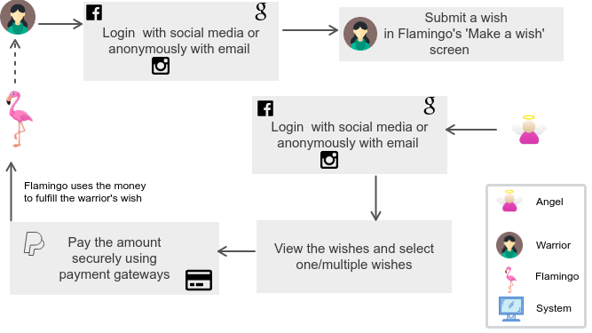
Make a Wish & Sponsor

Slide 9
Benefits, Future Enhancements & Tech Stack
Benefits
Tech Stack Used
Future Enhancements
Angular
Node JS
Material Design
MySQL DB
HTML 5
CSS3

Slide 10

Our Proposed Solution
Pleasantly DESIRABLE
Technologically FEASIBLE
Economically VIABLE

