Slide 1


Arun Gopala Krishnan K R
Balaji Ashok Kumar
Jayalakshmi Tirupathi
Divya Lakshmi Anna Ganesh
Surendar Mohanraj
Venkata Sai Charan Amarthaluru

Slide 2



Problem Statement & Solution
Problems
Spending a day for admission
Manual processing for admission
Long waiting time for bus
Not aware of daily activities, Kids location at school
Manual announcements in school
Missed out school events
Late notification on emergency
No Direct communication between staff and parents
Flamingo
Online students' admission
Online approval of student admission
Track bus online
Live tracking & Timeline for students' activities
Digital announcements
Google/Outlook calendar sync with school events
SOS
Digital communication between staff and parents using chatbot
Flamingo - A Progressive Web App (PWA) which can be used by Warriors & Doctors in any devices like Mobile/Laptop/Desktop.
GitHub Link for the source code: https://github.com/dynamicbalaji/hack-for-pink-2020
ReadMe Direct Link: https://github.com/dynamicbalaji/hack-for-pink-2020/blob/master/README.md

Slide 3



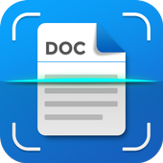




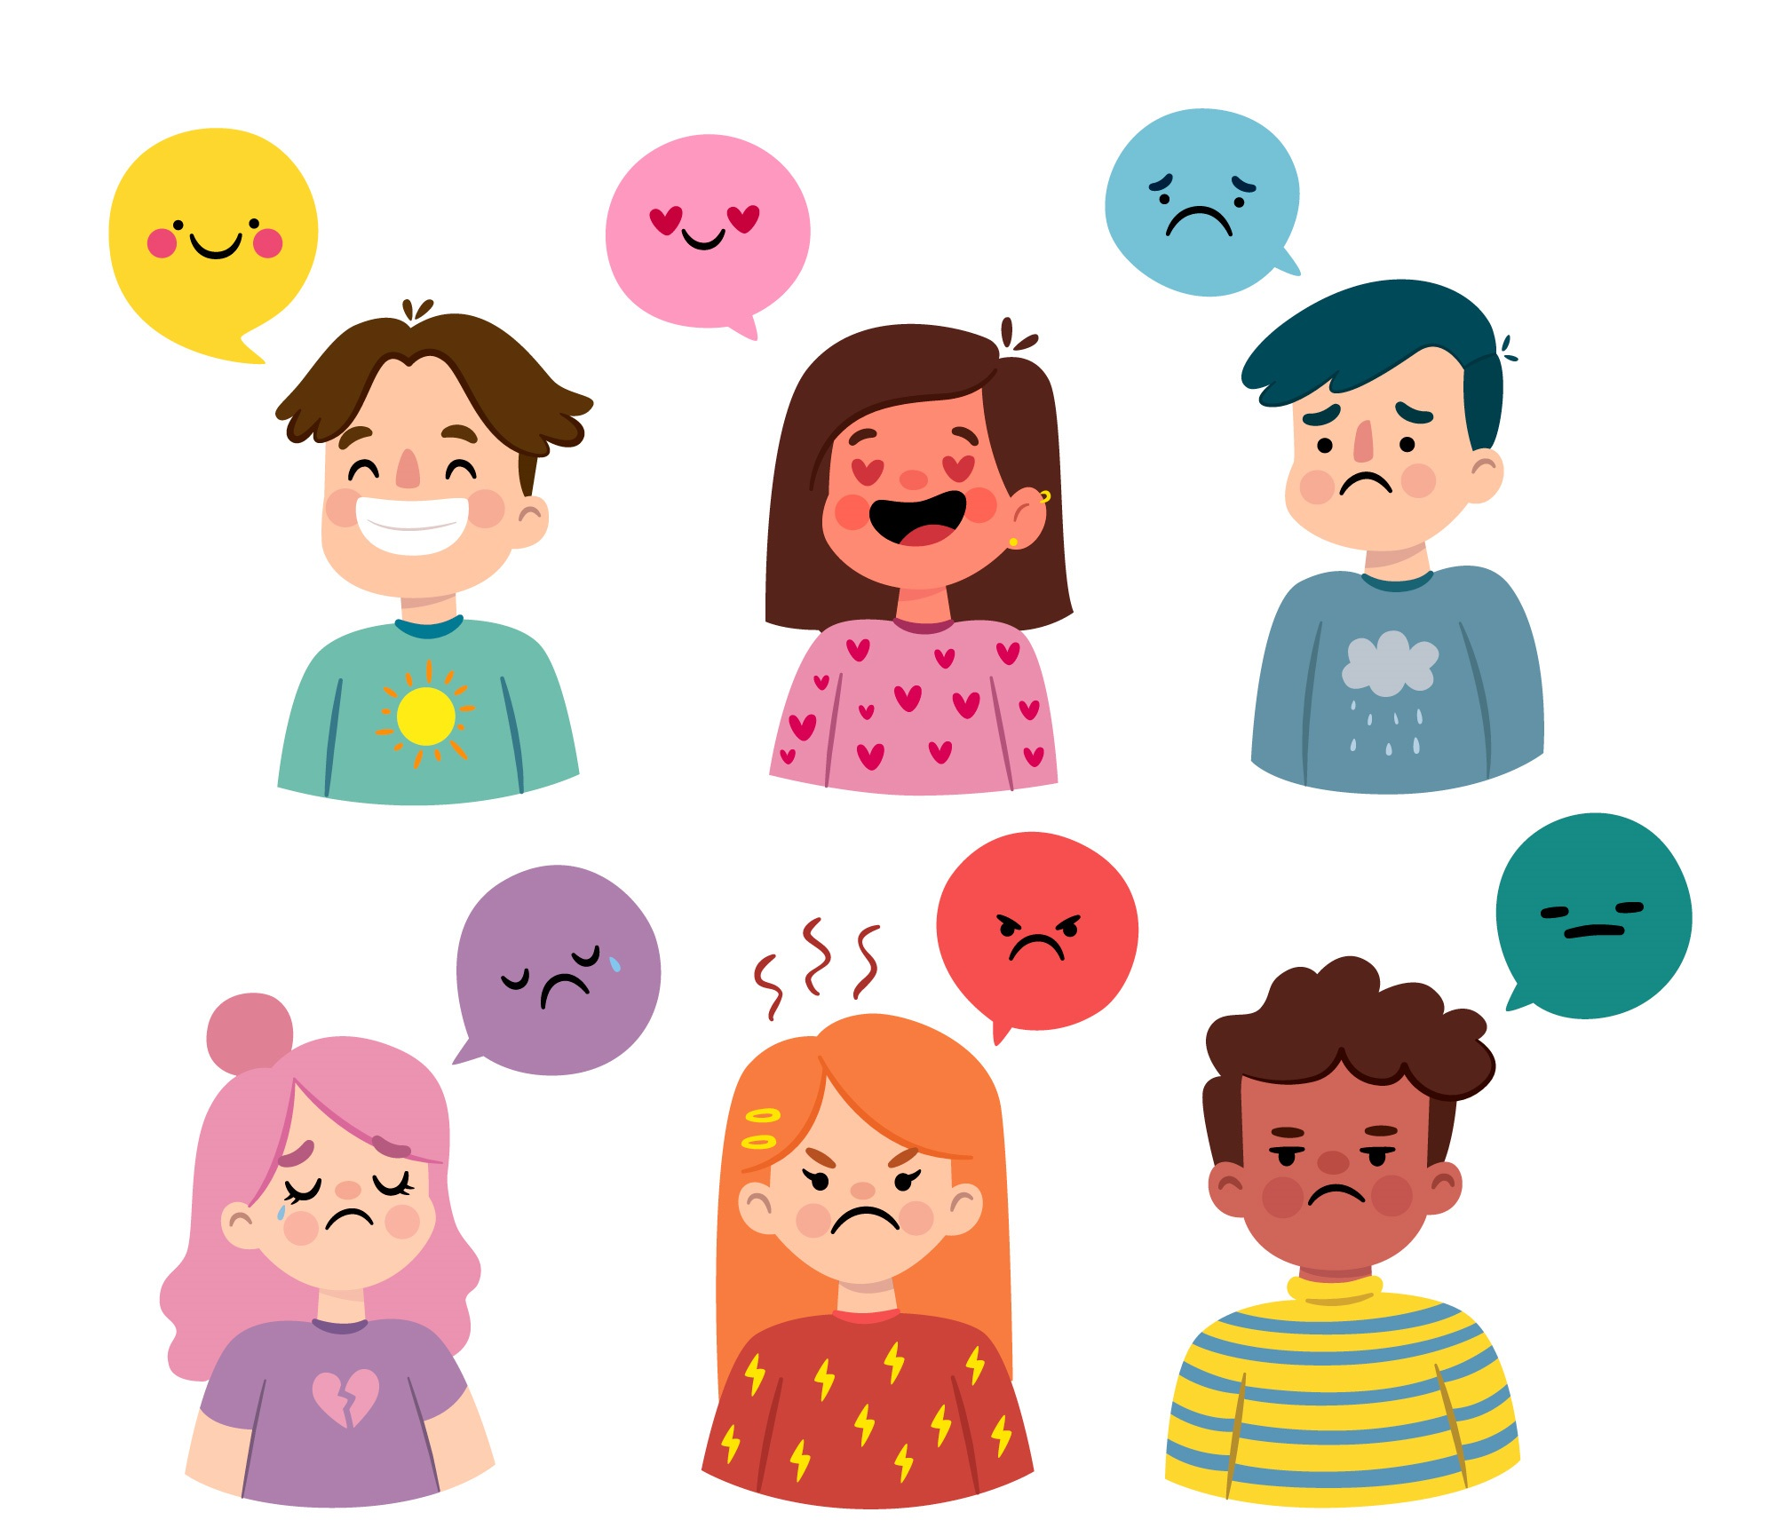



Social Media Login
Warrior Functionalities
Anonymous Login
Timeline View
Doc Scanning
Chatbot/Live Chat
Make-A-Wish
News Feed
Secure File Sharing
Mood Detection
Timely Reminder
Nearby Medical Centers
Doctor Appointment

Slide 4





Doctor/Psychiatrist Functionalities
Secure File Sharing
Live Chat
Appointment Management
Motivational Counseling
Sponsor Make-a-wish
Donation for Treatment
Angel Functionalities
News Feed
Sponsor Make-a-wish
Donation for Treatment

Slide 6
Benefits, Future Enhancements & Tech Stack
Benefits
Tech Stack Used
Future Enhancements
Angular
Node JS
Material Design
MySQL DB
HTML 5
CSS3

Slide 7

Our Proposed Solution
Pleasantly DESIRABLE
Technologically FEASIBLE
Economically VIABLE

