Slide 1
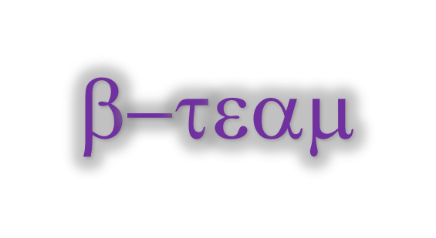

Arun Gopala Krishnan K R
Balaji Ashok Kumar
Jayalakshmi Tirupathi
Divya Lakshmi Anna Ganesh
Surendar Mohanraj
Venkata Sai Charan Amarthaluru

Slide 2
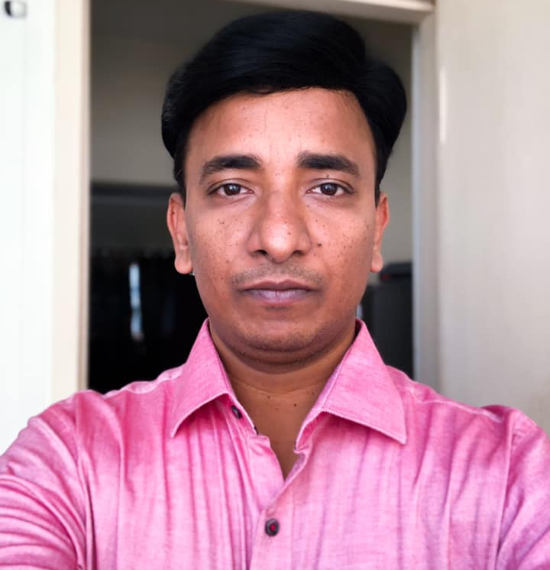
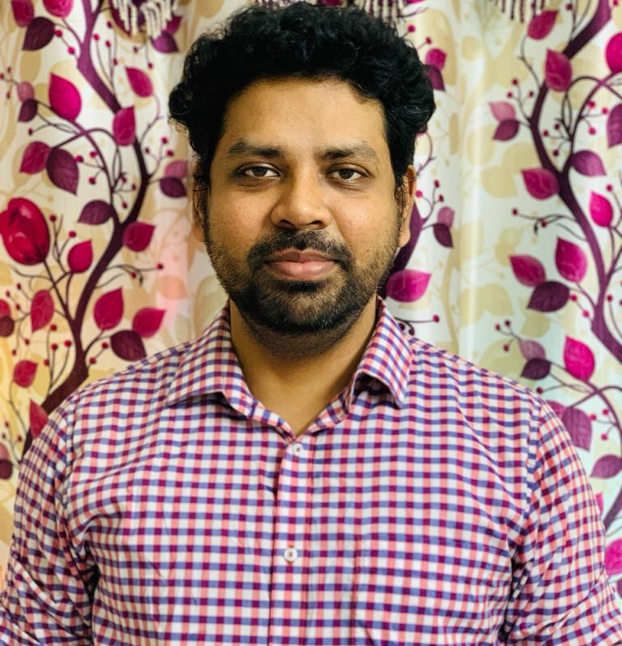
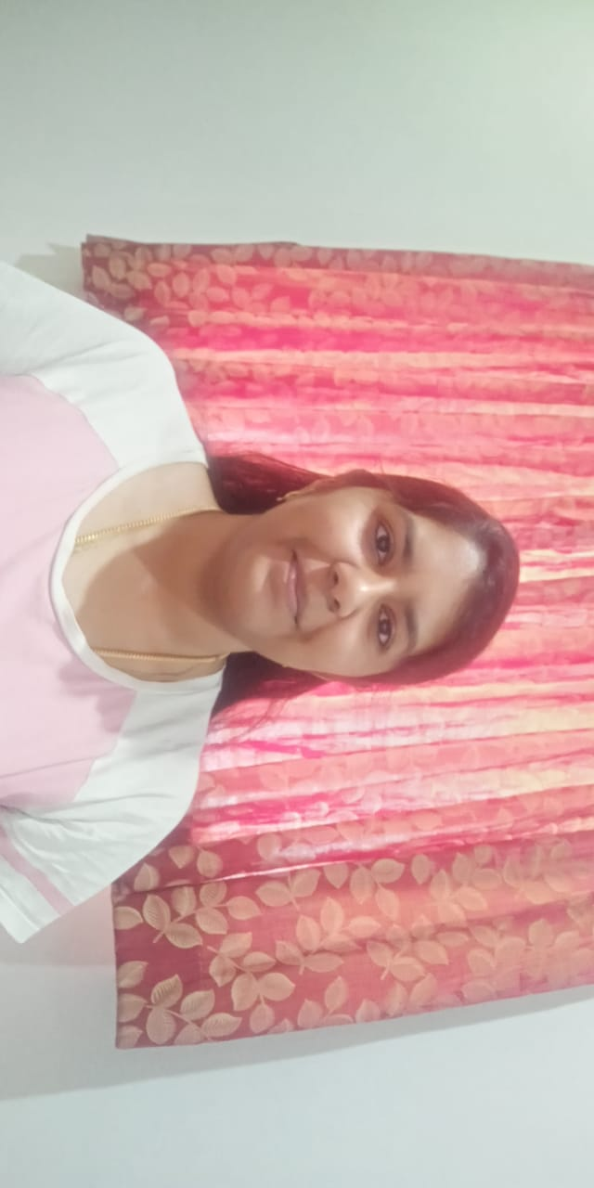
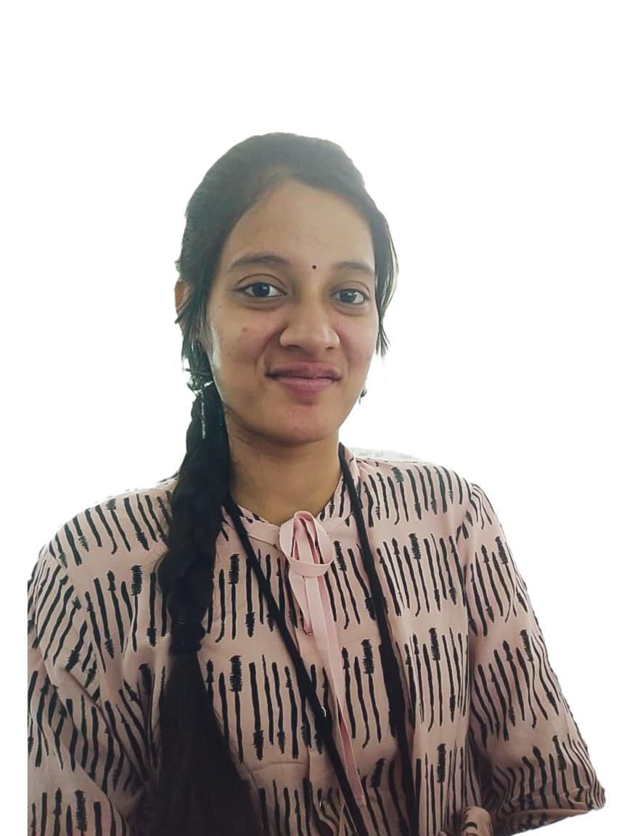
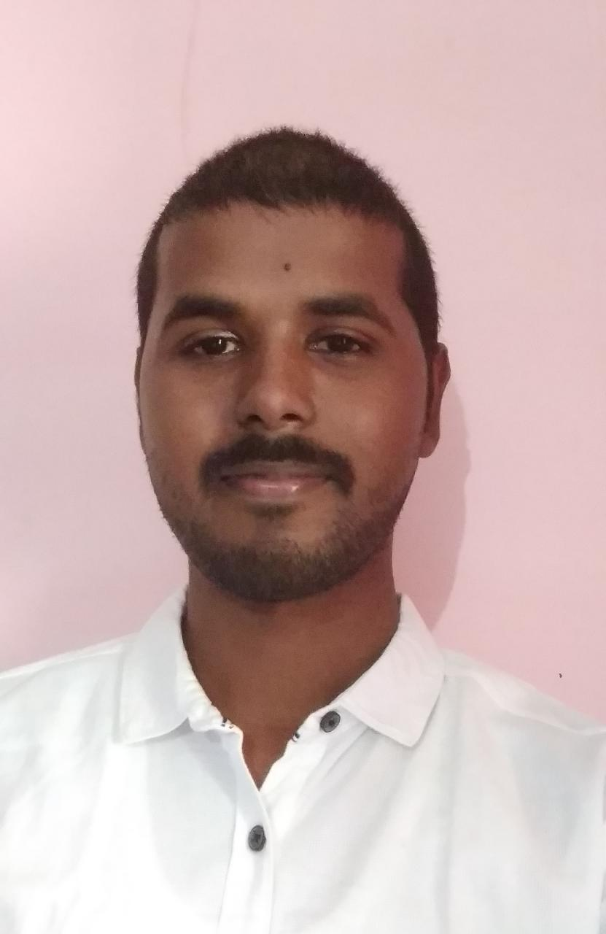
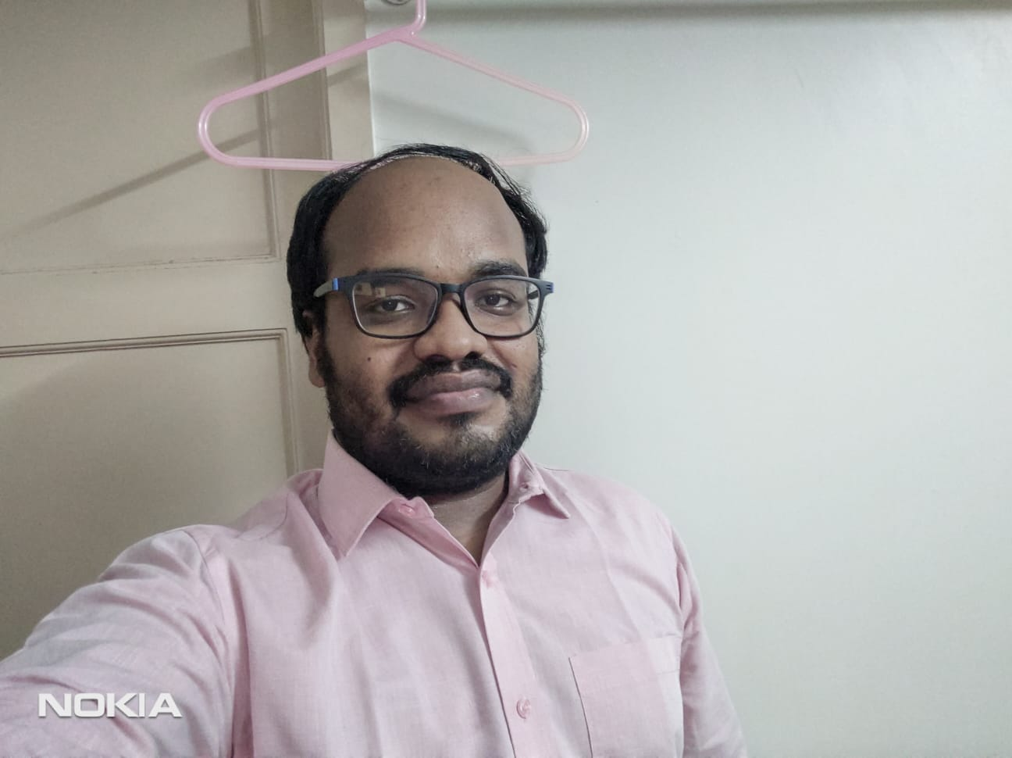
B-Team
Arun Gopala Krishnan K R
Balaji Ashok Kumar
Jayalakshmi Tirupathi
Divya Lakshmi Anna Ganesh
Surendar Mohanraj
Venkata Sai Charan Amarthaluru

Slide 3



Problem Statement & Solution
Problems
Exposure based consultation
Need to meet the doctor for assessment based on symptoms
Need to go to hospital and wait for consultation
Report sharing among doctors without warrior’s consent
Third party Make a wish foundations.
Flamingo
Privacy enabled consultation
Self assessment can be made using AI enabled chatbot.
Online consultation with doctors
Approval based image sharing among doctors.
In built Make a wish functionality for raising funds.
Digitally Organized Prescription and Reports by scanning through OCR.
Flamingo - A Progressive Web App (PWA) which can be used by Warriors, Doctors & Angels in any devices like Mobile/Laptop/Desktop.
GitHub Link for the source code: https://github.com/dynamicbalaji/hack-for-pink-2020
ReadMe Direct Link: https://github.com/dynamicbalaji/hack-for-pink-2020/blob/master/README.md

Slide 4








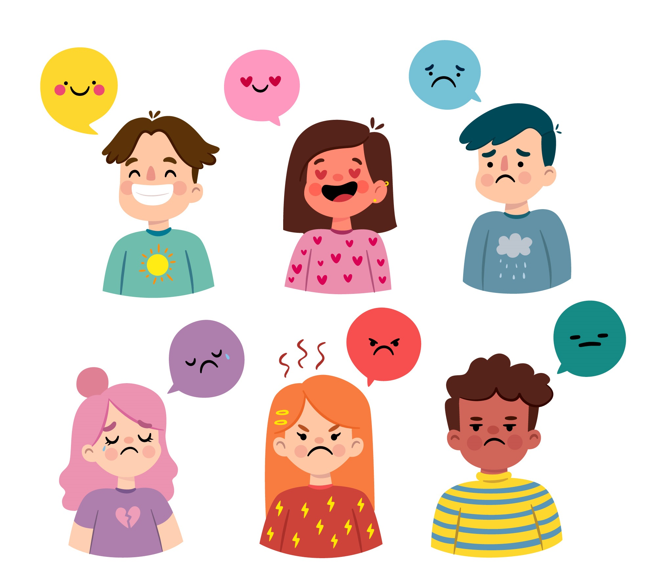



Social Media Login
Warrior Functionalities
Anonymous Login
Timeline View
Doc Scanning
Chatbot/Live Chat
Make-A-Wish
News Feed
Secure File Sharing
Mood Detection
Timely Reminder
Nearby Medical Centers
Doctor Appointment

Slide 5





Doctor/Psychiatrist Functionalities
Secure File Sharing
Live Chat
Appointment Management
Motivational Counseling
Sponsor Make-a-wish
Donation for Treatment
Angel Functionalities
News Feed
Sponsor Make-a-wish
Donation for Treatment

Slide 6
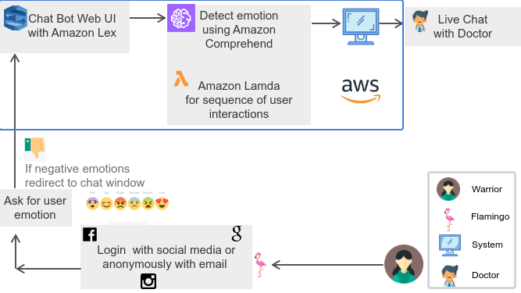
Mood Detection & Live Chat

Slide 7
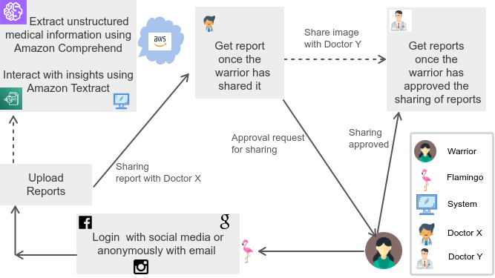
Anonymous Login, Image Analysis & Sharing

Slide 8
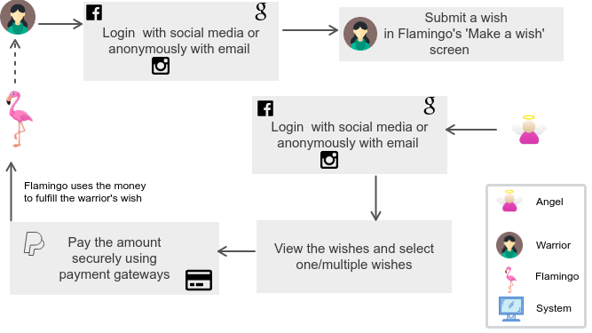
Make a Wish & Sponsor

Slide 9
Benefits, Future Enhancements & Tech Stack
Benefits
Tech Stack Used
Future Enhancements
Angular
Node JS
Material Design
MySQL DB
HTML 5
CSS3
Self Assessment using AI enabled chatbot.
Privacy enabled Online consultation with doctors.
Promoting awareness through recovered warrior’s feeds and screening methods.
Maintaining Timeline of the warrior.
Including warrior’s insurance details.
Timely Reminder to self assess.
Organized Reports and prescription.
Medical centers based on warrior’s location.
Smart scheduling of warriors for doctor appointment based on AI/ML algorithms.

Slide 10

Our Proposed Solution
Pleasantly DESIRABLE
Technologically FEASIBLE
Economically VIABLE

