Slide 1
What is Airflow?
It is a tool to BUILD, SCHEDULE and MONITOR data piplines

Slide 2
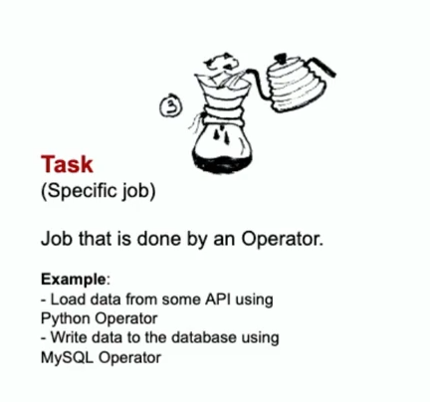
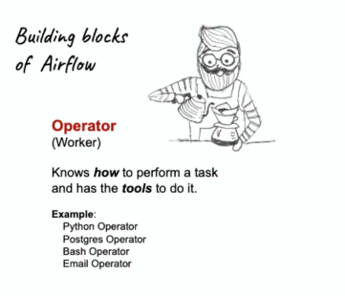
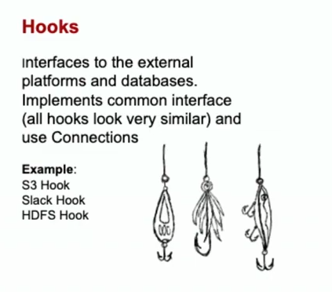
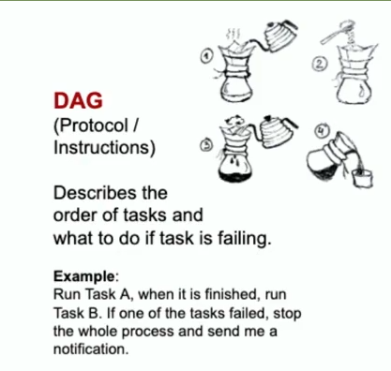
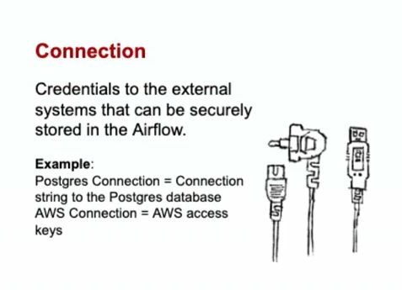
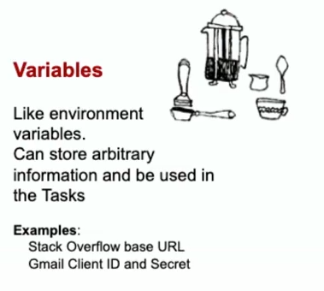
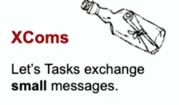
Building blocks of Airflow

Slide 3
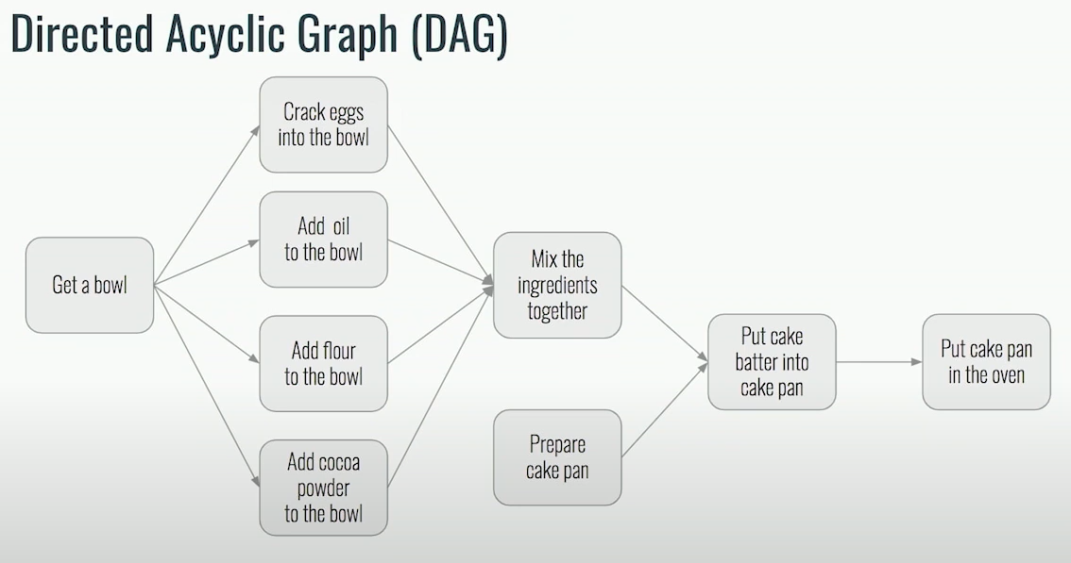

Slide 4
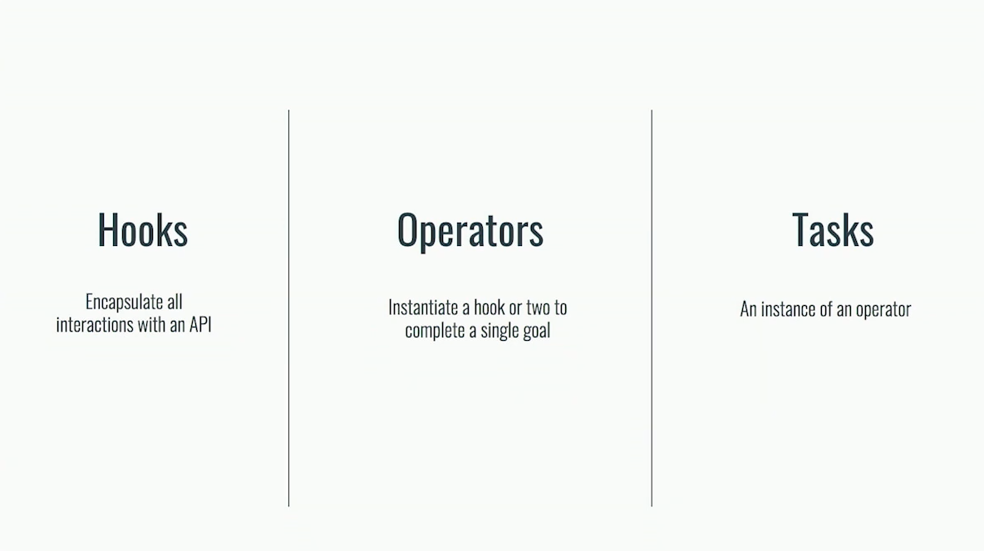

Slide 5
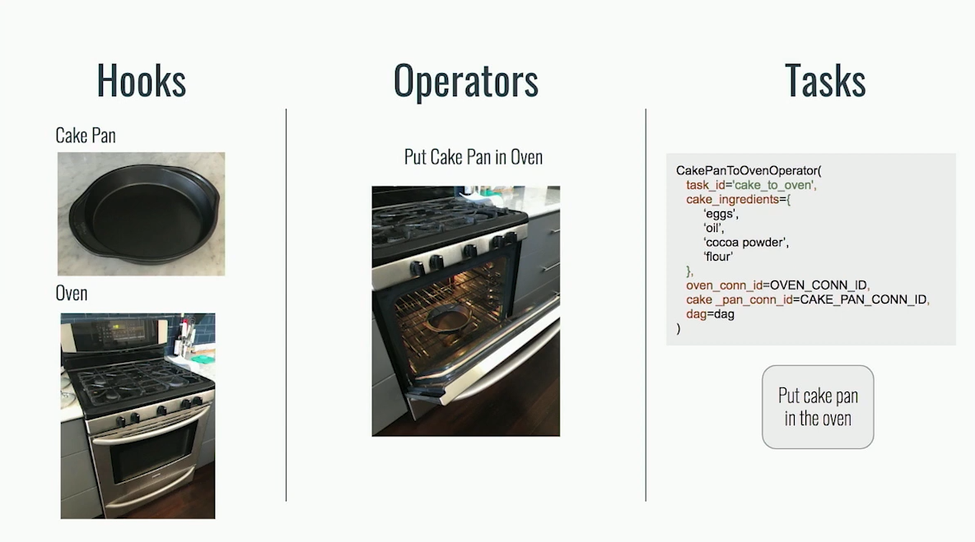

Slide 6
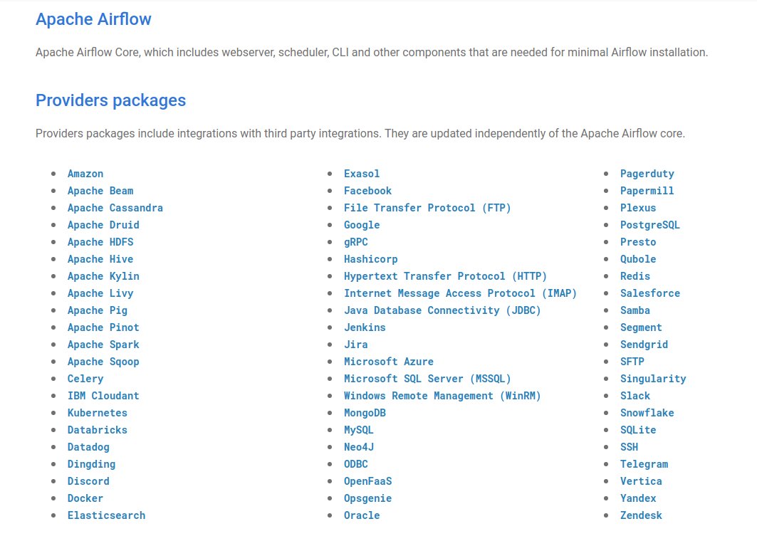

Slide 7
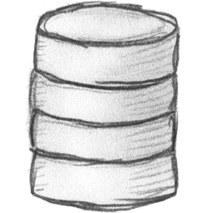



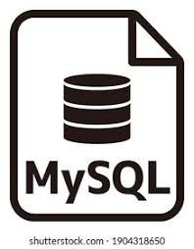


Detect Schema and flatten complex jsons
Persistent Storage to Cloud
Data Clean-up Ex. PII removal,
Fill missing pins
Write clean organized Data to (destination)
Check if table exists
Executes Alteryx Workflows and tableau extracts

Slide 8
What value does Airflow add?
Open Source (developed everyday, active slack community)
Retries tasks elegantly
Alerts on failure
Re-run specific tasks in Dag
Supports Distributed execution
Built onpython but can execute java codes too.

