Slide 1
EW1 PROJECT PRESENTATION
GROUP 19
CHARCHIT GUPTA (2019102034)
SANJAI KUMARAN (2019112012)

Slide 2
Morse code transceiver
Idea
Make an Arduino transmitter and receiver that converts the text into optical Morse code , transmit the Morse code using a laser and decode it in the receiver end using an LDR and show it to the receiver.

Slide 3
Components used
Arduino UNO
Breadboard
Low power laser
Photo resistor (LDR)
Resistors
Jumper wires

Slide 4
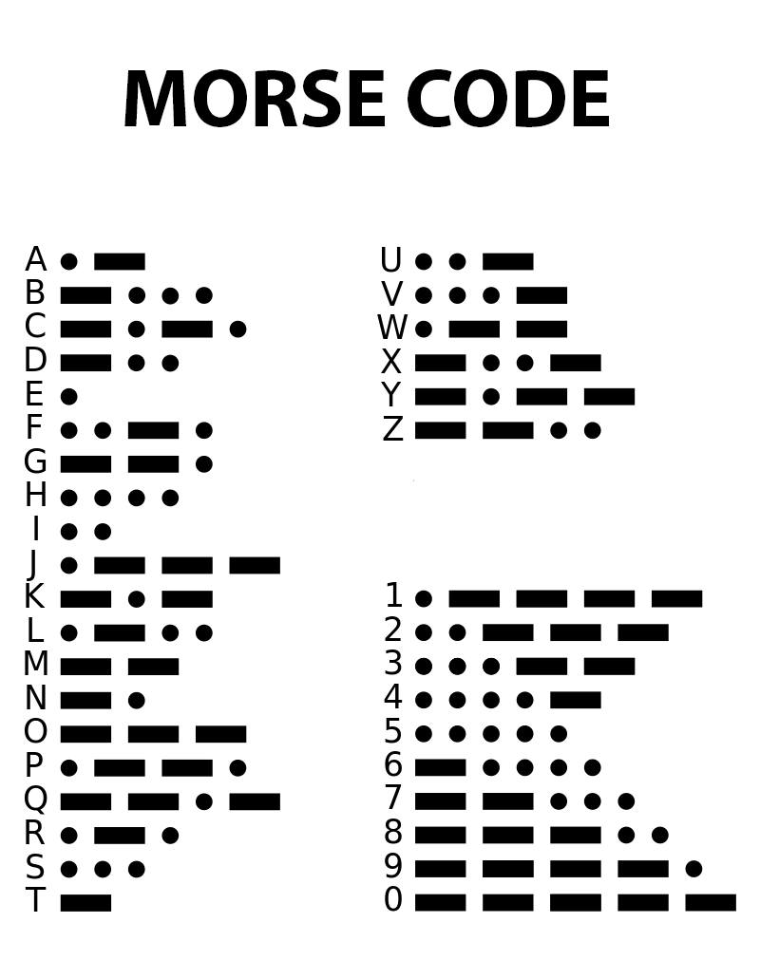

Slide 5
Working
Input is given to Arduino using IDE.
Laser Is connected to the transmitter Arduino and it is used to transmit the optical Morse code given by the Arduino.
In the receiver end LDR is used to detect the transmitted code.
The received signal is given to the receiver Arduino and it decodes it and shows it in the IDE as original text.

Slide 6
Block diagram
Input from user using IDE
Encoding to Morse Code
Input to laser
Transmission as Optical Morse Code
Detection of Optical Morse code by LDR
Output to receiver Arduino
Decoding to alphabets and digits
Display on receiver IDE
Transmitting to Arduino

Slide 7
Implementations
Can be used for encryption like cypher code.
Instead of optical Morse code, using high frequency waves, the encrypted code can be transmitted to other parts of the world.
During the times of war, Morse code was used by military to send information to other base camps. Instead of human work to decode the message it can be automated using this project.

Slide 8

THANK YOU

