Slide 1
ACTIVITY RECOGNITION USING SCENE-GRAPH
Presented by
Aditi Agrahari (17100002)
Charchit Dhawan (17100013)
Harsh Singh (17101021)
Guided by
Dr. Muneendra Ojha(Asst. Prof. CSE Dept)

Slide 2
Problem Statement
Recognising suspicious activities in a parking lot
Objective
Image Scene Graph Generation using Visual Genome Dataset
Generating dataset that imitates/depicts a real-life parking area scenario

Slide 3
MOTIVATION
This project is intended to evaluate the ability of algorithms to recognize activities in trimmed video sequences. Here, videos contain a single activity, and all the clips have a standard duration.
To recognise suspicious activities in order to effectively implement smart parking via live video surveillance.
Relation between objects through predicates based on Image Scene-Graph.

Slide 4
Where does it start? Open Scene-Graph
A scene graph is a structured representation of an image, where nodes in a scene graph correspond to object bounding boxes with their object categories, and edges correspond to their pairwise relationships between objects.
The task of scene graph generation is to generate a scene graph that most accurately correlates with an image.

Slide 5
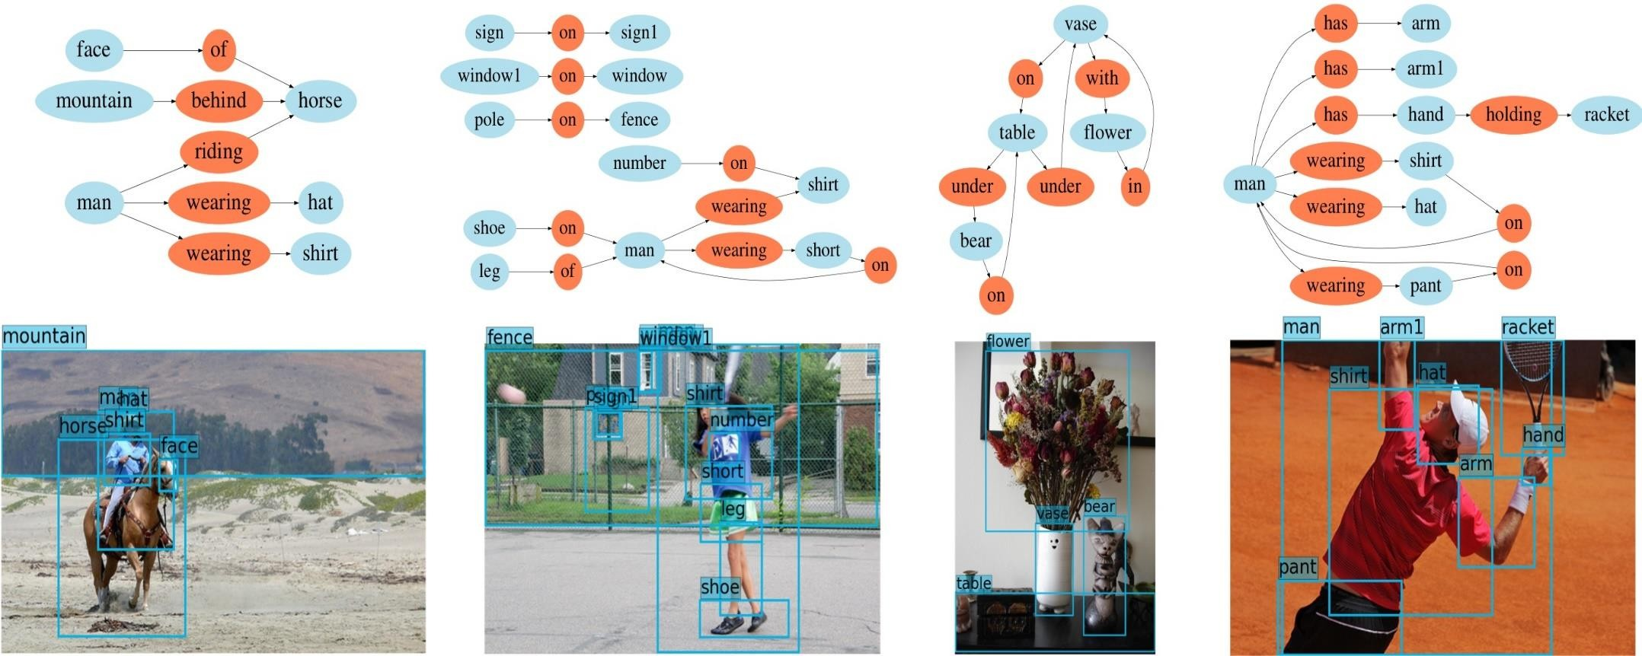
Visualization of image scene graph

Slide 6
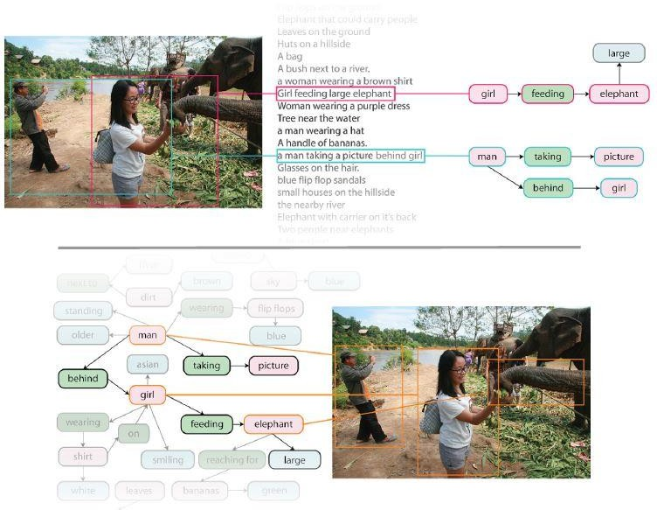
Visual Genome
Visual Genome is a dataset of images densely annotated with numerous region descriptions, objects, attributes, and relationships. Specially, this dataset contains over 108K images where each image has an average of 35 objects, 26 attributes, and 21 pairwise relationships between objects.
6

Slide 7
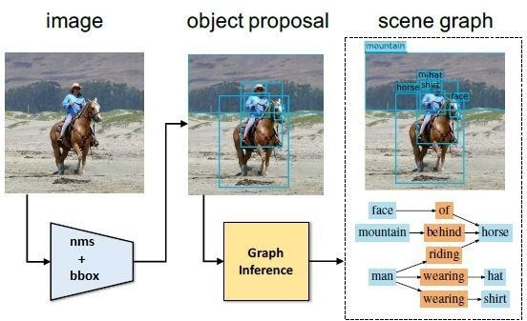
How does it work?
Let’s start with the first set of slides
Fig 2. An overview of model architecture. Given an image as input, the model first produces a set of object proposals using nms and bbox libraries, and then passes the extracted features of the object regions to graph inference module. The output of the model is a scene graph, which contains a set of localized objects, categories of each object, and relationship types between each pair of objects.

Slide 8
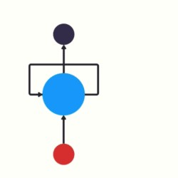
Scene Graph Generation Using Iterative Message Passing
Uses the concept of recurrent neural network
Recurrent Neural Network(RNN) is a type of neural network where the output from previous step are fed as input to the current step.
The model enables contextual information to propagate through the scene graph topology via a message passing scheme
Graph Inference Model
7

Slide 9
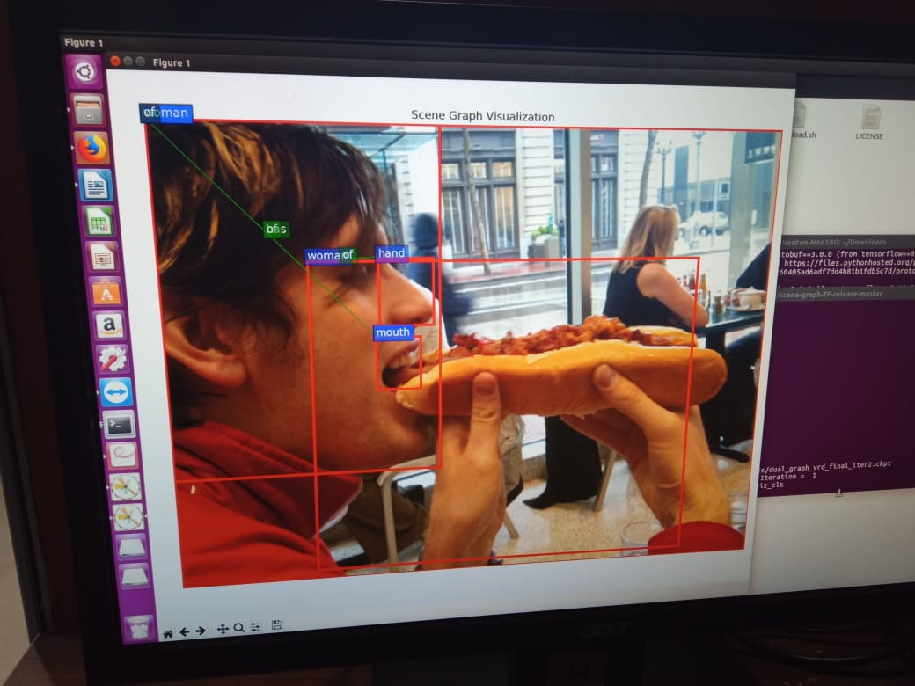
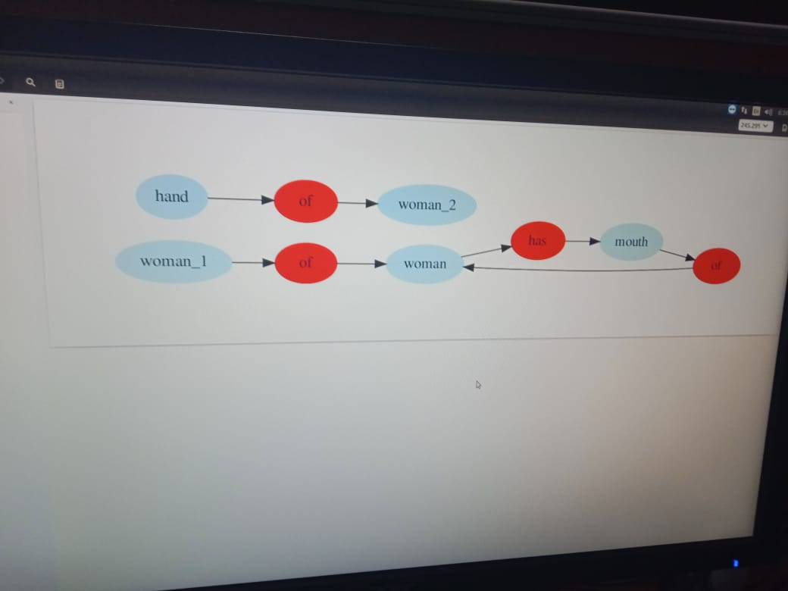
Experiment
Scene-graph generation

Slide 10
Creating Dataset
Creating a dataset with arbitrary images
Consisting of some arbitrary images we perform execution of create.sh command to create imdb.hdf5 image dataset.
That create.sh consist of code that parse the vg_to_imdb.py to images to generate dataset.

Slide 11
Implementation
Quick start
Installing dependencies
Setting up the environment using all dependencies.
Downloading VG-dataset
Run command: ./experiments/scripts/test.sh mini-vg -1 \ dual_graph_vrd_final 2 \ checkpoints/dual_graph_vrd_final_iter2.ckpt \ viz_cls \ GPU_ID
Train a model
The program saves a checkpoint to checkpoints/CHECKPOINT_DIRECTORY/ every 50000 iterations. Training a full model.
Using the self created database for arbitrary images in the .hdf5 format this perform training.
Python library used:
- ROIs - Bbox -Bblob -IMDB
Evaluate and Visualize model
To evaluate the final model with inference iterations = 2 using 100 images in the test set of the full VG dataset (use mini-vg dataset),run: ./experiments/scripts/test.sh vg 100 dual_graph_vrd_final 2 CHECKPOINT_PATH(.ckpt) all GPU_ID
To visualize the predicted graph of the first 100 images in the test set of the full VG dataset (use mini-vg),run: ./experiments/scripts/test.sh vg 100 dual_graph_vrd_final 2 CHECKPOINT_PATH(.ckpt) viz_cls GPU_ID

Slide 12
Future Plan
Build a model to detect suspicious activities in a parking lot
Studying and establishing rules, regulations and constraints to classify activities as dubious and observing a common pattern for the same and training the model based on this dataset
Apply the model to new dataset
Applying the built model to live surveillance footage and implement smart parking

Slide 13
Dataset formation using Trimmed Videoes
We prepared our dataset from video footages .There are 10 folders in our dataset and each folders is named according to a certain activity. In the classes of activities there are substantial amount of videos describing that particular activity with total size of complete folder of 6-8MB ,there are 204 clips in total , on average there are 20-25 clips per activity and average running time of each clip is 4-5sec.
Number trimmed activities as follows:
Attempt to damage a car
Group of people passing neary parking
Moving around a car.
Openning the door.
Person entering and exiting the car.
Touching of car
Putting or withdrawing item from the car.
Sneaking in the car.
Trying to open the door.
Opening the door.

Slide 14
SUMMARY
Creating a suitable environment for generating Image Scene-graph
Train the model with specified python libraries such as IMDB,ROIdb, nms,bbox etc..using VG-Dataset.
Generation of scene graph.
Implemented training to our model on VG-dataset and created our own dataset of arbitrary images in desired format.(.hdf5)
For recognition of suspicious training we trimmed video clips in different-different activities to create dataset .

Slide 15
References
https://gist.github.com/mjdietzx/0ff77af5ae60622ce6ed8c4d9b419f45
https://askubuntu.com/questions/889015/cant-install-cuda-8-but-have-correct-nvidia-driver- ubuntu-16
https://stackoverflow.com/jobs?utm_source=website&utm_medium=banner&utm_content=mpu_6&utm_campaign=house_ads_house_ads_ROS_SU
https://stackoverflow.com/questions/41626830/pip-only-install-cpu-tensorflow-of-tensorflow-0-11
https://askubuntu.com/questions/764032/how-to-uninstall-tensorflow-completely

Slide 16
Reference
Danfei Xu1, Yuke Zhu1, Christopher, B. Choy2 ,Li Fei-Fei1 1Department of Computer Science: Scene-Graph Generation by Iterative Message Passing Stanford University.[25,32]
[25] W.Liao, M.Y.Yang, H.Ackermann,andB.Rosenhahn. On support relations and semantic scene graphs. arXiv preprint arXiv:1609.05834, 2016.
[32] S. Ren, K. He, R. Girshick, and J. Sun. Faster R-CNN: Towards real-time object detection with region proposal networks. In Advances in Neural Information Processing Systems (NIPS), 2015
Image Retrievalusing Scene Graphs Justin Johnson1, Ranjay Krishna1, Michael Stark2, Li-Jia Li3,4, David A. Shamma3, Michael S. Bernstein1, Li Fei-Fei1 1Stanford University, 2Max Planck Institute for Informatics, 3Yahoo Labs, 4Snapchat [34,63]
[63] ] J. R. R. Uijlings, K. E. A. van de Sande, T. Gevers, and A.W.M.Smeulders. Selectivesearchforobjectrecognition. International Journal of Computer Vision, 104(2):154–171, 2013.
[34] A. Krizhevsky, I. Sutskever, and G. E. Hinton. Imagenet classiﬁcation with deep convolutional neural networks. In Advances in neural information processing systems, pages 1097–1105, 2012. 6, 7

Slide 17
Thank you!
Any questions?
You can find me at:
@username
user@mail.me

