Slide 1
Real Time Motion Detection Video
Surveillance System

Slide 2
Made by:
Name : Charchit Dhawan(CSE) Name : Pushpak Singh(CSE)
Roll no: 17100013 Roll no: 17100038
Under the Guidance of: Dr Anurag Singh
Source : MATLAB ,Computer Vision

Slide 3
Objective of Project :
The main objective is to design a video surveillance system using simple image processing algorithm as to detect the motion at particular instance and classify it.
To improve the Security system in efficient manner using Computer vision.

Slide 4
MOTIVATION OF THE WORK
Motion detection from a moving observer has been a very important technique for computer vision applications. Especially in recent years, for autonomous driving systems and driver supporting systems, vision-based navigation method has received more and more attention worldwide [1]-[3]. One of its most important tasks is to detect the moving obstacles like cars, bicycles or even pedestrians while the vehicle itself is running in a high speed. Methods of image differencing with the clear background or between adjacent frames are well used for the motion detection.
But when the observer is also moving, which leads to the result of continuously changing background scene in the perspective projection image, it becomes more difficult to detect the real moving objects by differencing methods
Computer Vision is one of the powerful source of benefit among all techniques which is efficient and improved.

Slide 5
How it is Helpful?
This project was designed for security purposes and the condition was to use MATLAB instead of PIR Sensor. We all know that PIR sensor is used for motion detection but for that we have to design a hardware but using this software we can easily detect any motion using MATLAB.
In video surveillance, video signals from multiple remote locations are displayed on several TV screens which are typically placed together in a control room. In the so-called third generation surveillance systems (3GSS), all the parts of the surveillance systems will be digital [I], and consequently, digital video will be transmitted and processed. Additionally, in 3GSS some 'intelligence' has to be introduced to detect relevant events in the video signals in an automatic way. This allows filtering of the irrelevant time segments of the video sequences and the displaying on the TV screen only those segments that require the attention of the surveillance operator. Motion detection is a basic operation in the selection of significant segments of the video signals.
This present a motion detection algorithm in the compressed domain with a low computational cost that considered efficient.

Slide 6
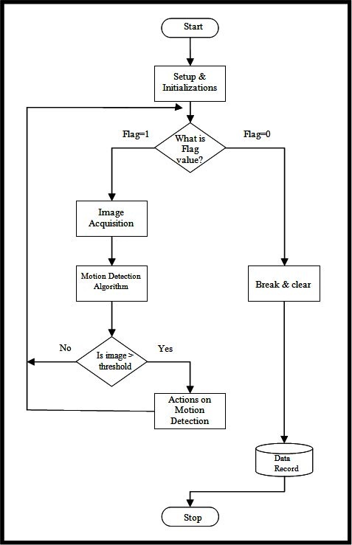
This is How it Works!

Slide 7
Techniques Using :
With pure points matching and the introduction of camera’s Focus of Expansion (FOE), our method is able to determine camera’s rotation and translation parameters theoretically by using only three pairs of matching points between adjacent frames, which make it faster and more efficient for real-time applications.
The main task of the software was to read the still images recorded from the camera and then process these images to detect motions and take necessary actions accordingly.

Slide 8
a
Algorithm used:
Motion Detection Using Sum of Absolute Difference (SAD)
This algorithm is based on image differencing techniques. It is mathematically represented using the following equation
Where is the number of pixels in the image used as scaling factor,
I(t_{i)} is the image I at time i ,
I(t_{i)} is the image I at time j and
D(t) is the normalized sum of absolute difference for that time.
In an ideal case when there is no motion
I(t_{i}) = I(t_{i}) and D(t). However noise is always presented in images and a better model of the images in the absence of motion will be I(t_{i}) = I(t_{j}) + n(p)
Where n(p) is a noise signal.
The value D(t) that represents the normalized sum of absolute difference can be used as a reference to be compared with a threshold area.

Slide 9
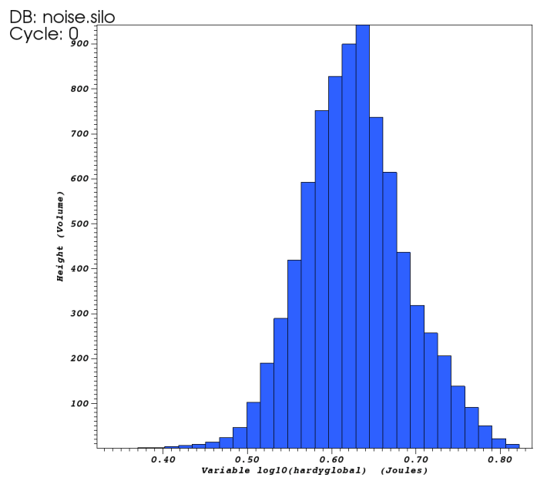
Operations performed on the Capture in Surveillance
Image Histogram plot : An Image Histogram is a chart that shows the distribution
of intensities in an indexed or gray scale image.

Slide 10
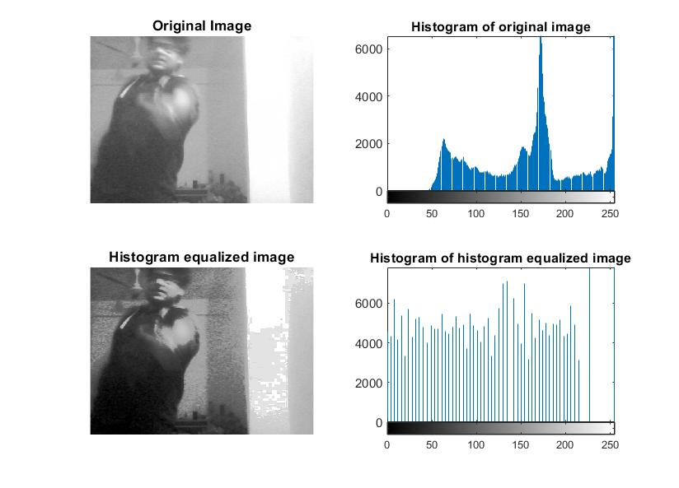
Result Obtained:
The Surveillance Motion
is detected and operated
over gray scale for more
clarity and Discrete values

Slide 11
Conclusion:
This Design concluded the efficiency model towards the Security.
The way of better technology implementation invoked.
This system reduced the need of hardware so low cost.

Slide 12
Concepts learnt :
We learnt the importance of the signal processing as image is also a form of signal and how to implement in real time projects.
The Concept of Computer Vision over MATLAB.

Slide 13


