Slide 1
Amazon Sales Data Analysis

Slide 2
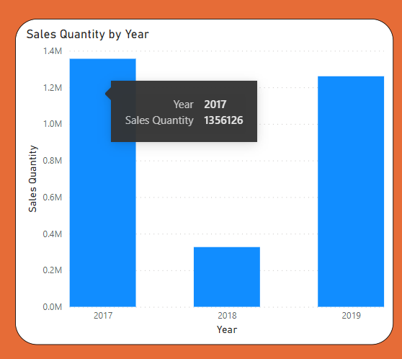
1.) Sales Quantity by Year

Slide 3
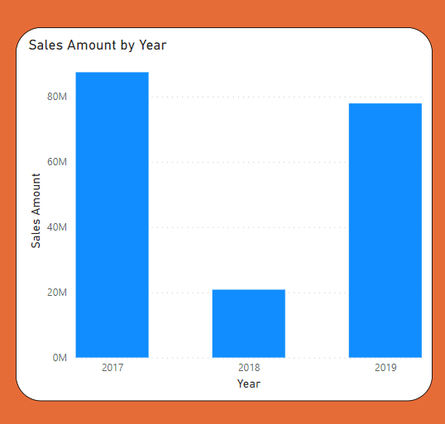
1.) Sales Amount by Year

Slide 4
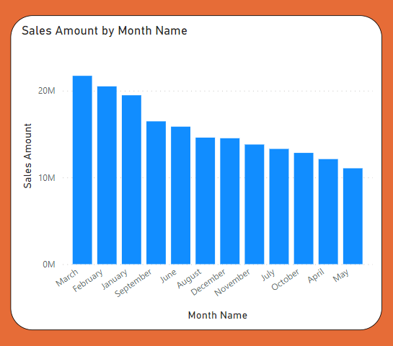
3.) Sales Amount by Month Name

Slide 5
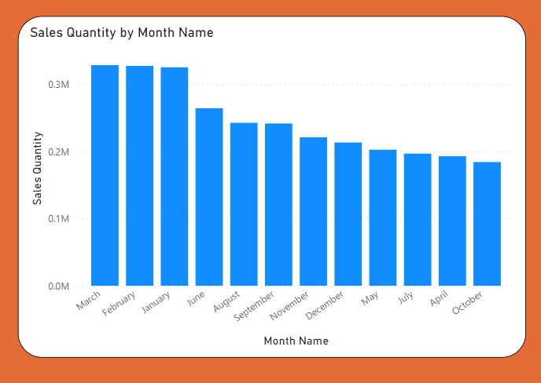
4.) Sales Quantity by Month Name

Slide 6
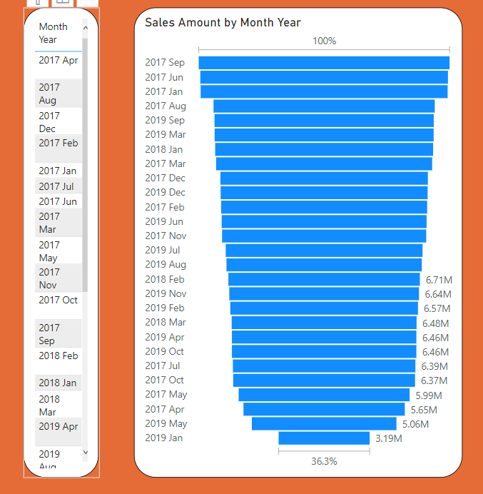
5.) Sales Amount by Month Year

Slide 7
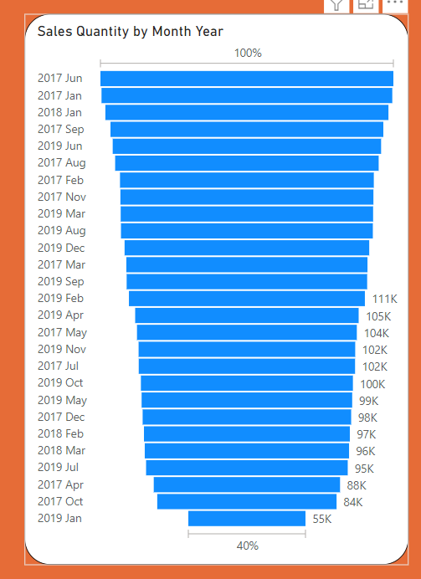
6.) Sales Quantity by Month Year

Slide 8
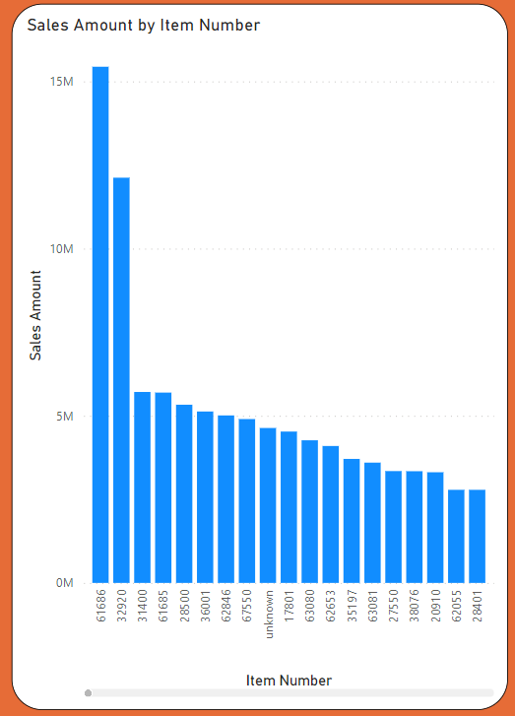
7.) Sales Amount by Item Number

Slide 9
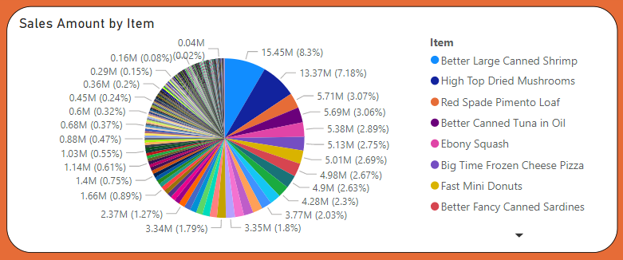
8.) Sales Amount by Item

Slide 10
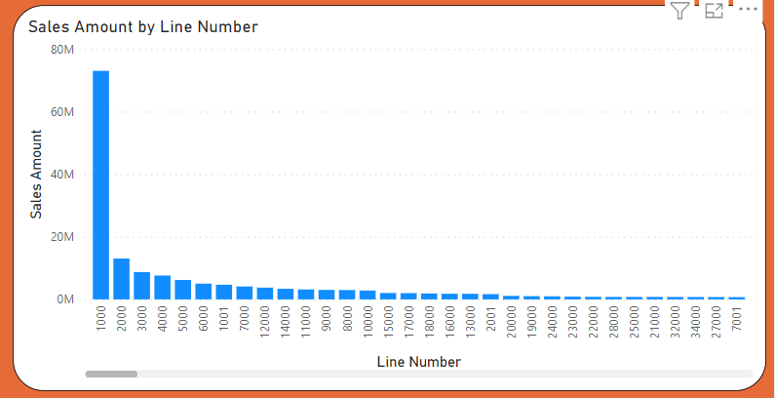
9.) Sales Amount by Line Number

Slide 11
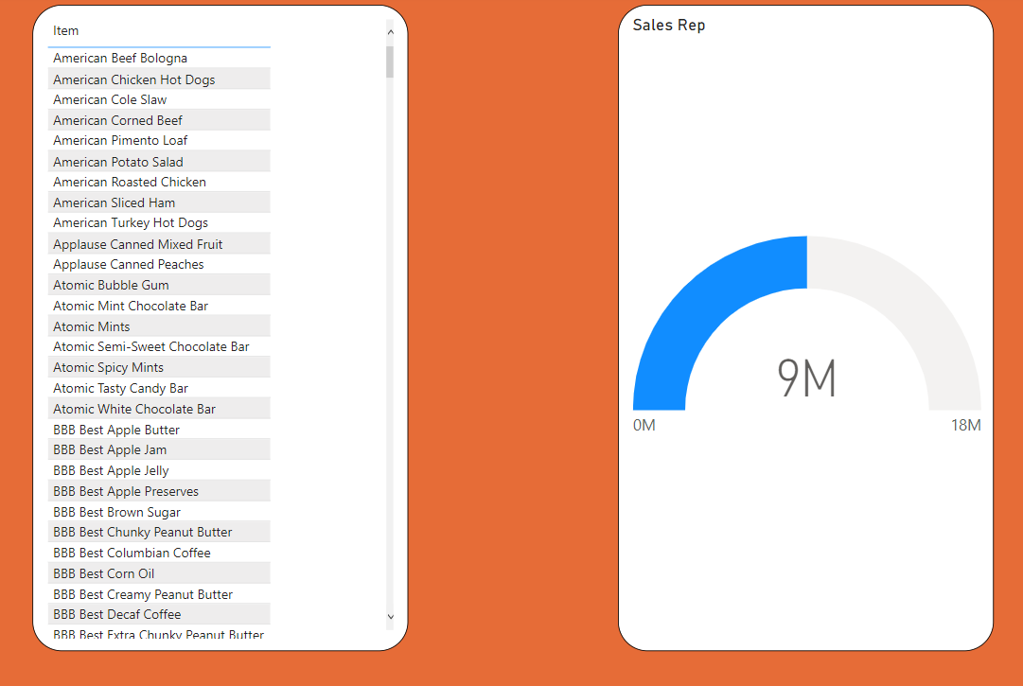
10.) Repeat Sales according to Item

Slide 12
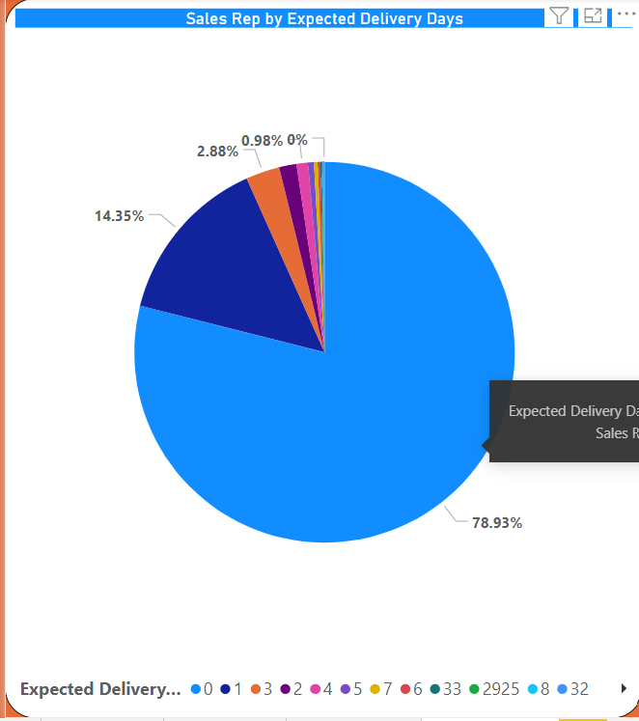
11.) Sales Rep by Expected delivery days

Slide 13
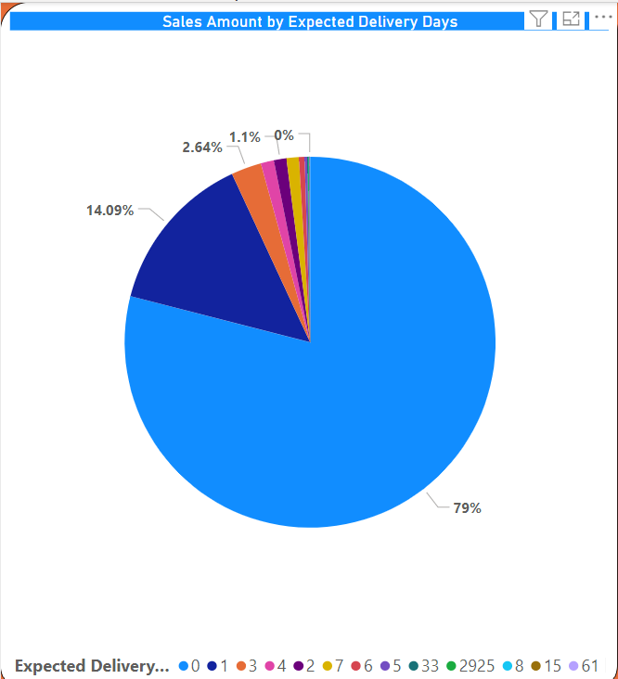
12.) Sales Amount by Expected Delivery Days

