Slide 1
Budget Sales Data Analysis

Slide 2
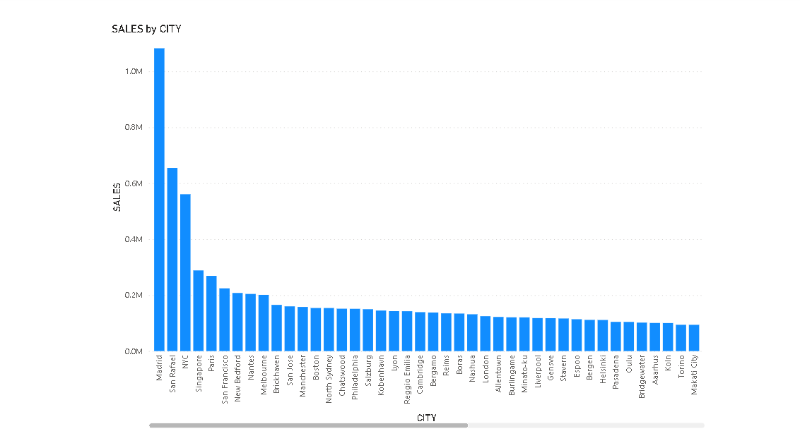
1.) Sales by City

Slide 3
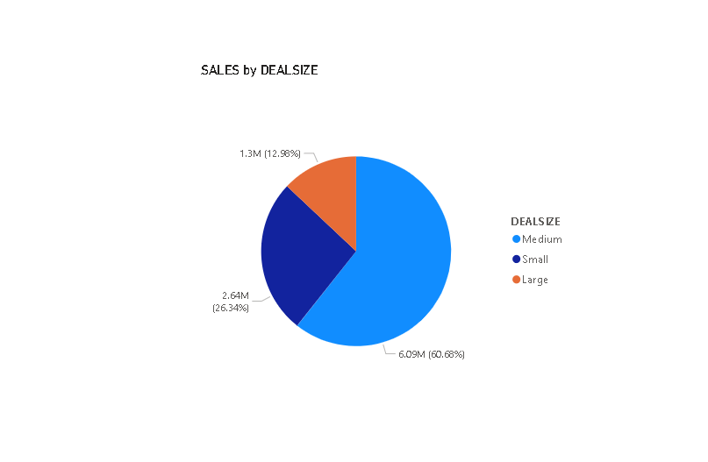
2.) Sales by DealSize

Slide 4
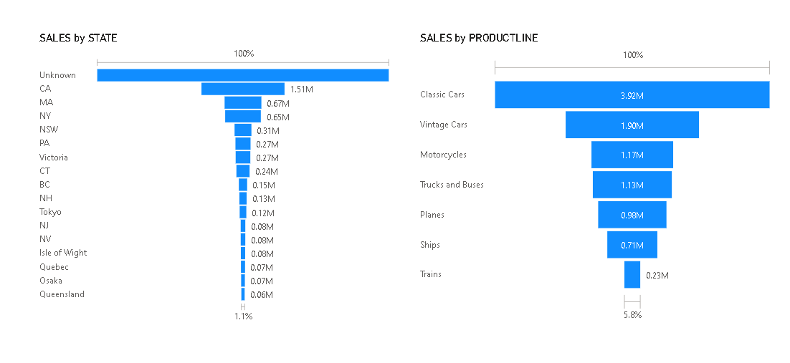
3.) Sales by State & Sales by ProductLine

Slide 5
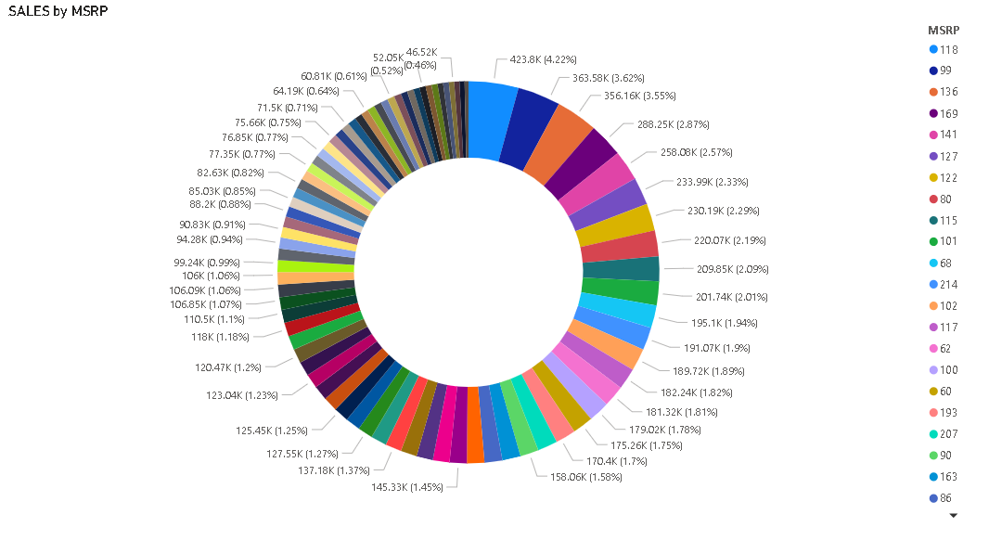
4.) Sales by MSRP

Slide 6
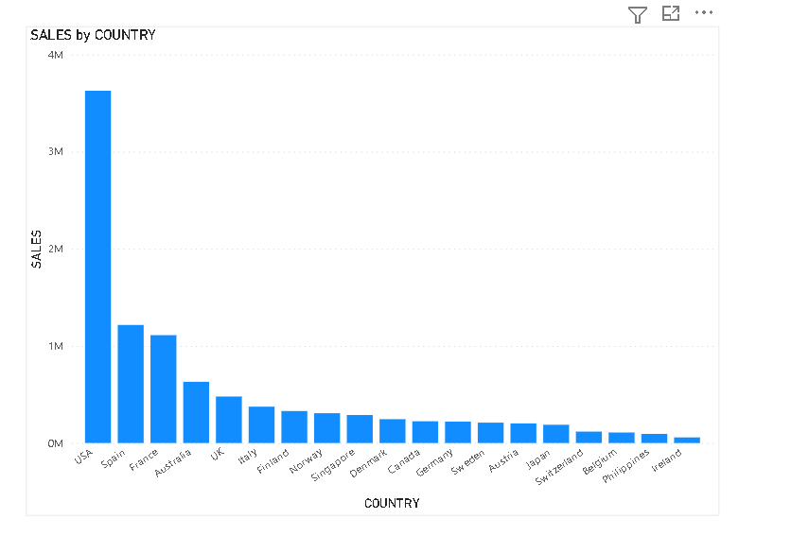
5.) Sales by Country

