Slide 1
Modern C++
...a few things to know…
Jesse Williamson, Senior Storage Engineer, SUSE (jwilliamson@suse.de)
All images © owners.

Slide 2
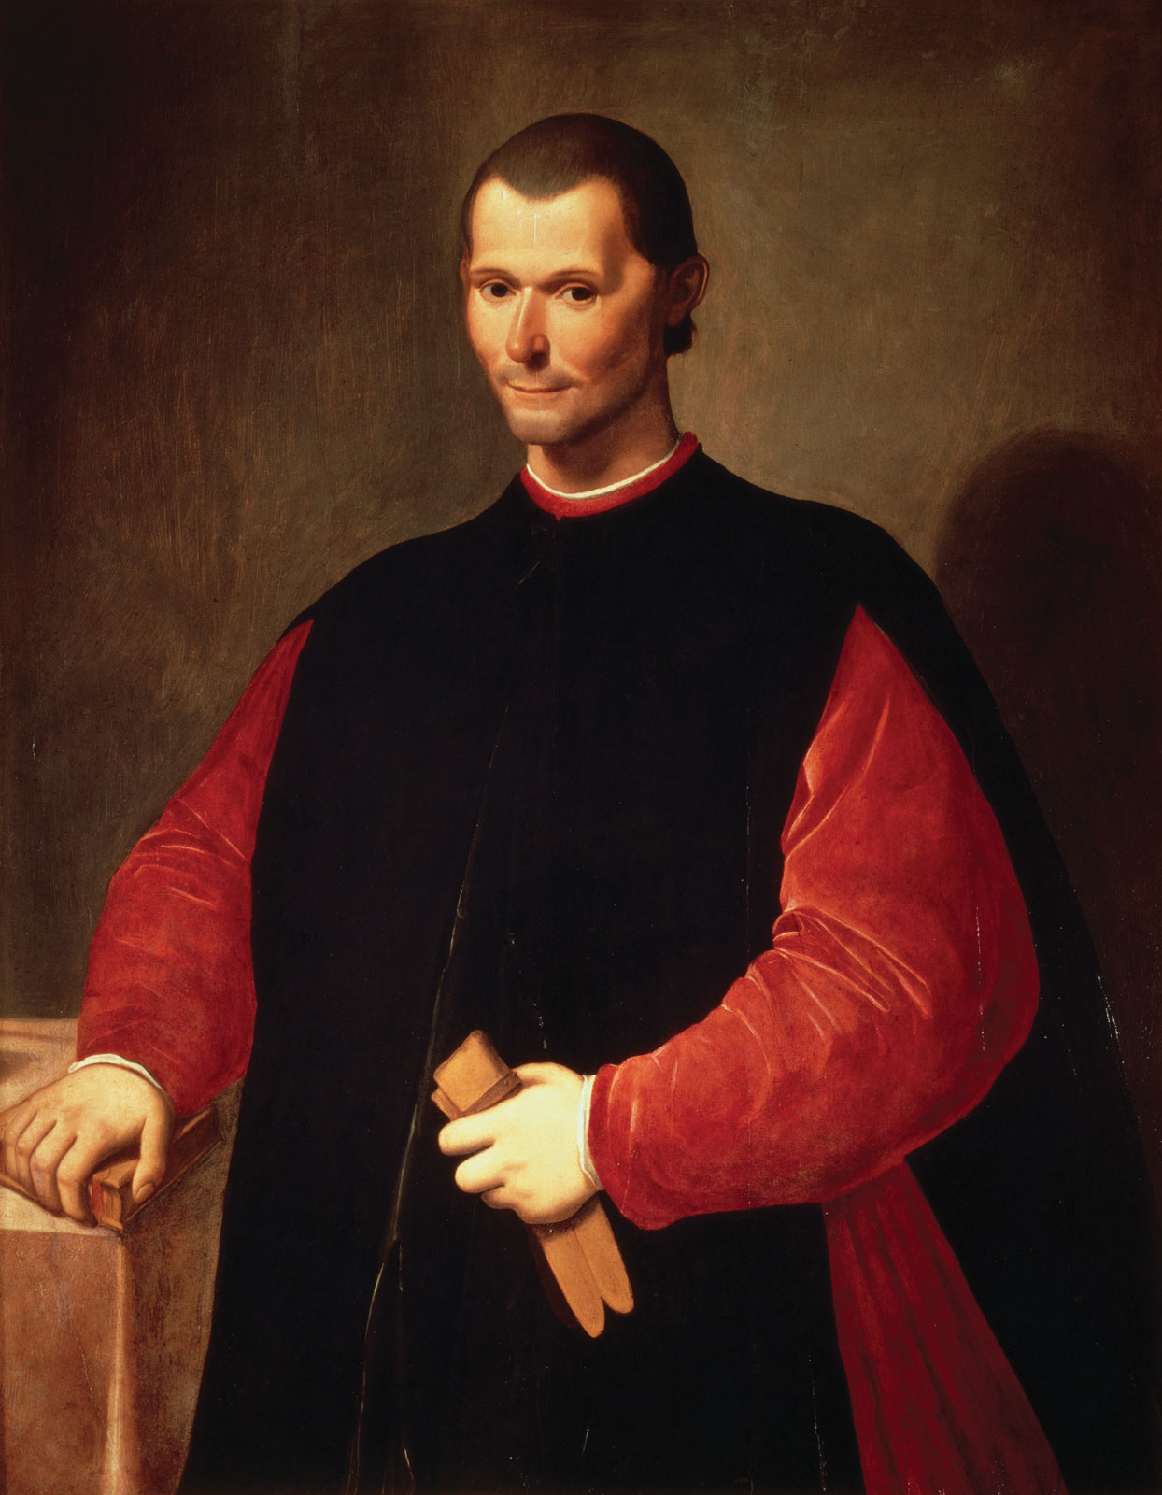
Modern C++
...a few things to know…
Jesse Williamson, Senior Storage Engineer, SUSE (jwilliamson@suse.de)
All images © owners.

Slide 3
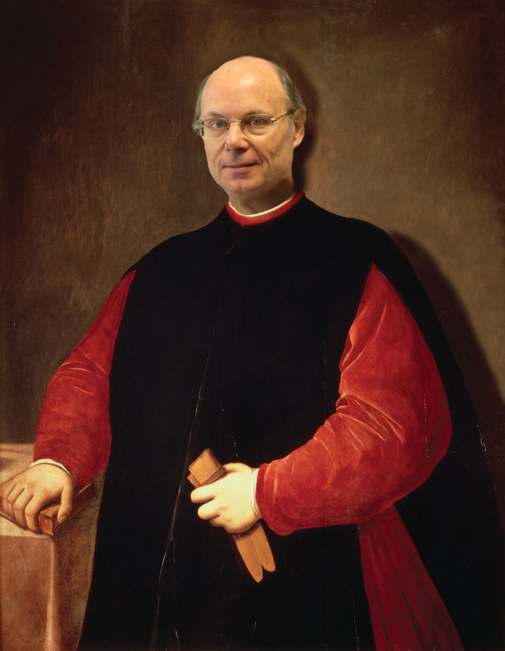
Modern C++
...a few things to know…
Jesse Williamson, Senior Storage Engineer, SUSE (jwilliamson@suse.de)
All images © owners.

Slide 4
Modern C++
...a few things to know...
What the heck is it?
What are some important concepts?
How is it still improving?
Is there a community?
Where can one learn more?

Slide 5
Modern C++
What in the heck is it?

Slide 6
Modern C++
What in the heck is it?
  A way of using the language that embraces its entire scope:

Slide 7
Modern C++
What in the heck is it?
  A way of using the language that embraces its entire
  scope:
    Leverage the stack to control resources
    Utilize C++'s multi-paradigm nature
      Structured, object-oriented, generic, and functional programming
    Work with the Standard Library
      Software components “fit together”
    An attitude of minimizing “moving parts”
      decrease complexity (bare pointers, side-effects/action at a distance, global state, code organization)
    Rely on the type system
    Zero-overhead abstraction (“don't pay for what you don't use”)

Slide 8
Modern C++
What in the heck is it?
  A way of using the language that embraces its entire
  scope:
    Leverage the stack to control resources
    Utilize C++'s multi-paradigm nature
      Structured, object-oriented, generic, and functional programming
    Work with the Standard Library
      Software components “fit together”
    An attitude of minimizing “moving parts”
      decrease complexity (bare pointers, side-effects/action at a distance, global state, code organization)
    Rely on the type system
    Zero-overhead abstraction (“don't pay for what you don't use”)
Since C++11, increasingly formalized in the language.

Slide 9

RAII Intro
“Use the Scope, Luke!”

Slide 10
RAII Intro
Resource Acquisition Is Initialization

Slide 11
RAII Intro
Resource Acquisition Is Initialization
When an object is constructed, one of its
constructors (ctors) is called.
When a stack object goes out of scope, it's
destructor (dtor) is called.
“Simple”, and one of the most powerful, most
critical ideas in C++.
Use the stack to control heap resources.

Slide 12
Time for code!
#include <string>
#include <vector>
#include <iostream>
// ...etc...
using namespace std;
int main(int argc, char *argv[])
{
}

Slide 13
RAII Intro
int main(int argc, char *argv[])
{
int x = 5;
}

Slide 14
RAII Intro
int main(int argc, char *argv[])
{
int x = 5;
string s = "Hello, World!";
vector<int> xs = { 1, 2, 3, 4, 5 };
vector<string> args(argv, argc + argv);
}
...notice the absence of manual memory operations and bare pointers. Yet, this program does not leak, even if an exception is thrown!
Note: “args” knows how to copy C strings because std::string has a constructor for
them. std::vector<>'s ctor knows how to deal with a pointer and a length.

Slide 15
RAII Intro
struct S
{
~S() { cout << "S::~S()\n"; }
};
int main()
{
{
S s;
} // s goes out of scope right here
cout << "===========" << endl;
{
vector<S> vs(5);
} // vs dtor, and thus all s instances contained in it
cout << "===========" << endl;
}
OUTPUT:
S::~S()
===========
S::~S()
S::~S()
S::~S()
S::~S()
S::~S()
===========

Slide 16
RAII Intro
// Adapted from: http://en.cppreference.com/w/cpp/thread/lock_guard
int g_i = 0;
mutex g_i_mutex; // protects g_i
void safe_increment() {
lock_guard<mutex> lock(g_i_mutex);
++g_i;
} // ...lock is released here...
int main() {
thread t1(safe_increment);
thread t2(safe_increment);
t1.join();
t2.join();
}

Slide 17
Cheat Sheet
When you want to have... | ...and are tempted by... | ...consider this healthy alternative!
A static array | T[n] xs | array<T, n> xs
A dynamic array | T** xs | vector<T> xs
An owning pointer | T *x = fn(); | unique_ptr<T>
A shared pointer | T *x | shared_ptr<T>
Safely observe a shared pointer | T *observer | weak_ptr<T>
Pure observing pointer | T * | T *
Read-only string | char* or const char* | string_view<> (C++17)
Heap object | new, delete | the stack(!), a factory (ie. make_unique<T>)

Slide 18
A bit of C++14
(and beyond)

Slide 19
“Fancy” Things are Helpful
// C++98/03 style:
map<shard_id_t, ObjectStore::Transaction> trans;
for (set<pg_shard_t>::const_iterator i =
get_parent()->get_actingbackfill_shards().begin();
i != get_parent()->get_actingbackfill_shards().end();
++i) {
trans[i->shard];
}

Slide 20
“Fancy” Things are Helpful
// C++98/03 style:
map<shard_id_t, ObjectStore::Transaction> trans;
for (set<pg_shard_t>::const_iterator i =
get_parent()->get_actingbackfill_shards().begin();
i != get_parent()->get_actingbackfill_shards().end();
++i) {
trans[i->shard];
}
----
// C++11 style:
map<shard_id_t, ObjectStore::Transaction> trans;
for(const auto& i : get_parent()->get_actingbackfill_shards())
trans[i.shard];

Slide 21
“Newer sugar, nicer syntax”
// C++14:
struct some_data
{
int x = 0;
string s = "data";
};
template <typename KeyType>
using data_map = unordered_map<KeyType, some_data>;
int main()
{
data_map<string> d = {
{ "key0", { 5, "some data" } },
{ "key2", { 2, "some extra data" } },
{ "key1", { 7, "some more data" } },
};
for(const auto& kv : d)
cout << kv.first << ", " << kv.second.s << '\n';
}

Slide 22
RAII with C… for Cheap!
// C++14
using file_ptr = unique_ptr<FILE, decltype(&fclose)>;
auto write_things(const vector<char>& things)
{
auto fp = file_ptr(fopen("data.dat", "w"), &fclose);
return fwrite(things.data(), things.size(), 1, fp.get());
}
int main()
{
write_things({ 'a', 'b', 'c', 'd', 'e' });
}

Slide 23
Things begin to “feel” lighter
struct context
{
vector<string> params = { "Hi", "there!" };
};
bool fn0(const context ctx)
{
for(const auto& s : ctx.params)
cout << s << '\n';
return true;
}
using dispatch_fn = function<bool(context)>;
using dispatch_map = unordered_map<string, dispatch_fn>;
int main()
{
dispatch_map cmds = { { "show", fn0 } };
context c;
cmds["show"](c);
}

Slide 24
Nicer… everything! :-)
// C++14:
auto f()
{
return make_tuple(1.0, 1, "hello!");
}
int main()
{
double d;
int i;
string s;
tie(d, i, s) = f();
if(1 == i)
cout << "Yay!\n";
else
cout << "Daww. I got " << i << '\n';
}

Slide 25
Nicer… everything! :-)
// C++17:
auto f()
{
return make_tuple(1.0, 1, "hello!");
}
int main()
{
if(auto [d, i, s] = f(); 1 == i)
cout << "Yay!\n";
else
cout << "Daww. I got " << i << '\n';
}

Slide 26
Part 2: Improvements Continue!
Case Study: Variadic Templates

Slide 27
Part 2: Improvements Continue!
Case Study: Variadic Templates
...we want to write a function, sum(), that can take multiple arguments.
It should work for most any appropriate type, and be type-checked by
the compiler.
int result = sum(1);
int result = sum(1, 2);
int result = sum(1, 2, 3);
int result = sum(1, 2, 3, ...)

Slide 28
Part 2: Improvements Continue!
– Summation (Haskell):
my_sum0 :: Num a => [a] -> a
my_sum0 [] = 0
my_sum0 (x:xs) = x + (my_sum0 xs)
my_sum1 xs = foldr (+) 0 xs

Slide 29
Part 2: Improvements Continue!
// C++98:
template <typename ResultT>
ResultT sum() { return 0; }
template <typename ResultT, typename X0>
ResultT sum(const X0 x0)
{
return x0 + sum<ResultT>();
}
template <typename ResultT, typename X0, typename X1>
ResultT sum(const X0 x0, const X1 x1)
{
return x0 + sum<ResultT>(x1);
}
template <typename ResultT, typename X0, typename X1, typename X2>
ResultT sum(const X0 x0, const X1 x1, const X2 x2)
{
return x0 + sum<ResultT, X1, X2>(x1, x2);
}
cout << sum<int>(1) << sum<int>(1, 2) << sum<int>(1, 2, 3) << '\n';

Slide 30
Part 2: Improvements Continue!
// C++11:
auto sum(void) -> decltype(0) { return 0; }
template <typename X0>
auto sum(const X0 x0) -> decltype(x0 + sum())
{
return x0 + sum();
}
template <typename X0, typename X1>
auto sum(const X0 x0, const X1 x1) -> decltype(x0 + x1)
{
return x0 + sum(x1);
}
template <typename X0, typename ...XS>
auto sum(const X0 x0, const XS ...xs) -> decltype(x0 + sum(xs...))
{
return x0 + sum(xs...);
}
cout << sum(1) << sum(1, 2) << sum(1, 2, 3) << '\n';

Slide 31
Part 2: Improvements Continue!
// C++14:
auto sum(void) { return 0; }
template <typename X0, typename ...XS>
auto sum(const X0 x0, const XS ...xs)
{
return x0 + sum(xs...);
}

Slide 32
Part 2: Improvements Continue!
// C++17:
template <typename ...XS>
auto sum(const XS ...xs)
{
return (0 + … + xs);
}

Slide 33
Part 2: Improvements Continue!
// C++17 (with Concepts):
auto sum(const auto ...xs)
{
return (xs + ... + 0); sum = foldr (+) 0 xs
}

Slide 34
Part 2: Improvements Continue!
template <typename XS>
void show_sorted(XS xs)
{
sort(begin(xs), end(xs));
for(const auto& x : xs)
cout << x;
cout << '\n';
}
vector<int> xs { 1, 6, 3, 4, 8, 7, 9, 5, 10 };
show_sorted(xs);

Slide 35
Part 2: Improvements Continue!
template <typename XS>
void show_sorted(XS xs)
{
sort(begin(xs), end(xs));
for(const auto& x : xs)
cout << x;
cout << '\n';
}
struct non_ord_showable
{};
vector<non_ord_showable> ys(10);
show_sorted(ys);

Slide 36
Part 2: Improvements Continue!
template <typename XS>
void show_sorted(XS xs)
{
sort(begin(xs), end(xs));
for(const auto& x : xs)
cout << x;
cout << '\n';
}
struct non_ord_showable
{};
vector<non_ord_showable> ys(10);
show_sorted(ys);
...the compiler thinks… and finally…

Slide 37
Part 2: Improvements Continue!
template <typename XS>
void show_sorted(XS xs)
{
sort(begin(xs), end(xs));
for(const auto& x : xs)
cout << x;
cout << '\n';
}
struct non_ord_showable
{};
vector<non_ord_showable> ys(10);
show_sorted(ys);
...the compiler thinks… and finally… dumps
a 293 line error message (yes, really!).

Slide 38
Part 2: Improvements Continue!
template <typename T, typename U>
concept bool OrdShowable()
{
return requires (T a, U b) {
{ a < b } -> bool;
{ cout << a } ;
{ cout << b } ;
};
};
template <typename XS, typename ValT = typename XS::value_type>
requires OrdShowable<ValT, ValT>()
void show_sorted(XS& xs)
{
return no_concept::show_sorted(xs);
}

Slide 39
Part 2: Improvements Continue!
1.cpp: In function ‘int main()’:
1.cpp:61:16: error: cannot call function ‘void show_sorted(XS) [with XS = std::vector<non_ord_showable>]’
show_sorted(ys);
^
1.cpp:38:6: note: constraints not satisfied
void show_sorted(XS xs)
^~~~~~~~~~~
1.cpp:12:14: note: within ‘template<class T, class U> concept bool OrdShowable() [with T = std::vector<non_ord_showable>::value_type; U = std::vector<non_ord_showable>::value_type]’
concept bool OrdShowable()
^~~~~~~~~~~
1.cpp:12:14: note: with ‘std::vector<non_ord_showable>::value_type a’
1.cpp:12:14: note: with ‘std::vector<non_ord_showable>::value_type b’
1.cpp:12:14: note: the required expression ‘(a < b)’ would be ill-formed
1.cpp:12:14: note: the required expression ‘(std::cout << a)’ would be ill-formed
1.cpp:12:14: note: the required expression ‘(std::cout << b)’ would be ill-formed

Slide 40
Variadic functions & lambda
template <typename HaystackT, typename ...NeedleT>
bool contains(const HaystackT& haystack, const NeedleT& ...needle)
{
auto found = [](auto needle, auto haystack) {
return haystack.end() !=
find_first_of(begin(haystack), end(haystack),
begin(needle), end(needle));
};
return (found(haystack, needle) && ...);
}
bool satisfy(const string& s, const vector<string>& untouchables)
{
return s.size() >= 12 && s.size() <= 20
and contains(s, upcase, locase, num, punct)
and none_of(begin(untouchables), end(untouchables),
[&s](const auto& u) { return string::npos != s.find(u); });
}

Slide 41
Part 2: Improvements Continue!
Too many changes to list!
  rvalue references, perfect forwarding
  lambda functions, std::function<>
  constexpr, constexpr lambda
  Concurrency: threading, futures and promises, parallel algorithms, atomics; parallel STL
  type_traits
  tuple<>, variant<>, optional<>, any<>
  more containers: array<>, unordered_map<>, string_view<>…
  <random>
  regular expressions
  <filesystem>
  C++17 TS: ranges, networking, …
  C++17 TS(?): modules!
  ...a zillion I'm forgetting!

Slide 42
Part 3: There's a Community!

Slide 43
Part 3: There's a Community!
C++ Foundation Website (finally!):
  “https://isocpp.org/”
  Excellent resource: Super FAQ, Books, Tutorials, ...
Active ISO Committee, WG21
  Just met last week(!)
  http://www.open-std.org/Jtc1/sc22/wg21/
Boost (“boost.org”), Boost incubator (“http://blincubator.com/”)
Conferences:
  CppCon (“http://cppcon.org/”)
  C++Now! (“http://cppnow.org/”)
  Meeting C++ (“http://meetingcpp.com/”)
  ACCU (“https://conference.accu.org/”)
  ...more at “https://isocpp.org/blog/category/events”.
User's Groups:
  “https://isocpp.org/wiki/faq/user-groups-worldwide”
Reddit: “https://www.reddit.com/r/cpp/”

Slide 44

Questions?
Jesse Williamson, “jwilliamson@suse.de” / IRC: chardan
Examples and slides: http://github.com/chardan/2016_Provo

Slide 45
Further Resources
C++ Foundation: “https://isocpp.org/”
  - Extremely useful FAQ, “getting started”, book recommendations.
C++ User's Groups, worldwide:
  https://isocpp.org/wiki/faq/user-groups-worldwide
CppCon YouTube channel:
  https://www.youtube.com/user/CppCon
Reddit (“https://www.reddit.com/r/cpp/”)
Bjarne Storustrup's homepage. “http://www.stroustrup.com/”
  Many excellent essays, articles, papers, and resources.
  “A Tour of C++”, “http://stroustrup.com/Tour.html”
Jon Kalb and Gašper Ažman, “C++ Today: The Beast is Back”:
  - “https://www.jetbrains.com/cpp/cpp-today-oreilly/” (register-to-download)
Herb Sutter, “Elements of Modern C++ Style. “https://herbsutter.com/elements-of-modern-c-style/”.
Scott Meyers, “Effective Modern C++”. “http://shop.oreilly.com/product/0636920033707.do”
Boost C++ Libraries: “http://www.boost.org/”.
Boost library incubator: “http://blincubator.com/alphabetically/”
Hartmut Kaiser's HPX presentation (CppCon 2016), “Parallelism in Modern C++”.
  “https://www.youtube.com/watch?v=6Z3_qaFYF84”
Eric Niebler's experimental Ranges support (really cool demo programs):
  “https://github.com/ericniebler/range-v3”.
C++ Core Guidelines:
  “https://github.com/isocpp/CppCoreGuidelines/blob/master/CppCoreGuidelines.md”
There are many specialty-domain libraries. Look for those using modern style.
Graham Hutton, “On the Universality and Expressiveness of fold”:
  “http://www.cs.nott.ac.uk/~pszgmh/fold.pdf“
Paul Keir, “On the Universality and Expressiveness of std::accumulate”:
  “https://accu.org/index.php/journals/2182”

