Slide 1
IAS - Client Satisfaction Evaluation and Management System (CSEMS)

Slide 2
IAS - Client Satisfaction Evaluation and Management System (CSEMS) Prepared By: Team Richard
INTRODUCTION

Slide 3
IAS - Client Satisfaction Evaluation and Management System (CSEMS)
INTRODUCTION

Slide 4
The IAS Client Satisfaction Evaluation and Management System (IAS-CSEMS) is a web-based platform designed to modernize client feedback processes for the IAS office. It aims to streamline survey submissions, provide real-time access to analytics, and ensure secure data storage. By offering a user-friendly and efficient system, IAS-CSEMS will enhance decision-making and improve service quality, aligning with the IAS office's goal of delivering exceptional client experiences.

Slide 5
The IAS Client Satisfaction Evaluation and Management System (IAS-CSEMS) is a web-based platform designed to modernize client feedback processes for the IAS office. It aims to streamline survey submissions, provide real-time access to analytics, and ensure secure data storage. By offering a user-friendly and efficient system, IAS-CSEMS will enhance decision-making and improve service quality, aligning with the IAS office's goal of delivering exceptional client experiences.
Objectives
General Objective:
To develop a web-based system for the IAS office to gather client satisfaction feedback, streamline evaluation processes, and provide efficient survey result management for administrators.
Specific Objectives:
1. To allow users to fill out survey forms online for client satisfaction evaluation.
2. To provide administrators with real-time access to survey results and analytics.
3. To ensure that survey responses are securely stored and easily retrievable.
4. To improve decision-making processes through detailed reporting of survey data.
5. To create a user-friendly interface for both users and administrators to enhance accessibility.

Slide 6
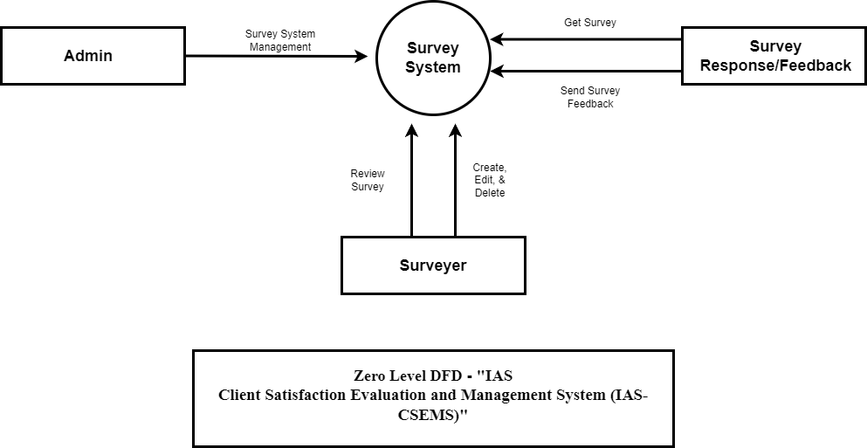
Objectives
General Objective:
To develop a web-based system for the IAS office to gather client satisfaction feedback, streamline evaluation processes, and provide efficient survey result management for administrators.
Specific Objectives:
1. To allow users to fill out survey forms online for client satisfaction evaluation.
2. To provide administrators with real-time access to survey results and analytics.
3. To ensure that survey responses are securely stored and easily retrievable.
4. To improve decision-making processes through detailed reporting of survey data.
5. To create a user-friendly interface for both users and administrators to enhance accessibility.
Data Flow Diagram

Slide 7
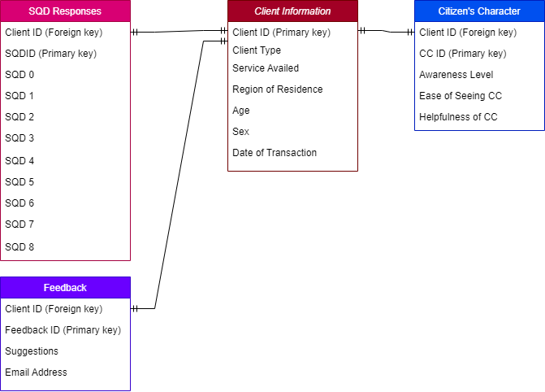
General Objective:
To develop a web-based system for the IAS office to gather client satisfaction feedback, streamline evaluation processes, and provide efficient survey result management for administrators.
Specific Objectives:
1. To allow users to fill out survey forms online for client satisfaction evaluation.
2. To provide administrators with real-time access to survey results and analytics.
3. To ensure that survey responses are securely stored and easily retrievable.
4. To improve decision-making processes through detailed reporting of survey data.
5. To create a user-friendly interface for both users and administrators to enhance accessibility.
Data Flow Diagram
ERD & DATA DICTIONARY

Slide 8

Data Flow Diagram
ERD & DATA DICTIONARY

Slide 9
ERD & DATA DICTIONARY

