Slide 1
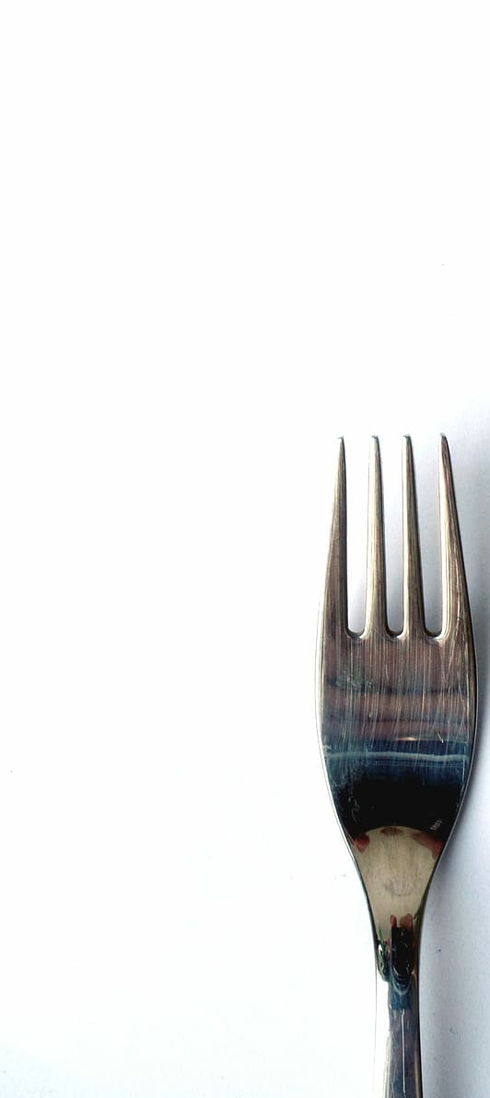
NYC RESTAURANT INSPECTION
How does the grading system impact the operational trajectory of new restaurants?

Slide 2
Methodologies
References
Sources
pandas, matplotlib,seaborn
Data cleaning
Descriptive statistics
Grouping
Filtering Data
211687 rows 27 columns
https://data.cityofnewyork.us/Health/DOHMH-New-York-City-Restaurant-Inspection-Results/43nn-pn8j
Department of Health and Mental Hygiene (DOHMH)
https://www.nyc.gov/site/doh/about/about-doh.page

Slide 3
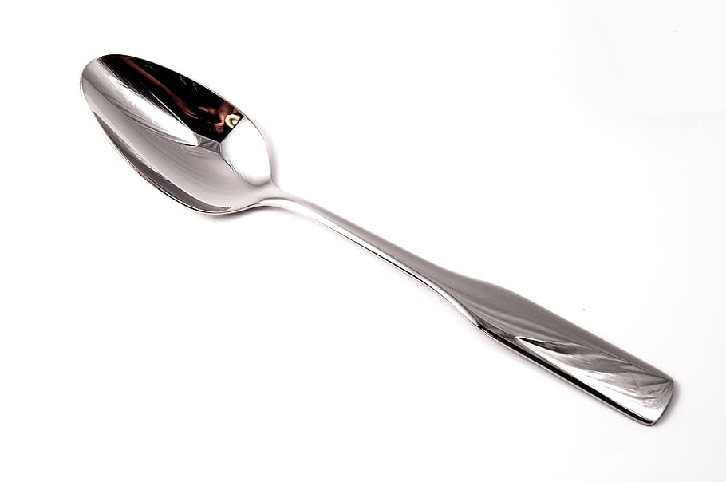
How the DOHMH grade restaurants?
INSPECTION
SCORE
GRADE
Gradable inspections
INSPECTION TYPE
Cycle Inspection/Initial Inspection.
Cycle Inspection/Re-Inspection,
Pre-Permit (Operational)/Initial Inspection.
Pre-Permit (Operational)/Re-Inspection)
POINTS FOR VIOLATIONS
14 points or less= “A” grade
14-27 “B” grade and a “Grade Pending”
28 “C” grade and a “Grade Pending” card
• N= Not Yet Graded
• A = Grade A
• B = Grade B
• C = Grade C
• Z = Grade Pending
• P=Grade Pending issued on re-opening following an initial inspection that resulted in a closure
W= WAITING (fill NaN )
Department of Health and Mental Hygiene (DOHMH)

Slide 4
What were the trends in both first inspections and re-inspections in NYC over the past 3 years?
Two-step inspection process.
Opportunity for restaurants who do not receive an A
Re-inspection occurs no less than 7 days after the initial inspection.
Average visits
Visits without GRADE in Initial Inspection
2021 | 0.78
2022 | 3.35
2023 | 3.36
Year | Visits | W | %
2021 | 10,831 | 7,015 | 64.7%
2022 | 52,149 | 35,473 | 68%
2023 | 41,286 | 23,487 | 56%
FIRST INSPECTION
Initial Inspection
114681
Re-inspection
37083
211,687 Inspections
55% Grade NaN values

Slide 5
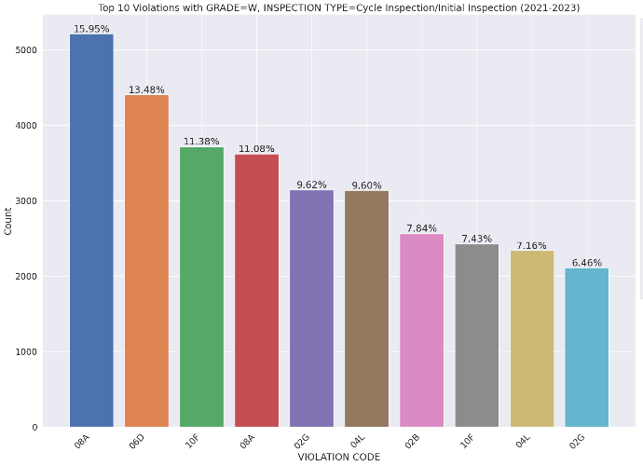
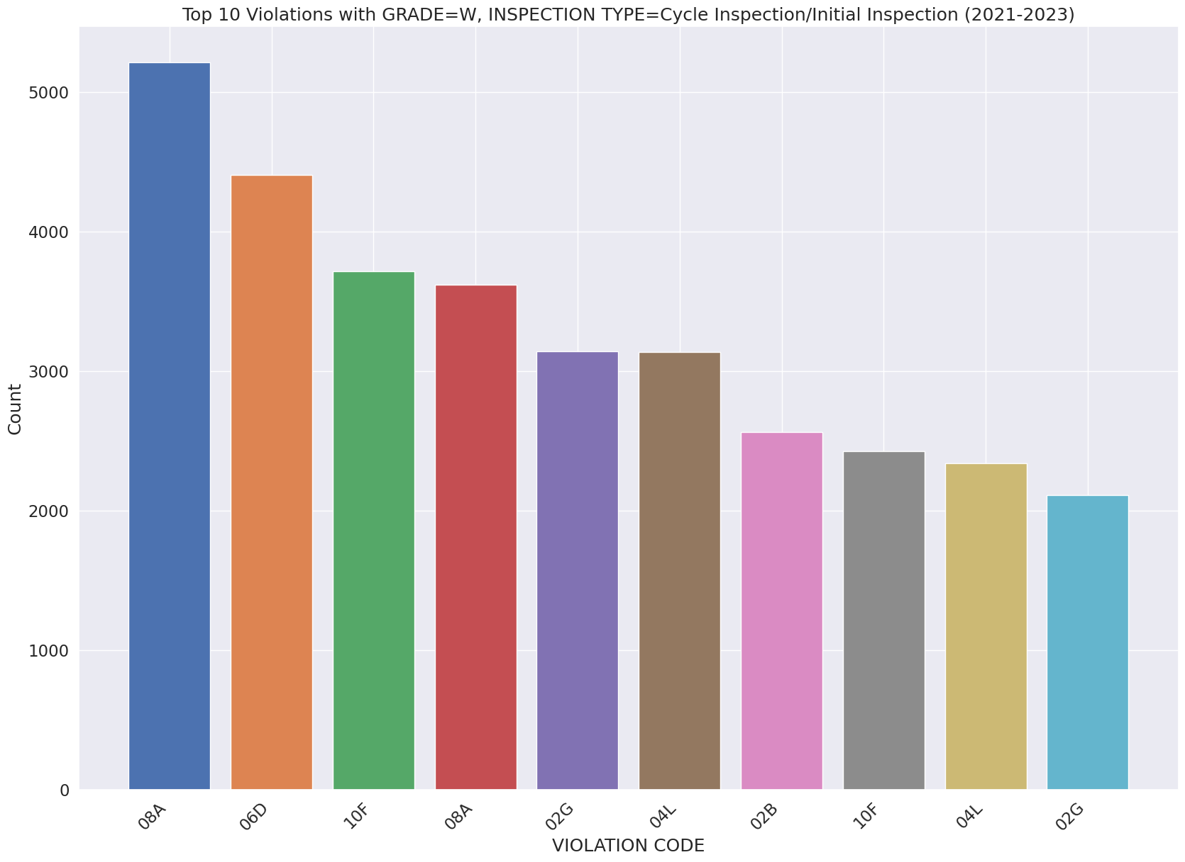
Are there specific violations that commonly occur and may prevent a restaurant from receiving a grade during the initial inspection?
VIOLATION DESCRIPTION
Establishment is not free of harborage or conditions conducive to rodents, insects or other pests.
Food contact surface not properly washed, rinsed and sanitized after each use and following any activity when contamination may have occurred.
Facility not vermin proof. Harborage or conditions conducive to attracting vermin to the premises and/or allowing vermin to exist.
Non-food contact surface or equipment made of unacceptable material, not kept clean, or not properly sealed, raised, spaced or movable to allow accessibility for cleaning on all sides, above and underneath the unit.
Cold TCS food item held above 41 °F; smoked or processed fish held above 38 °F; intact raw eggs held above 45 °F; or reduced oxygen packaged (ROP) TCS foods held above required temperatures except during active necessary preparation.
Evidence of mice or live mice in establishment's food or non-food areas.
Evidence of mice or live mice present in facility's food and/or non-food areas.
Non-food contact surface improperly constructed. Unacceptable material used. Non-food contact surface or equipment improperly maintained and/or not properly sealed, raised, spaced or movable to allow accessibility for cleaning on all sides, above and underneath the unit.
Hot TCS food item not held at or above 140 °F.
Cold food item held above 41º F (smoked fish and reduced oxygen packaged foods above 38 ºF) except during necessary preparation.

Slide 6
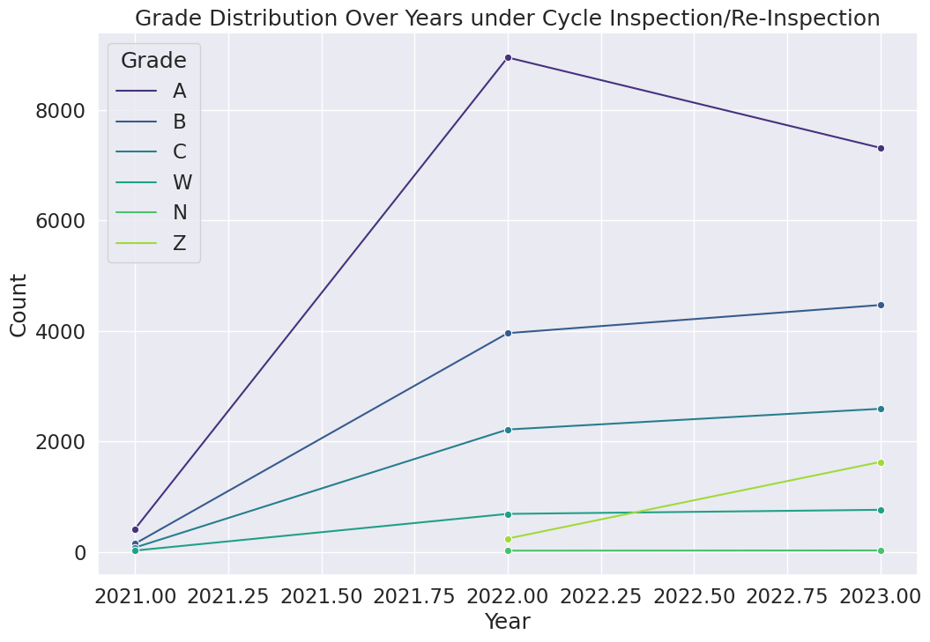
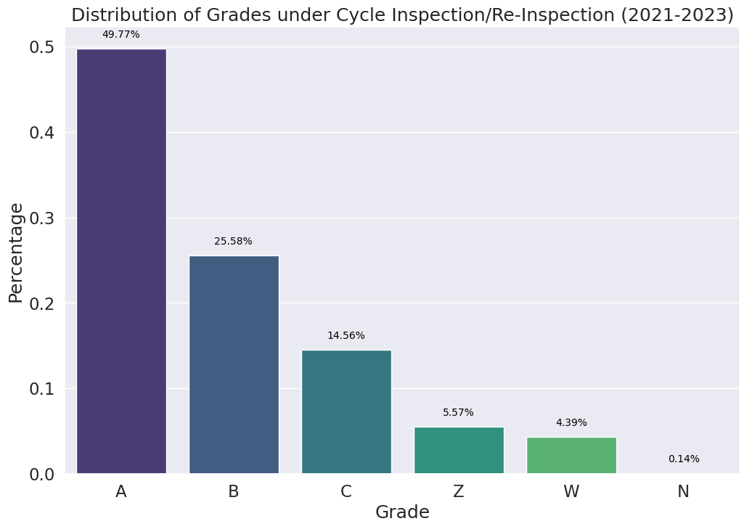
GRADES AFTER RE-INSPECTION

Slide 7

Conclusion
Many grading changes occur post-re-inspection due to adjudication.
Certain violations may hinder immediate grading upon the first inspection.
Some restaurants undergo over 10 inspections annually, emphasizing scrutiny.
It's important to note that not all inspections result in a grade assignment.
This understanding is crucial for a comprehensive perspective on restaurant evaluations.
Low scores don't guarantee an A grade; re-inspections may influence final outcomes.
Carlos Arellano Gallegos

