Slide 1

Activitar
A comprehensive gym management system with distinct interfaces for admins, trainers, and clients. The system facilitates gym scheduling, trainer-client interactions, and includes a store for supplements and equipment as well as a workout page for trainers to share routines with trainees.

Slide 2
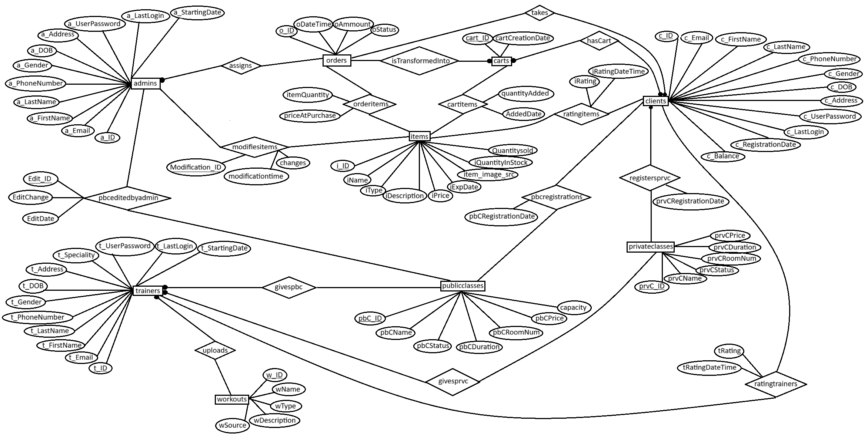
ER diagram

Slide 3
ACTIVITAR USERS
01
02
03
GYM CLIENTS
GYM ADMINS
FITNESS TRAINERS
Charelle Yazbeck 11936f
Client side
Jana Tarhini 11961f
Mahdi Assaad 11943f
Admin dashboard
Ali Ibrahim 11958f
Powerpoint
Database
Trainer dashboard
Store

