Slide 1
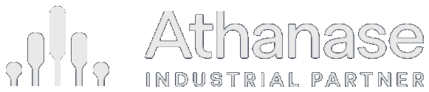
Investor Presentation
June 2026

Slide 2

Overview
Table of contents
Part I · The opportunity
Part III · Your portfolio
3 Passive has become a concentrated bet
4 From passive risk to active opportunity
5 What AI changes — and what it can’t
6 The inefficiency Athanase harvests
7 Why mid-market is the sweet spot
8 Why mid-caps are more often mispriced
9 Why this opportunity isn’t arbitraged away
Part II · Why Athanase
10 Athanase at a glance
11 Why Athanase is best built to capture it
12 Operators and investors in one team
13 The people behind the track record
14 We buy hidden cores, not broken companies
15 The ownership playbook
16 Why the specialist, not the household name
17 A complement to global equities
18 Built for down markets
19 Lower downside risk compounds
20 What it does to your portfolio
21 What a blend does to the whole portfolio
Appendix · Track record
22 Outperformance with downside protection
23 Independently validated: 20 years, net of fees
Strictly confidential 2

Slide 3
Market Context
Passive has become a concentrated bet
A cap-weighted index puts the most money into the stocks that have already risen the most — concentration and factor risk dressed as diversification.
~38%
of the S&P 500 in its
10 largest stocks*
~33%
in the “Magnificent
Seven” alone*
~50 yrs
since US equity was
this concentrated*
› Cap-weighting buys high by design. The more a stock rises, the more of it you must own — the opposite of buy-low discipline.
› A concentrated factor bet. The “diversified” index is now a leveraged position in large-cap growth, momentum and a single theme (AI) — not diversification.
› Breadth is fragile. A stumble in a handful of mega-caps now moves the entire index; the rest of the market has been left behind.
*Illustrative, recent data (2024–25); source: S&P Dow Jones Indices. Index concentration and factor tilts change over time.
Strictly confidential 3

Slide 4
Market Context
From passive risk to active opportunity
An expensive, concentrated, passive-dominated market is exactly the environment active management is built for — and as analysis itself commoditises, the most durable edge is ownership, not stock-picking.
1 · The setup
2 · Why active now
3 · A better kind of active
Expensive equities, record index concentration, and price-insensitive passive flows that inflate the most crowded names.
Wider mispricing and dispersion; valuation discipline is rewarded again. The “active underperforms” critique is cyclical — and weakest in exactly this market.
Other genuine edges exist — quant and specialist alpha — but they compete on analysing the same public data, which is what commoditises fastest. The most durable edge is ownership: buying mispriced businesses and changing the outcome.
→
→
When the index is the crowded, expensive, fragile trade, the answer is not to pick stocks and hope — it is to own undervalued businesses and make them better. That is engaged ownership.
Strictly confidential 4

Slide 5
The Proposition
Table 1
What AI changes — and what it can’t
As machine analysis becomes ubiquitous, information-based edges are competed away faster. Engaged ownership creates the change rather than reads it — the least commoditised style.
Investment style
How AI changes it
Effect on the edge
Quantitative / factor
Known signals are replicated and arbitraged at machine speed.
More crowded — published factors already fade ~58% post-publication (McLean & Pontiff, 2016).
Growth & value (fundamental)
LLMs already match or beat analysts at predicting the direction of earnings (Kim, Muhn & Nikolaev, 2024).
The analytical edge commoditises; the crowd grows and the edge thins.
Passive / index
Method unchanged — but more capital chases a shrinking pool of active alpha.
Concentration and reflexivity risk rise (see p.3).
Engaged ownership
Alpha comes from changing the earnings trajectory from a board seat — not from reading public data faster. AI augments our sourcing and diligence; it can’t replicate access, influence or execution.
Least commoditised — the edge is created, not discovered.
When everyone can analyse, analysis stops being an edge. The durable edge is the one AI can’t run — changing the company itself.
Strictly confidential 5

Slide 6
Market Opportunity
Figure 1
The inefficiency Athanase harvests
Corporate decay is structural — it continuously recreates low-risk, high-return entry points.
› Duration mismatch. CEOs run 7–8 year defensive cycles while moats erode at hyper-speed; an 80%-correct strategy decays to ~50% efficient.
› The prestige trap. Empire-building and the sunk-cost fallacy lead management to double down on unprofitable ventures.
› Shareholder exhaustion. As patience runs out, price hits a long-term low and liquidity dries up — Athanase becomes the “buyer of last resort” at a discount.
› Low competition. Passive buys the most expensive names; active managers wait for proof; PE needs 10× the capital — leaving these bargains open.
Even an excellent team’s edge erodes as the external environment shifts.
Strictly confidential 6

Slide 7
The Opportunity
Table 2
Why mid-market is the sweet spot
Big enough to run well, small enough to change — and to grow. The engaged-ownership opportunity is richest in the middle.
Small-cap
Mid-market
Large-cap
Organisational depth
Often too thin to support a capable team
Enough structure for a real management team and processes
Deep, but layered and slow
Growth runway
Long, but fragile and under-resourced
Still long — small enough to compound for years
Largely played out; growth is incremental
Speed of change
Fast, but limited resources to execute
Operational change lands within ~1.5 years
Years to turn; entrenched complexity
Owner influence
High, but little to work with
A board seat genuinely moves the outcome
Diluted; one owner rarely shifts the agenda
Mid-market companies are run well enough to be worth owning, yet small enough that an engaged owner can still change — and grow — them.
And the opportunity set is deep and global: ~50,000 listed companies worldwide (World Federation of Exchanges, 2024); the investable MSCI ACWI IMI spans ~8,800 large-, mid- and small-cap names across 23 developed and 24 emerging markets — about 1,600 of them mid-caps (MSCI, 2024). Our €50m–€3bn target band, in markets with a stable legal system, is a large subset.
Strictly confidential 7

Slide 8
The Opportunity
Why mid-caps are more often mispriced
The companies that are easiest to improve are also the most likely to be mispriced — three structural features of the mid-market leave more value on the table.
1 · Thin analyst coverage
2 · Fewer sophisticated investors
3 · Higher earnings volatility
Far fewer sell-side analysts follow a mid-cap than a mega-cap, and many have little or no coverage at all. Less information reaches the market, so price discovery is slower and the gap between price and intrinsic value persists for longer.
The segment is too small to move the needle for the largest institutions, so it is under-owned by the most resourced investors. Pricing is set at the margin by less-informed holders — leaving more frequent, and larger, mispricings.
Mid-caps’ earnings swing more than large caps’ — they are less diversified and earlier in their growth. The market over-extrapolates each swing, over-punishing a soft quarter and widening the discount to an otherwise durable core.
Less coverage, fewer expert owners and lumpier earnings mean mid-caps are mispriced more often and by more — a deeper opportunity set of low-risk entry points for a disciplined engaged owner.
Strictly confidential 8

Slide 9
Barriers to Entry
Why this opportunity isn’t arbitraged away
Engaged ownership is hard, uncomfortable and off-mandate for most investors — so the crowd stays away and the inefficiency is never competed out. Four barriers keep the lane open.
Fear keeps the crowd on the sidelines
The skill bar is genuinely high
Most investors avoid a company while it is underperforming and wait for the turn — buying back only once results visibly improve, and the price with them. We do the opposite: we buy at the point of maximum doubt and create the improvement ourselves.
It takes three things at once — operating credibility, deep investment experience, and the psychological strength to convince a board and fellow shareholders you are right. Few managers have all three, so few can even attempt it.
Career risk — and the wrong mandate
They misread the discount
Voicing a public or private view on what a company must do carries real career risk; the typical, risk-averse equity manager would rather stay quiet. And most funds have no mandate to engage at all — they simply vote with their feet and sell.
The crowd assumes a cheap, troubled company is even worse than it looks — and is often right. We play a different game: we buy good businesses hidden inside a poorly-run structure — quality at a discount, not a value trap.
Each barrier filters out the typical manager; together they keep the opportunity uncrowded — and clearing all four at once is exactly what our combination of operating and investing experience is built to do.
Strictly confidential 9

Slide 10
Overview
Athanase at a glance
38
investments as
engaged owners
19%
avg annualised NET,
any entry month*
7%
worst-ever entry,
still positive*
18×
growth of capital
since 2006
› ~19% average annualised return* whatever month you invested and held to today — entry timing has barely mattered.
› ~7% in the single worst entry month even the unluckiest possible entry still compounded at a mid-single-digit net return — no investor lost over the holding period.
› 16.3% time-weighted NET since 2006 vs MSCI IMI 6.2% — net of all fees.
*Average of the annualised NET return earned investing in each individual month and holding to the end (107 entry months, AIPFII). Time-weighted figure annualised over actual invested time. Past performance is not indicative of future results.
Strictly confidential 10

Slide 11
Why Athanase
Why Athanase is the firm best built to capture this inefficiency
Harvesting this mispricing takes four capabilities at once — find the hidden core, win real control, fix it from the boardroom, and prove it repeats. Few managers have one; we have built all four.
1 · We find what others miss
2 · We can actually change it
› A proprietary universe — ~60,000 companies restated to economic reality, separating the profitable core from the value-destroying pivot.
› Moat- and CEO-scored — ~20,000 names ranked; about 1 in 1,000 screened is ever bought.
› Hidden cores, not broken companies — market leaders attractive even if we change nothing — no adverse selection.
› An operator’s edge, not an analyst’s — one integrated team for 20 years; 30+ public board seats; former CEOs and CIOs.
› Control from the boardroom — the experience to fix capital allocation, M&A and focus — not merely to advise.
› The edge AI cannot replicate — access, influence and execution, not reading public data faster.
3 · We own the lane others abandoned
4 · And we have proven it repeats
› The mid-market sweet spot — €50m–€3bn, where a single board seat genuinely moves the outcome.
› Uncontested by the giants — mega-cap activists left it behind as they scaled: high return, low competition.
› Control by agreement — we invest only after securing agreement on board engagement with the other shareholders.
› 19% net p.a., capital grown 18×, 7% worst-entry record — through two full market cycles, net of every fee.
› 92% deal-level hit rate (35 of 38) — a 5× MOIC roughly every two years: skill, not luck.
› 93% up / 43% down capture — we harvest the inefficiency and protect the downside.
Strictly confidential 11

Slide 12
Our Edge
Operators and investors in one team
The rare combination behind our model: we have run real companies as chief executives — industrial conglomerates, consumer durables and services — and invested with this exact playbook, driving operating change from the boardroom, for 20 years.
1992
1996
2006
2015
Öresund
Custos
Creades
Athanase
› We have run the companies, not just modelled them. Former CEOs and senior operators of industrial, consumer-durables and services businesses — we have sat in the chief executive’s seat and lived the operational “how”.
› We have invested this way for two decades. 38 companies owned and 30+ public board seats — value created by operating change through board representation, the heart of our model.
› The combination is the edge. A forensic investing lens to find the mispriced value and a C-suite operating lens to realise it — few managers have genuinely done both.
› Skin in the game. The team uses Athanase as its own investment vehicle and shares in the success economics.
› Institutional memory. Multiple market cycles together eliminate key-person risk and prevent repeating historical mistakes.
Strictly confidential 12

Slide 13
Experience
The people behind the track record
An integrated investment team — and an independent operations, finance and control function that safeguards investor capital.
INVESTMENT TEAM
Stefan Charette
Kenth Eriksson
Sven Thorén
Anders Elsell
Daniel Nyhrén
CIO & PARTNER
SENIOR PM & PARTNER
PM & PARTNER
SENIOR PM
PARTNER
CEO/CIO of Custos, Investment AB Öresund and Creades; CEO of Brokk; investment banker at Lehman Brothers and Salomon Smith Barney.
Ex-CEO of Tradimus; Senior VP, Electrolux; tech owner-operator.
Ex-PM at Adrigo, Catella, Pan Capital and Nordea.
On the team since 1996; ex-CEO/CIO of HQ Fonder; Carnegie.
On the team since 2006; ex-CFO of Global Batterier.
OPERATIONS, FINANCE & CONTROL — INDEPENDENT OF THE INVESTMENT TEAM
Malin Norrman
Grant Loon
Eva Andersson
Zetong Liu
CFO
HEAD OF FUND OPERATIONS
FUND OPERATIONS
TECHNOLOGY
Ex-COO/CFO of Captor Fund Mgmt; risk manager at Carnegie and AB Industrivärden.
Ex-COO of Madrague Capital and Port Capital; Soros, Commerzbank, Morgan Stanley.
MBA, Business School London; sales-executive background.
MSc applied & computational mathematics, KTH; projects for the Swiss Finance Institute / EPFL.
Segregation of duties protects investors: operations, valuation and risk sit apart from investment decisions — with SEB (custody), MUFG (administration) and KPMG (audit) independently verifying every NAV and fee.
Strictly confidential 13

Slide 14
Investment Strategy
Figure 2
We don’t buy broken companies — we buy hidden cores
The classic objection to activism is adverse selection. Our model inverts it.
› The critique. Buy “cheap and troubled” and you select for lemons — worse than they look. The market discounted them for a reason.
› Our precondition removes it. We invest only where the core is a market leader earning high returns on capital — attractive even if we change nothing. No structurally weak turnarounds.
› The real setup. Profitable leaders whose management pivoted into weak adjacencies — chasing growth as the core matured. A capital-allocation overlay on a good asset, not a bad asset.
› The inversion. Blended results make it look mediocre, so it is priced mediocre. The appearance understates reality.
Figure 2 · SUM-OF-THE-PARTS (ILLUSTRATIVE · CONSTANT MULTIPLE)
140
+40% hidden value
100
Market price
(blended optics)
Core alone
(high ROIIC)
The +40% is pure earnings and mix — the same multiple on a cleaner, higher-ROIIC core. Any re-rating is upside we underwrite at zero.
Strictly confidential 14

Slide 15
Ownership Model
The ownership playbook, honed over 38 investments
A repeatable sequence that turns a board seat into operational value — refocusing a good core, then growing it.
1
Secure the board seat
2
Align the thesis
3
Refocus to drive earnings
Often a precondition to invest — the nomination committee proposes an AIP director.
Collaborate with management and stakeholders to agree where the value is and what must change.
Cut overhead and admin, optimise the footprint, exit loss-making “growth-trap” ventures.
4
Reallocate to winners
5
Grow by acquisition
6
Exit
Redeploy freed-up capital into the profitable core and its strongest adjacencies; lift R&D where it pays.
Add complementary products, geographies or scale through value-accretive bolt-ons.
Realise via M&A or in the equity market once the core is refocused and compounding.
The same playbook across 38 companies — value created by fixing capital allocation, not by financial engineering or leverage.
Strictly confidential 15

Slide 16
Investment Strategy
Table 8
Why the specialist, not the household name
Recommending Athanase over a brand name is a choice for structural alpha over institutional inertia.
The household name
Athanase — the specialist
Scale & influence
$10bn+ AUM forces them into large- and mega-caps, where one owner rarely shifts the agenda and growth is incremental.
Mid-market (€50m–€3bn), where a single board seat changes the outcome — the high-return, low-competition lane the giants left behind.
Return source
Large buyouts are leveraged beta — ~0.89 correlated to small/mid equities once de-smoothed; driven by GDP, rates and multiples.
Idiosyncratic, event-driven alpha at 0.44 correlation — a genuine diversifier, not a duplicate of your equity book.
Entry & structure
A ~40% control premium up front, a 10-year blind-pool lock-up, and fees on undeployed dry powder.
Entry at “shareholder exhaustion” — the turnaround effectively for free — with daily liquidity and zero capital-call liability.
What you’re buying
A brand — but brand recognition does not compound capital.
Asymmetric capture (93% up / 43% down) and a validated 16.3% net, +7% worst-entry record — institutional process, not a logo.
Brand recognition does not compound capital — asymmetric capture does. The edge is the very lane the household names had to abandon as they scaled.
Strictly confidential 16
De-smoothed large-buyout correlation to small/mid-cap equities ~0.89 (Two Sigma / Venn, 2024; Couts, Gonçalves & Rossi, 2020; Boyer et al., 2018). Athanase correlation 0.44 (real). See references.

Slide 17
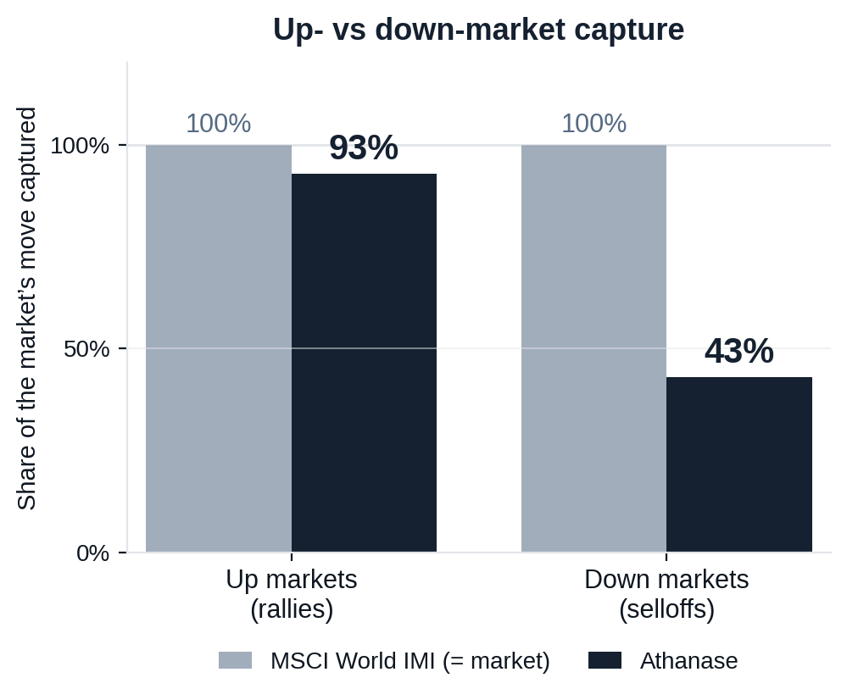
Risk-Adjusted Outcomes
Figure 7
A complement to global equities, not a duplicate
What a global-equity holder asks of a new manager: do you keep up in rallies, lose less in selloffs, and add something the index can’t?
CAPTURE ASYMMETRY
93% up / 43% down
Keeps pace with rallies but takes less than half of selloffs — the essence of the edge.
DIVERSIFICATION
0.44 correlation · 0.73 beta
Low correlation to your existing equity book — a genuine diversifier, not levered beta.
RELIABILITY OVER TIME
Beat MSCI in 90% of 5-yr and 100% of 7-yr windows
Over every rolling 7-year holding period in 20 years, Athanase out-returned the index.
Athanase captures 93% of the market’s upside but only 43% of its downside — at 0.44 correlation, it improves the whole portfolio, not just one line of it.
Strictly confidential 17
Source: monthly net returns, 235 months (2006–2025). Capture = compounded Athanase return in the market’s up/down months ÷ the market’s. Past performance is not indicative of future results.

Slide 18
Risk-Adjusted Outcomes
Built for down markets — where the record is made
The edge shows most when the market falls: a small positive return in the average down month, and outperformance in four of the last five stress years.
OUTPERFORMANCE IN STRESS YEARS
IN THE AVERAGE MONTH OF A DOWN YEAR
2008
+2.2%
+0.2%
2011
+7.9%
Athanase — a small gain in the average month of a down year.
2015
+11.8%
−1.7%
2018
−1.7%
MSCI World IMI — the market itself.
2022
+20.1%
The risk system forces diversification of business exposures and screens out weak competitive positions and untrustworthy management — which pays in demanding markets.
When the market falls, the discipline pays — outperformance in four of the last five stress years, and a gain in the average down month.
Down-year figure: average monthly return across all months of the years in which the MSCI World IMI finished down. Annual figures: AIP net return − MSCI IMI. Source: Athanase, April 2026.
Strictly confidential 18

Slide 19
Risk-Adjusted Outcomes
Table 16
Lower downside risk compounds into better outcomes
Athanase carries higher total volatility than the market — but its downside volatility is lower, which is what protects compounding.
ANNUALISED RETURN
TOTAL VOLATILITY
DOWNSIDE VOLATILITY
MSCI 6.2%
AIP 16.3%
MSCI 16.3%
AIP 27.0%
MSCI 11.5%
AIP 10.9%
↑ Athanase downside volatility is LOWER than the market’s.
EXPECTED VALUE OF 100 INVESTED, BY HOLDING PERIOD
3 years
5 years
7 years
10 years
Median outcome — MSCI
120
135
152
182
Median outcome — Athanase
157
213
287
452
Adverse case* — MSCI
99
105
114
129
Adverse case* — Athanase
133
172
223
335
Chance of a loss — MSCI
18%
11%
8%
4%
Chance of a loss — Athanase
0%
0%
0%
0%
Even in the adverse case, Athanase’s lower downside volatility leaves an investor ahead at every horizon — and the gap widens with time.
Strictly confidential 19
Source: monthly net returns, 235 months (2006–2025). *Adverse case = one downside-deviation outcome (≈1-in-6), narrowing with horizon as dd/√T. Illustrative; past performance is not indicative of future results.

Slide 20
Portfolio Impact
Figure 6
What it does to an allocator’s portfolio
Illustrative: redirecting a sleeve into Athanase rather than a long-only global fund or another activist.
Table 15. Annual uplift to TOTAL-portfolio return (bps), by sleeve size
Down-market year
523
Sleeve
vs Long-only
vs Other activist
3%
+31 bps
+23 bps
5%
+52 bps
+38 bps
8%
+83 bps
+60 bps
Athanase: holds
271
HOW THE PATH IS EARNED
Long-only: −19%
208
The smooth line is not won by chasing rallies. On average monthly returns (p.18), Athanase roughly matches the market up (1.2% vs 1.3%) but protects sharply down (+0.2% vs −1.7%).
Losing less in the down months — not winning more up — is what compounds the lines apart: a steadier path, not just a higher one.
Illustrative only; not a projection. Athanase 18% (headline net IRR); other activist 10.5%; long-only 7.6% (MSCI IMI). Uplift = sleeve × return spread; growth = annual compounding. Past performance ≠ future results.
Strictly confidential 20

Slide 21
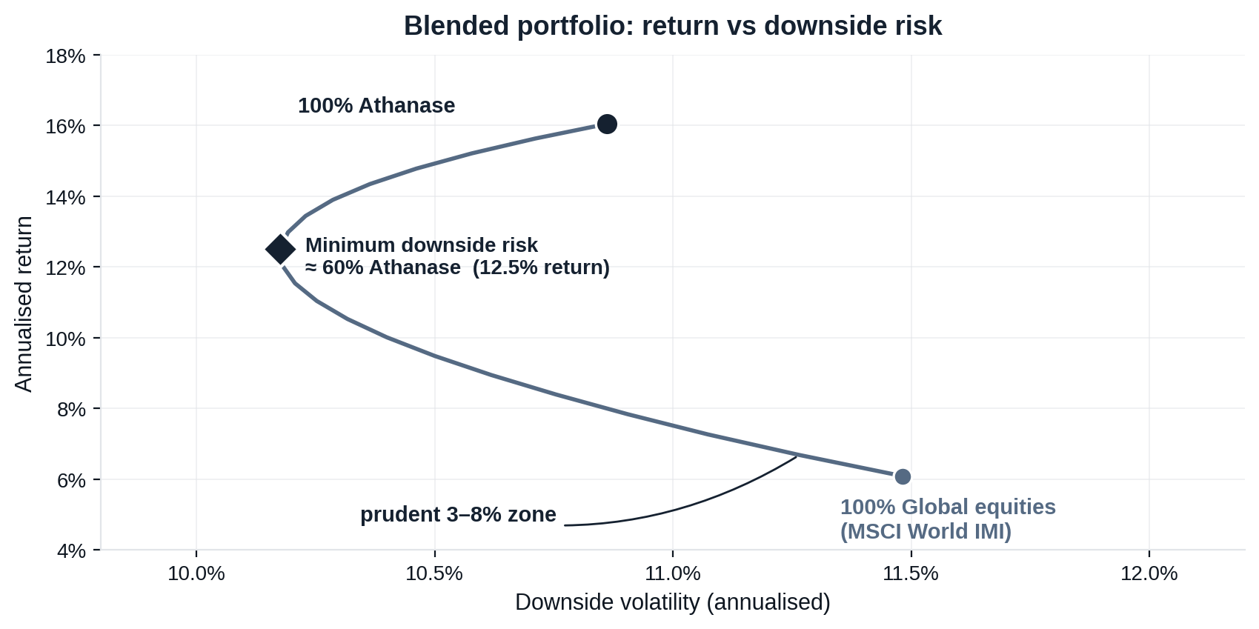
Risk-Adjusted Outcomes
Figure 8
What a blend does to the whole portfolio
Adding Athanase to a global-equity book moves the portfolio up and to the left — more return for less downside risk, thanks to low correlation.
ALL GLOBAL EQUITIES
6.1% return · 11.5% downside risk
100% MSCI World IMI
ADD A PRUDENT 8% SLEEVE
7.3% return · 11.1% downside risk
92% MSCI / 8% Athanase
HOW TO READ IT
Every blend on the curve beats holding equities alone, and the benefit keeps building until past half the portfolio (downside risk bottoms near 60%). That is a directional case to size up — within prudent limits — not a target: a 59% position would breach concentration, liquidity and the 3–8% sizing discipline. Even an 8% sleeve already moves the portfolio the right way.
The blend is not a trade-off: every allocation raises return and lowers downside risk — so to a committee this is a mathematical risk-reduction tool, not a risky bet, sized within prudent 3–8% limits.
Strictly confidential 21
Source: monthly net returns, 235 months (2006–2025), monthly rebalanced blends. The minimum-risk point is in-sample and shown for shape, not as advice. Illustrative; past performance is not indicative of future results.

Slide 22
Track Record
Figure 5
Proof: outperformance with downside protection
What downside protection means
In the market’s down months — any month the market fell — Athanase fell ~1.5% on average versus the market’s ~3.8%, losing less than half as much when it matters.
Positive when the market wasn’t
Across the six worst years for global equities, Athanase outperformed in five — and stayed positive in two: +9% in 2015 and +0.3% in 2022, while the market fell −6% and −20%.
Why it compounds
Losing less in drawdowns leaves more capital working in the recovery — the engine behind 18× growth of capital vs 3.2× for the market since 2006.
Strictly confidential 22

Slide 23
Independent Review
Independently validated: 20 years, net of every fee
A prospective LP’s investment committee reconciled the security-level (StatPro) data against the LP-level NET return series.
+1,743%
cumulative NET return
over 19.3 years
+16.3%
annualised NET
(net of all fees)
+10 pts
annualised alpha,
net, vs the market
5.8×
the relevant equity
benchmark
› Two full cycles, survived. Drawdowns of −52.8% (2008, recovered by 2010) and −45.9% (2017–2020, recovered by Sep 2020) — navigated live with the same philosophy, not back-tested.
› Top-tier downside-adjusted return. 20-year Sortino 1.54; AIPFII Sortino 2.40, with upside volatility 3.9× the downside.
› Realised cash, not marks. The largest contributors are realised LP cash — removing the mark-to-model objection.
Source: independent institutional due-diligence review, May 2026, on StatPro security-level data and LP-level NET monthly returns (2006–2026).
Strictly confidential 23

