Slide 1

Engaged Ownership as an Asset Class
Why allocators should consider it — and why Athanase
An allocator briefing · May 2026

Slide 2

Overview
Contents
Part I · Why allocate to engaged ownership
Part II · Why choose Athanase
1 Why now — the easy decade for beta is over
2 Passive has become a concentrated bet
3 Passive flows cut both ways
4 The total cost of ownership
5 From passive risk to active opportunity
6 Two ways to own actively: public or private
7 Where the allocation fits: three legitimate homes
8 A catalyst-driven source of return
9 What AI changes — and what it can’t (Table 1)
10 Aligned with horizon and fiduciary duty
11 Diversification and the total-portfolio view
12 Governance and the ESG synergy
13 Why mid-market is the sweet spot (Table 2)
14 Why mid-cap management listens
15 Why boards say yes — constructive control, not a proxy war
16 The evidence: constructive engagement works (Table 3)
17 What separates a great engaged owner
1 Team & operations
1.1 Athanase at a glance
1.2 An integrated team, 20 years together
1.3 The people behind the track record
1.4 A risk system that engineers out permanent loss (Table 4)
1.5 The ownership playbook, honed over 38 investments
2 The opportunity & our edge
2.1 The inefficiency Athanase harvests (Figure 1)
2.2 We don’t buy broken companies — we buy hidden cores (Figure 2)
2.3 Quality-core constructivism — how we differ (Table 5)
2.4 We don’t need to be right more than ~50% (Table 6)
2.5 The same playbook as mid-market PE — without its costs (Table 7)
2.6 Why the specialist, not the household name (Table 8)
3 How we invest
3.1 How decisions are made: three tollgates, clear owners
3.2 Sourcing & screening: from ~20,000 to a shortlist (Figure 3)
3.3 Due diligence: is the competitive position durable?
3.4 Research & due diligence: four analytical steps
3.5 Decision, execution and board engagement
3.6 Constructive by design — agreement before capital
3.7 Walking away is a mechanic, not a mood
3.8 Evaluating the board and management — before we commit
3.9 In the boardroom: consensus, one conversation at a time
3.10 How we use AI — and why it widens our edge
4 Risk, honestly
4.1 A risk system built to avoid permanent loss
4.2 Which risks we are trying to avoid — and why (Table 9)
4.3 Diversification by design: the risk limits (Table 10)
4.4 How risk is governed: who decides, and when
4.5 The visible risks are the engine — not the cost
4.6 Restructuring, honestly — and the headline question
4.7 Earnings compound the value — re-rating is upside we don’t need
4.8 When the thesis breaks: determined, not forced
4.9 A non-linear path — honestly priced (Figure 4)
4.10 Risk reframing for the investment committee (Table 11)
4.11 Why an allocation here is not career-ending
5 The 20-year track record
5.1 Proof: outperformance with downside protection (Figure 5)
5.2 AIP Fund II — transactions (2015–present) (Table 12)
5.3 Prior period — transactions (2006–2014) (Table 13)
5.4 Earlier deals — part of the team (1996–2006) (Table 14)
5.5 Independently validated: 20 years, net of every fee
5.6 Repeatable and conviction-sized — not lucky
5.7 Why a non-linear path won’t get you fired
6 What it means for your portfolio
6.1 What it does to an allocator’s portfolio (Figure 6)
6.2 Lower downside risk compounds into better outcomes (Table 16)
6.3 A complement to global equities, not a duplicate (Figure 7)
6.4 A drawdown you can actually defend
6.5 What a blend does to the whole portfolio (Figure 8)
7 Versus private equity
7.1 What allocators actually earn from private equity (Table 17)
7.2 Switching a private-equity sleeve into Athanase (Figure 9)
7.3 The volatility gap is settled in the literature (Figure 10)
7.4 Same headline volatility — far lower real risk (Figure 11)
7.5 PE’s “diversification” is an artefact — Athanase’s is real (Figure 12)
7.6 When the tide goes out: the drawdown trap
7.7 Responsible ownership, by construction
Strictly confidential 1

Slide 3
PART I · THE ASSET CLASS
Why allocate to engaged ownership

Slide 4
Market Context
1 Why now — the easy decade for beta is over
Equities are expensive on almost every measure, and the disinflation and zero-rate tailwind that lifted all assets has reversed.
EXPENSIVE ON MOST MEASURES
Shiller CAPE near ~36× — close to the dot-com extreme, and roughly double the long-run ~17×.
Forward P/E ~22× against a ~16× long-run average; the equity risk premium is compressed to multi-decade lows.
Most of the 2010s’ return came from re-rating — paying more per dollar of earnings — not earnings growth. That lever is largely spent.
THE MACRO TAILWIND HAS REVERSED
The zero-rate, disinflationary backdrop that lifted every asset for a decade has reversed.
Deglobalisation, fiscal deficits and demographics point to structurally higher inflation and rates — higher for longer.
A higher cost of capital compresses valuations and punishes long-duration, unprofitable growth — the opposite of the last cycle.
Whether or not AI-driven productivity lifts returns, beta is priced for perfection and the easy tailwind has shifted — so idiosyncratic, valuation-disciplined returns matter more, not less.
Illustrative, recent data (2024–25); sources: R. Shiller (Yale) CAPE; S&P Dow Jones Indices; consensus forward earnings. Valuations move — the regime, not the decimal, is the point.
Strictly confidential 2

Slide 5
Market Context
2 Passive has become a concentrated bet
A cap-weighted index puts the most money into the stocks that have already risen the most — concentration and factor risk dressed as diversification.
~38%
of the S&P 500 in its
10 largest stocks*
~33%
in the “Magnificent
Seven” alone*
~50 yrs
since US equity was
this concentrated*
› Cap-weighting buys high by design. The more a stock rises, the more of it you must own — the opposite of buy-low discipline.
› A concentrated factor bet. The “diversified” index is now a leveraged position in large-cap growth, momentum and a single theme (AI) — not diversification.
› Breadth is fragile. A stumble in a handful of mega-caps now moves the entire index; the rest of the market has been left behind.
*Illustrative, recent data (2024–25); source: S&P Dow Jones Indices. Index concentration and factor tilts change over time.
Strictly confidential 3

Slide 6
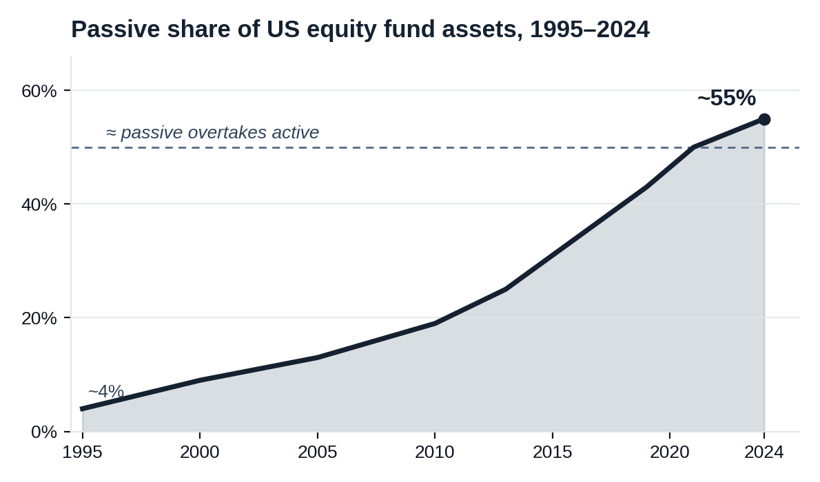
Market Context
3 Passive flows cut both ways
Index buying has grown from a niche to the majority of US equity fund assets — and the same price-insensitive mechanics can force selling on the way down.
WHY IT CUTS BOTH WAYS
Markets are inelastic — a $1 flow can move aggregate value by ~$5; flows increasingly set the level (Gabaix & Koijen, 2021).
ETFs raise the volatility of the stocks they hold (Ben-David et al., 2018); index inclusion inflates prices and comovement (Wurgler, 2011).
The reported passive share understates the true price-insensitive base (Chinco & Sammon, 2024).
The multiplier runs in reverse: if flows slow, the most-owned mega-caps face mechanical selling — with few price-sensitive buyers left to absorb it.
The concentration that flattered index returns on the way up is a forced-seller overhang on the way down — a risk you do not carry when returns come from company-specific change, not from flows.
Strictly confidential 4
Passive share approximate; sources: ICI, Morningstar (index funds + ETFs as a share of US equity fund assets). Research citations in references.

Slide 7
Market Context
4 The total cost of ownership
The quoted fee is the smallest, most visible layer — the real cost of owning the index is a multiple of it, and largely undisclosed.
MEASURABLE ANNUAL DRAG
FURTHER, HARDER-TO-SEE COSTS
› 3–9 bps the headline expense ratio — all you are quoted.
› ~20–80 bps/yr index reconstitution / front-running (Petajisto, 2011).
› ~30 bps+ unrecovered foreign dividend-withholding tax on international holdings — more for emerging markets.
› $1–2 bn/yr transferred to arbitrageurs at index changes (Chen, Noronha & Singal, 2006).
› Tracking difference — funds lag the index by more than their fee.
› Bid-ask spread & market impact on every trade and every rebalance.
› Cash drag from the uninvested buffer, in rising markets.
› Premium / discount to NAV — widens exactly when you need to sell.
› Securities lending — revenue give-up and counterparty risk; it also supplies short-sellers.
› Liquidity illusion / fire-sale risk in illiquid underlyings (Ben-David et al., 2018).
› Capital-gains overhang in index mutual funds.
Quoted at a few basis points, the true cost runs into the tens — before the biggest cost of all: paying peak prices for the most crowded companies. That is what valuation-disciplined, idiosyncratic ownership is paid to avoid.
Strictly confidential 5
Peer-reviewed: Petajisto (2011); Chen, Noronha & Singal (2006); Ben-David et al. (2018). Withholding and other costs are structural/illustrative and vary by fund, domicile and period. See references.

Slide 8
Market Context
5 From passive risk to active opportunity
An expensive, concentrated, passive-dominated market is exactly the environment active management is built for — and as analysis itself commoditises, the most durable edge is ownership, not stock-picking.
1 · The setup
2 · Why active now
3 · A better kind of active
Expensive equities, record index concentration, and price-insensitive passive flows that inflate the most crowded names.
Wider mispricing and dispersion; valuation discipline is rewarded again. The “active underperforms” critique is cyclical — and weakest in exactly this market.
Other genuine edges exist — quant and specialist alpha — but they compete on analysing the same public data, which is what commoditises fastest. The most durable edge is ownership: buying mispriced businesses and changing the outcome.
→
→
When the index is the crowded, expensive, fragile trade, the answer is not to pick stocks and hope — it is to own undervalued businesses and make them better. That is engaged ownership.
Strictly confidential 6

Slide 9
Active Ownership
6 Two ways to own actively: public or private
The same operational value creation is available in both private equity and public markets — but the public route keeps what private gives up.
Private — PE / buyout
Public — engaged ownership
How you act
Buy and control the whole company
Take a board seat and real influence
Entry price
A ~40% control premium, up front
Market price — often at a discount
Liquidity
A 10-year lock-up; blind-pool capital calls
Daily liquidity; exit at any time
Pricing
Smoothed quarterly appraisal marks
Honest daily market prices
Fees
2 & 20, plus fees on idle dry powder
Lower, on capital actually deployed
The value engine
Board-led operational improvement
The same — board-led operational improvement
Both are active ownership. The public route captures the same value creation while keeping liquidity, transparency and lower fees — and skips the control premium and the lock-up (Part II quantifies this).
Strictly confidential 7

Slide 10
Portfolio
7 Where the allocation fits: three legitimate homes
Engaged ownership does not need a bucket of its own. It can be funded from public equity, event-driven hedge funds or private equity — each defensible, depending on what it replaces.
Public equity
Event-driven hedge funds
Private equity
THE LENS
A concentrated, active equity sleeve — long-only public companies with daily pricing and full transparency.
WHY FUND IT HERE
Adds idiosyncratic, governance-driven alpha to a beta-dominated equity book, while keeping liquidity, transparency and low fees inside an existing equity mandate.
THE TRADE-OFF
Higher active risk than an index sleeve — it is meant to differ from the benchmark.
THE LENS
A catalyst strategy — returns come from proxy contests, board change, spin-offs, M&A and capital-return programmes, not market direction.
WHY FUND IT HERE
The return driver is event-specific and largely independent of rates and growth; it diversifies an absolute-return book and matches how the alpha is actually generated.
THE TRADE-OFF
More concentrated and longer-horizon than a typical multi-strategy fund; positions are owned outright, not hedged.
THE LENS
PE-style value creation — board influence, operational improvement and multi-year holds — executed in public markets.
WHY FUND IT HERE
The same engaged-ownership return engine as private equity, but with public-market liquidity, daily transparency, lower fees and no J-curve or lock-up.
THE TRADE-OFF
Marked to market daily — honest volatility instead of smoothed quarterly appraisals (see Part II).
The same strategy, three valid homes — fund it wherever engaged ownership is the better risk-adjusted alternative to what it replaces.
Strictly confidential 8

Slide 11
The Proposition
8 A catalyst-driven source of return
Engaged owners change the outcome — they do not merely absorb underperformance.
› ~7% announcement return. Average abnormal return around an activist filing, with no reversal over the following year; success or partial success in ~two-thirds of campaigns (Brav, Jiang, Partnoy & Thomas, 2008).
› ~10.2% around the 13D, plus a further ~11.4% over the next year for engaged-owner targets (Klein & Zur, 2009).
› No long-term give-back. ~2,000 interventions show no negative drift and no “pump-and-dump” (Bebchuk, Brav & Jiang, 2015).
› Real, not financial, value. Production efficiency improves in the three years after intervention (Brav, Jiang & Kim, 2015).
› Idiosyncratic alpha. Returns tied to a specific change at a specific company — scarce in a beta-dominated portfolio.
Strictly confidential 9

Slide 12
The Proposition
Table 1
9 What AI changes — and what it can’t
As machine analysis becomes ubiquitous, information-based edges are competed away faster. Engaged ownership creates the change rather than reads it — the least commoditised style.
Investment style
How AI changes it
Effect on the edge
Quantitative / factor
Known signals are replicated and arbitraged at machine speed.
More crowded — published factors already fade ~58% post-publication (McLean & Pontiff, 2016).
Growth & value (fundamental)
LLMs already match or beat analysts at predicting the direction of earnings (Kim, Muhn & Nikolaev, 2024).
The analytical edge commoditises; the crowd grows and the edge thins.
Passive / index
Method unchanged — but more capital chases a shrinking pool of active alpha.
Concentration and reflexivity risk rise (see §2–3).
Engaged ownership
Alpha comes from changing the earnings trajectory from a board seat — not from reading public data faster. AI augments our sourcing and diligence; it can’t replicate access, influence or execution.
Least commoditised — the edge is created, not discovered.
When everyone can analyse, analysis stops being an edge. The durable edge is the one AI can’t run — changing the company itself.
Strictly confidential 10

Slide 13
The Proposition
The AI monoculture: machine-run portfolios crowd and decay
A growing body of research models the mechanism: as managers adopt similar AI, they herd into the same trades — eroding market depth, crowding factors and accelerating alpha decay. Engaged ownership sits outside the monoculture.
Algorithmic monoculture
Strategy convergence
High AI penetration makes managers share a common signal and herd into the same trades; correlated pressure erodes market depth, drives down fundamental values and amplifies systemic risk.
Agents trained on overlapping data and rewarded on similar objectives synchronise; order books thin and AI-strategy returns decay rapidly.
Meng & Chen, 2026
Tran, 2026
Algorithmic coherence
Factor crowding
LLM-augmented investors adopt comparable trade logic, crowding the same risk-premia, distorting price discovery and amplifying volatility through reflexive loops.
LLM agents generate highly redundant factors — so managers select the same stocks on the same signals, cannibalising each other’s returns.
Gimmelberg, 2025
Han et al., 2026
The more the market runs on the same machines, the more it converges on one trade — and the faster that edge decays. Changing the company is the edge no shared model can copy.
Strictly confidential 11

Slide 14
Fit
10 Aligned with horizon and fiduciary duty
› Patient capital wins. Board seats, strategic reviews and turnarounds play out over years — perpetual endowments and long-dated pensions can hold through to full value realisation.
› Stewardship is the duty. Engaged ownership expresses fiduciary obligation (UK Stewardship Code; UN PRI) rather than conflicting with it.
› Mission alignment. Demanding accountability and good governance reflects institutional values and is defensible to beneficiaries.
› Engagement as risk management. Turns hidden governance risk in the portfolio into a remediable, return-generating exposure.
Strictly confidential 12

Slide 15
Portfolio
11 Diversification and the total-portfolio view
› A distinct return engine. Alpha driven by proxy contests, spin-offs and capital-return programmes — largely independent of rates, growth and inflation.
› Diversifies the equity book. Small- and mid-cap value and special situations, typically underweight in institutional portfolios.
› Counter-cyclical dry powder. Dislocations create the next targets; patient capital deploys into weakness rather than selling it.
› PE-style upside, public-market terms. Operational engagement with daily pricing, transparency, lower fees and better liquidity.
Strictly confidential 13

Slide 16
Stewardship
12 Governance and the ESG synergy
› Applied governance. Board independence, pay-for-performance and capital discipline are the “G” of ESG put into practice.
› Constructive engagement. Return and stewardship objectives expressed through one allocation, disciplined by a value thesis.
› A positive externality. Governance precedents improve the quality of the beta the whole portfolio owns.
› Defensible to stakeholders. “We own companies and make them better-run and more valuable” is an easy story to tell.
Strictly confidential 14

Slide 17
The Opportunity
Table 2
13 Why mid-market is the sweet spot
Big enough to run well, small enough to change — and to grow. The engaged-ownership opportunity is richest in the middle.
Small-cap
Mid-market
Large-cap
Organisational depth
Often too thin to support a capable team
Enough structure for a real management team and processes
Deep, but layered and slow
Growth runway
Long, but fragile and under-resourced
Still long — small enough to compound for years
Largely played out; growth is incremental
Speed of change
Fast, but limited resources to execute
Operational change lands within ~1.5 years
Years to turn; entrenched complexity
Owner influence
High, but little to work with
A board seat genuinely moves the outcome
Diluted; one owner rarely shifts the agenda
Mid-market companies are run well enough to be worth owning, yet small enough that an engaged owner can still change — and grow — them.
And the opportunity set is deep and global: ~50,000 listed companies worldwide (World Federation of Exchanges, 2024); the investable MSCI ACWI IMI spans ~8,800 large-, mid- and small-cap names across 23 developed and 24 emerging markets — about 1,600 of them mid-caps (MSCI, 2024). Our €50m–€3bn target band, in markets with a stable legal system, is a large subset.
Strictly confidential 15

Slide 18
The Opportunity
14 Why mid-cap management listens
The structural reason engaged ownership works here: capable operators with predictable blind spots, and the room to act on good advice.
THE BLIND SPOT
Mid-cap CEOs are usually promoted from sales or operations — strong in their domain, first-time chief executives
They have not run capital allocation, M&A, financing or board strategy before — predictable, correctable gaps
They know it — so credible, experienced owners are welcomed, not resisted, unlike at entrenched large-caps
WHAT IT MEANS FOR AN ENGAGED OWNER
A board seat is genuinely productive — advice is acted on, not filtered through layers
Change is collaborative, not a proxy fight — faster, cheaper, less headline risk
The owner supplies exactly the missing experience: capital discipline, focus and a wider strategic lens
Capable management with a known blind spot, in a company small enough to change: the conditions under which engaged ownership compounds.
Strictly confidential 16

Slide 19
The Opportunity
15 Why boards say yes — constructive control, not a proxy war
Four structural reasons mid-cap boards adopt the plan — the same edge Cevian, ValueAct and TCI built, applied where it meets the least resistance.
The capital-allocation blind spot
Industrial-peer credibility
Mid-cap CEOs are first-time chiefs promoted from operations or sales — they have rarely run M&A, financing or portfolio capital allocation. Firms systematically misallocate across divisions and are slow to correct it (Scharfstein & Stein, 2000; Lindlbauer, 2025) — a real, correctable gap they know they have.
The owner arrives as a 20-year operator who speaks ROIC, ROIIC and operations — not a financial engineer. Met as a peer who supplies the missing experience, defensiveness gives way to collaboration.
The board seat is the start, not a threat
We fund their best business
In the Nordics the nomination committee is shareholder-led and rarely includes sitting directors — owners reshape boards without a public fight. Secured as a precondition, it is the proven, low-cost route to change (Bebchuk, Brav, Jiang & Keusch, 2020) versus the ~$10.7m and entrenchment a proxy fight triggers (Gantchev, 2013).
Quality-core constructivism: cut the loss-making “growth-trap” adjacencies and reinvest in the winning core. Management complies because we champion the part of the company they are proud of — not break up the house.
A proxy fight is expensive and breeds defenses; a board seat by agreement is faster, cheaper and collaborative — which is why ~two-thirds of engagements succeed without ever seeking control (Brav, Jiang, Partnoy & Thomas, 2008).
Strictly confidential 17

Slide 20
The Opportunity
Table 3
16 The evidence: constructive engagement works
Three decades of peer-reviewed research — across the US and Europe — converge on the same finding.
Study
What it covers
What it establishes
Brav, Jiang, Partnoy & Thomas (2008) · J. Finance
1,000+ US engagements, 2001–06
Activists “seldom seek control” and are “nonconfrontational”; ~2/3 reach full or partial success; +7% announcement return with no reversal; payout, operating performance and CEO turnover all rise.
Becht, Franks, Grant & Wagner (2017) · Rev. Fin. Studies
1,740 engagements, 23 countries
Outcomes and market responses are similar in Europe and North America — the playbook travels; board representation is a central, value-creating outcome.
Becht, Franks, Mayer & Rossi (2009) · Rev. Fin. Studies
Clinical study — Hermes UK Focus Fund
Returns come from engagement, not stock-picking — via private, cooperative interventions: refocus on the core, return cash, change the CEO / chair.
Bebchuk, Brav, Jiang & Keusch (2020) · J. Fin. Economics
US settlement agreements
Boards settle by granting board seats — the intermediary step to the operational and leadership change activists seek. Exactly the precondition model.
Gantchev (2013) · J. Fin. Economics
1,492 campaigns, 2000–07
A campaign escalating to a proxy fight costs ~$10.7m; settling at the board-representation stage avoids most of it — collaboration is cheaper.
Strictly confidential 18
The academic record converges with our own 38 engagements: control secured cooperatively through a board seat is how operational value is created.

Slide 21
Selection
17 What separates a great engaged owner
Dispersion is wide — manager selection matters more here than in almost any other equity strategy.
› A repeatable process for sourcing and underwriting correctable, undervalued companies.
› Genuine operating capability, not just financial engineering — the experience to control the outcome from the boardroom.
› A track record of outcomes, board seats won and value delivered across multiple market cycles.
› Aligned economics and a stable, long-tenured team that invests its own capital.
› Disciplined entry and risk control so the strategy delivers without uncompensated concentration risk.
Part II shows how Athanase meets each of these criteria.
Strictly confidential 19

Slide 22
PART II · AMONG ENGAGED OWNERS
Why Athanase

Slide 23
PART II · WHY ATHANASE · 1 OF 7
Team & operations
1 Team & operations
2 The opportunity & our edge
3 How we invest
4 Risk, honestly
5 The 20-year track record
6 What it means for your portfolio
7 Versus private equity
Strictly confidential 20

Slide 24
Overview
1.1 Athanase at a glance
38
investments as
engaged owners
19%
avg annualised NET,
any entry month*
7%
worst-ever entry,
still positive*
18×
growth of capital
since 2006
› ~19% average annualised return* whatever month you invested and held to today — entry timing has barely mattered.
› ~7% in the single worst entry month even the unluckiest possible entry still compounded at a mid-single-digit net return — no investor lost over the holding period.
› 16.3% time-weighted NET since 2006 vs MSCI IMI 6.2% — net of all fees.
*Average of the annualised NET return earned investing in each individual month and holding to the end (107 entry months, AIPFII). Time-weighted figure annualised over actual invested time. Past performance is not indicative of future results.
Strictly confidential 21

Slide 25
Experience
1.2 An integrated team, 20 years together
In a world of specialists, a rare unit that has the operating experience to control the outcome.
1992
1996
2006
2015
Öresund
Custos
Creades
Athanase
› 38 companies managed, with a proven ability to tell a “strong core” from a “prestige trap”.
› 30+ public board seats — real experience mandating pivots and protecting shareholder interests, not writing engagement letters.
› A dual lens: a forensic investing lens to find the value and a C-suite operating lens that understands the “how” of execution.
› Skin in the game. The team uses Athanase as its own investment vehicle and shares in the success economics.
› Institutional memory. Multiple market cycles together eliminate key-person risk and prevent repeating historical mistakes.
Strictly confidential 22

Slide 26
Experience
1.3 The people behind the track record
An integrated investment team — and an independent operations, finance and control function that safeguards investor capital.
INVESTMENT TEAM
Stefan Charette
Kenth Eriksson
Sven Thorén
Anders Elsell
Daniel Nyhrén
CIO & PARTNER
SENIOR PM & PARTNER
PM & PARTNER
SENIOR PM
PARTNER
CEO/CIO of Custos, Investment AB Öresund and Creades; CEO of Brokk; investment banker at Lehman Brothers and Salomon Smith Barney.
Ex-CEO of Tradimus; Senior VP, Electrolux; tech owner-operator.
Ex-PM at Adrigo, Catella, Pan Capital and Nordea.
On the team since 1996; ex-CEO/CIO of HQ Fonder; Carnegie.
On the team since 2006; ex-CFO of Global Batterier.
OPERATIONS, FINANCE & CONTROL — INDEPENDENT OF THE INVESTMENT TEAM
Malin Norrman
Grant Loon
Eva Andersson
Zetong Liu
CFO
HEAD OF FUND OPERATIONS
FUND OPERATIONS
TECHNOLOGY
Ex-COO/CFO of Captor Fund Mgmt; risk manager at Carnegie and AB Industrivärden.
Ex-COO of Madrague Capital and Port Capital; Soros, Commerzbank, Morgan Stanley.
MBA, Business School London; sales-executive background.
MSc applied & computational mathematics, KTH; projects for the Swiss Finance Institute / EPFL.
Segregation of duties protects investors: operations, valuation and risk sit apart from investment decisions — with SEB (custody), MUFG (administration) and KPMG (audit) independently verifying every NAV and fee.
Strictly confidential 23

Slide 27
Risk Management
Table 4
1.4 A risk system that engineers out permanent loss
Risk is controlled before the investment is made — through valuation, diversification and influence — not managed after the fact.
BUILT ON THREE PILLARS
AUTOMATIC GUARDRAILS
Predictability
Core & satellite: a 30-stock equal-weighted index compounds all unallocated capital; 8–12 concentrated ideas sit on top.
Only durable, market-leading cores in slow-moving industries — businesses whose future demand we can underwrite.
Entry gauntlet: every idea must clear a ≥12% expected IRR and ≤20% probability of a 30% drawdown before funding.
Price
A hard valuation floor: value the rectifiable core, assign zero to “growth-trap” divisions — a 30–40% margin of safety vs a PE bidder.
Eleven standardised risk tags cap any single macro/business factor at ~20% of the concentrated book.
Influence
Hard triggers at −10% / −20% / −30% force a mandatory re-underwrite — and an exit where the thesis is broken — removing emotion and PM bias.
A board seat as the “kill switch” — the ability to stop one bad decision lowers risk below any passive or active manager.
Strictly confidential 24
The system is designed to make permanent capital loss structurally unlikely — not merely to react to it.

Slide 28
Ownership Model
1.5 The ownership playbook, honed over 38 investments
A repeatable sequence that turns a board seat into operational value — refocusing a good core, then growing it.
1
Secure the board seat
2
Align the thesis
3
Refocus to drive earnings
Often a precondition to invest — the nomination committee proposes an AIP director.
Collaborate with management and stakeholders to agree where the value is and what must change.
Cut overhead and admin, optimise the footprint, exit loss-making “growth-trap” ventures.
4
Reallocate to winners
5
Grow by acquisition
6
Exit
Redeploy freed-up capital into the profitable core and its strongest adjacencies; lift R&D where it pays.
Add complementary products, geographies or scale through value-accretive bolt-ons.
Realise via M&A or in the equity market once the core is refocused and compounding.
The same playbook across 38 companies — value created by fixing capital allocation, not by financial engineering or leverage.
Strictly confidential 25

Slide 29
PART II · WHY ATHANASE · 2 OF 7
The opportunity & our edge
1 Team & operations
2 The opportunity & our edge
3 How we invest
4 Risk, honestly
5 The 20-year track record
6 What it means for your portfolio
7 Versus private equity
Strictly confidential 26

Slide 30
Market Opportunity
Figure 1
2.1 The inefficiency Athanase harvests
Corporate decay is structural — it continuously recreates low-risk, high-return entry points.
› Duration mismatch. CEOs run 7–8 year defensive cycles while moats erode at hyper-speed; an 80%-correct strategy decays to ~50% efficient.
› The prestige trap. Empire-building and the sunk-cost fallacy lead management to double down on unprofitable ventures.
› Shareholder exhaustion. As patience runs out, price hits a long-term low and liquidity dries up — Athanase becomes the “buyer of last resort” at a discount.
› Low competition. Passive buys the most expensive names; active managers wait for proof; PE needs 10x the capital — leaving these bargains open.
Even an excellent team’s edge erodes as the external environment shifts.
Strictly confidential 27

Slide 31
Investment Strategy
Figure 2
2.2 We don’t buy broken companies — we buy hidden cores
The classic objection to activism is adverse selection. Our model inverts it.
› The critique. Buy “cheap and troubled” and you select for lemons — worse than they look. The market discounted them for a reason.
› Our precondition removes it. We invest only where the core is a market leader earning high returns on capital — attractive even if we change nothing. No structurally-weak turnarounds.
› The real setup. Profitable leaders whose management pivoted into weak adjacencies — chasing growth as the core matured. A capital-allocation overlay on a good asset, not a bad asset.
› The inversion. Blended results make it look mediocre, so it is priced mediocre. The appearance understates reality.
Figure 2 · SUM-OF-THE-PARTS (ILLUSTRATIVE · CONSTANT MULTIPLE)
140
+40% hidden value
100
Market price
(blended optics)
Core alone
(high ROIIC)
The +40% is pure earnings and mix — the same multiple on a cleaner, higher-ROIIC core. Any re-rating is upside we underwrite at zero.
Strictly confidential 28

Slide 32
Investment Strategy
Table 5
2.3 Quality-core constructivism — how we differ
Even Hohn (TCI) and Loeb (Third Point) pivoted to quality — we capture quality at a discount, with a catalyst in our control.
Large generalist activists (e.g. Elliott)
Athanase — quality-core constructivism
Entry precondition
Wide range of situations — breakups, credit, event-driven; business quality often secondary
Only a market-leading, high-ROIIC core — “attractive even if we change nothing”
Source of return
Financial / transactional pressure: force a sale, return cash, exit
Operational refocus of a genuinely good business, from a board seat, over years
What gets fixed
The price, the structure, the outcome of a contest
The capital-allocation overlay — the core already works
Margin of safety
Winning the campaign
The core’s proven high-ROIIC economics — the hard floor
Cadence & style
Many simultaneous campaigns, leverage, often confrontational
~one deal a year, constructive, board-led, mid-cap surgical
The megacap activists left mid-cap surgical engagements behind as they scaled. That hidden-core niche is our lane.
Strictly confidential 29

Slide 33
Investment Strategy
Table 6
2.4 We don’t need to be right more than ~50%
Because we buy at a discount, not at a 40% control premium.
Metric
Private Equity (take-private)
Athanase (engaged owner)
Entry basis
$140 (market + 40% premium)
$100 (exhaustion price)
Holding period
5 years
3 years (earnings inflection)
Earnings growth required
+148% total growth
+73% total growth
Operational success needed
~85–100% of thesis
~45–55% of thesis
A margin-for-error strategy: we win by being directionally right where PE must be precisely perfect.
Strictly confidential 30

Slide 34
Investment Strategy
Table 7
2.5 The same playbook as mid-market PE — without its costs
Operational value creation in mid-cap businesses, but in a public wrapper that removes private equity’s structural drags.
Mid-market private equity
Athanase — engaged owner
Entry price
Market + ~40% control premium — pays up front for the right to fix it
A discount to the core’s value at “shareholder exhaustion” — gets that right for free
Liquidity
10-year lock-up, blind pool; capital trapped until exit
Listed, daily-priced positions — LPs keep liquidity and can exit
Fees & capital efficiency
2&20 on committed capital; fee drag while undeployed dry powder waits
Lower fees; capital is deployed, not sitting in a capital-call queue
The J-curve
Opaque, model-marked write-downs before any mark-up
Live and visible — a tradable entry point, not a hidden cost
Transparency & control
Annual mark-to-model; thesis underwritten once at close
Daily public scoreboard; board control secures cash flow, capex and pay
Scalability for PE
Rational to skip: 10× more capital per buyout, richer fees
Exactly why the niche stays open — little competition for these assets
Private-equity-style operational turnarounds, imported into public markets — keeping the liquidity, transparency and lower fees PE gives up.
Strictly confidential 31

Slide 35
Investment Strategy
Table 8
2.6 Why the specialist, not the household name
Recommending Athanase over a brand name is a choice for structural alpha over institutional inertia.
The household name
Athanase — the specialist
Scale & influence
$10bn+ AUM forces them into large- and mega-caps, where one owner rarely shifts the agenda and growth is incremental.
Mid-market (€50m–€3bn), where a single board seat changes the outcome — the high-return, low-competition lane the giants left behind.
Return source
Large buyouts are leveraged beta — ~0.89 correlated to small/mid equities once de-smoothed; driven by GDP, rates and multiples.
Idiosyncratic, event-driven alpha at 0.44 correlation — a genuine diversifier, not a duplicate of your equity book.
Entry & structure
A ~40% control premium up front, a 10-year blind-pool lock-up, and fees on undeployed dry powder.
Entry at “shareholder exhaustion” — the turnaround effectively for free — with daily liquidity and zero capital-call liability.
What you’re buying
A brand — but brand recognition does not compound capital.
Asymmetric capture (93% up / 43% down) and a validated 16.3% net, +7% worst-entry record — institutional process, not a logo.
Brand recognition does not compound capital — asymmetric capture does. The edge is the very lane the household names had to abandon as they scaled.
Strictly confidential 32
De-smoothed large-buyout correlation to small/mid-cap equities ~0.89 (Two Sigma / Venn, 2024; Couts, Gonçalves & Rossi, 2020; Boyer et al., 2018). Athanase correlation 0.44 (real). See references.

Slide 36
PART II · WHY ATHANASE · 3 OF 7
How we invest
1 Team & operations
2 The opportunity & our edge
3 How we invest
4 Risk, honestly
5 The 20-year track record
6 What it means for your portfolio
7 Versus private equity
Strictly confidential 33

Slide 37
How we invest · Decisions
3.1 How decisions are made: three tollgates, clear owners
Every idea passes through the same three gates — each with an explicit bar and a named decision-maker. The process is documented, governed and repeatable.
Tollgate 1 · Valuation
Tollgate 2 · The plan
Tollgate 3 · Go / No-Go
AFTER SOURCING & SCREENING
THE QUESTION
“Is it cheap enough even if we change nothing?”
PASS ONLY IF
The core business alone justifies the price — a 30–40% margin of safety versus a private-equity bidder.
DECIDED BY
Investment team
AFTER RESEARCH & DUE DILIGENCE
THE QUESTION
“Is the improvement plan real — and can we deliver it?”
PASS ONLY IF
Upside quantified across the six value levers and validated with management and industry experts, with a credible path to a board seat.
DECIDED BY
Deal lead + Head of Research
INVESTMENT COMMITTEE
THE QUESTION
“Right risk, right size, right fit?”
PASS ONLY IF
Within risk and portfolio limits, conviction-sized, with no better use of the capital available.
DECIDED BY
Investment Committee — CIO + PMs; risk independent
Repeatable by design — the same gates the team has run since 2006, a written investment case, minuted decisions, and every holding re-underwritten each quarter. About 1 in 1,000 screened names is bought.
A “no” at any gate ends the process — most ideas are rejected at Tollgate 1 or 2, long before capital is at risk.
Strictly confidential 34

Slide 38
How we invest · Source
Figure 3
3.2 Sourcing & screening: from ~20,000 to a shortlist
Five sourcing channels feed a funnel that narrows our moat-scored universe — across every market with a stable legal system that supports ownership (Europe, Japan, Korea, Australia and more) — to a handful of candidates.
FIVE SOURCING CHANNELS
Network
Own research
Interviews
Company visits
External experts
≈ 20,000 moat-scored universe (from our ~60k database)
≈ 7,200 in our selected geographies
≈ 2,800 with a market cap between €50m and €3bn
Shortlist suitable shareholder base for constructive ownership
First tollgate — is the valuation attractive even if we change nothing? We only proceed when the core alone justifies the price.
Strictly confidential 35

Slide 39
How we invest · Due diligence
3.3 Due diligence: is the competitive position durable?
Every diligence has one goal — the sustainability of the moat. We build the view from proprietary data, then field-test it with everyone who knows the company.
LAYER 1
Economic reality
Our financial database spans just under 60,000 companies; we restate their accounting numbers into economic reality — separating the true performance of the profitable core from management’s newer strategic pivot, the part destroying value.
LAYER 2
Moat & CEO scoring
From that universe — minus industries we don’t cover — we do deeper work on ~20,000 companies: our own moat scores and CEO evaluation distil to a real target universe of about 2,500 companies.
LAYER 3
Field-tested
We then interview customers (quality, product ROI, competitive position), competitors, suppliers, former employees and former directors — to a structured question set built over 20 years, including what our own mistakes taught us.
LAYER 4
The incumbents, last
Only then do we hear how current management and the board see the company — testing their view against the evidence we have already built, not the other way round.
WHERE WE HUNT
Slow-innovation industries where the future is predictable and market share has not shifted more than ~2% in five years — so our read on the competitive position is as certain as it can be.
Strictly confidential 36

Slide 40
How we invest · Research
3.4 Research & due diligence: four analytical steps
STEP 1
Idea generation
Internal research, our industry network and external advisors — plus meetings with company management, board members or former employees, and dialogue with other investors.
STEP 2
Financial analysis
In-depth analysis of public financials; comparison with industry standards and similar businesses; interviews with senior and subsidiary management and with competitors; and an estimate of the optimal capital structure and M&A headroom.
STEP 3
Operational analysis
Interviews with management and selected board members; discussions across our network of industry leaders; visits to competitors, customers and suppliers; and interviews with former employees and board members.
STEP 4
Validation of the operating plan
Value the potential operational and structural improvements; pressure-test the plan with management and industry experts and secure their commitment; and select potential board members (and, if needed, a new management team).
Strictly confidential 37
Second tollgate — value the improvement programme across six levers: organic growth, M&A, cost, structural, operational and financial.

Slide 41
How we invest · Execute
3.5 Decision, execution and board engagement
STEP 5
Investment team meeting
Discuss the analysis, the recommended size of the investment, and the risk and portfolio impact.
STEP 6
Investment committee
Review the recommendation, the stake size and the risk and portfolio impact, and challenge the team — the third tollgate and the final Go / No-Go decision.
STEP 7
Trade execution
Work with our prime brokers to build the stake in the most cost- and time-efficient way, tracking any new information that could change the case.
STEP 8
Inform company, board & stakeholders
Brief the Chairman and CEO, present the case to co-investors, secure at least one board seat for the Athanase team, and align subsidiary managers behind the plan.
Strictly confidential 38
Roughly one investment a year clears all three tollgates. The board seat is the engine of both value creation and risk control.

Slide 42
How we invest · Engage
3.6 Constructive by design — agreement before capital
A Nordic governance model, exported and honed over 20 years: we secure the board’s agreement before we commit — and never stake our reputation on a public fight.
HOW WE SECURE CHANGE WITHOUT A FIGHT
Nordic roots: there the nomination committee is appointed by shareholders and rarely includes sitting directors — owners reshape the board, incumbents don’t defend it. We built the model there and exported it.
Agreement before capital: we secure the board’s alignment before committing a larger position — the engagement risk is underwritten before the capital is.
We pre-screen management and run a behavioural analysis, so we know how each board and CEO will respond before we engage.
Honed over 20 years by trial and error with immediate feedback — every engagement reinforces what works.
THE DISCIPLINE — AND THE BACKSTOP
We have never needed a public fight to win a board seat — and will not stake a 20-year reputation on one.
If alignment can’t be reached, we walk away — and the sequencing makes that easy: we secure agreement before the larger commitment, so little is ever sunk at the decision point. The gates enforce it, not willpower.
Once we hold a position, if the board obstructs we replace the board and management — through the shareholder-led committee, not a proxy war.
In every case where that has been required, we have secured the change.
Constructive by default, decisive when required: agreement before capital, the willingness to walk away, and a shareholder-led route to change the board and management if needed.
Strictly confidential 39

Slide 43
How we invest · Discipline
3.7 Walking away is a mechanic, not a mood
Emotional detachment from a researched deal is hard — so we don’t rely on it. Four hardwired controls take portfolio-manager emotion out of the decision.
The toehold rule
The psychometric tollgate
Position size is capped at a minimal toehold until the board seat is secured and minuted; if the board obstructs, the toehold is liquidated. “Agreement before capital” is a sizing limit, not a promise.
At Tollgate 2 a behavioural read of the CEO and chair is exclusionary: a high-conflict, entrenched-obstructer profile is an automatic No-Go, as rigid as our ≤20% drawdown-probability limit. The one override — undisputed shareholder support for change (as at Haldex: with major institutions we replaced the whole board, took the chair and changed the CEO).
No research is ever sunk
The walk-away ledger
We run no per-deal diligence P&L. Research is the continuous cost of covering our industries and ~20,000 scored companies — reusable on the same name at a new price, or across its competitors. Passing is the funnel working, not a loss.
A documented record of situations we declined when alignment couldn’t be secured. Robit is a clear case: first invested May 2015, added over time, and began negotiating a board seat in 2019. Unable to secure it, we exited — disciplined, yet still profitable at a ~14% annual IRR (more than twice the index). The shares have since halved: walking away was also avoided loss.
Walking away isn’t willpower — it’s a sizing limit, a hard tollgate, a research model with no sunk cost, and a documented record. The emotion is engineered out.
Strictly confidential 40

Slide 44
How we invest · Discipline
The walk-away ledger: agreement before capital, in practice
We log every Tollgate-2 “No-Go.” We will not size to conviction without secured board alignment — if alignment fails, the position is unwound. One documented entry; the full ledger is available in diligence.
Situation
Value hypothesis (Tollgate 1)
Diligence & sizing
The breaking point (Tollgate 2)
Exit & post-walk-away outcome
Robit Plc — Finnish-listed drilling tools & consumables (Nasdaq Helsinki).
Niche consumables franchise below intrinsic value; correctable cost base and capital allocation — a board-level engagement.
Invested in stages from May 2015; followed and added on over several years while pursuing engagement.
From 2019 we sought a board seat to formalise the plan — and could not secure board alignment.
Exited rather than stay without influence — still ~14% IRR (>2× the index). Shares have since roughly halved: the discipline avoided the loss.
One documented entry shown; further Tollgate-2 No-Go decisions are logged and available in diligence. Robit was a built, multi-year position, not a small toehold — the discipline is the same.
The exit trade is small and clean — but the point is the fundamental risk we avoided: we take a paper cut over a value trap, every time.
Strictly confidential 41

Slide 45
How we invest · People
3.8 Evaluating the board and management — before we commit
People decide whether the plan gets executed — so management and board quality is underwritten as rigorously as the numbers, and it gates the investment.
WHAT WE ASSESS
Capability & track record: operational strength versus the capital-allocation gap — their history of M&A, financing and capital returns, and whether they built or diluted the core.
Incentives & alignment: pay-for-performance, ownership and skin in the game, and any related-party or governance red flags.
Behavioural profile: how the CEO and chair respond to scrutiny and change — collaborator, fence-sitter or obstructer — read from references, the public record and direct interaction.
Board & governance: independence, the nomination-committee structure, and whether owners can reshape the board without a public fight.
HOW IT GATES THE DECISION
It is a tollgate input: a credible path to alignment is a precondition — no path, no position.
It sets the engagement plan: who to back, who to replace, and what to expect the moment we engage.
It sizes the risk: management and execution risk is the one a cheap stock cannot survive — so it is underwritten, not assumed.
The backstop: if the read is wrong and the board obstructs, board control lets us change it — otherwise we walk away.
THE PROPRIETARY EDGE
A proprietary database of ~20,000 CEOs — adjusted for industry and size — benchmarks each management team’s real track record. For the behavioural read we bring in psychologists to assess the actions of the board and management, and apply our own interviewing — a core skill honed over countless meetings — to hear what they really say and mean.
This is where the investment process and the risk system meet: it decides whether we invest, how we engage, and how we protect the capital once we do.
Strictly confidential 42

Slide 46
How we invest · Boardroom
3.9 In the boardroom: consensus, one conversation at a time
A structured divide-and-build approach — Sun Tzu’s principle of taking one position at a time — applied to align an entire governing team behind the plan.
STEP 1
Map every motivation
One-on-one with each director and senior manager to understand their incentives, priorities and what truly matters to them — whether they have articulated it or not.
STEP 2
Profile the whole team
We build a profile of every member of the governing team; with psychologists we model how each behaves in a group — not just one-on-one — anticipating the room before we enter it.
STEP 3
Open with a small, reasonable ask
Begin with a modest, easy-to-accept proposal. Early agreement is easy to give and sets a constructive, consistent tone for what follows.
STEP 4
Win agreement one by one
Secure each director individually and, with their consent, carry that endorsement to the next — building momentum and peer support so consensus forms before any formal meeting.
STEP 5
Build from there
Each small commitment makes the next step the natural, consistent choice — so the board arrives aligned, and decisions pass without a public fight.
Strictly confidential 43
The same approach aligns management. Done well, the hard decisions are agreed quietly, in advance — not fought over in public.

Slide 47
How we invest · AI
3.10 How we use AI — and why it widens our edge
We hand the commoditised work to machines and spend the time we save on the parts that actually generate alpha — the hard, human, non-consensus work.
WHERE AI ACCELERATES US
AI does the heavy lifting on gathering and structuring public data — filings, transcripts, financials, news — at machine speed.
It compresses the rote analysis competitors now also automate, so we reach a working picture faster and cheaper.
That frees our analysts’ time for the parts of the job that don’t scale — and don’t commoditise.
WHERE THE HUMAN EDGE IS
Our interviews: we read far more than a transcript — what is unsaid, how it is said — and we change the questions in real time as the conversation turns. AI can’t run that today.
Non-consensus truth: an LLM returns the most likely answer, so it is poor at conclusions that are true but not yet common knowledge — which is exactly where investment edge lives.
Engagement and execution: changing the company from the boardroom — not something a model can do.
So more competition doesn’t shrink our edge — it widens it: the machine handles the commoditised work, and we spend the time saved on the hard things AI can’t do.
Strictly confidential 44

Slide 48
PART II · WHY ATHANASE · 4 OF 7
Risk, honestly
1 Team & operations
2 The opportunity & our edge
3 How we invest
4 Risk, honestly
5 The 20-year track record
6 What it means for your portfolio
7 Versus private equity
Strictly confidential 45

Slide 49
Risk Management
4.1 A risk system built to avoid permanent loss
Predictability, price and influence combined to lower risk systematically.
THE VALUATION FLOOR
Enter only at “shareholder surrender” — dried-up liquidity and long-term price lows
Value only the rectifiable core; assign zero to “growth trap” divisions
Creates a structural 30–40% margin of safety vs a PE bidder
THE BOARD-LEVEL KILL SWITCH
Secure board seats and chairmanships as a prerequisite — not proxy threats
Mandated rectification: freeze prestige projects the moment the macro shifts
Automatic −10/−20/−30% triggers force a mandatory re-underwrite — removing portfolio-manager bias
Core & satellite: a 30-stock equal-weighted core index compounds capital; 8–12 concentrated ideas must clear a 12% IRR hurdle and a ≤20% downside gate.
Strictly confidential 46

Slide 50
Risk Management
Table 9
4.2 Which risks we are trying to avoid — and why
Four levers — knowledge, influence, diversification and low leverage — each aimed at a specific risk we refuse to carry.
The risk we refuse
Why it is the one that matters
How the system removes it
Permanent loss of capital
The only loss that never recovers — and the one that ends careers.
Enter at the valuation floor; value only the rectifiable core; a structural 30–40% margin of safety.
Operational / execution risk
A cheap stock can still be run into the ground from the inside.
Board seats and control posts — chair and committees — so we hold the levers to act, not just advise.
Concentration risk
One bad underlying driver can sink a focused book.
Hard limits on the economic drivers — sector, cycle, geography, maturity — never on industry labels.
Leverage / solvency risk
Debt turns a drawdown into a wipeout and forces selling at the bottom.
Leverage is low and isolated to a single investment — never at the fund level.
Unwanted, uncompensated exposure
FX, raw materials and weak divisions add risk we are not paid to take.
Hedged or carved out — we keep only the exposure we actually underwrote.
Behavioural “hold-the-loser” risk
Conviction curdles into denial; managers average down on emotion.
Automatic −10/−20/−30% triggers force a mandatory re-underwrite — and a determined (not forced) exit if the thesis is broken.
We do not try to avoid volatility — we try to avoid the losses that do not come back. The limits and the board seat are what make that a discipline, not a hope.
Strictly confidential 47

Slide 51
Risk Management
Table 10
4.3 Diversification by design: the risk limits
Hard limits on the underlying economic drivers — not industry labels — so the portfolio can never quietly become a single bet.
Risk dimension
Max % of NAV
How it is spread
Sector
≤ 50%
≤ 30% in any one; at least 5 sectors
Economic cycle
≤ 60%
early / mid / late — at least 2 represented
Development maturity
≤ 60%
early / mid / late stage — at least 2 represented
Geography
≤ 50%
≤ 30% in any one; at least 4 of 6 regions
Core ownership stake
≤ 40%
8–12 high-conviction positions
Single financial position
≤ 20% long / ≤ 10% short
satellite book; single-name shorts ≤ 30% in total
Limits are set on the underlying macroeconomic drivers, not labels. Leverage is limited and isolated to the single investment; unwanted exposures — FX, raw materials, weak divisions — are hedged out.
Strictly confidential 48

Slide 52
Risk Management
4.4 How risk is governed: who decides, and when
Every holding is re-underwritten continuously by the people closest to it — with sizing and exits owned at the committee, and operations independent.
THE CADENCE — RE-UNDERWRITTEN, NOT SET-AND-FORGET
Continuous monitoring of every holding against the original thesis and operating plan.
Each quarter, the company’s operating model is rebuilt from new financials — earnings power, competitive position and economic-cycle exposure re-assessed.
Stress tests on each holding’s financial and operating performance to find weak spots and refine the action plan.
WHO DECIDES
The deal lead and investment team re-underwrite each name and propose the action.
The Investment Committee owns position sizing and portfolio-level risk.
Operations, risk and valuation sit independent of the investment team — SEB · MUFG · KPMG verify every mark.
The board seat is the lever to act — freeze bad capital allocation, change management.
And a hard backstop: automatic −10% / −20% / −30% triggers force a mandatory re-underwrite — and an exit where the thesis is broken — so no position spirals on portfolio-manager emotion.
Strictly confidential 49

Slide 53
Risk Management
Low cadence is the risk control — not the risk
The objection: a higher deal count diversifies risk. In engaged ownership that logic inverts — every additional campaign compounds frictional, operational and reputational exposure. Concentration under board control is the discipline, not the hazard.
THE MATHEMATICS OF RUIN
Activity is not risk management.
Diversification lowers idiosyncratic risk in passive equity; in engaged ownership it dilutes the board control that actually de-risks the asset.
Hold the loss rate fixed at 8%. The crisis count is not.
10
DEALS
Low cadence → ≈ 1 situation to contain
Highly vetted; a single underperformer to manage and contain.
The churn tax — measured, not asserted.
Each campaign carries a large fixed cost — ~$10.7m on average (Gantchev, 2013) — recovered only by holding through the operating turnaround, where the value is actually made: activist targets keep improving operationally for years after intervention (Bebchuk, Brav & Jiang, 2015). A high-cadence book re-pays that cost every turn and exits before the change compounds; we hold until it does.
100
DEALS
High cadence → ≈ 8 concurrent crises
In public engagement a “failure” is a broken turnaround or board battle — eight running at once.
Forced deployment lowers the bar.
A high-velocity machine must keep buying — pushing managers to thinner margins of safety and weaker turnarounds to keep capital moving.
Reputational surface area.
Every public campaign is an option on controversy. High velocity multiplies the headline surface; conviction holders win seats quietly.
Absolute exposure to tail events scales with the number of transactions — not with the percentage loss rate.
Sources: Gantchev (2013), JFE; Bebchuk, Brav & Jiang (2015), Columbia Law Review.
Our record: 38 deals in 20 years — about one a year, held ~5 years across 8–12 names, at a 92% deal-level hit rate.
We pay these frictions once per hold and let earnings growth amortise them; a high-cadence book re-pays them every turn — taxing the compounding it claims to diversify.
Strictly confidential 50

Slide 54
Strategic Case
4.5 The visible risks are the engine — not the cost
From “corporate raider” to “industrial constructivist”: the willingness to own publicly — and sit through a visible J-curve — is what competitors won’t, and what keeps the edge from being arbitraged away.
› Visibility, not confrontation. We win board seats by agreement — never a proxy war, and we walk away rather than fight — so the return comes from compounding earnings under that control, not from a public battle or a market re-rating.
› The discomfort is the moat. Few managers will own publicly and see a multi-year engagement through a visible J-curve — so headline-shy, scale-constrained capital leaves the inefficiency to those who will.
› A board seat de-risks the asset. We trade optical, mark-to-market volatility for direct control of cash flow, capex and pay. Fundamental risk falls the moment control is secured — whatever the share price does.
› The J-curve is tradable, not painful. Unlike PE’s accounting J-curve, ours is live and observable — an engineered entry point (and a co-invest “free look”) at de-risked governance at distressed prices.
› Public scoreboard, daily. There is nowhere to hide poor capital allocation — the discipline behind a 92% deal-level hit rate over 20 years.
Strictly confidential 51

Slide 55
Strategic Case
4.6 Restructuring, honestly — and the headline question
Operational change is not always bloodless. Here is what we actually do — and why the headline risk is smaller, not larger, than with a brand-name activist.
WHAT WE ACTUALLY DO
We reallocate capital to grow the winning core — not asset-strip for financial engineering (the raider / PE model we explicitly reject).
The fix is usually redirecting investment and management focus; where cost must come out, it is to save and grow a viable business, not to dress it for a quick sale.
It is done by agreement with the board and management — constructive, not imposed; we would rather walk away than fight.
We don’t claim it is costless: change can affect jobs and sites, and we own that honestly.
THE HEADLINE QUESTION
Adversarial, brand-name activists generate far more press — proxy fights and public campaigns are their tool, and their main event.
We engage privately and by agreement, so there is rarely a public “battle” to report in the first place.
A global brand attracts scrutiny; it does not deflect it — the biggest names draw the most coverage.
And as a small, reversible, daily-priced sleeve, the committee is never locked into a position that turns uncomfortable in the press.
We grow good businesses, by agreement — and generate fewer headlines than the brand names, not more. We don’t pretend change is painless; we make sure it is constructive and reversible.
Strictly confidential 52

Slide 56
Strategic Case
How the value is created: 14.5% EBITA growth a year
Across ~40 investments, the companies we own have grown operating profit (EBITA) about 14.5% a year while we owned them — the operating engine behind the return.
THE LEVERS THAT DRIVE THE EBITA GROWTH
14.5%
Organic growth. focus on the profitable core — up-sell, cross-sell and sell current products to new customers and markets.
Bolt-on M&A. value-accretive acquisitions that add complementary products and scale to the core.
Cost & margin. reduce complexity, right-size the footprint, and mechanise and digitise operations.
Capital allocation. exit loss-making “growth-trap” ventures and redeploy the freed capital into the profitable core.
average annual EBITA growth in the companies we own — during our ownership.
EBITA is operating profit. The return tracks earnings growth — not multiple expansion.
Average annual EBITA growth in portfolio companies during the ownership period, across ~40 investments.
We compound earnings, not multiples — the value tracks ~14.5% a year of EBITA growth, whatever the market pays for it.
Strictly confidential 53

Slide 57
Strategic Case
4.7 Earnings compound the value — re-rating is upside we don’t need
Historically the returns came from a better business, not a higher multiple — and board control lets us realise them without waiting for the market.
THE ENGINE IS EARNINGS, NOT THE MULTIPLE
The 20-year record was driven by earnings, ROIC and ROIIC improvement — not by paying-up multiple expansion.
Every deal is underwritten to a constant exit multiple; a re-rating is modelled at zero and treated as optional upside.
As quality rises a higher multiple is often warranted — but the return never depends on the market granting it.
And if the industry degrades, even a constant multiple isn’t guaranteed — so the entry floor, bought at exhaustion below the core’s value, is what carries the downside.
WE DON’T NEED THE MARKET TO BANK IT
Board control returns cash directly — special dividends, buybacks and the sale of non-core divisions — without selling a share.
Concentrated stakes are realised through corporate transactions — trade sale, strategic buyer, take-private — that clear the whole block at fair value, not into thin daily liquidity.
If the market never re-rates, intrinsic value keeps compounding and we keep owning a better business — with no fund clock or capital calls, we are never a forced seller.
A flat share price is not a failed investment: the earnings keep compounding, the discount to intrinsic value widens, and the eventual buyer pays for the value we built.
Strictly confidential 54

Slide 58
Strategic Case
4.8 When the thesis breaks: determined, not forced
The patient case holds while the business compounds. When its competitive position weakens, we sell decisively — even at a discount — and diversification is what lets us.
WHEN WE SELL — AND WHY
The thesis breaks when the competitive position weakens — surfaced by a price-drop re-underwrite, new information from our board seat, or the news flow.
Then we sell. Not because we are forced to — no margin or capital calls — but because we are determined to: redeploying into a winner beats nursing a loser.
We accept that the mark falls meanwhile: in an illiquid name our own selling pushes the price toward the now-lower intrinsic value. We take that cost knowingly.
Twenty years have taught us that hesitating here costs far more than the exit discount.
WHY THE PROCESS AND PORTFOLIO MAKE IT WORK
The purpose of our due diligence is to avoid businesses whose competitive position will deteriorate — so this is the exception, not the rule.
We hold a portfolio, not a single bet, precisely so no one thesis can sink the fund.
Diversification is what lets us sell even an illiquid stake at the necessary discount and still stay within our risk limits.
The board seat that surfaces the change early is also why we often see it before the market does.
Patient while the business compounds; decisive the moment it doesn’t — and diversified enough to act.
Strictly confidential 55

Slide 59
Strategic Case
Figure 4
4.9 A non-linear path — honestly priced
Public engaged ownership marks to market every day. The destination is compounding intrinsic value; the route is rarely a straight line.
› Value moves over the holding period. A 5× outcome is realised over years — the interim mark moves with the market, the cycle and the campaign. It is a journey, not a coupon.
› PE looks smooth because it is appraised, not traded. Infrequent, model-based marks understate true economic volatility — “volatility laundering.” Marked daily, a levered buyout would swing as much or more.
› Same economics, honest optics. We hold the same kind of assets PE does — we simply report them at live prices and accept the J-curve as the toll paid for liquidity.
Illustrative. Both reach the same value; only the public line shows the honest interim drawdown.
Strictly confidential 56

Slide 60
Strategic Case
Table 11
4.10 Risk reframing for the investment committee
What the committee sees on the surface — versus what it is actually underwriting.
What the IC sees
What it is actually underwriting
Reputational / headline risk
The catalyst that wins control to drive the operational turn — and a moat that keeps competitors out
Public J-curve & mark-to-market drawdown
A live, tradable entry into an asset already de-risked by board control
~50% peak-to-trough swings
Optical volatility; two such drawdowns fully recovered (2010, 2020) · Sortino 2.40
Concentration in 8–12 names
Deliberate conviction sizing — the skill (85.7% hit on ≥10% names; +0.73)
“Catching a falling knife”
Hard-floor valuation gates; entry below the value of the rectifiable core
Single-name dependence
One ≥5× MOIC win every ~2 years; competitive even excluding the largest
The IC is not paying for safety. It is paying for proven willingness to take compensated discomfort — +10 percentage points per year versus the index, net of every fee, for 20 years.
Strictly confidential 57

Slide 61
Strategic Case
4.11 Why an allocation here is not career-ending
The three institutional anxieties — mark-to-market volatility, headline risk and concentration — each disarmed by the mechanics of the strategy.
Mark-to-market volatility
Headline risk
Concentration
ISOLATED BY MANDATE DESIGN
› Sized for immunity — a 1–3% special-situations sleeve, so no single mark can dominate the fund or trigger board-level panic.
› Pre-underwritten — a ~50% drawdown tolerance agreed with the IC up front; reallocation triggers on manager turnover or style drift — never the share price.
› No capital-call trap — unlike PE’s smoothed marks and the denominator effect, there is zero capital-call liability — you are never forced to sell liquid assets at the bottom.
REFRAMED AS FIDUCIARY STEWARDSHIP
› Constructive, not confrontational — quality-core constructivism — profitable market leaders that welcome capital discipline, not proxy fights.
› Applied governance — board independence, pay-for-performance and capital discipline are the “G” in ESG — turning hidden governance risk into a return engine.
› Defensible — aligned with UN PRI fiduciary duty and easy to explain to stakeholders.
FLOORED BY HARDENED GUARDRAILS
› A valuation floor — every idea clears a tollgate where the core alone justifies the price: a structural 30–40% margin of safety.
› Mechanized triggers — automatic −10% / −20% / −30% force a mandatory re-underwrite — and an exit where the thesis is broken — removing PM emotion.
› A core-and-satellite buffer — 8–12 conviction ideas sit on a 30-stock equal-weighted core that absorbs idiosyncratic shocks.
Career risk is engineered out — sized so no mark dominates, governed so headlines read as stewardship, floored so concentration cannot blow up: a bad quarter is underwritten, not a surprise.
Strictly confidential 58

Slide 62
Strategic Case
Built for the committee: the harder objections, answered
Beyond volatility, headline and concentration (prior page), four structural objections decide a conservative allocation — each answered so the choice is defensible to a board, not just attractive in a model.
The objection
The concern beneath it
The structural cover we provide
It doesn’t fit our public- or private-equity bucket.
Public-sleeve tracking error invites scrutiny; PE-sleeve liquidity invites the auditors.
Sits in the PE sleeve as a liquidity-positive complement — PE-style operational returns (~16% net) with daily marks and zero capital calls, so it cushions the denominator effect instead of feeding it.
A boutique carries key-person risk for a small sleeve.
If a boutique stumbles, the choice is hard to defend without a household name behind it.
A boutique team inside an institutional fortress: investment, risk and valuation segregated; custody SEB, administration MUFG, audit KPMG — an independently validated, tier-one paper trail.
~One mid-cap deal a year can’t move our needle.
Hard to justify the team’s underwriting bandwidth on a 1–3% sleeve.
A first-right co-investment “free look”: scale nominal exposure into the highest-conviction, already board-de-risked targets — without diluting the core fund’s agility (full terms in the appendix).
And the statistical blanket: across 20 years of live cycles, even the single unluckiest entry month still compounded positively — net of all fees.
~19%
+7%
0%
avg net, any entry month
worst-ever entry month
lost over the hold period
Strictly confidential 59

Slide 63
PART II · WHY ATHANASE · 5 OF 7
The 20-year track record
1 Team & operations
2 The opportunity & our edge
3 How we invest
4 Risk, honestly
5 The 20-year track record
6 What it means for your portfolio
7 Versus private equity
Strictly confidential 60

Slide 64
Track Record
Figure 5
5.1 Proof: outperformance with downside protection
What downside protection means
In the market’s down months Athanase fell ~1.5% on average versus the market’s ~3.8% — losing less than half as much when it matters.
Positive when the market wasn’t
Across the six worst years for global equities, Athanase outperformed in five — and stayed positive in two: +9% in 2015 and +0.3% in 2022, while the market fell −6% and −20%.
Why it compounds
Losing less in drawdowns leaves more capital working in the recovery — the engine behind 18× growth of capital vs 3.2× for the market since 2006.
Strictly confidential 61

Slide 65
Track Record
Table 12
5.2 AIP Fund II — transactions (2015–present)
Each position shown against its benchmark; invested capital weighted MOIC of 2.2x.
Company
Holding
IRR
MOIC
vs Index
Bufab
2015-2025
35%
2.0x
+27%
DistIt
2015-2025
7%
1.2x
-1%
Ngex
2016-2025
69%
6.2x
+59%
Alcadon
2016-2025
74%
1.7x
+65%
Tempest
2018-2025
12%
1.2x
+3%
Zalaris
2018-2025
26%
1.5x
+16%
Zutec
2018-2025
38%
2.8x
+29%
Roko
2019-2025
28%
5.1x
+18%
Catella
2020-2025
12%
1.2x
+2%
AI
2020-2025
n.m.
5.4x
n.m.
Renold
2024-2025
220%
1.6x
+211%
Actic
2017-2023
-27%
0.4x
-33%
Haldex
2019-2022
36%
1.6x
+33%
Robit
2015-2020
14%
1.4x
+8%
Kitron
2016-2018
40%
1.5x
+16%
Sandvik
2015-2017
49%
1.6x
+43%
Transcom
2015-2016
80%
1.7x
+80%
17 deals · weighted MOIC 2.2x · ex best/worst IRR 41% vs index ~9% · 35 of 38 deals profitable since 2006
IRR/MOIC net of the position; “n.m.” where short holding periods make annualised figures not meaningful. Capital in SEK.
Strictly confidential 62

Slide 66
Track Record
Table 13
5.3 Prior period — transactions (2006–2014)
The same strategy, the prior fund — repeatable across two decades and multiple cycles.
Company
IRR
MOIC
Company
IRR
MOIC
Bilia
11%
2.9x
Usports
-51%
0.3x
Concentric
81%
3.9x
Catena
n.m.
3.1x
eWork
30%
4.4x
Tigerholm Products
111%
1.4x
Haldex
94%
5.5x
Avanza
34%
8.4x
Lindab
32%
1.6x
Fabege
25%
2.3x
Note
32%
5.1x
Johnson Pump
52%
3.0x
Transcom
13%
1.3x
Klövern
18%
2.1x
Global
16%
1.5x
Nobia
8%
1.4x
Ferronordic Machines
43%
2.0x
SkiStar
20%
5.4x
Klarna
108%
28.2x
HQ
-5%
0.6x
Acne
29%
5.5x
21 deals · weighted MOIC 2.6x · capital-weighted IRR 38.4% (+25 pts vs index) · average IRR 67.7% (+53.5 pts)
Selected larger deals of the investment team. Losses shown in italic. Capital in SEK; ~$400M invested over the period.
Strictly confidential 63

Slide 67
Track Record
Table 14
5.4 Earlier deals — part of the team (1996–2006)
The 38-deal record is the full team since 2006. Earlier, members of the team led these larger deals from 1996 — the same engaged-ownership playbook, through earlier cycles.
Company
IRR
MOIC
Company
IRR
MOIC
Bilia I
18%
2.2x
Perbio
119%
4.2x
Skanska
26%
1.6x
Perstorp
10%
1.6x
Svedala
11%
1.5x
Acando
-2%
0.9x
ASG
67%
2.2x
Pergo
-22%
0.9x
SCA
16%
2.0x
Brokk
74%
5.2x
10 deals · weighted MOIC 2.0x · capital-weighted IRR 22% (+9.9 pts vs index) · average IRR 31.7% (+19.6 pts)
Selected larger deals led by members of the current team from 1996, before the full team formed in 2006. Losses shown in lighter type. Capital in SEK; SEK 7.2bn invested → SEK 14.3bn returned.
Strictly confidential 64

Slide 68
Independent Review
5.5 Independently validated: 20 years, net of every fee
A prospective LP’s investment committee reconciled the security-level (StatPro) data against the LP-level NET return series.
+1,743%
cumulative NET return
over 19.3 years
+16.3%
annualised NET
(net of all fees)
+10 pts
annualised alpha,
net, vs the market
5.8×
the relevant equity
benchmark
› Two full cycles, survived. Drawdowns of −52.8% (2008, recovered by 2010) and −45.9% (2017–2020, recovered by Sep 2020) — navigated live with the same philosophy, not back-tested.
› Top-tier downside-adjusted return. 20-year Sortino 1.54; AIPFII Sortino 2.40, with upside volatility 3.9× the downside.
› Realised cash, not marks. The largest contributors are realised LP cash — removing the mark-to-model objection.
Source: independent institutional due-diligence review, May 2026, on StatPro security-level data and LP-level NET monthly returns (2006–2026).
Strictly confidential 65

Slide 69
Independent Review
5.6 Repeatable and conviction-sized — not lucky
The review tested the “you can’t rely on the big winners” objection directly against 38 deals over 20 years.
REPEATABLE
92% deal-level hit rate (35 of 38 profitable); losses ~8% of cumulative invested capital
9 of 38 deals returned ≥5× MOIC — one such win every ~2 years
Two decade-definers, not one: Klarna 28× (2007) and Athanase Tech 5.4× (2021)
CONVICTION-SIZED (THE SKILL SIGNAL)
The 7 positions ever sized ≥10% of NAV hit at 85.7% and contributed +209 pts — ~77% of the positive book
+0.73 rank correlation between position size and outcome within winners — they size their best ideas biggest
Win/loss asymmetry: average winner 2.74× the average loser; +333 pts of winners vs −61 pts of losers
“The team has done this twice in 20 years, not once — the ‘every 10–20 years’ objection is empirically unsupportable.”
Strictly confidential 66

Slide 70
Allocation
5.7 Why a non-linear path won’t get you fired
Career risk is managed by mandate design — not by hoping the line goes straight.
SIZE AND STRUCTURE IT RIGHT
Size at 1–3% of total assets in a special-situations sleeve — no single mark can dominate the portfolio or force action
Pre-agree a ~50% mark-to-market drawdown tolerance with the IC at commitment; align reporting to the multi-year holding cycle, not monthly marks
Define reallocation triggers in advance — manager turnover, style drift, weaker sizing discipline — never the share price
JUDGE THE RIGHT THING
Underwrite whether business risk is falling — board seat secured, cash-flow control — not whether the news flow looks calm
The big winners are realised LP cash, not marks: the value is bankable, not modelled
Two ~50% drawdowns have already been recovered with the same philosophy — the path has been bumpy before and still paid +10 pts/yr net versus the index
A pre-underwritten, correctly-sized, fundamentally-monitored allocation turns a bad quarter into “as expected” — not a surprise that invites blame.
Strictly confidential 67

Slide 71
PART II · WHY ATHANASE · 6 OF 7
What it means for your portfolio
1 Team & operations
2 The opportunity & our edge
3 How we invest
4 Risk, honestly
5 The 20-year track record
6 What it means for your portfolio
7 Versus private equity
Strictly confidential 68

Slide 72
Portfolio Impact
Figure 6
6.1 What it does to an allocator’s portfolio
Illustrative: redirecting a sleeve into Athanase rather than a long-only global fund or another activist.
Table 15. Annual uplift to TOTAL-portfolio return (bps), by sleeve size
Down-market year
523
Sleeve
vs Long-only
vs Other activist
3%
+31 bps
+23 bps
5%
+52 bps
+38 bps
8%
+83 bps
+60 bps
Athanase: holds
271
HOW THE PATH IS EARNED
Long-only: −19%
208
The smooth line is not won by chasing rallies. On average monthly returns (p.17), Athanase roughly matches the market up (1.2% vs 1.3%) but protects sharply down (+0.2% vs −1.7%).
Losing less in the down months — not winning more up — is what compounds the lines apart: a steadier path, not just a higher one.
Illustrative only; not a projection. Athanase 18% (headline net IRR); other activist 10.5%; long-only 7.6% (MSCI IMI). Uplift = sleeve × return spread; growth = annual compounding. Past performance ≠ future results.
Strictly confidential 69

Slide 73
Risk-Adjusted Outcomes
Table 16
6.2 Lower downside risk compounds into better outcomes
Athanase carries higher total volatility than the market — but its downside volatility is lower, which is what protects compounding.
ANNUALISED RETURN
TOTAL VOLATILITY
DOWNSIDE VOLATILITY
MSCI 6.2%
AIP 16.3%
MSCI 16.3%
AIP 27.0%
MSCI 11.5%
AIP 10.9%
↑ Athanase downside volatility is LOWER than the market’s.
EXPECTED VALUE OF 100 INVESTED, BY HOLDING PERIOD
3 years
5 years
7 years
10 years
Median outcome — MSCI
120
135
152
182
Median outcome — Athanase
157
213
287
452
Adverse case* — MSCI
99
105
114
129
Adverse case* — Athanase
133
172
223
335
Chance of a loss — MSCI
18%
11%
8%
4%
Chance of a loss — Athanase
0%
0%
0%
0%
Even in the adverse case, Athanase’s lower downside volatility leaves an investor ahead at every horizon — and the gap widens with time.
Strictly confidential 70
Source: monthly net returns, 235 months (2006–2025). *Adverse case = one downside-deviation outcome (≈1-in-6), narrowing with horizon as dd/√T. Illustrative; past performance is not indicative of future results.

Slide 74
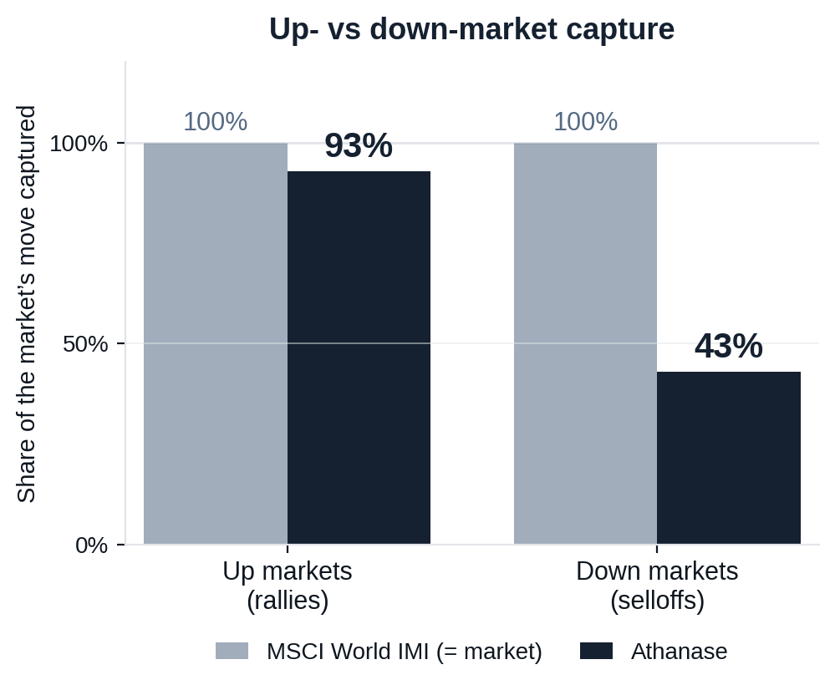
Risk-Adjusted Outcomes
Figure 7
6.3 A complement to global equities, not a duplicate
What a global-equity holder asks of a new manager: do you keep up in rallies, lose less in selloffs, and add something the index can’t?
CAPTURE ASYMMETRY
93% up / 43% down
Keeps pace with rallies but takes less than half of selloffs — the essence of the edge.
DIVERSIFICATION
0.44 correlation · 0.73 beta
Low correlation to your existing equity book — a genuine diversifier, not levered beta.
RELIABILITY OVER TIME
Beat MSCI in 90% of 5-yr and 100% of 7-yr windows
Over every rolling 7-year holding period in 20 years, Athanase out-returned the index.
Athanase captures 93% of the market’s upside but only 43% of its downside — at 0.44 correlation, it improves the whole portfolio, not just one line of it.
Strictly confidential 71
Source: monthly net returns, 235 months (2006–2025). Capture = compounded Athanase return in the market’s up/down months ÷ the market’s. Past performance is not indicative of future results.

Slide 75
Risk-Adjusted Outcomes
Built for down markets — where the record is made
The edge shows most when the market falls: a small positive return in the average down month, and outperformance in four of the last five stress years.
OUTPERFORMANCE IN STRESS YEARS
IN THE AVERAGE DOWN MONTH
2008
+2.2%
+0.2%
2011
+7.9%
Athanase — a small gain when the market is down.
2015
+11.8%
−1.7%
2018
-1.7%
MSCI World IMI — the market itself.
2022
+20.1%
The risk system forces diversification of business exposures and screens out weak competitive positions and untrustworthy management — which pays in demanding markets.
When the market falls, the discipline pays — outperformance in four of the last five stress years, and a gain in the average down month.
Down-month figure: average monthly return in months the MSCI World IMI was negative. Annual figures: AIP net return − MSCI IMI. Source: Athanase, April 2026.
Strictly confidential 72

Slide 76
Portfolio Impact
6.4 A drawdown you can actually defend
The fear is defending a halved position in a live crisis review. The arithmetic — and the down-capture — make this the line item you point to with relief, not apology.
WHY IT CUSHIONS, NOT AMPLIFIES
At 43% down-capture, in a macro selloff the sleeve falls roughly half as much as the equity book — it softens the crisis, it doesn’t add to it.
Down months average ~1.5% versus the market’s ~3.8%.
Daily marks and zero capital calls — no forced selling of good assets at the bottom (the denominator effect that traps PE allocators).
The two ~50% episodes were idiosyncratic and fully recovered (2010, 2020); Sortino 2.40.
THE FULL-FUND ARITHMETIC
≈ 1% of the fund
is what a 50% drawdown in a 2% sleeve costs at the total-fund level — inside a normal month’s equity noise.
≈ 1.5% at a 3% sleeve — recoverable, and small.
Sized so that no single name — and no sleeve-wide drawdown — can move the fund’s outcome. The position is liquid and daily-priced, so the committee can exit at will: it is never locked in defending it.
A 50% drawdown on a small, liquid, low-down-capture sleeve is a ~1% fund event you can exit at will — not a career-defining hole you are locked into. The PE alternative is also down ~50%, but invisible and illiquid.
Strictly confidential 73

Slide 77
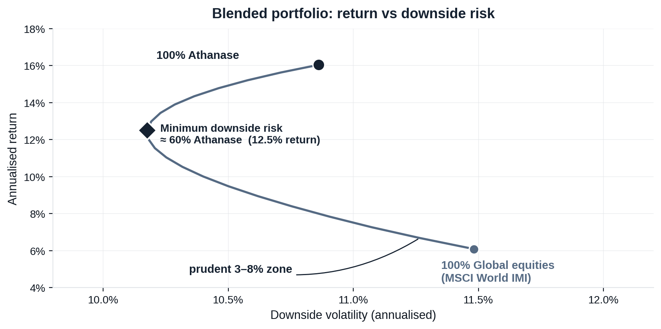
Risk-Adjusted Outcomes
Figure 8
6.5 What a blend does to the whole portfolio
Adding Athanase to a global-equity book moves the portfolio up and to the left — more return for less downside risk, thanks to low correlation.
ALL GLOBAL EQUITIES
6.1% return · 11.5% downside risk
100% MSCI World IMI
ADD A PRUDENT 8% SLEEVE
7.3% return · 11.1% downside risk
92% MSCI / 8% Athanase
HOW TO READ IT
Every blend on the curve beats holding equities alone, and the benefit keeps building until past half the portfolio (downside risk bottoms near 60%). That is a directional case to size up — within prudent limits — not a target: a 59% position would breach concentration, liquidity and the 3–8% sizing discipline. Even an 8% sleeve already moves the portfolio the right way.
The blend is not a trade-off: every allocation raises return and lowers downside risk — so to a committee this is a mathematical risk-reduction tool, not a risky bet, sized within prudent 3–8% limits.
Strictly confidential 74
Source: monthly net returns, 235 months (2006–2025), monthly rebalanced blends. The minimum-risk point is in-sample and shown for shape, not as advice. Illustrative; past performance is not indicative of future results.

Slide 78
PART II · WHY ATHANASE · 7 OF 7
Versus private equity
1 Team & operations
2 The opportunity & our edge
3 How we invest
4 Risk, honestly
5 The 20-year track record
6 What it means for your portfolio
7 Versus private equity
Strictly confidential 75

Slide 79
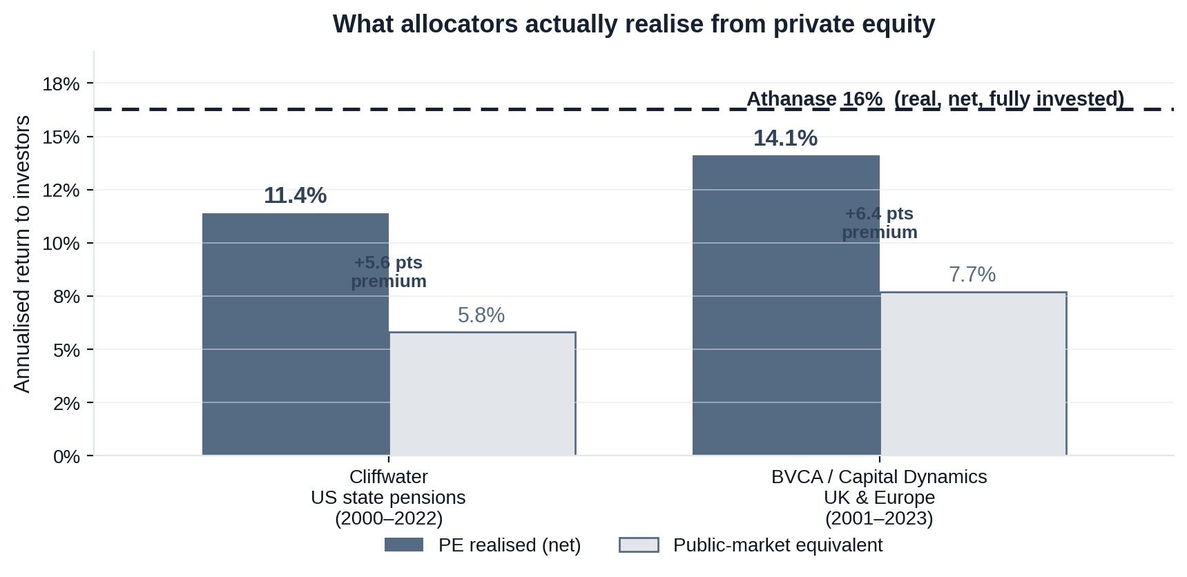
Private Equity
Table 17
7.1 What allocators actually earn from private equity
Stripping out headline-IRR marketing, cash-matched (PME) data shows PE earns a real ~3–6 pt premium over public markets — but lands below Athanase.
HEADLINE ≠ REALISED
Top-quartile IRR is shown as ~18–22%, struck on drawn capital. Cash-matched to public markets, the real figure is far lower.
THE REAL PREMIUM IS GENUINE
PME studies agree: ~1.2× wealth multiple, a real 3–5 pt premium (Cambridge; Kaplan-Harris-Jenkinson / Burgiss; Cliffwater; BVCA).
BUT BELOW ATHANASE
Allocators realise ~11–14% from PE. Athanase has delivered ~16% — net, real, and fully invested from day one.
PE’s premium over public markets is real — but Athanase’s ~16% sits above even what the best allocators realise, with daily liquidity.
Strictly confidential 76
Sources: Cliffwater (US state pensions, 2000–22) PE 11.4% vs PME 5.8%; BVCA / Capital Dynamics (UK & Europe, 2001–23) 14.1% vs 7.7%; corroborated by Cambridge Associates mPME 1.15–1.25× and Kaplan-Harris-Jenkinson KS-PME 1.20–1.27×. Athanase real, net, 2006–2025. See references.

Slide 80
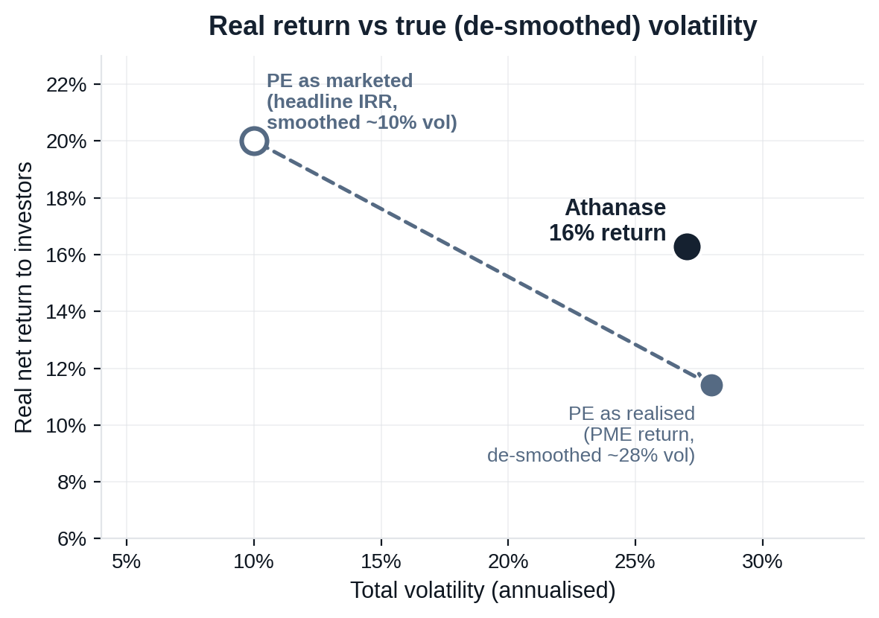
Private Equity
Figure 9
7.2 Switching a private-equity sleeve into Athanase
On true risk, PE and Athanase carry similar volatility — but Athanase’s is mostly upside, and it returns more, with daily liquidity.
RETURN
~16% vs ~11–14% realised
Above what even the best allocators realise from PE (Cliffwater; BVCA).
LIQUIDITY
Daily vs 10-yr lock-up
Listed positions you can exit; no blind-pool capital calls.
FEES & CAPITAL
Lower drag, fully invested
No fees on undeployed dry powder waiting in a queue.
TRANSPARENCY
Daily marks, real control
A public scoreboard plus board control of cash flow, capex and pay.
RISK, HONESTLY
Similar vol, opposite shape
PE’s true ~28% vol is levered downside; Athanase’s 27% is mostly upside (downside only ~11%).
De-smoothed, PE’s ~10% reported vol is really ~28% (PIMCO; AQR beta 1.5–1.6) — about Athanase’s 27%, but levered downside, not upside.
Once PE’s smoothing is removed, the two carry similar volatility — but Athanase returns more, its risk is upside not downside, and it stays liquid and transparent.
Strictly confidential 77
Athanase: net monthly returns, 235 months (2006–2025), real (total vol 27%). PE realised ~11–14% vs headline IRR ~18–22%; reported ~10% vol de-smoothed to ~25–30% (PIMCO; AQR beta 1.5–1.6). See references.

Slide 81
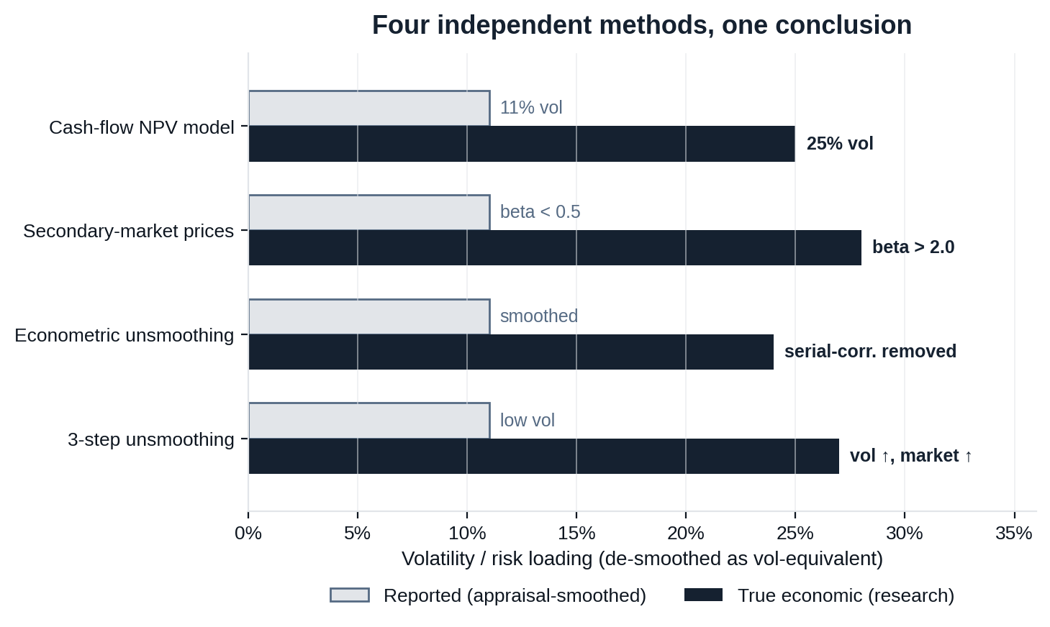
Private Equity
Figure 10
7.3 The volatility gap is settled in the literature
Cash-flow models, secondary-market prices and econometric unsmoothing all converge: PE’s true risk is roughly 2–3× its reported figure.
CASH-FLOW NPV MODEL
Buyout vol 25% (vs 11% index), beta > 1 — Ang, Chen, Goetzmann & Phalippou (2018), J. Finance.
SECONDARY-MARKET PRICES
Traded-stake beta > 2.0 vs < 0.5 on NAV — Boyer, Nadauld, Vorkink & Weisbach (2018).
ECONOMETRIC UNSMOOTHING
Illiquidity creates spurious smoothness — Getmansky, Lo & Makarov (2004), JFE (cited 1,300+).
CATERING / “LAUNDERING”
GPs smooth because LPs value the “phony happiness” — Jackson, Ling & Naranjo (2022); Couts et al. (2020).
Independent methods, the same answer: PE is a highly-levered equity portfolio whose reported smoothness is an artefact.
Strictly confidential 78
Sources: Ang, Chen, Goetzmann & Phalippou (2018); Boyer, Nadauld, Vorkink & Weisbach (2018); Getmansky, Lo & Makarov (2004); Couts, Gonçalves & Rossi (2020); Jackson, Ling & Naranjo (2022); PIMCO (2022); AQR. Bars show vol-equivalent risk; beta rows scaled for comparison. See references.

Slide 82
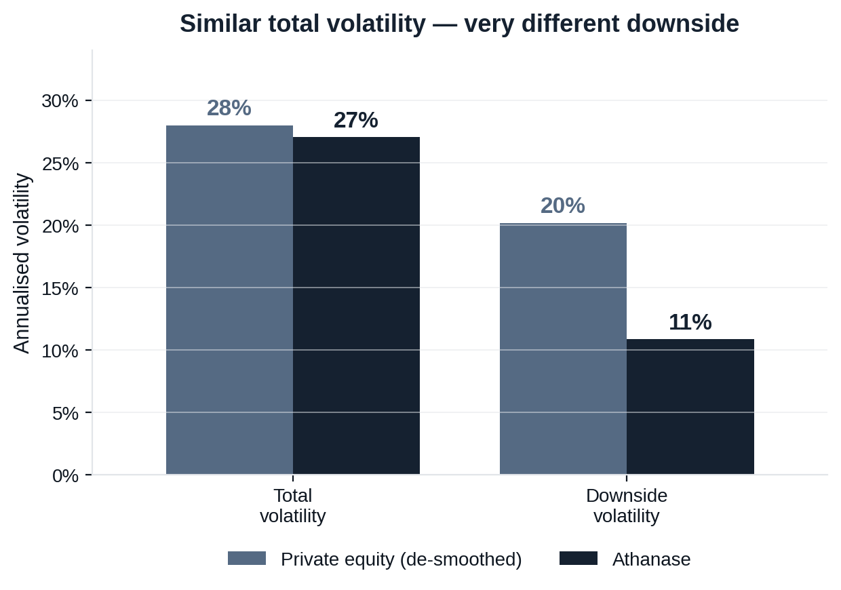
Private Equity
Figure 11
7.4 Same headline volatility — far lower real risk
Volatility is not symmetric. PE’s true risk is levered downside; Athanase’s is mostly upside, so its real loss risk is a fraction of PE’s.
CHANCE OF A 30%+ LOSS OVER THREE YEARS
~16% private equity
~2% Athanase (actual 3-yr windows)
VOLATILITY ≠ RISK OF LOSS
PE’s ~28% true vol is dominated by downside (levered, left-skewed). Athanase’s 27% is mostly upside — downside deviation only ~11%.
THE RISK THAT MATTERS
On large permanent loss — what allocators actually fear — Athanase’s real risk is roughly one-eighth of private equity’s.
Matched on true volatility, Athanase carries far less of the risk that actually hurts: its downside is a fraction of private equity’s.
Strictly confidential 79
Athanase downside vol 11% vs total 27% (real); 30%+ loss in 2% of actual rolling 3-yr windows. PE de-smoothed total vol ~28%, ~15–16% chance of a 30% drawdown over 3 years (PIMCO, 2022). See references.

Slide 83
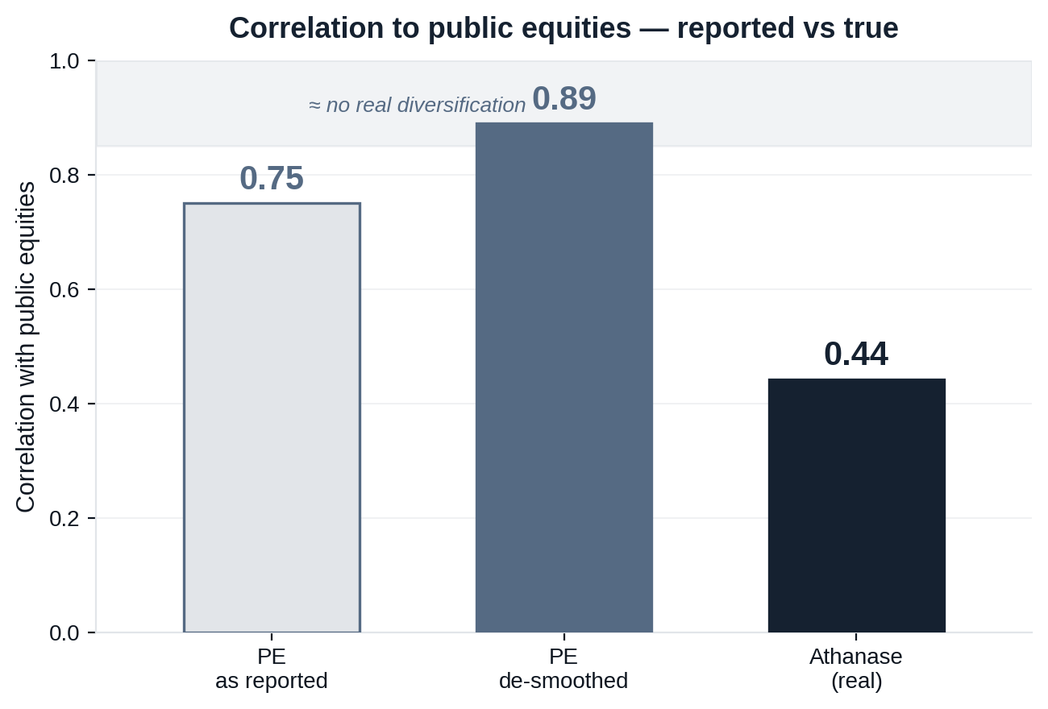
Private Equity
Figure 12
7.5 PE’s “diversification” is an artefact — Athanase’s is real
De-smoothed, PE is ~0.9 correlated to public equities: the same risk factors, just reported late. Athanase is genuinely uncorrelated.
THE SMOOTHING ILLUSION
Quarterly appraisals lag the market, so reported correlation looks low (0.75, beta 0.41). De-smoothed it is 0.89 / beta 0.87 (Two Sigma, 2024).
SAME RISK FACTORS
PE is long-only levered equity driven by GDP, rates and earnings; over 10–20 yrs its correlation to small/mid-caps is ~0.89–0.92.
THE CRISIS MIRAGE
In severe drawdowns true correlation converges toward 1.0 — PE takes the same hit, it just reports the markdown later.
PE adds leveraged beta dressed as diversification. Athanase, at 0.44 correlation, is the genuine diversifier in a public-equity portfolio.
Strictly confidential 80
Athanase correlation 0.44 / beta 0.73 to MSCI World IMI (real). PE reported 0.75 / beta 0.41 de-smoothed to 0.89 / beta 0.87 (Two Sigma / Venn, 2024); long-horizon PE–small/mid-cap correlation ~0.89–0.92. See references.

Slide 84
Private Equity
7.6 When the tide goes out: the drawdown trap
PE’s smooth marks feel safe in calm markets — but in a shock they trigger the exact sequence that gets a CIO fired. Engaged ownership is the fiduciary safe harbour.
THE TRAP — HELD AT FAKE NAVs IN A CRASH
THE SAFE HARBOUR — ENGAGED OWNERSHIP
1 · The denominator effect
Honest pricing keeps weights balanced
Public equities fall 25%; PE is marked flat. The PE weight jumps from 15% to 22%+ — an instant breach of board concentration limits.
Daily marks mean the sleeve falls with the market — so the denominator effect never fires and no threshold is breached.
2 · The liquidity death spiral
Zero capital-call liability
Distributions stop but capital calls keep coming. To meet them, the allocator is forced to sell liquid equities at the bottom.
No blind pools, no surprise calls. The allocator is never forced to become a distressed seller of other assets.
3 · The secondary-market humiliation
Alpha from turnarounds, not leverage
To cure the breach, PE stakes are sold at 15–25% haircuts — publicly crystallising losses and proving the “low volatility” was a fiction.
Returns come from board-led operational change in high-ROIIC mid-caps — not the leverage and multiple-expansion that break in a downturn.
When the tide goes out, artificially-priced illiquid assets are indefensible to a board. Engaged ownership delivers PE-like alpha while protecting portfolio balance, liquidity — and the allocator’s seat.
Strictly confidential 81
Mechanism described follows from PE’s appraisal-based marking and capital-call structure (see references). Illustrative; for professional investors, not investment advice.

Slide 85
Ownership Model
7.7 Responsible ownership, by construction
› Governance is the lever. Value is created through board representation and active promotion of strong corporate governance across all holdings.
› Five improvement dimensions. Operational, financial, structural, environmental and social improvements — each tied to enterprise value.
› PRI signatory since 2019, adhering to the Six Principles for Responsible Investment.
› Credible oversight. SEB custodian · MUFG administrator · KPMG auditor · Swedish FI-registered AIFM.
Strictly confidential 82

Slide 86
The Case
The objections we hear — and the arsenal to answer them
The common declines are rarely about the returns. Each concern has a concrete, quantified rebuttal.
The objection
The arsenal — how we answer it
“It falls between our buckets.”
Concern: tracking-error fear
› 0.44 correlation, 43% down-capture — the divergence is portfolio armour, not a risk — it stops you riding the index to the bottom.
› Alpha from corporate events — stripping growth traps, reallocating to ROIIC — measurable, not macro.
› When the market tanks — that deliberate divergence defends your short-term numbers.
“Key-person risk at a boutique.”
Concern: political cover
› Segregation of duties — operations, risk and finance sit fully independent of the investment team.
› SEB · MUFG · KPMG — custody, administration and audit verify every move — a heavyweight institutional fortress.
› The same investment team since 2006 — a 20-year playbook — institutional memory that engineers out permanent loss, not key-person risk.
“Capacity — only one deal a year.”
Concern: effort vs. sleeve size
› A 3–8% sleeve is not a rounding error — it shifts the whole equity book’s frontier up-and-to-the-left — real basis points.
› No fees on undeployed dry powder — deploy once, capital works immediately.
› No blind-pool capital calls — none of the administration that comes with them.
“Duration ties up our risk budget.”
Concern: comp-cycle mismatch
› Down months ~1.5% vs the market’s ~3.8% — immediate downside preservation, this year.
› −10% / −20% / −30% hard triggers — force a re-underwrite and exit a broken thesis — capping drawdowns and removing PM bias.
› Worst-ever entry still +7% net — a statistical safety blanket over the holding period.
We meet each objection where it sits — and answer it with structure, not optimism. The allocation is engineered to be defensible, not just to perform.
Strictly confidential 83

Slide 87
The Case
The case for your investment committee
The argument in four moves — structure, engine, downside and proof.
1 · The mandate & structure
2 · The engine — quality-core constructivism
› PE-style operational value creation — executed entirely in the public markets.
› Daily transparency and liquidity, lower fees — and no 10-year blind-pool lock-up.
› Applied corporate governance — board independence, capital discipline and pay-for-performance — fulfilling UN PRI fiduciary duty.
› Market-leading developed-market mid-caps — with highly profitable, durable cores — not broken turnarounds.
› We enter at “shareholder exhaustion” — the buyer of last resort after management diluted the core chasing prestige projects.
› Secure the board seat — strip the growth-trap adjacencies and reallocate capital to the core to maximise ROIIC.
3 · The moat — engineered downside protection
4 · The proof — two decades of compounding
› A valuation floor — the core alone justifies the price; zero value to weak divisions — a 30–40% margin of safety vs a PE bidder.
› The board seat is the kill switch — authority to freeze bad capital deployment the moment the macro shifts.
› Mechanized discipline — automatic −10% / −20% / −30% triggers force a re-underwrite and exit a broken thesis.
› 16.3% net p.a.; capital grown 18× — across multiple market cycles.
› 92% deal-level hit rate (38 deals) — a 5× MOIC roughly every two years.
› 93% up-capture vs 43% down-capture — losing less than half preserves the compounding base.
Strictly confidential 84

Slide 88
The Case
What protects the committee — not just the capital
Beyond the returns, four things an investment committee can point to — a due-diligence shield, a capital floor, peer-reviewed cover and a liquidity escape hatch.
1 · Independent validation
2 · No investor has lost capital
› Independently validated — the 20-year net record was reconciled from security-level StatPro data to actual LP-level returns — not a back-test or internal spreadsheet.
› SEB · MUFG · KPMG — custody, administration and audit by top-tier institutions verify every NAV and fee.
› An air-tight paper trail — no auditor or regulator can level an accusation of lax oversight.
› 19% average net return — regardless of the month an investor entered the fund.
› +7% in the worst entry month — the single unluckiest entry over 20 years was still positive, net.
› Zero holding-period losses — historically, no investor has lost money over a holding period.
3 · Backed by peer-reviewed science
4 · A liquidity escape hatch
› Settled in the literature — 13D alpha and PE’s volatility laundering / de-smoothing are backed by the Journal of Finance and Review of Financial Studies.
› 0.44 correlation, by the science — the low correlation and risk/return profile are established, not asserted.
› Cover in a bad quarter — point to the evidence, not to hope — a fundamentally sound economic engine.
› Daily pricing and liquidity — the strategy lives entirely in listed public equities.
› No lock-up or capital-call queue — none of PE’s 10-year blind-pool traps or blind extensions.
› Total optionality — if style drifts or the landscape changes, the committee can vote to pivot out seamlessly.
Strictly confidential 85

Slide 89
The Case
Is a household name really the safer choice?
The instinct to reach for a tier-one brand is understandable — but for a fund our size it adds correlated risk and cost, and it is not what discharges fiduciary duty.
THE BRAND PROMISES COVER — BUT
“No one is fired for picking a household name.” Yet fiduciary duty is discharged by process and outcome — not by brand recognition.
A mega-cap activist’s returns are leveraged beta — ~0.89 correlated to equities once de-smoothed: correlated risk dressed as diversification, at tier-one fees.
When that book falls with the market, the brand is no defence — and you have paid up for the privilege.
Reaching for the familiar name is herding; crowding into the same mega-cap trades is itself a fiduciary risk.
WHAT ACTUALLY PROTECTS A FIDUCIARY
A documented, repeatable process and a 20-year record independently reconciled and audited — SEB · MUFG · KPMG.
Daily transparency — a drawdown you can explain with facts, and exit at will — not an opaque mark you must take on faith.
Alignment — the team invests its own capital alongside yours.
A genuine 0.44-correlation diversifier that defends the book when the index falls — the opposite of buying more of what you already own.
Brand is reputational comfort, not fiduciary protection. The defensible choice is the one backed by process, independent validation and genuine diversification — not the most familiar logo.
Strictly confidential 86

Slide 90
The Case
The ground is already moving — two shocks to a traditional book
This is not a forecast. Right now, private markets are gating redemptions and AI is commoditizing the analytical edge active equity is sold on.
PRIVATE MARKETS ARE GATING — NOW
Partners Group capped redemptions in its $8.6bn evergreen PE fund at 5% of NAV after requests hit 9.8% — KKR, Blackstone and Ares fell (Bloomberg / CNBC, Jun 2026).
It is spreading — redemption pressure has moved from private credit into private equity, with several managers restricting withdrawals.
The trap closes: frozen distributions while capital calls continue force selling good assets at the bottom — and smoothed marks hid the damage until now.
AI IS COMMODITIZING EQUITY ALPHA
Every manager now runs the same AI-driven analysis instantly; the screenable names are bid up and long-only alpha decays toward zero.
That analytical edge is exactly what active equity fees pay for (Kim, Muhn & Nikolaev, 2024; McLean & Pontiff, 2016).
Passive is no refuge — record concentration in the same mega-caps is a crowded trade, not diversification.
Both legs of a traditional book — illiquid PE and crowded public equity — are under pressure at once. A liquid, low-correlation engaged-ownership sleeve is the antidote to both — and the cost is in waiting.
Strictly confidential 87

Slide 91
The Case
AI commoditizes analytical alpha — not engaged ownership
As AI lets every firm run the same financial analysis instantly, the alpha in screenable, well-covered equities is competed away and the “easy” names are bid up. The durable edge shifts from discovering value to creating it.
WHAT AI COMMODITIZES — DISCOVERED ALPHA
The same analysis, instantly — every manager ingests the same filings and data and runs the same models; the analytical edge long-only alpha rests on erodes toward zero.
The “easy” stuff gets bid up — screenable large- and mega-caps are arbitraged fastest, compressing margins of safety and deepening the index concentration you already carry.
Your current equity alpha is exposed — much of what active global-equity managers charge for is precisely this analytical edge.
WHAT IT CANNOT — CREATED ALPHA
Returns we create, not discover — ours come from board control, capital-allocation change and operational improvement, not a mispricing a model can replicate.
You can’t download a board seat — a multi-year, relationship- and execution-dependent turnaround is the opposite of a commoditizable screen.
The inefficiency persists where analysis can’t reach — under-covered mid-caps that need governance and operating change, not a faster spreadsheet: our lane.
Documented mechanism: LLMs already perform financial-statement analysis at analyst level (Kim, Muhn & Nikolaev, 2024); return predictability decays once a strategy is replicable (McLean & Pontiff, 2016) — AI accelerates both.
As analytical alpha commoditizes, created — engaged-ownership — alpha becomes scarcer and more valuable. The edge AI cannot copy is the one to add now.
Strictly confidential 88

Slide 92
The Case
When valuations crack, where will you be holding?
At record valuations and concentration the cycle will turn. The career risk isn’t a planned drawdown here — it’s being trapped in the most-expensive, least-liquid assets when it does.
GLOBAL EQUITIES
FULLY EXPOSED
PRIVATE EQUITY
THE TRAP
ATHANASE
THE HEDGE
› You own the peak — the most-expensive, most-concentrated names take the full drawdown — no protection.
› Concentration cuts both ways — the crowding that flattered returns on the way up amplifies the fall.
› Nothing to do — you are the market — there is no lever to pull.
› Marks catch down — smoothed valuations lag, then fall; the denominator effect pushes PE past its limits.
› Calls keep coming — distributions stop while capital calls continue — forcing sales of good liquid assets at the bottom.
› No exit — illiquidity hides the loss until it is too late to act.
› Risk is floored — board control owns the cash flow, capex and pay — fundamental risk falls whatever the ticker does.
› Liquid & uncorrelated — daily liquidity and a genuine 0.44-correlation diversifier that defends the book.
› The crack is the entry — the dislocation becomes your co-invest free look — not your trap.
When the cycle turns, two of these put your board review at risk and one defends it — and the hedge can only be bought before the crack, not after.
Strictly confidential 89

Slide 93
The Case
Waiting is the riskier decision — and it never gets underwritten
Allocating carries a small, bounded, pre-agreed risk. Not allocating carries an open-ended one — concentration you already own, the compounding you forgo, and capacity you cannot get back.
THE RISK OF ALLOCATING — BOUNDED & REVERSIBLE
Sized for immunity — a 1–3% sleeve, so no single mark can move the fund.
Pre-underwritten — a ~50% drawdown tolerance signed by the IC: a bad quarter is planned, not a surprise.
Reversible — daily marks and liquidity, exit at will, zero capital-call lock.
Entry timing is a non-risk — the worst entry month in 20 years still compounded at +7% net.
THE RISK OF WAITING — OPEN-ENDED & UN-MINUTED
Concentration you already own — your equity book is a crowded mega-cap factor bet at record valuations; a genuine 0.44-correlation diversifier is what cushions it when the index falls.
The PE denominator trap — in a downturn your illiquid sleeve breaches limits and forces selling good assets at the bottom, with nothing liquid to absorb it.
Alpha decay — AI is commoditizing the analytical edge your active equity managers sell (prior page); engaged ownership is the edge it cannot copy.
Compounding foregone — at a delivered ~16% net, €100m deferred 12 months reaches the same horizon ~€61m smaller; that gap never returns.
Capacity forfeited — only ~one deal a year, and co-investment is pro-rata to commitment: those in early set their share, latecomers take what is left.
Delay illustration: €100m at ~16% net — nine vs ten years of compounding to a common horizon; illustrative only, past returns not indicative.
The bigger risk isn’t the upside you forgo — it’s where you’re holding when valuations crack (prior page): a crowded index, or PE you cannot exit.
Two years on, the harder board question isn’t a planned 2% drawdown here — it’s why you sat in the most-expensive, most-correlated assets with no liquid hedge. Doing nothing is also a decision; it just never gets minuted.
Strictly confidential 90

Slide 94
The asset class rewards patient, governance-minded capital.
Among engaged owners, Athanase brings the team, the discipline and the 20-year proof to deliver it.
Stefan Charette
Athanase Industrial Partner
charette@athanase.se · +46 73 994 7079
Offices
Birger Jarlsgatan 6, 114 34 Stockholm, Sweden
Landmark Square, West Bay Road, Grand Cayman

Slide 95
APPENDIX
Optional co-investment facility

Slide 96
Appendix · Co-investment
The co-investment “free look”: a post-engagement drawdown
We decouple the co-investment’s timing from the engagement: the main fund bears the execution risk, and LP capital enters only after the turnaround is board-secured — when the public market discounts the price.
STEP 1 · MAIN FUND LEADS
STEP 2 · FACILITY UNCALLED
STEP 3 · VALUATION TRIGGER
STEP 4 · LP CAPITAL ENTERS
›
›
›
Initiates the position, clears the tollgates and secures the board seat — the capital-allocation kill switch. Fundamental risk is structurally lowered.
Co-investment is committed but dormant through the engagement — no upfront execution risk, control premium or broken-deal cost for the LP.
Activated only if the public market later dislocates and discounts the price — after the board seat and operating plan are confirmed.
Capital draws instantly at the pre-agreed threshold, accumulating at the discounted multiple — below the main fund’s own basis.
WHAT THE CO-INVESTOR GETS
› De-risked, at a discount. — a governed, ROIIC-compounding core bought after the plan is secured — at a basis below the main fund’s.
› Zero frictional drag. — no broken-deal, advisory or syndication fees; ~20,000-company research is baseline, so 100% of drawn capital compounds in the equity.
› No blind-pool scramble. — pre-agreed terms bypass the 3–4-week syndication — capital hits the dislocation instantly at the optimal basis.
ALIGNMENT & EXIT GOVERNANCE
› Pro-rata exit. — bound to exit in lockstep with the main fund — no separate timing, full parity with the Investment Committee.
› Patient-capital enforcement. — the same multi-year holding discipline — no reactionary selling into daily liquidity before the restructuring shows in cash flows and earnings.
The core fund carries zero capital calls; this optional facility is the single, deliberate exception — and only on a named, board-de-risked asset.
Decoupled in time, optical volatility becomes a pricing advantage — the ultimate institutional free look: turnaround execution risk, stripped of deal costs, priced at a market-driven discount.
Strictly confidential 91

Slide 97
Appendix · Co-investment
Co-investment term sheet: the drawdown mechanics
Dormant until the board seat is secured; drawn only on a 20–30% dislocation to accumulate a 10–20% block; zero fees until the promote; converts to a permanent capital vehicle at 2.5×.
1 · ACTIVATION PREREQUISITES
2 · DRAWDOWN TRIGGER
3 · CALL EXECUTION & EXPIRY
Board control secured — the vehicle stays dormant until the main fund holds the board seat and the capital-allocation playbook.
Zero blind-pool risk — any drawdown notice names a vetted asset the team already runs from the inside.
Price is the sole trigger — capital is called only if the market hands LPs a 20–30% discount; the main fund drives the operational change either way.
Offensive accumulation — build a 10–20% block at exhaustion prices — arbitrage on market psychology, not a falling knife: the board seat already floors fundamental risk.
Notice period — a standard 10–15 business-day capital call funds the block build.
Time is the sole opt-out — an 18-month sunset from the board seat; if no discount appears the commitment expires uncalled — LPs pay next to nothing for the optionality and free the risk budget.
4 · FEES & PROMOTE
5 · LIQUIDITY — THE PCV FLIP
LP PROTECTIONS · PROPOSED
Zero management fees — through dormancy and accumulation — only a capped pass-through of verified admin and legal costs.
2.5× super-promote — the manager takes a 20% stake in the listed vehicle only at 2.5× drawn capital, tested continuously (not a single date) — the moment LPs lock a 2.0× net return.
Direct listing at NAV — a pre-agreed direct listing — a route the team has executed in Sweden — converts the vehicle to a PCV at NAV, with no bookbuild discount.
NAV-tight & evergreen — a mandatory buyback whenever the price trades >10% below NAV holds the discount tight; LPs get daily liquidity, the manager keeps infinite duration.
No gaming the conversion — NAV is mark-to-market from the listed holdings, valued on a 10-day VWAP — no independent appraisal, and a continuous test leaves no single window the manager can time.
Catastrophe-only LP veto — the LPAC veto covers fund-level events only — key-person or style drift — never the target’s price or operating metrics; NAV redemption if no listing by the longstop.
Fees accrue to LPs first: nothing to the manager until 2.5× — at which point the LP’s 2.0× net is already locked.
Indicative terms for IC / LP discussion, subject to final fund documentation. The 2.0× is a contractual lock contingent on the 2.5× test — not a guarantee. Buybacks are funded from the vehicle’s distributable cash and capped per year. The “LP protections” cell is a proposal, not yet agreed.
Strictly confidential 92

Slide 98
Appendix · Co-investment
Co-investment capacity: a dividend for backing the core
Capacity is allocated by flagship commitment, not handed out as a marketing tool — so the “free look” rewards the partners who back the core strategy.
90% · STRICT PRO-RATA — by flagship commitment
10% · GP
1
2
3
Pro-rata by flagship commitment
An LP’s right of first refusal equals its share of main-fund commitments — 15% of the fund earns first call on 15% of the sidecar. The lucrative free look is a structural dividend for the investors who back the core.
Roll-up of declined capacity
Capacity a smaller LP declines is pooled and re-offered, pro-rata, to the remaining participants — automatically concentrating the sidecar among the largest, most agile institutional anchors.
A 10% GP-discretionary carve-out
90% is allocated by strict formula to prevent LP infighting; the remaining 10% is reserved for LPs who can contribute directly to a deal — bringing specific industrial knowledge or operating expertise to the situation.
Capacity rewards conviction: the free look deepens the relationships with the anchors who fund the flagship — a structural dividend, not a giveaway.
Strictly confidential 93

Slide 99
References
1 of 3
References & Methodology — Peer-reviewed literature (Part I)
ENGAGED OWNERSHIP, ACTIVISM & CAPITAL ALLOCATION
PASSIVE INVESTING & MARKET STRUCTURE
Bebchuk, L. A., Brav, A., & Jiang, W. (2015). The long-term effects of hedge fund activism. Columbia Law Review, 115(5), 1085–1156.
Bebchuk, L. A., Brav, A., Jiang, W., & Keusch, T. (2020). Dancing with activists. Journal of Financial Economics, 137(1), 1–41. https://doi.org/10.1016/j.jfineco.2020.01.001
Becht, M., Franks, J., Mayer, C., & Rossi, S. (2009). Returns to shareholder activism: Evidence from a clinical study of the Hermes UK Focus Fund. The Review of Financial Studies, 22(8), 3093–3129. https://doi.org/10.1093/rfs/hhn054
Becht, M., Franks, J. R., Grant, J., & Wagner, H. F. (2017). Returns to hedge fund activism: An international study. The Review of Financial Studies, 30(9), 2933–2971. https://doi.org/10.1093/rfs/hhx048
Brav, A., Jiang, W., Partnoy, F., & Thomas, R. (2008). Hedge fund activism, corporate governance, and firm performance. The Journal of Finance, 63(4), 1729–1775. https://doi.org/10.1111/j.1540-6261.2008.01373.x
Brav, A., Jiang, W., & Kim, H. (2015). The real effects of hedge fund activism: Productivity, asset allocation, and labor outcomes. The Review of Financial Studies, 28(10), 2723–2769. https://doi.org/10.1093/rfs/hhv037
Gantchev, N. (2013). The costs of shareholder activism: Evidence from a sequential decision model. Journal of Financial Economics, 107(3), 610–631. https://doi.org/10.1016/j.jfineco.2012.09.007
Klein, A., & Zur, E. (2009). Entrepreneurial shareholder activism: Hedge funds and other private investors. The Journal of Finance, 64(1), 187–229. https://doi.org/10.1111/j.1540-6261.2008.01432.x
Lindlbauer, N. (2025). Unpacking the inertia in resource allocation adjustments of multi-business firms. Strategic Management Journal, advance online publication. https://doi.org/10.1002/smj.3722
Scharfstein, D. S., & Stein, J. C. (2000). The dark side of internal capital markets: Divisional rent-seeking and inefficient investment. The Journal of Finance, 55(6), 2537–2564. https://doi.org/10.1111/0022-1082.00299
Ben-David, I., Franzoni, F., & Moussawi, R. (2018). Do ETFs increase volatility? The Journal of Finance, 73(6), 2471–2535. https://doi.org/10.1111/jofi.12727
Bond, P., & García, D. (2022). The equilibrium consequences of indexing. The Review of Financial Studies, 35(7), 3175–3230.
Chen, H., Noronha, G., & Singal, V. (2006). Index changes and losses to index fund investors. Financial Analysts Journal, 62(4), 31–47. https://doi.org/10.2469/faj.v62.n4.4185
Chinco, A., & Sammon, M. (2024). The passive-ownership share is double what you think. SSRN Electronic Journal.
Gabaix, X., & Koijen, R. S. J. (2021). In search of the origins of financial fluctuations: The inelastic markets hypothesis. NBER Working Paper No. 28967. https://doi.org/10.3386/w28967
Kim, A. G., Muhn, M., & Nikolaev, V. V. (2024). Financial statement analysis with large language models. Chicago Booth Research Paper (working paper). https://doi.org/10.48550/arXiv.2407.17866
McLean, R. D., & Pontiff, J. (2016). Does academic research destroy stock return predictability? The Journal of Finance, 71(1), 5–32. https://doi.org/10.1111/jofi.12365
Petajisto, A. (2011). The index premium and its hidden cost for index funds. Journal of Empirical Finance, 18(2), 271–288. https://doi.org/10.1016/j.jempfin.2010.10.002
Wurgler, J. (2011). On the economic consequences of index-linked investing. NBER Working Paper No. 16376. https://doi.org/10.3386/w16376
AI & alpha decay (emerging working papers, 2025–26): Gimmelberg (2025), MDPI; Han et al. (2026), arXiv; Meng & Chen (2026), arXiv; Tran (2026), Atlantis Press.
Strictly confidential 94

Slide 100
References
2 of 3
References & Methodology — Peer-reviewed literature (Part II)
PRIVATE EQUITY RISK & RETURN (PART II)
PRIVATE EQUITY RISK & RETURN (CONT.)
Ang, A., Chen, B., Goetzmann, W. N., & Phalippou, L. (2018). Estimating private equity returns from limited partner cash flows. The Journal of Finance, 73(4), 1751–1783. https://doi.org/10.1111/jofi.12688
Boyer, B. H., Nadauld, T. D., Vorkink, K. P., & Weisbach, M. S. (2018). Private equity indices based on secondary market transactions. SSRN Electronic Journal. https://doi.org/10.2139/ssrn.3272357
Buchner, A., Kaserer, C., & Wagner, N. F. (2010). Private equity funds: Valuation, systematic risk and illiquidity. SSRN Electronic Journal. https://doi.org/10.2139/ssrn.1102471
Couts, S., Gonçalves, A. S., & Rossi, A. (2020). Unsmoothing returns of illiquid funds. SSRN Electronic Journal. https://doi.org/10.2139/ssrn.3544854
Getmansky, M., Lo, A. W., & Makarov, I. (2004). An econometric model of serial correlation and illiquidity in hedge fund returns. Journal of Financial Economics, 74(3), 529–609. https://doi.org/10.1016/j.jfineco.2004.04.001
Harris, R. S., Jenkinson, T., & Kaplan, S. N. (2014). Private equity performance: What do we know? The Journal of Finance, 69(5), 1851–1882. https://doi.org/10.1111/jofi.12154
Hayley, S., & Sefiloglu, O. (2022). Biases in private equity returns. SSRN Electronic Journal. https://doi.org/10.2139/ssrn.4245715
Jackson, B., Ling, D. C., & Naranjo, A. (2022). Catering and return manipulation in private equity. SSRN Electronic Journal. https://doi.org/10.2139/ssrn.4244467
Meyer, T. (2020). Hidden in plain sight — the impact of undrawn commitments. The Journal of Alternative Investments, 23(2), 94–110. https://doi.org/10.3905/jai.2020.1.101
Phalippou, L. (2020). An inconvenient fact: Private equity returns and the billionaire factory. The Journal of Investing, 30(1), 11–39. https://doi.org/10.3905/joi.2020.1.153
Strictly confidential 95

Slide 101
References
3 of 3
References & Methodology — Datasets, practitioner research & methodology
INDUSTRY DATASETS & PRACTITIONER RESEARCH
DATA & METHODOLOGY
Asness, C. S. (2023). The volatility-laundering hidden in private-asset marks. AQR Capital Management — Cliff’s Perspectives.
British Private Equity & Venture Capital Association & Capital Dynamics. (2024). BVCA Private Equity Performance Measurement Survey (PME+). London: BVCA.
Cambridge Associates. (2024). US Private Equity Index and Selected Benchmark Statistics (Q2 2024). Boston: Cambridge Associates LLC.
Cliffwater LLC. (2023). Long-term private equity performance in US state pension plans (2000–2022). Marina del Rey: Cliffwater LLC.
Financial Reporting Council. (2020). The UK Stewardship Code 2020. London: FRC.
Morningstar. (2023). Volatility laundering: How private equity funds understate the risk of their investments. Chicago: Morningstar, Inc.
MSCI. (2024). MSCI ACWI IMI Index and MSCI ACWI Mid Cap Index — factsheets. New York: MSCI Inc.
PIMCO. (2022). The discreet charm of private assets: De-smoothing and the true volatility of private equity. Newport Beach: PIMCO.
Principles for Responsible Investment. (2021). What are the Principles for Responsible Investment? London: UN PRI.
Two Sigma Investments. (2024). The alternative truth of private equity (Venn by Two Sigma). New York: Two Sigma.
World Federation of Exchanges. (2024). WFE market statistics — number of listed companies. London: WFE.
All Athanase figures are computed from the fund’s audited net monthly return series across two vehicles (Öresund/Creades Jan 2006–Jun 2014; AIPFII from 23 Feb 2015):
• Annualised return — cumulative net return compounded, then annualised over actual invested time (19.32 yrs, excluding the 2014–15 setup gap): 16.3%.
• Total volatility — st. dev. of monthly returns × √12 (27.0%).
• Downside volatility — deviation of negative months below a 0% MAR × √12 (10.9%).
• Correlation / beta — versus MSCI World IMI over the common period (0.44 / 0.73).
• Large-loss frequency — share of rolling 36-month windows below −30% (≈2%).
• Up/down capture — compounded Athanase return in the market’s up/down months ÷ the market’s.
• Efficient frontier — monthly-rebalanced MSCI/Athanase blends; minimum-risk point is in-sample.
Private-equity figures are taken from the cited research. De-smoothed / true-economic / committed-capital values reflect that literature rather than reported (appraisal-based) data — including the de-smoothed large-buyout correlation to small/mid-cap equities of ~0.89 (Two Sigma / Venn, 2024; Couts, Gonçalves & Rossi, 2020; Boyer, Nadauld, Vorkink & Weisbach, 2018). Bridge and illustrative magnitudes reconcile cited endpoints and are labelled as such. For professional investors; not investment advice. Past performance is not indicative of future results.
Strictly confidential 96

