Slide 1

Engaged Ownership as an Asset Class
Why allocators should consider it — and why Athanase
An endowment briefing · Replacing part of global public equity · June 2026

Slide 2

Market Context
From passive risk to active opportunity
An expensive, concentrated, passive-dominated market is exactly the environment active management is built for — and as analysis itself commoditises, the most durable edge is ownership, not stock-picking.
1 · The setup
2 · Why active now
3 · A better kind of active
Expensive equities, record index concentration, and price-insensitive passive flows that inflate the most crowded names.
Wider mispricing and dispersion; valuation discipline is rewarded again. The “active underperforms” critique is cyclical — and weakest in exactly this market.
Other genuine edges exist — quant and specialist alpha — but they compete on analysing the same public data, which is what commoditises fastest. The most durable edge is ownership: buying mispriced businesses and changing the outcome.
→
→
When the index is the crowded, expensive, fragile trade, the answer is not to pick stocks and hope — it is to own undervalued businesses and make them better. That is engaged ownership.
Strictly confidential 2

Slide 3
Overview
Athanase at a glance
38
investments as
engaged owners
19%
avg annualised NET,
any entry month*
7%
worst-ever entry,
still positive*
18×
growth of capital
since 2006
› ~19% average annualised return* whatever month you invested and held to today — entry timing has barely mattered.
› ~7% in the single worst entry month even the unluckiest possible entry still compounded at a mid-single-digit net return — no investor lost over the holding period.
› 16.3% time-weighted NET since 2006 vs MSCI IMI 6.2% — net of all fees.
*Average of the annualised NET return earned investing in each individual month and holding to the end (107 entry months, AIPFII). Time-weighted figure annualised over actual invested time. Past performance is not indicative of future results.
Strictly confidential 3

Slide 4
Ownership Model
The ownership playbook, honed over 38 investments
A repeatable sequence that turns a board seat into operational value — refocusing a good core, then growing it.
1
Secure the board seat
2
Align the thesis
3
Refocus to drive earnings
Often a precondition to invest — the nomination committee proposes an AIP director.
Collaborate with management and stakeholders to agree where the value is and what must change.
Cut overhead and admin, optimise the footprint, exit loss-making “growth-trap” ventures.
4
Reallocate to winners
5
Grow by acquisition
6
Exit
Redeploy freed-up capital into the profitable core and its strongest adjacencies; lift R&D where it pays.
Add complementary products, geographies or scale through value-accretive bolt-ons.
Realise via M&A or in the equity market once the core is refocused and compounding.
The same playbook across 38 companies — value created by fixing capital allocation, not by financial engineering or leverage.
Strictly confidential 4

Slide 5
The Opportunity
Table 3
The evidence: constructive engagement works
Three decades of peer-reviewed research — across the US and Europe — converge on the same finding.
Study
What it covers
What it establishes
Brav, Jiang, Partnoy & Thomas (2008) · J. Finance
1,000+ US engagements, 2001–06
Activists “seldom seek control” and are “nonconfrontational”; ~2/3 reach full or partial success; +7% announcement return with no reversal; payout, operating performance and CEO turnover all rise.
Becht, Franks, Grant & Wagner (2017) · Rev. Fin. Studies
1,740 engagements, 23 countries
Outcomes and market responses are similar in Europe and North America — the playbook travels; board representation is a central, value-creating outcome.
Becht, Franks, Mayer & Rossi (2009) · Rev. Fin. Studies
Clinical study — Hermes UK Focus Fund
Returns come from engagement, not stock-picking — via private, cooperative interventions: refocus on the core, return cash, change the CEO / chair.
Bebchuk, Brav, Jiang & Keusch (2020) · J. Fin. Economics
US settlement agreements
Boards settle by granting board seats — the intermediary step to the operational and leadership change activists seek. Exactly the precondition model.
Gantchev (2013) · J. Fin. Economics
1,492 campaigns, 2000–07
A campaign escalating to a proxy fight costs ~$10.7m; settling at the board-representation stage avoids most of it — collaboration is cheaper.
Strictly confidential 5
The academic record converges with our own 38 engagements: control secured cooperatively through a board seat is how operational value is created.

Slide 6
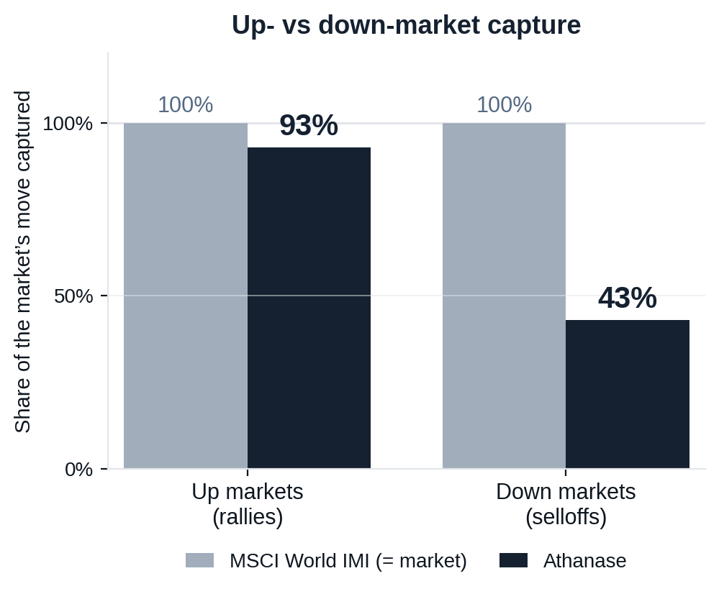
Risk-Adjusted Outcomes
Figure 7
A complement to global equities, not a duplicate
What a global-equity holder asks of a new manager: do you keep up in rallies, lose less in selloffs, and add something the index can’t?
CAPTURE ASYMMETRY
93% up / 43% down
Keeps pace with rallies but takes less than half of selloffs — the essence of the edge.
DIVERSIFICATION
0.44 correlation · 0.73 beta
Low correlation to your existing equity book — a genuine diversifier, not levered beta.
RELIABILITY OVER TIME
Beat MSCI in 90% of 5-yr and 100% of 7-yr windows
Over every rolling 7-year holding period in 20 years, Athanase out-returned the index.
Athanase captures 93% of the market’s upside but only 43% of its downside — at 0.44 correlation, it improves the whole portfolio, not just one line of it.
Strictly confidential 6
Source: monthly net returns, 235 months (2006–2025). Capture = compounded Athanase return in the market’s up/down months ÷ the market’s. Past performance is not indicative of future results.

Slide 7
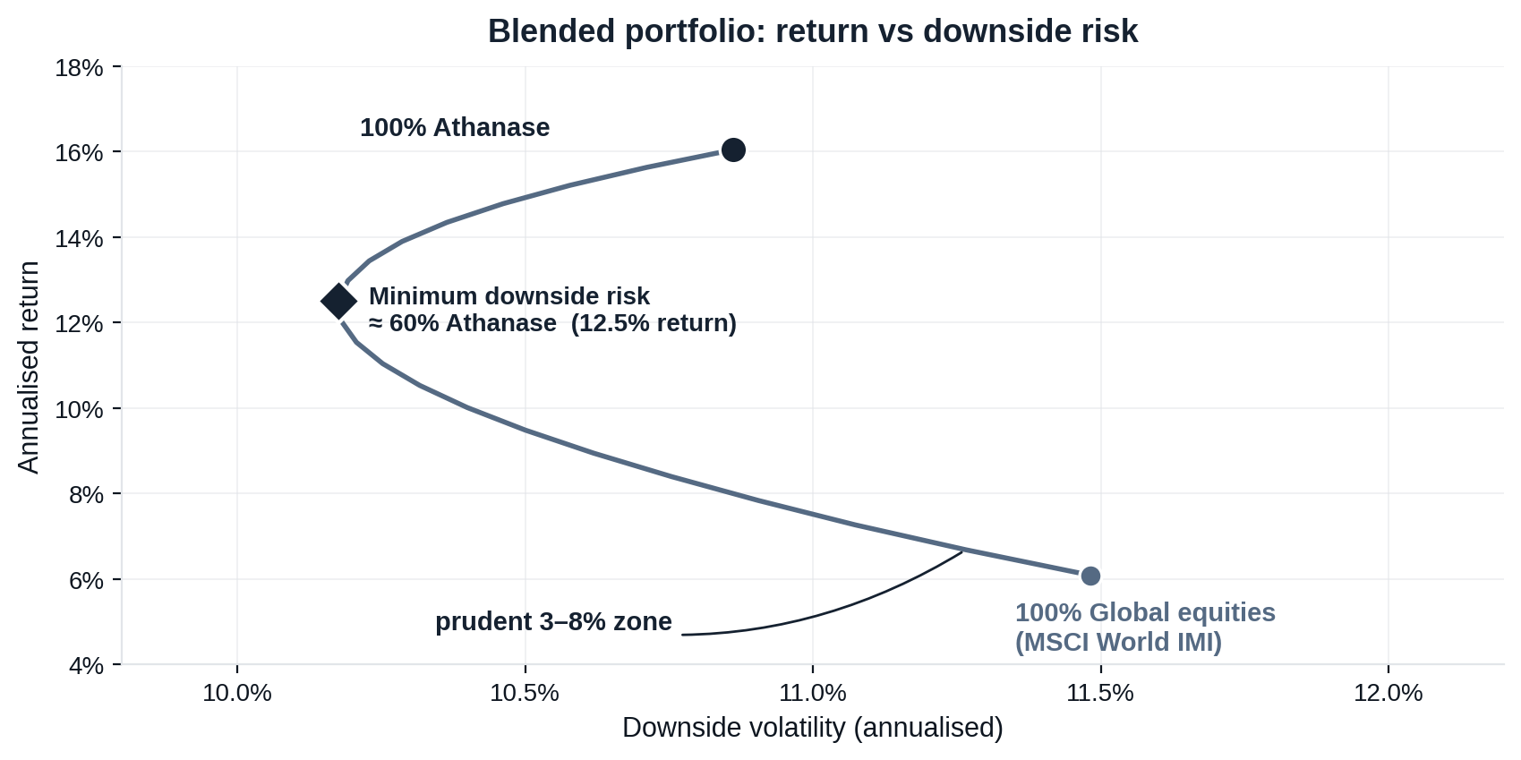
Risk-Adjusted Outcomes
Figure 8
What a blend does to the whole portfolio
Adding Athanase to a global-equity book moves the portfolio up and to the left — more return for less downside risk, thanks to low correlation.
ALL GLOBAL EQUITIES
6.1% return · 11.5% downside risk
100% MSCI World IMI
ADD A PRUDENT 8% SLEEVE
7.3% return · 11.1% downside risk
92% MSCI / 8% Athanase
HOW TO READ IT
Every blend on the curve beats holding equities alone, and the benefit keeps building until past half the portfolio (downside risk bottoms near 60%). That is a directional case to size up — within prudent limits — not a target: a 59% position would breach concentration, liquidity and the 3–8% sizing discipline. Even an 8% sleeve already moves the portfolio the right way.
The blend is not a trade-off: every allocation raises return and lowers downside risk — so to a committee this is a mathematical risk-reduction tool, not a risky bet, sized within prudent 3–8% limits.
Strictly confidential 7
Source: monthly net returns, 235 months (2006–2025), monthly rebalanced blends. The minimum-risk point is in-sample and shown for shape, not as advice. Illustrative; past performance is not indicative of future results.

Slide 8
Track Record
Figure 5
Proof: outperformance with downside protection
What downside protection means
In the market’s down months Athanase fell ~1.5% on average versus the market’s ~3.8% — losing less than half as much when it matters.
Positive when the market wasn’t
Across the six worst years for global equities, Athanase outperformed in five — and stayed positive in two: +9% in 2015 and +0.3% in 2022, while the market fell −6% and −20%.
Why it compounds
Losing less in drawdowns leaves more capital working in the recovery — the engine behind 18× growth of capital vs 3.2× for the market since 2006.
Strictly confidential 8

Slide 9
Track Record
Table 12
AIP Fund II — transactions (2015–present)
Each position shown against its benchmark; invested capital weighted MOIC of 2.2x.
Company
Holding
IRR
MOIC
vs Index
Bufab
2015-2025
35%
2.0x
+27%
DistIt
2015-2025
7%
1.2x
-1%
Ngex
2016-2025
69%
6.2x
+59%
Alcadon
2016-2025
74%
1.7x
+65%
Tempest
2018-2025
12%
1.2x
+3%
Zalaris
2018-2025
26%
1.5x
+16%
Zutec
2018-2025
38%
2.8x
+29%
Roko
2019-2025
28%
5.1x
+18%
Catella
2020-2025
12%
1.2x
+2%
AI
2020-2025
n.m.
5.4x
n.m.
Renold
2024-2025
220%
1.6x
+211%
Actic
2017-2023
-27%
0.4x
-33%
Haldex
2019-2022
36%
1.6x
+33%
Robit
2015-2020
14%
1.4x
+8%
Kitron
2016-2018
40%
1.5x
+16%
Sandvik
2015-2017
49%
1.6x
+43%
Transcom
2015-2016
80%
1.7x
+80%
17 deals · weighted MOIC 2.2x · ex best/worst IRR 41% vs index ~9% · 35 of 38 deals profitable since 2006
IRR/MOIC net of the position; “n.m.” where short holding periods make annualised figures not meaningful. Capital in SEK.
Strictly confidential 9

Slide 10
Independent Review
Independently validated: 20 years, net of every fee
A prospective LP’s investment committee reconciled the security-level (StatPro) data against the LP-level NET return series.
+1,743%
cumulative NET return
over 19.3 years
+16.3%
annualised NET
(net of all fees)
+10 pts
annualised alpha,
net, vs the market
5.8×
the relevant equity
benchmark
› Two full cycles, survived. Drawdowns of −52.8% (2008, recovered by 2010) and −45.9% (2017–2020, recovered by Sep 2020) — navigated live with the same philosophy, not back-tested.
› Top-tier downside-adjusted return. 20-year Sortino 1.54; AIPFII Sortino 2.40, with upside volatility 3.9× the downside.
› Realised cash, not marks. The largest contributors are realised LP cash — removing the mark-to-model objection.
Source: independent institutional due-diligence review, May 2026, on StatPro security-level data and LP-level NET monthly returns (2006–2026).
Strictly confidential 10

