Slide 1
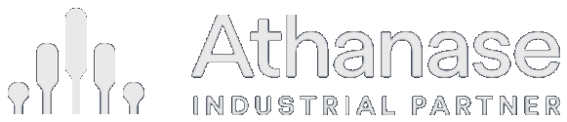
Case studies
Selected investments across three decades of engaged ownership

Slide 2

Disclaimer
This document has been prepared by Athanase Industrial Partner (‘AIP’) solely for the information of the person to whom it has been delivered. The information contained herein is strictly confidential and is only for the use of the person to whom it is sent. The information contained herein may not be reproduced, distributed or published by any recipient for any purpose without the prior written consent of AIP. The information herein is for general guidance only, and it is the responsibility of any person or persons in possession of this document to inform themselves of, and to observe, all applicable laws and regulations of any relevant jurisdiction.
The information regarding Athanase Industrial Partners Fund II (the “Fund”) is not intended to provide and should not be relied upon for accounting, legal or tax advice or investment recommendations. You should consult your tax, legal, accounting or other advisors about the issues discussed herein. Material terms of the Fund are subject to change. Any prospective investor will be provided with a copy of the Fund’s offering memorandum and an opportunity to review the documentation relating to the offering.
This document is not intended as an offer or solicitation with respect to the purchase or sale of any security. This document is not intended for distribution to, or use by, any person or entity in any jurisdiction or country where such distribution or use would be contrary to local law or regulation.
Any subscription may only be made on the terms of the offering memorandum and subject to completion of a subscription agreement. The Fund will not be registered under the Securities Act or the securities laws of any of the states of the United States and interests therein may not be offered, sold or delivered directly or indirectly into the United States, or to or for the account or benefit of any US person.
No reliance may be placed for any purpose on the information and opinions contained in this document or their accuracy or completeness. No representation, warranty or undertaking, expressed or implied, is given as to the accuracy or completeness of the information or opinions contained in this document by any of AIP, its officers, employees or affiliates, and nothing contained herein shall be relied upon as a promise or representation whether as to past or future performance. Past performance is not indicative of future results.
Notice to Swedish Residents — The Fund is authorized by the Finansinspektionen (‘FI’) in accordance with the Law on Managers of Alternative Investment Funds (Sw. Lag om Förvaltare av Alternativa Investeringsfonder, LAIF (2013:561)) for marketing to investors in Sweden that qualify as Professional Investors under the Swedish LAIF (2013:561).
Strictly confidential 1

Slide 3
Overview
Selected case studies
Transactions where the team acted as an engaged owner and implemented operational, structural and financial change. IRR is unleveraged and net of all costs.
AIP — fund-era investment cases
Earlier track record — Investment AB Öresund
Company
IRR
Money multiple
Company
IRR
Period
Haldex AB
64%
4.1×
J&W
94.4%
2000–01
Haldex AB (2nd)
100%
2.0×
Custos
58.9%
2000–04
Concentric AB
81%
3.9×
HQ / Avanza
37.8%
2000–
Kitron ASA
49%
1.6×
Johnson Pump
34.4%
2002–06
Note AB
33%
5.1×
Nobia
33.1%
2002–
Lindab AB
32%
1.6×
SkiStar
33.0%
2000–
Transcom SA
30%
3.0×
Wihlborgs / Drott
31.0%
2002–04
DistIt / Alcadon
—
—
Bilia
26.0%
2003–
Renold plc
234%
1.6×
Robit Plc (exited)
14%
—
Past performance is not indicative of future results. Öresund-era cases were executed by members of the team at Investment AB Öresund (1994–2007).
Strictly confidential 2

Slide 4
PART I · AIP — FUND ERA
Investment cases

Slide 5
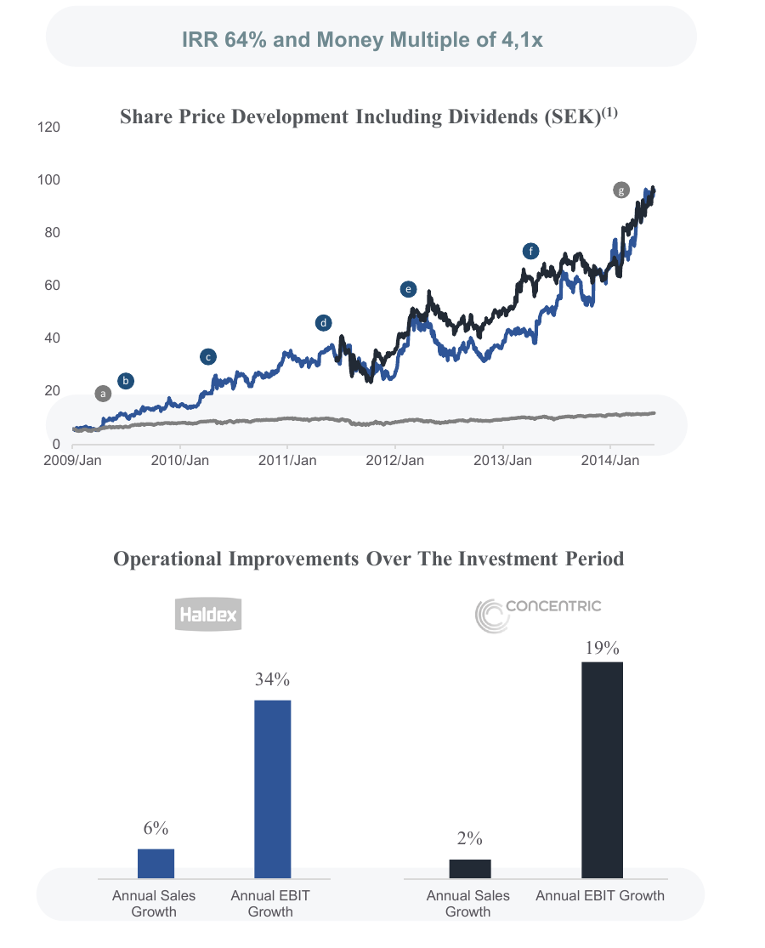
Case · AIP fund era
Investment case study: Haldex AB
Company description
Haldex was a conglomerate with four separate, non-integrated divisions: CVS — components for airbrake systems to trucks and trailers (50% of sales); Concentric — pumps for diesel engines and the secondary hydraulic system (25%); Traction Systems — four-wheel-drive systems for passenger cars (13%); and Wire Systems — spring wires for combustion engines and transmissions (12%).
Recognized opportunities
› All divisions had a profitable core, growing and holding strong market positions
› Three product groups within CVS were hiding overall profitability
› Higher operating costs than peers — cost-saving opportunities
› No structural integration between divisions
› Market price significantly lower than assets and earnings power
› High correlation with GDP — early cycle
Initial plan
1) Change the board to support restructuring; 2) rights issue to secure the competitive position; 3) split divisions into separate companies (sell/spin-off); 4) reduce overhead and consolidate factories; 5) exit or fix unprofitable products; 6) reinvest capital in leading products.
Results
✓ Changed board and management; exited unprofitable products
✓ Spun off and listed Concentric as a separate company
✓ Consolidated the factory footprint; focused R&D on winners
✓ Introduced new products, entered new markets, improved tax structure
✓ Ran a two-track process — sold to BorgWarner for 17× EBIT
✓ SEK 30/share redemption; sold Wire Systems to Suzuki Metal
Note: share price re-based to 100 at investment and includes dividends; benchmark OMXS30 / MSCI. Past performance is not indicative of future results.
Strictly confidential 3

Slide 6
Case · AIP fund era
Investment case study: Concentric AB
Company description
Concentric AB is a world-leading manufacturer of pumps and hydraulic systems — oil, water and fuel pumps and hydraulic solutions for diesel engines and off-/on-highway vehicles. It was the pumps division of Haldex (~25% of group sales), spun off and separately listed on Nasdaq Stockholm in 2011 as part of the Haldex restructuring.
Recognized opportunities
› A high-quality, market-leading niche business hidden inside the Haldex conglomerate
› Profitable core with strong margins and high return on capital, masked by the group structure
› A pure-play listing would remove the conglomerate discount and let the market value it on its own merits
› Clear margin and cost opportunity as a focused, independent company
› Strong cash generation to support capital return and bolt-on growth
Initial plan
Realise the hidden value in Haldex's pumps division by spinning it off as the independent, pure-play Concentric AB; install a focused board and management, drive margin improvement and capital discipline as a stand-alone company, and let the public market re-rate the business.
Results
✓ Spun off and separately listed on Nasdaq Stockholm in 2011
✓ Focused board and management; cost and margin programme as an independent company
✓ Annual EBIT growth of ~19% over the holding period
✓ Strong cash generation funded dividends, buy-backs and bolt-on M&A
✓ Re-rated as a pure-play — realised at ~81% IRR / ~3.9×, outperforming the parent
IRR 81% · Money multiple 3.9×
Operational improvement (annualised)
19%
2%
Annual sales growth
Annual EBIT growth
Spun off from Haldex and listed in 2011 — outperformed the parent
% per year, over the holding period
Note: Concentric was spun off from Haldex and held and realised as a separate listed company; figures relate to the team's Haldex-era investment. Past performance is not indicative of future results.
Strictly confidential 4

Slide 7
Case · AIP fund era
Investment case study: Haldex AB — second investment
Company description
Industrial company manufacturing and selling braking products for on-highway trucks and trailers. AIP re-invested by buying shares at a discount during the COVID crisis, after a takeover bid from competitor Knorr-Bremse had been blocked by the EU and US authorities.
Recognized opportunities
› Company in limbo after the blocked Knorr-Bremse takeover
› Subsequent poor management decisions and bad capital allocation
› Loss-making products with growing revenue eroded the balance sheet
› Key management was leaving due to lack of leadership
› Inexperienced board consisting of consultants
Initial plan
Change the board to members with industrial experience rather than lawyers and bankers; change the management team to an experienced team. Two large institutions (AP4 and AMF) and AIP jointly decided that Stefan Charette should take the board chair.
Results
✓ Changed the whole board and management
✓ Supported management in renegotiating disc-brake contracts
✓ Significantly reduced product costs and overhead; focused R&D
✓ Exited unprofitable products
✓ Company sold to SAFHolland one year later
IRR 100% · Money multiple 2.0×
“Our investment returned 100% within a one-year time period.”
Note: share price re-based to 100 at investment and includes dividends; benchmark OMXS30 / MSCI. Past performance is not indicative of future results.
Strictly confidential 5

Slide 8
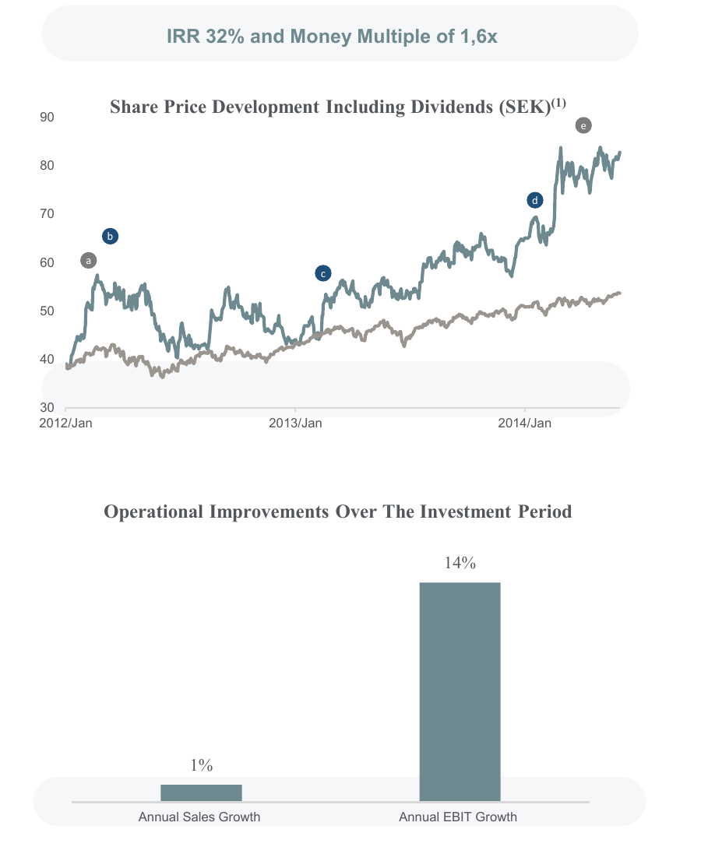
Case · AIP fund era
Investment case study: Lindab AB
Company description
Lindab is an international company that develops, manufactures and distributes products and system solutions for simplified construction and improved indoor climate. It used to be a conglomerate with three divisions: Ventilation (indoor-climate products sold through own distribution centres); Components (roof, wall and floor systems — gutters, rivets, screws); and Building Systems (solutions for residential and commercial properties).
Recognized opportunities
› All three divisions had a profitable, growing core with strong market positions
› Poor historical cost management — savings opportunities
› Scalable by adding more distribution centres without heavy capex
› No structural integration — break-up / consolidation upside
› Market price significantly lower than assets and earnings power
› Late-cycle company with exposure to Europe
Initial plan
1) Change the board; 2) consolidate Ventilation and Components or divest Components; 3) reduce OPEX and logistics complexity; 4) grow sales through the distribution centres; 5) allocate capital to winning products and markets; 6) renegotiate financing and leases.
Results
✓ Refinanced debt and lease structure; changed board and management
✓ Consolidated the Ventilation & Components business
✓ Significant profit potential through organic and acquired growth
✓ Identified ~22% EBIT uplift on current net sales via cost savings
✓ Opportunity to spin off or sell Building Systems
Note: share price re-based to 100 at investment and includes dividends; benchmark OMXS30 / MSCI. Past performance is not indicative of future results.
Strictly confidential 6

Slide 9
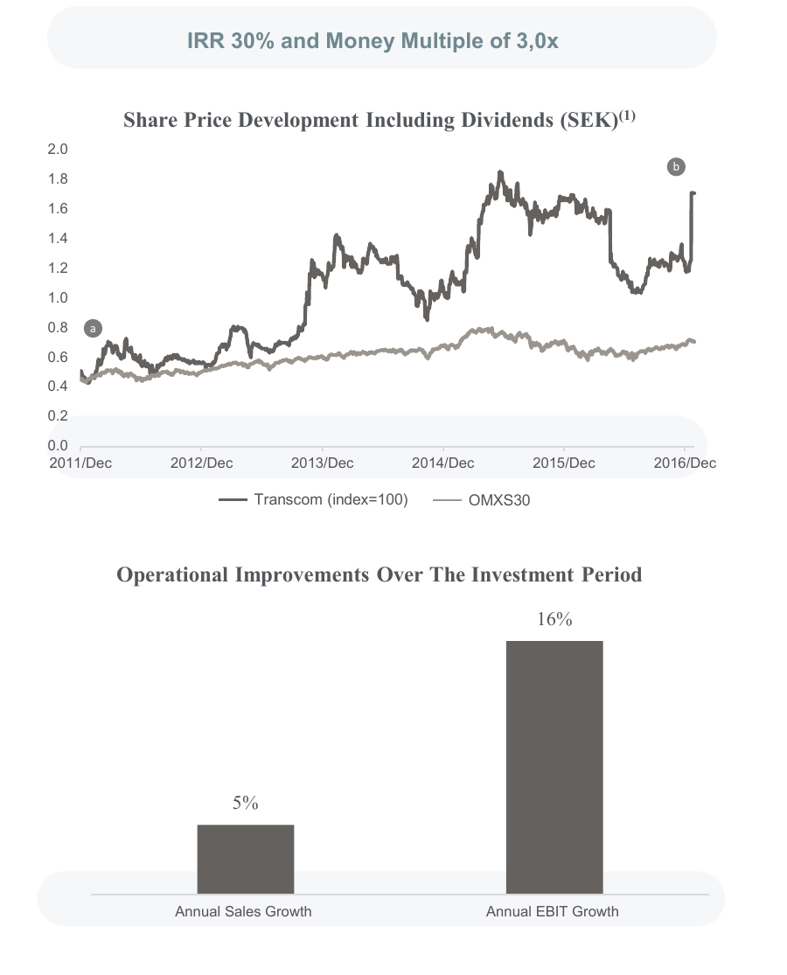
Case · AIP fund era
Investment case study: Transcom SA
Company description
Transcom is a global customer-care company providing customer care, sales, technical support and credit-management services through an extensive network of contact centres and work-at-home agents. It also operated a credit-management (CMS) company across Europe.
Recognized opportunities
› Two separate businesses with limited integration — sale/spin-off of the CMS business
› Losses in France reduced operating profit to break-even
› Higher operating costs than peers — cost-saving opportunity
› Problems with transfer taxes, reporting and product quality
› Market price below earnings-power potential (incl. rights issue)
› Growth opportunities given strong customer relationships
Initial plan
1) Call an EGM to gain a board seat; 2) close the French operation and settle the Italian tax claim; 3) rights issue; 4) spin off or sell the CMS business; 5) divest other assets; 6) exit loss-making sites; 7) reduce OPEX; 8) reinvest in IT to grow the non-voice product.
Results
✓ Changed board and management; rights issue and new financing
✓ Doubled EBIT potential at the same net sales — in line with peers
✓ Separated CMS with its own CEO; sold it in pieces to industrial and PE buyers
✓ Liquidated the French subsidiary far cheaper (€5M vs €20M)
✓ Negotiated Italian tax claims down to 3/5; won back the largest customer
✓ Closed unprofitable sites; introduced new non-voice products
Note: share price re-based to 100 at investment and includes dividends; benchmark OMXS30 / MSCI. Past performance is not indicative of future results.
Strictly confidential 7

Slide 10
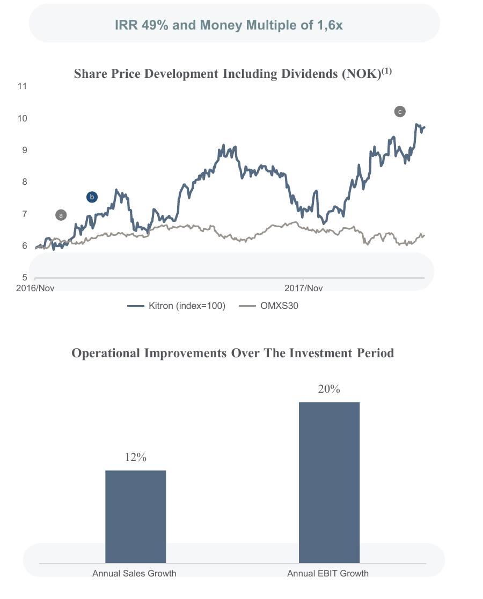
Case · AIP fund era
Investment case study: Kitron ASA
Company description
Kitron is one of the leading companies in Scandinavia specialising in the contract manufacturing of goods with electronics content, serving customers in Defence/Aerospace, Utilities, Industry, Medical Devices and Offshore/Marine. The company has operated since the 1960s.
Recognized opportunities
› Significant turn-around candidate
› Positive shift in industry outlook
› Stable customer base — defence, medical, utilities
› Cost-saving opportunities combined with strong growth in core areas
› Market price significantly lower than earnings power
› Offshore/Marine at an all-time low — additional turn-around upside
Initial plan
1) Reduce costs in Sweden/Norway; 2) board seat through an EGM in early 2017; 3) continued investment in technology to reduce manual labour; 4) acquisition opportunities to build presence; 5) grow within existing customers.
Results
✓ Continued cost-savings plan in Sweden/Norway
✓ Reached a 7% operating margin in Q2 2017 — a company first
✓ Growing significantly with existing customers
Note: share price re-based to 100 at investment and includes dividends; benchmark OMXS30 / MSCI. Past performance is not indicative of future results.
Strictly confidential 8

Slide 11
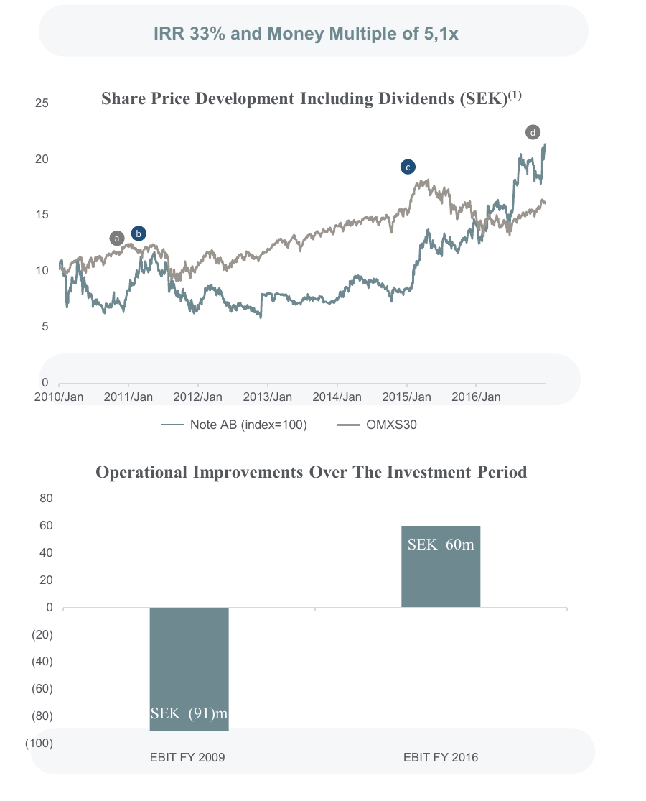
Case · AIP fund era
Investment case study: Note AB
Company description
Note is an electronics-manufacturing and logistics company with production plants near its main customer base in northern Europe, as well as low-cost plants in Eastern Europe and Asia. It focuses on small series with high variability and technology content.
Recognized opportunities
› Significant turn-around candidate with clear boundaries to losses
› The Polish purchasing business was a wrong strategic choice
› Higher operating costs than peers
› Significant mal-investments in the components database
› Market price significantly lower than earnings power
› Growth given strong customer relationships — high switching costs
Initial plan
1) Change the board and elect SC as chairman; 2) close Polish purchasing and the components database and reduce overhead; 3) rights issue to support restructuring; 4) exit loss-making sites; 5) reduce OPEX; 6) grow within existing customers.
Results
✓ Reduced non-profitable sales by changing customers and closing plants
✓ Shifted out close to 40% of the initial purchase price in dividends
✓ EBIT improved from SEK (91)m in FY2009 to SEK 60m in FY2016
Note: share price re-based to 100 at investment and includes dividends; benchmark OMXS30 / MSCI. Past performance is not indicative of future results.
Strictly confidential 9

Slide 12
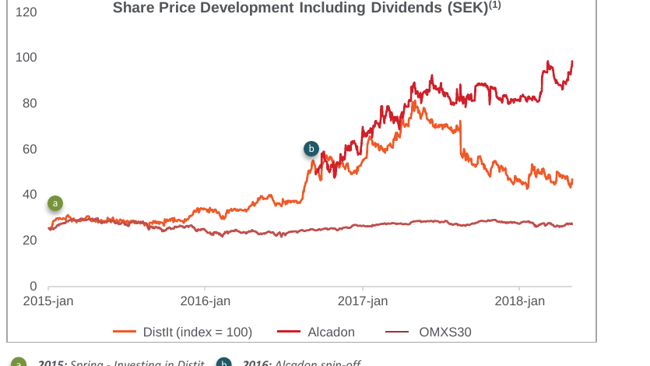
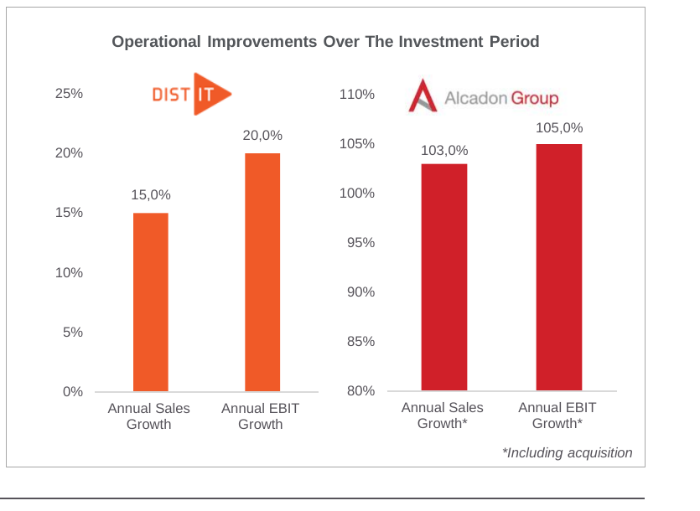
Case · AIP fund era
Investment case study: DistIt / Alcadon
Company description
DistIt was a conglomerate of three distributors: Aurora Group (Danish, Nordic sales of IT, electronics and appliances); Alcadon (Swedish/Norwegian sales of active and passive fibre products); and Deltaco (Nordic sales of electronics and appliances).
Recognized opportunities
› No structural integration between divisions — structural upside
› Market price significantly lower than assets and earnings power
› Alcadon could benefit from being stand-alone — right in the cycle
› Extension opportunities within Aurora; Deltaco a well-known brand
› Never a loss-making year, even through downturns
› Stable management team with a strong cost-minimising culture
Initial plan
1) Secure a board seat at the next AGM; 2) spin off Alcadon; 3) increase utilisation of the Aurora sales force through product extensions; 4) use 3PL in Deltaco to free up real-estate capital; 5) acquire more companies.
Results
✓ Changed the board; spun out and refinanced Alcadon — which then almost doubled in size through acquisition
✓ Aurora signed Duracell, P&G and Oral-B to leverage the sales force
✓ Moved Deltaco's warehouse to 3PL, freeing the building
✓ Acquired Septon and Sominis, with another acquisition pending
✓ Real-time pricing software drove sales of mispriced products
✓ Reduced IT costs through outsourcing
Investment 2015 – present
Note: share price re-based to 100 at investment and includes dividends; benchmark OMXS30 / MSCI. Past performance is not indicative of future results.
Strictly confidential 10

Slide 13
Case · AIP fund era
Investment case study: Renold plc
Company description
Renold plc is a London-listed global leader in industrial chain and torque-transmission products — roller chain, couplings, gearboxes and clutches — serving mining, materials-handling, transport and energy customers worldwide. A market-leading niche franchise (inventor of the bush roller chain, 1879) with a large installed base and recurring aftermarket demand.
Recognized opportunities
› Market-leading niche industrial — strong brand, global installed base, recurring aftermarket
› Mispriced, under-followed UK small-cap at a deep discount to earnings power (~50p)
› Multi-year self-help underway — margin expansion and operational improvement
› Strong cash generation and a de-risking balance sheet
› A credible consolidation / takeover candidate, with limited downside at entry
Initial plan
An opportunistic position rather than a control engagement: build a meaningful stake at a deep discount to intrinsic value, underwrite the downside through asset and earnings-power support, and let the catalysts — margin improvement and likely strategic interest — close the gap.
Results
✓ Built ~5.3m shares at ~50p average from spring 2024; core position from December 2024 — about six months before the takeover
✓ A recommended cash takeover emerged in 2025 at ~81p per share
✓ Realised the entire position into the offer at ~81p over June–July 2025
✓ ~1.6× money multiple, +62% gross (SEK 20.9m); money-weighted IRR ~234%
IRR 234% · Money multiple 1.6×
Capital invested vs. realised proceeds
56
35
Capital invested
Realised proceeds
Bought at ~50p; acquired at ~81p in a recommended takeover
SEK m
Source: AIPFII transaction history (Apr 2024 – Jul 2025). IRR is money-weighted; the short opportunistic hold lifts the annualised figure. Past performance is not indicative of future results.
Strictly confidential 11

Slide 14
Case · AIP fund era
Investment case study: Robit Plc
Company description
Robit Plc is a Finnish-listed (Nasdaq Helsinki) manufacturer of drilling tools and consumables for mining, construction and well-drilling — a niche industrial with a global distribution footprint and recurring aftermarket demand.
Why we invested
› An under-followed Nordic small-cap with a recurring-revenue consumables franchise
› Trading well below intrinsic value, with a correctable cost base and footprint
› A clear path to value through board-level engagement and capital discipline
› Limited downside at entry; a multi-year compounding opportunity
The engagement plan
Build the position in stages, follow the company closely, and secure a board seat to drive the operational and capital-allocation changes — engaged ownership, not a passive bet.
What happened — and the discipline
✓ First invested May 2015; followed the company and added on over several years
✓ Began negotiating a board seat in 2019 to formalise the engagement
✓ Unable to secure board alignment, we exited rather than stay without influence
✓ Still profitable: a ~14% annual IRR — more than twice the index over the hold
✓ Since our exit the shares have roughly halved — walking away was also avoided loss
IRR ~14% p.a. · > 2× the index · disciplined exit
Robit share price after we exited
100
50
At our exit
Today
We exited profitably (~14% IRR); the shares then halved
Indexed to 100 at our exit (indicative)
Source: AIPFII transaction history (first investment May 2015; board-seat negotiation 2019; exited thereafter). IRR is money-weighted and net of costs; benchmark is the relevant equity index; the post-exit move is indicative. Past performance is not indicative of future results.
Strictly confidential 12

Slide 15
PART II · INVESTMENT AB ÖRESUND (1994–2007)
Earlier track record

Slide 16
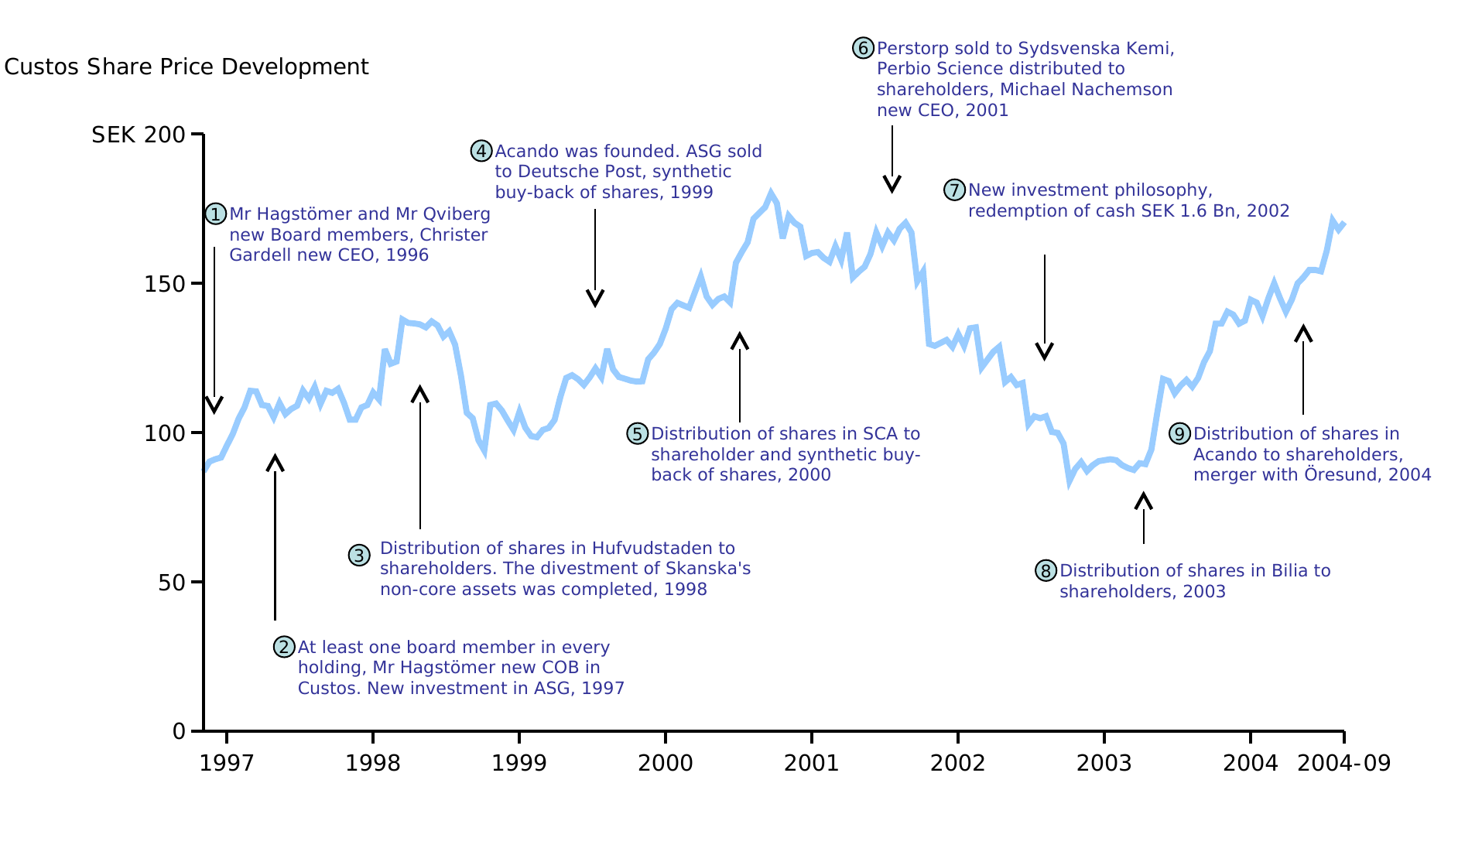
Case · Öresund era
Investment case study: Custos
Company description
Custos was a Swedish listed investment company holding a portfolio of listed companies. It traded at a significant discount to net asset value and had an inefficient capital structure.
Recognized opportunities
› Investment companies traded at a discount to NAV
› Inefficient capital structure
› An interesting portfolio of companies not optimally managed
› Opportunity to buy the underlying assets at a ~30% discount
› The largest shareholder, Skanska, had sold its holding in 1994
› The board was not focused on creating shareholder value
Initial plan
1) Increase shareholder value through extended engagement in holdings via active board management; 2) form a more heterogeneous board to enhance dialogue and decision-making; 3) reduce the discount to NAV through, if necessary, redemption of holdings/cash and synthetic buy-back programs.
Results
✓ New board and CEO (Christer Gardell); active ownership reduced the NAV discount
✓ Distributed Hufvudstaden to shareholders; sold ASG to Deutsche Post
✓ Founded Acando; synthetic buy-back distributing SEK 1.6bn
✓ ~SEK 3.5bn distributed via buy-back and the distribution of SCA
✓ Bilia and Acando distributed to shareholders
✓ Custos ultimately merged with Öresund
IRR 58.9% · 2000–2004
≈ SEK 11bn of shareholder value created over nine years
Note: 9 SEK ≈ 1€. IRR unleveraged and net of all costs. Executed by members of the team at Investment AB Öresund.
Strictly confidential 13

Slide 17
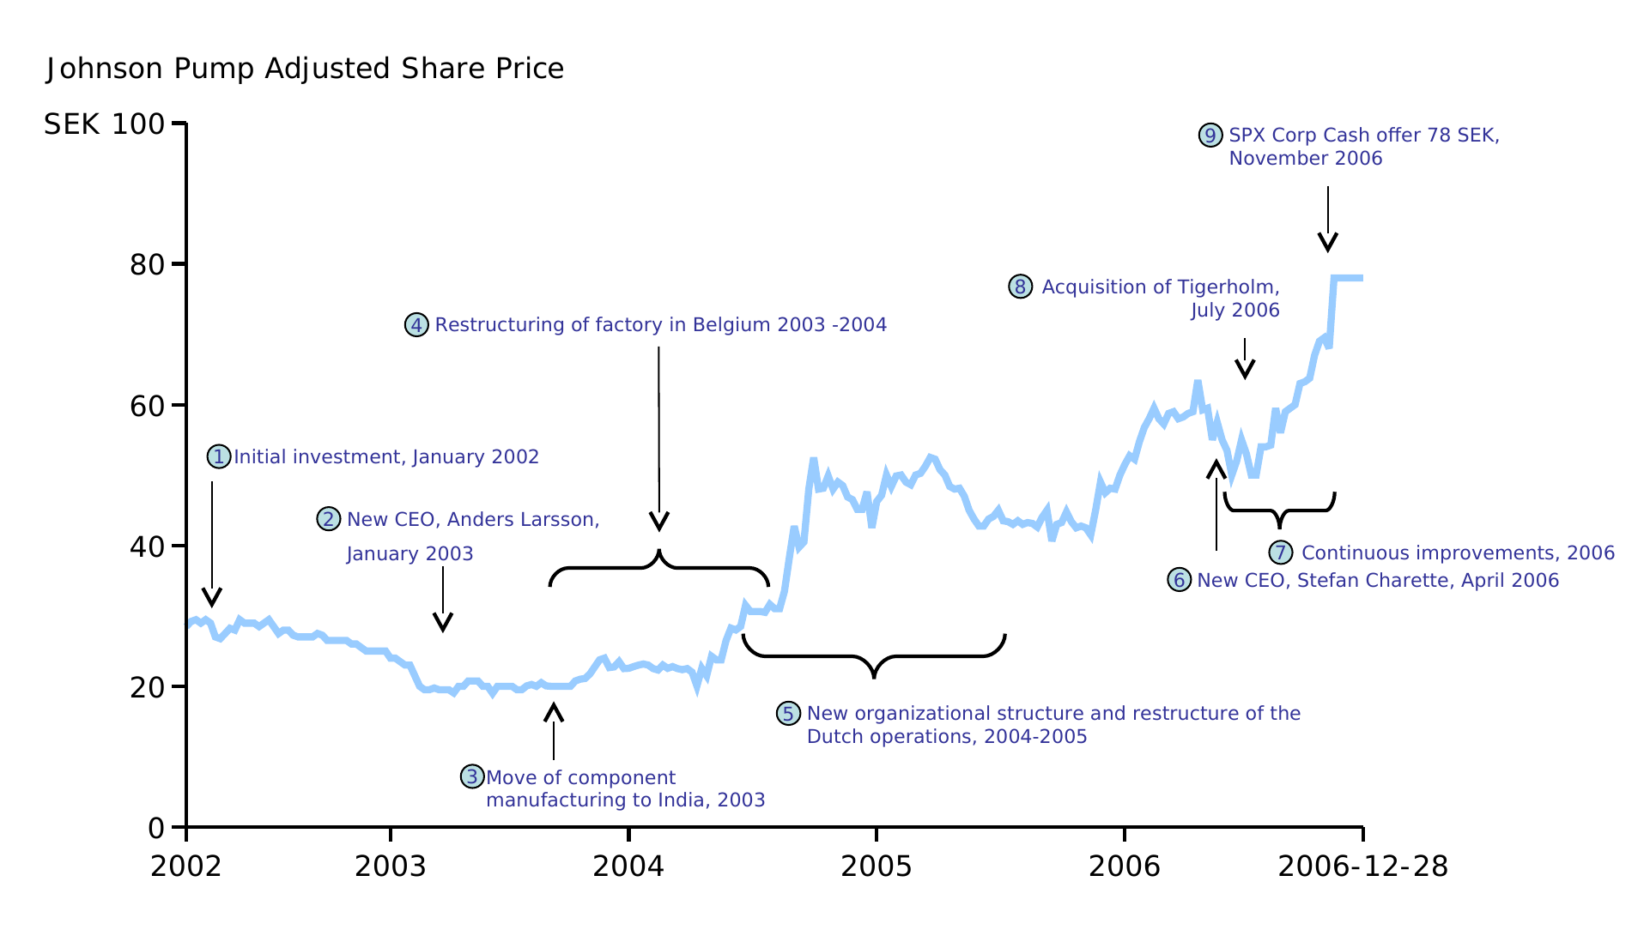
Case · Öresund era
Investment case study: Johnson Pump
Company description
Johnson Pump was a traditional industrial business — a pump OEM with an extensive sales force and a strong brand. It had suffered profitability issues but had started to recover, with revenues of SEK 647m and a negative EBIT.
Recognized opportunities
› Low profitability was largely a cost issue — customers kept buying and the gross margin was decent
› Significant upside on cost in both factories and sales offices
› The sales force could be leveraged with a wider product range (R&D, 3rd-party products, M&A)
› Market segmentation should reveal further niche potential
› Geographic expansion to follow customers moving to low-cost countries
Initial plan
Reduce costs in factories and sales offices, build a uniform sales process and a simplified product range, expand the range and geography, and grow in adjacencies through M&A.
Results
✓ New ERP system (2002); component manufacturing moved to India (2003)
✓ Restructured Dutch operations and centralised sourcing (2004–05)
✓ New CEO Stefan Charette (2006); separated Marine, acquired Tigerholm, launched an export organisation
✓ Revenues +~17%; SG&A −~18%; operating result +~SEK 62m (−15m to +47m)
✓ SPX Corporation public offer accepted by >90% of shareholders; delisted
IRR 34.4% · 2002–2006
Note: 9 SEK ≈ 1€. IRR unleveraged and net of all costs. Executed by members of the team at Investment AB Öresund.
Strictly confidential 14

Slide 18
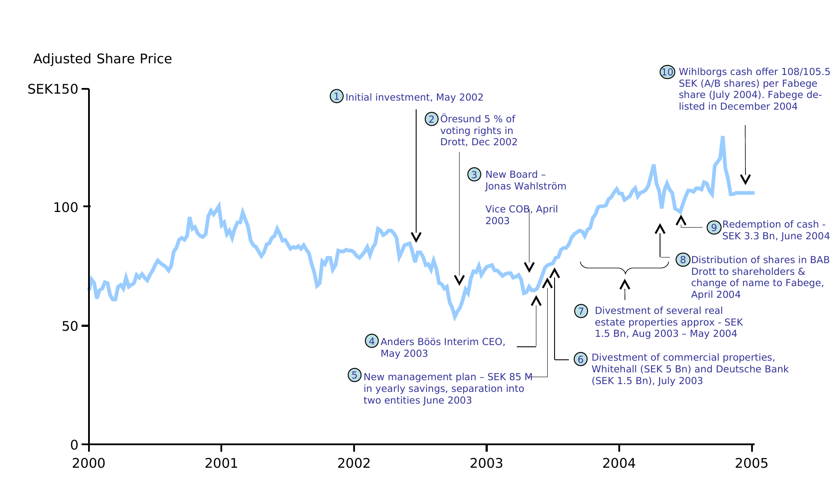
Case · Öresund era
Investment case study: Wihlborgs / Drott
Company description
Wihlborgs and Drott were Swedish listed real-estate companies holding commercial and residential properties in the growing Stockholm and Malmö regions, trading at a discount to NAV with no active owner.
Recognized opportunities
› Shares traded at a discount to NAV for real-estate companies
› Hidden values in both Wihlborgs and Drott
› Limited active ownership; inefficient debt/capital structure
› Limited synergies between commercial and residential — divest
› Inefficient organisations
› Property-investment funds were pushing prices upwards
Initial plan
Divest properties and reduce costs to enable cash distribution; split commercial and residential into separate companies — one for the Öresund/Malmö region and one for Stockholm; refinance to lower the cost of debt.
Results
✓ Öresund acquired 12% of Wihlborgs (2001); new board members joined
✓ Wihlborgs built a ~10% position in Drott; a new board was elected
✓ New management plan with ~SEK 85m of yearly savings
✓ Several properties divested — SEK 3.3bn cash redemption (2004)
✓ Drott split into BAB Drott (residential, sold to Stena) and Fabege (commercial, acquired by Wihlborgs)
✓ Combined operations later split into two regional companies
IRR 31.0% · 2002–2004
≈ SEK 3bn of net value created in 15 months
Note: 9 SEK ≈ 1€. IRR unleveraged and net of all costs. Executed by members of the team at Investment AB Öresund.
Strictly confidential 15

Slide 19
Case · Öresund era
Investment case study: J&W
Company description
J&W (Jacobson & Widmark) was a Swedish technical-consulting firm. Öresund first invested in 1994 and took a controlling interest in 2000.
Recognized opportunities
› Over-funded pension plans — cash to be returned from the SPP pension trust (now Alecta)
› A fragmented consulting market with consolidation potential
› A non-core subsidiary (Benima Ferator) that could be divested
Initial plan
Return excess cash to shareholders, divest non-core operations, and consolidate the fragmented technical-consulting market through acquisitions.
Results
✓ Spun off Benima Ferator to shareholders (later acquired by Sigma)
✓ Transferred SPP pension-plan cash to shareholders
✓ Acquired several smaller competitors and the larger Kjessler & Mannerstråle (KM)
✓ J&W was subsequently sold to WSP
IRR 94.4% · 2000–2001 · Technical consultants
Initial investment vs. current value
476
213
Initial investment
Current value
SEK M
Note: 9 SEK ≈ 1€. IRR unleveraged and net of all costs. Executed by members of the team at Investment AB Öresund.
Strictly confidential 16

Slide 20
Case · Öresund era
Investment case study: Nobia
Company description
Nobia is a European kitchen company. Originally active across several construction-component areas, it was streamlined to focus on kitchens.
Recognized opportunities
› Active across several construction-component areas — focus opportunity
› A fragmented European kitchen market with consolidation potential
Initial plan
Streamline Nobia to focus on kitchens by divesting other areas, and consolidate the European kitchen market through acquisitions.
Results
✓ Streamlined to focus on kitchens (sold Doors & Windows)
✓ Acquired Gower, EWE-FM and Hygena — the largest kitchen company in Europe
✓ Turnover up from SEK 9.2bn (2003) to SEK 16.1bn (12m to Jun 2007)
✓ EBIT up from SEK 560m to SEK 1,360m
IRR 33.1% · 2002– · Consumer discretionary
Initial investment vs. current value
1,083
162
Initial investment
Current value
SEK M
Note: 9 SEK ≈ 1€. IRR unleveraged and net of all costs. Executed by members of the team at Investment AB Öresund.
Strictly confidential 17

Slide 21
Case · Öresund era
Investment case study: HQ / Avanza
Company description
Hagströmer & Qviberg (HQ) and Avanza are Swedish financial companies — brokerage, fund management, wealth management and online brokerage. Sven Hagströmer founded Hagströmer Fondkommission in 1986; Mats Qviberg joined in 1989.
Recognized opportunities
› Separate online brokerage / fund management from traditional brokerage and investment banking
› Consolidation opportunities among internet brokerages
Initial plan
Split HQ into focused entities, consolidate internet brokerages into Avanza, and build a wealth-management business.
Results
✓ HQ split (2000) into HQ.SE (internet brokerage, fund management) and Hagströmer & Qviberg
✓ HQ.SE acquired Aktiespar FK and Avanza; split into HQ Fonder and Avanza
✓ Avanza expanded into pensions, fund distribution, corporate finance and banking
✓ HQ Fonder merged with Hagströmer & Qviberg (2005) — SEK 85bn AUM
IRR 37.8% · 2000– · Finance
Initial investment vs. current value
2,808
744
Initial investment
Current value
SEK M
Note: 9 SEK ≈ 1€. IRR unleveraged and net of all costs. Executed by members of the team at Investment AB Öresund.
Strictly confidential 18

Slide 22
Case · Öresund era
Investment case study: SkiStar
Company description
SkiStar is a Scandinavian operator of alpine ski resorts, built through the consolidation of several destinations into a single listed leisure company.
Recognized opportunities
› A fragmented ski-resort market with consolidation potential
› Opportunity to build a leading Scandinavian leisure platform
Initial plan
Consolidate alpine destinations into a single listed leisure company.
Results
✓ Hundfjället acquired Tandådalen; the combined entity was restructured
✓ Acquired Lindvallen; the combined entity was listed
✓ Acquired Åre, Duved and Vemdalen from Bure — renamed SkiStar
✓ Acquired Hemsedal (and later Trysil)
IRR 33.0% · 2000– · Leisure
Initial investment vs. current value
659
160
Initial investment
Current value
SEK M
Note: 9 SEK ≈ 1€. IRR unleveraged and net of all costs. Executed by members of the team at Investment AB Öresund.
Strictly confidential 19

Slide 23
Case · Öresund era
Investment case study: Bilia
Company description
Bilia is a leading Nordic car retailer and car-service company. Öresund became an owner in 2003 through a redemption of shares from Custos.
Recognized opportunities
› Opportunity to separate trucks/heavy vehicles from the car business
› Strong cash flow to fund consolidation of car retailers
› Hidden real-estate value
Initial plan
Separate the heavy-vehicle and car businesses, use strong cash flow to acquire competing car retailers, and unlock real-estate value.
Results
✓ Split into heavy vehicles (LV) and cars (PV); Volvo AB acquired the LV business for PV shares — leaving a pure car retailer
✓ Acquired several competing car retailers, expanding geography and brands; transferred excess cash to shareholders
✓ Spun off the real estate as Catena (2006), distributed to shareholders and listed
IRR 26.0% · 2003– · Consumer discretionary
Initial investment vs. current value
1,056
506
Initial investment
Current value
SEK M
Note: 9 SEK ≈ 1€. IRR unleveraged and net of all costs. Executed by members of the team at Investment AB Öresund.
Strictly confidential 20

Slide 24
Kenth Eriksson
Senior Portfolio Manager & Partner
+46 70 304 09 29
kenth.eriksson@athanase.se
info@athanase.se

