Slide 1

A PROPOSED UK INVESTMENT TRUST
Engaged ownership, in a listed trust
An institutional, 20-year strategy — daily-dealing access for wealth portfolios
For discussion · June 2026 · professional and intermediary use only

Slide 2

Fund overview
1. Athanase at a glance
A proven engaged-ownership strategy — proposed in a listed, daily-dealing trust for UK wealth.
38
19%
7%
18×
investments as engaged owners
avg annualised NET, any entry month
worst-ever entry, still positive net
growth of capital since 2006
~16% net p.a. since 2006 versus 6.2% for the MSCI World IMI — +10 pts a year, net of all fees.
Entry timing barely matters the average entry month returned ~19% net; the worst still compounded at +7%.
No investor loss over any full holding period in 20 years.
An integrated team
A core team together since 2006 (some since 1996) — 38 companies and 30+ public board seats. Operations, valuation and risk sit apart from investment decisions; custody, administration and audit by SEB, MUFG and KPMG.
Strictly confidential · professional & intermediary use only 1

Slide 3
Fund overview
2. The proposed trust at a glance
Indicative parameters for discussion — final terms to be set with the sponsor and prospectus.
Term
Proposal
Structure
UK closed-end investment trust, London-listed
Listing venue
LSE Main Market or Specialist Fund Segment (indicative)
Objective
Long-term capital growth via engaged ownership
Portfolio
8–12 high-conviction listed Nordic / European mid-caps
Liquidity
Daily dealing in the shares; no capital calls
Discount control
Buyback when shares trade materially below NAV (indicative)
Alignment
Significant team co-investment alongside shareholders
Providers
Custody SEB · Administration MUFG · Audit KPMG
Indicative and subject to contract, regulatory approval and final fund documentation. Not an offer of securities.
Strictly confidential · professional & intermediary use only 2

Slide 4
The opportunity
3. Why now — the easy decade for beta is over
Equities are expensive on almost every measure, and the zero-rate tailwind that lifted all assets has reversed.
EXPENSIVE ON MOST MEASURES
THE MACRO TAILWIND HAS REVERSED
Shiller CAPE near ~36× — close to the dot-com extreme, roughly double the long-run ~17×.
Forward P/E ~22× vs a ~16× average; the equity risk premium is at multi-decade lows.
Most of the 2010s’ return came from re-rating, not earnings growth — that lever is largely spent.
The zero-rate, disinflationary backdrop that lifted every asset for a decade has reversed.
Deglobalisation, deficits and demographics point to structurally higher inflation and rates.
A higher cost of capital compresses valuations and punishes long-duration, unprofitable growth.
Whether or not AI lifts productivity, beta is priced for perfection and the easy tailwind has shifted — so idiosyncratic, valuation-disciplined returns matter more, not less.
Strictly confidential · professional & intermediary use only 3

Slide 5
The opportunity
4. Passive has become a concentrated bet
A cap-weighted index puts the most money into the stocks that have already risen most — concentration dressed as diversification.
~38%
~33%
~50 yrs
of the S&P 500 in its 10 largest stocks
in the “Magnificent Seven” alone
since US equity was this concentrated
Cap-weighting buys high
A concentrated factor bet
Breadth is fragile
The more a stock rises, the more you must own — the opposite of buy-low discipline.
The “diversified” index is now a leveraged bet on large-cap growth, momentum and a single theme (AI).
A stumble in a handful of mega-caps now moves the whole index; the rest has been left behind.
Strictly confidential · professional & intermediary use only 4

Slide 6
The opportunity
5. From passive risk to active opportunity
An expensive, concentrated, passive-dominated market is what active is built for — and as analysis commoditises, the durable edge is ownership, not stock-picking.
The setup — expensive equities, record concentration and price-insensitive passive flows that inflate the most crowded names.
Why active now — wider mispricing and dispersion reward valuation discipline again; the “active underperforms” critique is cyclical, and weakest in exactly this market.
AI commoditises analysis — quant and specialist edges compete on the same public data, which commoditises fastest (Kim, Muhn & Nikolaev, 2024; McLean & Pontiff, 2016).
The most durable edge is ownership: buying mispriced businesses and changing the outcome — an edge AI cannot copy.
Strictly confidential · professional & intermediary use only 5

Slide 7
The opportunity
6. When valuations crack, where will clients hold?
At record valuations the cycle will turn — and the hedge can only be bought before the crack, not after.
Global equities — exposed
Private equity — the trap
This trust — the hedge
Clients own the most-expensive, most-concentrated names, with nothing to do when they fall.
Marks lag then catch down, while illiquidity blocks the exit exactly when it is needed.
Board control floors the risk, the shares stay liquid, and the dislocation becomes the entry.
LIVE — JUNE 2026 · BLOOMBERG / CNBC
Partners Group capped redemptions in its $8.6bn evergreen PE fund at 5% of NAV after requests hit 9.8% — KKR, Blackstone and Ares fell. The PE exit is closing, exactly as feared.
While evergreen PE gates redemptions, a listed trust trades every day the market is open — the liquidity clients keep when it matters.
Strictly confidential · professional & intermediary use only 6

Slide 8
The strategy
7. Two ways to own actively: public or private
The same operational value creation is available in PE and public markets — but the public route keeps what private gives up.
Feature
Private — PE / buyout
Public — Engaged ownership
How you act
Buy and control the whole company
Board seat and real influence
Entry price
A ~40% control premium, up front
Market price — often at a discount
Liquidity
10-year lock-up; blind-pool calls
Daily liquidity; exit any time
Pricing
Smoothed quarterly appraisal marks
Honest daily market prices
Fees
2 & 20, plus fees on idle dry powder
Lower, on capital deployed
Value engine
Board-led operational improvement
The same — board-led improvement
Strictly confidential · professional & intermediary use only 7

Slide 9
The strategy
8. Where it fits in a portfolio: three homes
Engaged ownership needs no bucket of its own — it can be funded from public equity, alternatives or private equity.
Public equity
Alternatives
Private equity
THE LENS
A concentrated, active equity sleeve — long-only listed companies with daily pricing and full transparency.
WHY FUND IT HERE
Adds idiosyncratic, governance-driven alpha to a beta-dominated book.
THE LENS
A catalyst strategy — returns from board change, capital returns and corporate events.
WHY FUND IT HERE
The driver is event-specific, largely independent of rates and growth; it diversifies.
THE LENS
PE-style value creation — board influence, operational improvement, multi-year holds — in public markets.
WHY FUND IT HERE
The same engaged-ownership engine as PE, but liquid, with no J-curve or lock-up.
Strictly confidential · professional & intermediary use only 8

Slide 10
The strategy
9. What we do — we don’t pick stocks, we build companies
Quality-core constructivism: own good businesses and make them better from the boardroom.
Quality at a discount — profitable, high-return businesses below intrinsic value; never broken turnarounds we cannot underwrite.
Value we create, not discover — board control, capital-allocation discipline and operational change, not leverage or financial engineering.
Returns from earnings, not re-rating — the gain comes from the business improving under our influence — bankable cash, not a hoped-for multiple.
Constructive, by agreement — board seats won collaboratively, not proxy wars fought — a Nordic governance model, 20 years honed.
Private-equity-style value creation — in transparent, listed, daily-liquid form.
Strictly confidential · professional & intermediary use only 9

Slide 11
Process
10. How we invest: three tollgates
Every idea passes the same three gates — each with an explicit bar and a named decision-maker.
1
Tollgate 1 — Valuation
The question: “Is it cheap enough even if we change nothing?”
Pass only if: The core business alone justifies the price — a 30–40% margin of safety vs a PE bidder. (Investment Team)
2
Tollgate 2 — The plan
The question: “Is the improvement plan real — and can we deliver it?”
Pass only if: Upside quantified across value levers and validated, with a credible path to a board seat; includes psychometric evaluation of CEO / Chair. (Deal Lead + Head of Research)
3
Tollgate 3 — Go / No-Go
The question: “Right risk, right size, right fit?”
Pass only if: Within risk and portfolio limits, conviction-sized, with no better use of the capital. (Investment Committee)
Strictly confidential · professional & intermediary use only 10

Slide 12
Process
11. The ownership playbook
A repeatable sequence, honed over 38 investments, that turns a board seat into operational value.
1 · Secure board seat
2 · Align the thesis
3 · Refocus earnings
Often a precondition to invest — the nomination committee proposes an AIP director.
Collaborate with management and stakeholders to agree where the value is.
Cut overhead, optimise footprint, exit loss-making “growth-trap” ventures.
4 · Reallocate to winners
5 · Grow by acquisition
6 · Exit
Redeploy freed-up capital into the profitable core and its strongest adjacencies.
Add complementary products or scale through value-accretive bolt-ons.
Realise via M&A or the equity market once the core is refocused and compounding.
We don’t buy broken companies — we buy hidden cores.
Strictly confidential · professional & intermediary use only 11

Slide 13
Process
12. Risk, honestly
A risk system built to engineer out permanent loss — controlled before the investment is made.
THREE PILLARS OF PROTECTION
AUTOMATIC GUARDRAILS
Predictability — only durable, market-leading cores in slow-moving industries where future demand is underwritable.
Price (a valuation floor) — value the rectifiable core, zero for “growth-trap” divisions — a structural 30–40% margin of safety vs PE.
Influence — a board seat as the “kill switch” — stopping a bad decision lowers risk below passive or active managers.
Entry gauntlet — ideas must clear ≥12% expected IRR and ≤20% probability of a 30% drawdown.
Diversification limits — capped exposures to sector (≤30%), cycle, maturity and geography.
Mechanised discipline — automatic −10 / −20 / −30% triggers force a re-underwrite, and an exit if the thesis is broken.
No leverage — isolated to single investments, never at the fund level.
Strictly confidential · professional & intermediary use only 12

Slide 14
Track record
13. Versus private equity
On true risk, PE and Athanase carry similar volatility — but Athanase returns more, with daily liquidity.
Metric
Private equity (realised)
Athanase (engaged owner)
Real return
~11–14% (above PME, below us)
~16% net, real, fully invested
Liquidity
10-year lock-up, blind pools
Daily liquidity, listed
Transparency
Smoothed, model-marked quarterly
Daily marks, public scoreboard
True volatility
~28% (de-smoothed, levered)
27% (downside only ~11%)
Downside risk
~16% chance of 30%+ loss / 3 yrs
~2% chance of 30%+ loss / 3 yrs
Athanase captures 93% of the market’s upside but only 43% of its downside; at 0.44 correlation it improves the whole portfolio’s efficient frontier.
Strictly confidential · professional & intermediary use only 13

Slide 15
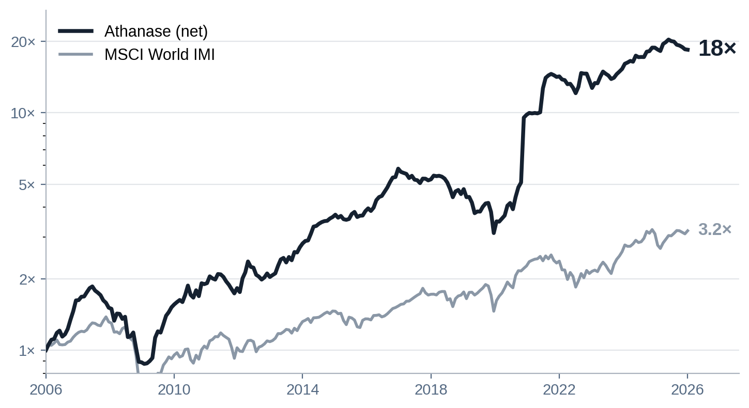
Track record
14. £1 has become ~£18, net — vs ~£3 for the index
Twenty years of compounding from operating improvement — net of all fees, independently reconciled.
~16%
net p.a. over 20 years
+10 pts
a year vs the index, net
0%
investor loss over a holding period
2.40
Sortino ratio — downside-aware
Cumulative growth of capital, net of fees, 2006–2025 (log scale). Newly proposed trust; manager’s existing strategy. Past performance is not a guide to future returns.
Strictly confidential · professional & intermediary use only 14

Slide 16
Track record
15. Every investment in the current fund (AIP Fund II)
The full book, ranked by money multiple — winners, and the discipline on the one that disappointed.
Company
Holding
Gross IRR
MOIC
vs index
Ngex
2016-2025
69%
6.2×
+59%
AI
2020-2025
n.m.
5.4×
n.m.
Roko
2019-2025
28%
5.1×
+18%
Zutec
2018-2025
38%
2.8×
+29%
Bufab
2015-2025
35%
2.0×
+27%
Transcom
2015-2016
80%
1.7×
+80%
Alcadon
2016-2025
74%
1.7×
+65%
Haldex
2019-2022
36%
1.6×
+33%
Sandvik
2015-2017
49%
1.6×
+43%
Renold
2024-2025
220%
1.6×
+211%
Kitron
2016-2018
40%
1.5×
+16%
Zalaris
2018-2025
26%
1.5×
+16%
Robit
2015-2020
14%
1.4×
+8%
DistIt
2015-2025
7%
1.2×
-1%
Catella
2020-2025
12%
1.2×
+2%
Tempest
2018-2025
12%
1.2×
+3%
Actic
2017-2023
-27%
0.4×
-33%
Gross deal-level figures, AIP Fund II to 2025; “n.m.” where holding periods are too short to annualise. Past performance is not a guide to future returns.
Strictly confidential · professional & intermediary use only 15

Slide 17
Structure & governance
16. Why a listed trust is the ideal home
A closed-end structure matches long-horizon engaged ownership better than any open-ended wrapper.
Permanent capital = patient capital — no forced redemptions, so we are never a forced seller; the multi-year engagement is protected and dislocations become opportunities.
Daily liquidity for clients — shares trade on the LSE — daily dealing, no capital calls — while evergreen PE funds gate redemptions (Partners Group, June 2026).
An independent board — a majority-independent board oversees the manager on shareholders’ behalf.
Tier-one providers — operations, valuation and audit segregated from investment — SEB · MUFG · KPMG.
An institutional strategy clients can buy and sell like any listed share — without giving up the patient capital it needs.
Strictly confidential · professional & intermediary use only 16

Slide 18
Structure & governance
17. Income and discount control
A total-return strategy the trust structure can still wrap with a predictable income and a tight discount.
Distribution policy (proposed)
Discount control
Capital growth at the core — realised as listed gains. UK trusts can pay a smoothed annual dividend from realised gains and revenue reserves, so a steady, quarterly income is available where advisers want it. Target yield and frequency to be set at launch.
A buyback policy that triggers when the shares trade materially below NAV — supported by realised exit gains — to keep any discount tight. Listing on the LSE Main Market or Specialist Fund Segment, weighed on index eligibility, investor base and compliance.
Proposed; distribution policy, yield and discount mechanism to be agreed with the sponsor and board, subject to reserves and regulation.
Strictly confidential · professional & intermediary use only 17

Slide 19
Structure & governance
18. An indicative launch timetable
A standard 3–4 month roadmap from mandate to admission.
MONTH 1
MONTH 2
MONTH 3
MONTH 4
Structuring, board and provider appointments; mandate and policies agreed.
Draft prospectus and due diligence; discount and distribution policies finalised.
Regulatory review; marketing and cornerstone engagement.
Roadshow, book-build and admission to listing.
Illustrative; actual timetable, venue and discount policy subject to the sponsor, board and regulatory approval.
Strictly confidential · professional & intermediary use only 18

Slide 20
Bringing institutional engaged ownership to UK wealth
For your clients: a liquid, listed, differentiated equity holding — a 20-year net track record, real diversification and downside protection, daily dealing.
Why now: expensive, concentrated markets, gating private equity and decaying analytical alpha — the hedge is bought before the crack.
The proposal: partner to launch a UK investment trust on this strategy.
Stefan Charette · Athanase Industrial Partner · charette@athanase.se

