Slide 1

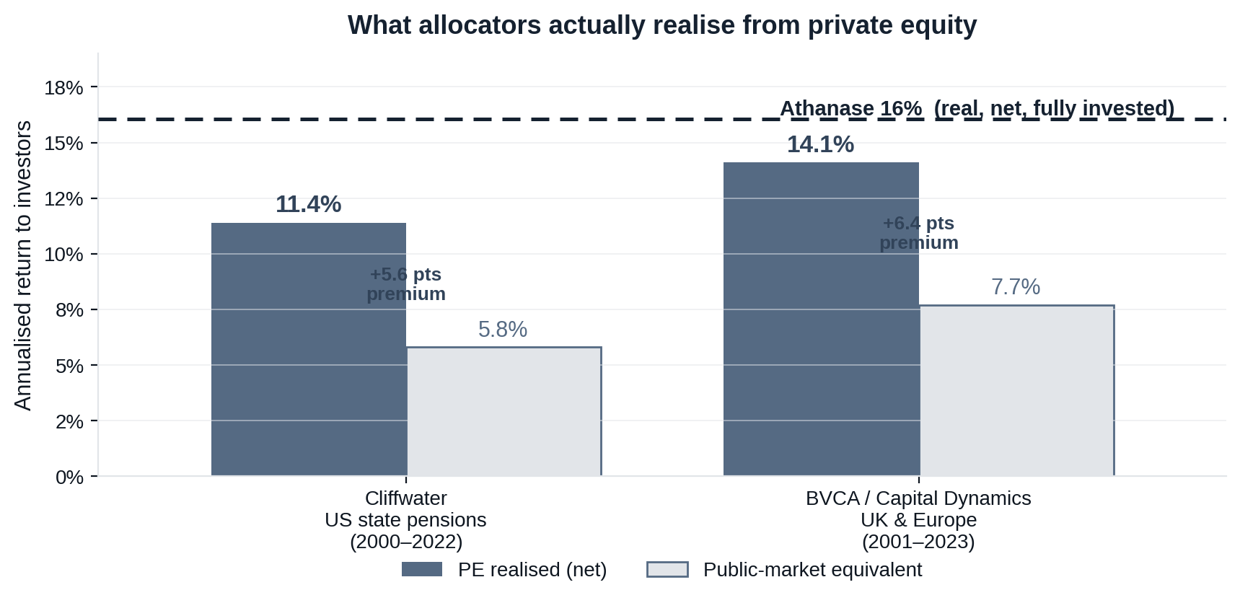
Risk-Adjusted Outcomes
Figure 1
What allocators actually earn from private equity
Stripping out headline-IRR marketing, cash-matched (PME) data shows PE earns a real ~3–6 pt premium over public markets — but lands below Athanase.
HEADLINE ≠ REALISED
Top-quartile IRR is shown as ~18–22%, struck on drawn capital. Cash-matched to public markets, the real figure is far lower.
THE REAL PREMIUM IS GENUINE
PME studies agree: ~1.2× wealth multiple, a real 3–5 pt premium over public equities (Cambridge; Kaplan-Schoar / Burgiss; Cliffwater; BVCA).
BUT BELOW ATHANASE
Allocators realise ~11–14% from PE. Athanase has delivered ~16% — net, real, and fully invested from day one.
PE’s premium over public markets is real — but Athanase’s ~16% sits above even what the best allocators realise, with daily liquidity.
Sources: Cliffwater (US state pensions, 2000–2022): PE 11.4% vs PME 5.8%. BVCA / Capital Dynamics (UK & Europe, 2001–2023): 14.1% vs 7.7% (PME+). Corroborated by Cambridge Associates mPME (1.15–1.25×) and Kaplan-Harris-Jenkinson KS-PME on Burgiss (1.20–1.27×), ≈ +3 pts/yr. Athanase real, net, 2006–2025.

Slide 2
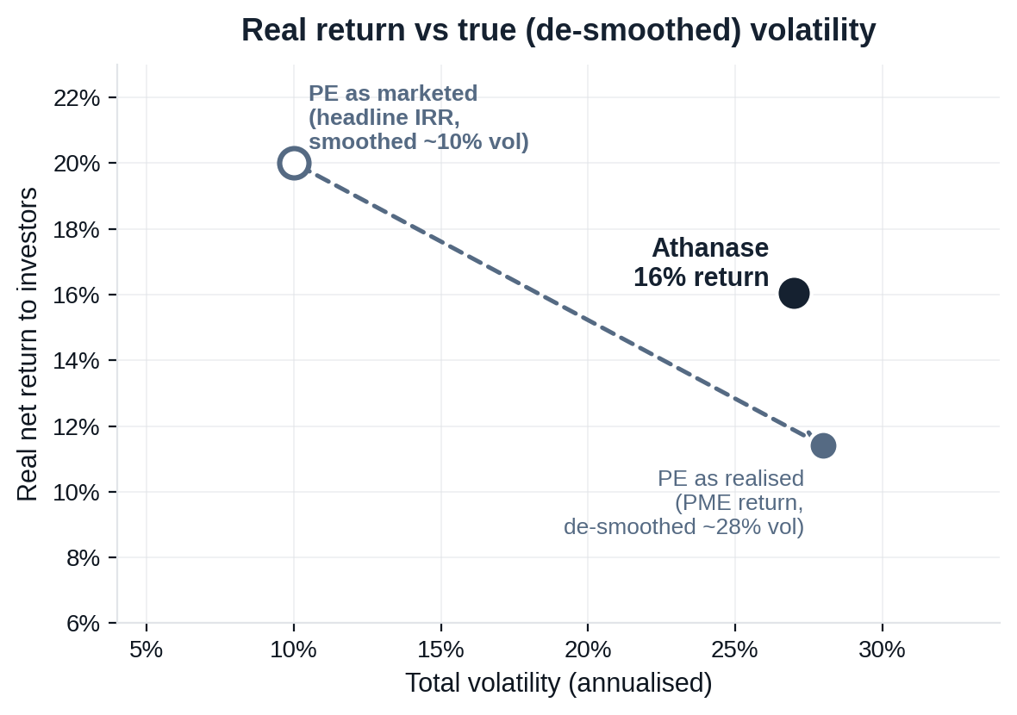
Risk-Adjusted Outcomes
Figure 2
Switching a private-equity sleeve into Athanase
On true risk, PE and Athanase carry similar volatility — but Athanase’s is mostly upside, and it returns more, with daily liquidity.
RETURN
~16% vs ~11–14% realised
Above what even the best allocators realise from PE (Cliffwater; BVCA).
LIQUIDITY
Daily vs 10-yr lock-up
Listed positions you can exit; no blind-pool capital calls.
FEES & CAPITAL
Lower drag, fully invested
No fees on undeployed dry powder waiting in a queue.
TRANSPARENCY
Daily marks, real control
A public scoreboard plus board control of cash flow, capex and pay.
De-smoothed, PE’s ~10% reported vol is really ~28% (PIMCO; AQR beta 1.5–1.6) — about Athanase’s 27%, but levered downside, not upside.
RISK, HONESTLY
Similar vol, opposite shape
PE’s true ~28% vol is levered downside; Athanase’s 27% is mostly upside (downside only ~11%).
Once PE’s smoothing is removed, the two carry similar volatility — but Athanase returns more, its risk is upside not downside, and it stays liquid and transparent.
Athanase: net monthly returns, 235 months (2006–2025), real (total vol 27%, downside 11%). PE realised ~11–14% (Cliffwater 11.4%; BVCA 14.1%) vs headline IRR ~18–22%; reported ~10% vol de-smoothed to ~25–30% (PIMCO; AQR equity beta 1.5–1.6; Couts-Gonçalves-Rossi, 2024). Illustrative; past performance ≠ future results.

Slide 3
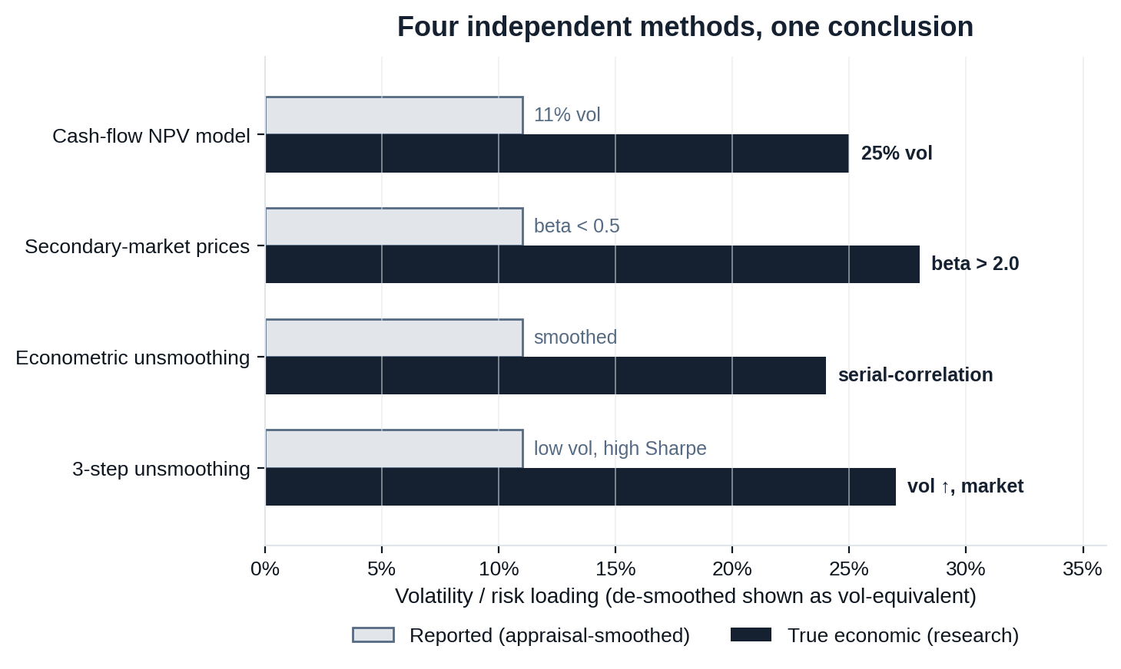
Risk-Adjusted Outcomes
Figure 3
The volatility gap is settled in the literature
Cash-flow models, secondary-market prices and econometric unsmoothing all converge: PE’s true risk is roughly 2–3× its reported figure.
CASH-FLOW NPV MODEL
Buyout vol 25% (vs 11% index), beta > 1 — Ang, Chen, Goetzmann & Phalippou (2018), J. Finance.
SECONDARY-MARKET PRICES
Traded-stake beta > 2.0 vs < 0.5 for the same firms on NAV — Boyer, Nadauld, Vorkink & Weisbach (2018).
ECONOMETRIC UNSMOOTHING
Illiquidity creates spurious smoothness that suppresses vol — Getmansky, Lo & Makarov (2004), JFE (cited 1,300+).
CATERING / “LAUNDERING”
GPs smooth returns because LPs value the “phony happiness” — Jackson, Ling & Naranjo (2022); Couts et al. (2020).
Independent methods, the same answer: PE is a highly-levered equity portfolio whose reported smoothness is an artefact — its true volatility rivals Athanase’s, without the upside skew.
Sources: Ang, Chen, Goetzmann & Phalippou (2018, J. Finance 73(4)); Boyer, Nadauld, Vorkink & Weisbach (2018); Getmansky, Lo & Makarov (2004, JFE 74(3)); Couts, Gonçalves & Rossi (2020); Jackson, Ling & Naranjo (2022); PIMCO (2022); AQR (Asness). Bars show vol-equivalent risk; beta rows scaled for comparison. Illustrative.

Slide 4
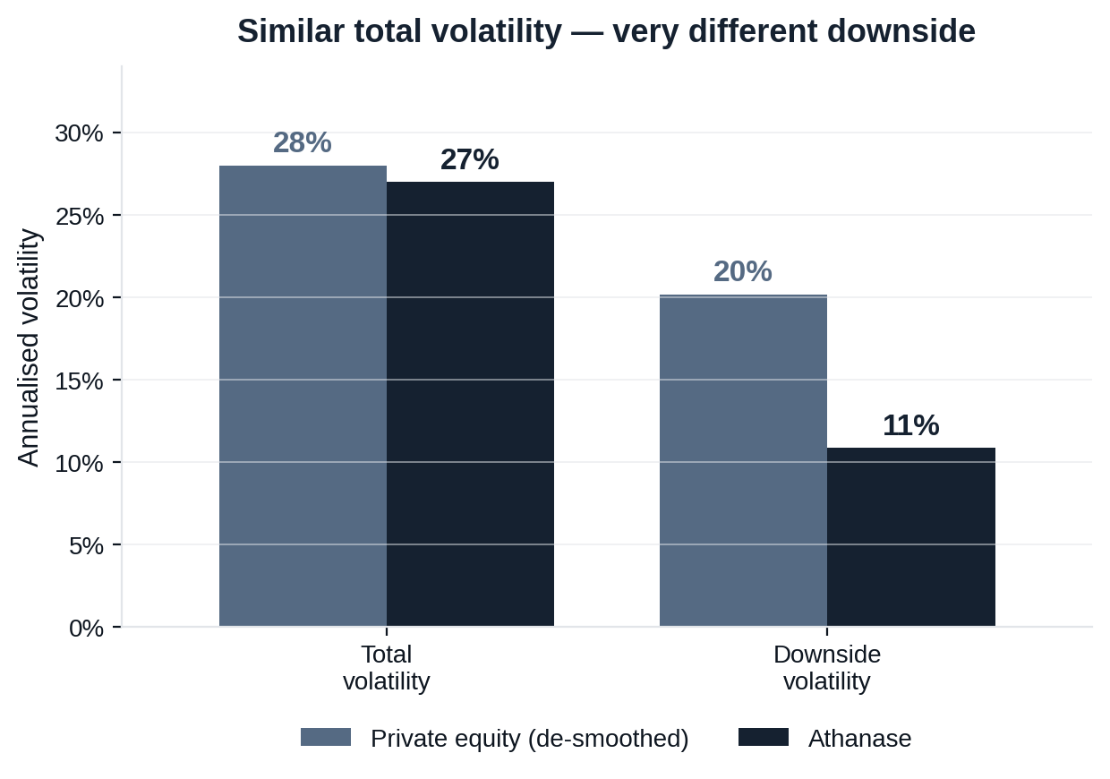
Risk-Adjusted Outcomes
Figure 4
Same headline volatility — far lower real risk
Volatility is not symmetric. PE’s true risk is levered downside; Athanase’s is mostly upside, so its real loss risk is a fraction of PE’s.
CHANCE OF A 30%+ LOSS OVER THREE YEARS
~16% private equity
~2% Athanase (actual 3-yr windows)
VOLATILITY ≠ RISK OF LOSS
PE’s ~28% true vol is dominated by downside (levered, left-skewed). Athanase’s 27% is mostly upside — downside deviation is only ~11%.
THE RISK THAT MATTERS
On the measure allocators actually care about — large permanent loss — Athanase’s real risk is roughly one-eighth of private equity’s.
Matched on true volatility, Athanase carries far less of the risk that actually hurts: its downside is a fraction of private equity’s.
Athanase downside vol 11% vs total 27% (real, 235 months); 30%+ loss in 2% of actual rolling 3-yr windows. PE de-smoothed total vol ~28%, ~15–16% chance of a 30% drawdown over 3 years (PIMCO, 2022). Illustrative; past performance ≠ future results.

Slide 5
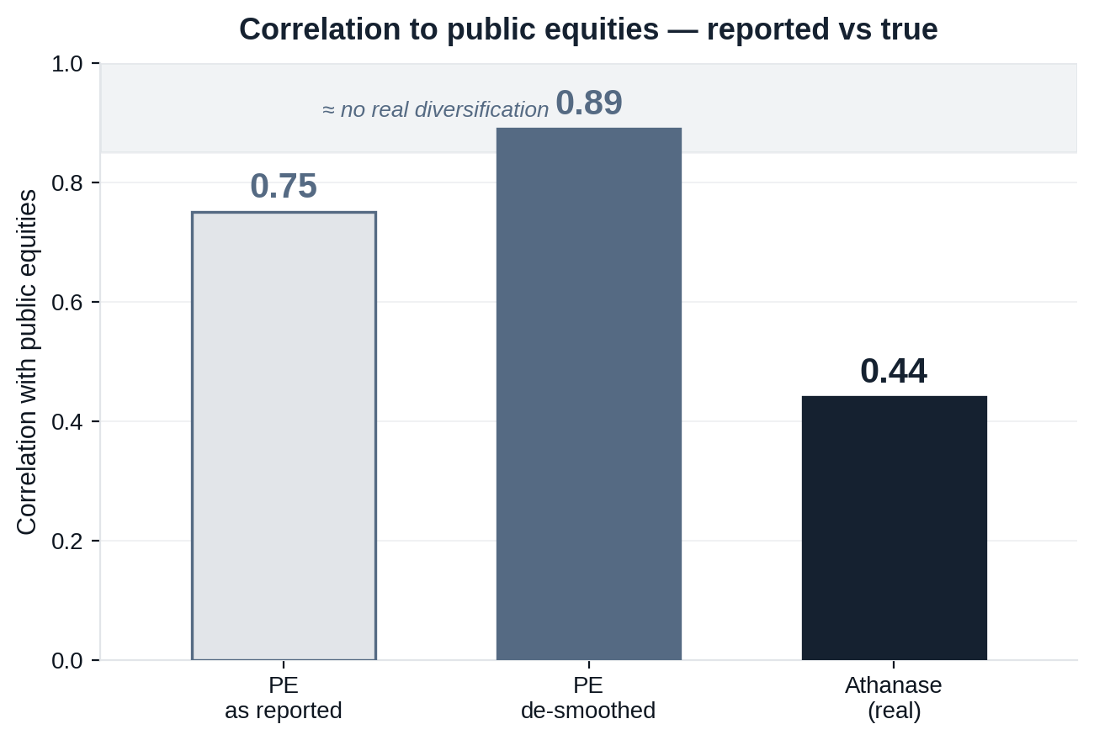
Risk-Adjusted Outcomes
Figure 5
PE’s “diversification” is an artefact — Athanase’s is real
De-smoothed, PE is ~0.9 correlated to public equities: the same risk factors, just reported late. Athanase is genuinely uncorrelated.
THE SMOOTHING ILLUSION
Quarterly appraisals lag the market, so reported PE correlation looks low (0.75, beta 0.41). De-smoothed it is 0.89 / beta 0.87 (Two Sigma, 2024).
SAME RISK FACTORS
PE is long-only levered equity driven by the same forces — GDP, rates, earnings. Over 10–20 yrs its correlation to small/mid-caps is ~0.89–0.92.
THE CRISIS MIRAGE
In severe drawdowns true correlation converges toward 1.0 — PE takes the same hit, it just reports the markdown later. No help when it’s needed.
PE adds leveraged beta dressed as diversification. Athanase, at 0.44 correlation, is the genuine diversifier in a public-equity portfolio.
Athanase correlation 0.44 / beta 0.73 to MSCI World IMI (real, 235 months). PE reported 0.75 / beta 0.41 de-smoothed to 0.89 / beta 0.87 (Two Sigma / Venn, 2024, Preqin PE Index); long-horizon PE–small/mid cap correlation ~0.89–0.92. Illustrative; past performance ≠ future results.

Slide 6
Risk-Adjusted Outcomes
References
Sources
Every private-equity figure traces to published research; every Athanase figure is computed from audited net monthly returns, 2006–2025.
ACADEMIC & EMPIRICAL RESEARCH
INDUSTRY DATASETS & PRACTITIONER RESEARCH
Ang, Chen, Goetzmann & Phalippou (2018), J. Finance 73(4), 1751–1783. — PE cash-flow returns; buyout vol ~25% vs 11% index, beta > 1.
Boyer, Nadauld, Vorkink & Weisbach (2018), SSRN 3272357. — Secondary-market PE index; traded beta > 2.0 vs < 0.5 on NAV.
Getmansky, Lo & Makarov (2004), J. Financial Economics 74(3). — Illiquidity creates serial correlation that suppresses reported vol.
Couts, Gonçalves & Rossi (2020), SSRN 3544854. — 3-step unsmoothing; true vol and market co-movement rise.
Jackson, Ling & Naranjo (2022), SSRN 4244467. — Catering / return manipulation — “volatility laundering”.
Phalippou (2020), “An Inconvenient Fact.” — PE 2006–18 ≈ S&P 500 on a public-market-equivalent basis.
Meyer (2020), J. Alternative Investments 23; Hayley & Sefiloglu (2022); Buchner, Kaserer & Wagner (2010). — Committed-capital / undrawn-commitment drag on realised returns.
Cliffwater (2023), State of US State Pension PE. — Realised PE 11.4% vs PME 5.8%, 2000–2022.
BVCA / Capital Dynamics (2024), PME+ analysis. — UK & Europe PE 14.1% vs PME 7.7%, 2001–2023.
Cambridge Associates (2024), US PE Benchmark. — Top-quartile headline IRR ~18–22%; mPME ~1.15–1.25×.
Kaplan, Harris & Jenkinson (Burgiss data). — KS-PME ~1.20–1.27×; ≈ +3 pts/yr net over public markets.
PIMCO (2022), “The Discreet Charm of Private Assets.” — De-smoothed PE vol ~30%; ~15–16% chance of a 30% 3-yr drawdown.
AQR / Asness (2019–2023), “Volatility Laundering.” — PE equity beta ~1.5–1.6 from leverage; smoothing critique.
Two Sigma / Venn (2024), Preqin PE Index analysis. — Correlation 0.75→0.89, beta 0.41→0.87 once de-smoothed.
Athanase returns, volatility, downside deviation, correlation and rolling loss frequencies are computed directly from the fund’s net monthly return series (2006–2025).

