Slide 1
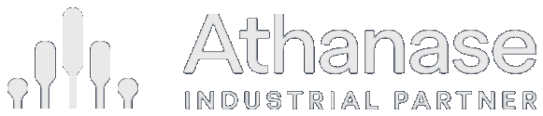
Engaged Ownership as an Asset Class
Why allocators should consider it — and why Athanase
An endowment briefing · Replacing part of global public equity · June 2026

Slide 2

Market Context
Passive has become a concentrated bet
A cap-weighted index puts the most money into the stocks that have already risen the most — concentration and factor risk dressed as diversification.
~38%
of the S&P 500 in its
10 largest stocks*
~33%
in the “Magnificent
Seven” alone*
~50 yrs
since US equity was
this concentrated*
› Cap-weighting buys high by design. The more a stock rises, the more of it you must own — the opposite of buy-low discipline.
› A concentrated factor bet. The “diversified” index is now a leveraged position in large-cap growth, momentum and a single theme (AI) — not diversification.
› Breadth is fragile. A stumble in a handful of mega-caps now moves the entire index; the rest of the market has been left behind.
*Illustrative, recent data (2024–25); source: S&P Dow Jones Indices. Index concentration and factor tilts change over time.
Strictly confidential 2

Slide 3
Market Context
From passive risk to active opportunity
An expensive, concentrated, passive-dominated market is exactly the environment active management is built for — and as analysis itself commoditises, the most durable edge is ownership, not stock-picking.
· The setup
· Why active now
· A better kind of active
Expensive equities, record index concentration, and price-insensitive passive flows that inflate the most crowded names.
Wider mispricing and dispersion; valuation discipline is rewarded again. The “active underperforms” critique is cyclical — and weakest in exactly this market.
Other genuine edges exist — quant and specialist alpha — but they compete on analysing the same public data, which is what commoditises fastest. The most durable edge is ownership: buying mispriced businesses and changing the outcome.
→
→
When the index is the crowded, expensive, fragile trade, the answer is not to pick stocks and hope — it is to own undervalued businesses and make them better. That is engaged ownership.
Strictly confidential 3

Slide 4
Market Opportunity
Figure 1
The inefficiency Athanase harvests
Corporate decay is structural — it continuously recreates low-risk, high-return entry points.
› Duration mismatch. CEOs run 7–8 year defensive cycles while moats erode at hyper-speed; an 80%-correct strategy decays to ~50% efficient.
› The prestige trap. Empire-building and the sunk-cost fallacy lead management to double down on unprofitable ventures.
› Shareholder exhaustion. As patience runs out, price hits a long-term low and liquidity dries up — Athanase becomes the “buyer of last resort” at a discount.
› Low competition. Passive buys the most expensive names; active managers wait for proof; PE needs 10x the capital — leaving these bargains open.
Even an excellent team’s edge erodes as the external environment shifts.
Strictly confidential 4

Slide 5
The Opportunity
Table 2
Why mid-market is the sweet spot
Big enough to run well, small enough to change — and to grow. The engaged-ownership opportunity is richest in the middle.
Small-cap
Mid-market
Large-cap
Organisational depth
Often too thin to support a capable team
Enough structure for a real management team and processes
Deep, but layered and slow
Growth runway
Long, but fragile and under-resourced
Still long — small enough to compound for years
Largely played out; growth is incremental
Speed of change
Fast, but limited resources to execute
Operational change lands within ~1.5 years
Years to turn; entrenched complexity
Owner influence
High, but little to work with
A board seat genuinely moves the outcome
Diluted; one owner rarely shifts the agenda
Mid-market companies are run well enough to be worth owning, yet small enough that an engaged owner can still change — and grow — them.
And the opportunity set is deep and global: ~50,000 listed companies worldwide (World Federation of Exchanges, 2024); the investable MSCI ACWI IMI spans ~8,800 large-, mid- and small-cap names across 23 developed and 24 emerging markets — about 1,600 of them mid-caps (MSCI, 2024). Our €50m–€3bn target band, in markets with a stable legal system, is a large subset.
Strictly confidential 5

Slide 6
The Opportunity
Table 3
The evidence: constructive engagement works
Three decades of peer-reviewed research — across the US and Europe — converge on the same finding.
Study
What it covers
What it establishes
Brav, Jiang, Partnoy & Thomas (2008) · J. Finance
1,000+ US engagements, 2001–06
Activists “seldom seek control” and are “nonconfrontational”; ~2/3 reach full or partial success; +7% announcement return with no reversal; payout, operating performance and CEO turnover all rise.
Becht, Franks, Grant & Wagner (2017) · Rev. Fin. Studies
1,740 engagements, 23 countries
Outcomes and market responses are similar in Europe and North America — the playbook travels; board representation is a central, value-creating outcome.
Becht, Franks, Mayer & Rossi (2009) · Rev. Fin. Studies
Clinical study — Hermes UK Focus Fund
Returns come from engagement, not stock-picking — via private, cooperative interventions: refocus on the core, return cash, change the CEO / chair.
Bebchuk, Brav, Jiang & Keusch (2020) · J. Fin. Economics
US settlement agreements
Boards settle by granting board seats — the intermediary step to the operational and leadership change activists seek. Exactly the precondition model.
Gantchev (2013) · J. Fin. Economics
1,492 campaigns, 2000–07
A campaign escalating to a proxy fight costs ~$10.7m; settling at the board-representation stage avoids most of it — collaboration is cheaper.
Strictly confidential 6
The academic record converges with our own 38 engagements: control secured cooperatively through a board seat is how operational value is created.

Slide 7
Overview
Athanase at a glance
38
investments as
engaged owners
19%
avg annualised NET,
any entry month*
7%
worst-ever entry,
still positive*
18×
growth of capital
since 2006
› ~19% average annualised return* whatever month you invested and held to today — entry timing has barely mattered.
› ~7% in the single worst entry month even the unluckiest possible entry still compounded at a mid-single-digit net return — no investor lost over the holding period.
› 16.3% time-weighted NET since 2006 vs MSCI IMI 6.2% — net of all fees.
*Average of the annualised NET return earned investing in each individual month and holding to the end (107 entry months, AIPFII). Time-weighted figure annualised over actual invested time. Past performance is not indicative of future results.
Strictly confidential 7

Slide 8
Experience
An integrated team, 20 years together
In a world of specialists, a rare unit that has the operating experience to control the outcome.
1992
1996
2006
2015
Öresund
Custos
Creades
Athanase
› 38 companies managed, with a proven ability to tell a “strong core” from a “prestige trap”.
› 30+ public board seats — real experience mandating pivots and protecting shareholder interests, not writing engagement letters.
› A dual lens: a forensic investing lens to find the value and a C-suite operating lens that understands the “how” of execution.
› Skin in the game. The team uses Athanase as its own investment vehicle and shares in the success economics.
› Institutional memory. Multiple market cycles together eliminate key-person risk and prevent repeating historical mistakes.
Strictly confidential 8

Slide 9
Investment Strategy
Figure 2
We don’t buy broken companies — we buy hidden cores
The classic objection to activism is adverse selection. Our model inverts it.
› The critique. Buy “cheap and troubled” and you select for lemons — worse than they look. The market discounted them for a reason.
› Our precondition removes it. We invest only where the core is a market leader earning high returns on capital — attractive even if we change nothing. No structurally-weak turnarounds.
› The real setup. Profitable leaders whose management pivoted into weak adjacencies — chasing growth as the core matured. A capital-allocation overlay on a good asset, not a bad asset.
› The inversion. Blended results make it look mediocre, so it is priced mediocre. The appearance understates reality.
Figure 2 · SUM-OF-THE-PARTS (ILLUSTRATIVE · CONSTANT MULTIPLE)
140
+40% hidden value
100
Market price
(blended optics)
Core alone
(high ROIIC)
The +40% is pure earnings and mix — the same multiple on a cleaner, higher-ROIIC core. Any re-rating is upside we underwrite at zero.
Strictly confidential 9

Slide 10
Ownership Model
The ownership playbook, honed over 38 investments
A repeatable sequence that turns a board seat into operational value — refocusing a good core, then growing it.
1
Secure the board seat
2
Align the thesis
3
Refocus to drive earnings
Often a precondition to invest — the nomination committee proposes an AIP director.
Collaborate with management and stakeholders to agree where the value is and what must change.
Cut overhead and admin, optimise the footprint, exit loss-making “growth-trap” ventures.
4
Reallocate to winners
5
Grow by acquisition
6
Exit
Redeploy freed-up capital into the profitable core and its strongest adjacencies; lift R&D where it pays.
Add complementary products, geographies or scale through value-accretive bolt-ons.
Realise via M&A or in the equity market once the core is refocused and compounding.
The same playbook across 38 companies — value created by fixing capital allocation, not by financial engineering or leverage.
Strictly confidential 10

Slide 11
Investment Strategy
Table 5
Quality-core constructivism — how we differ
Even Hohn (TCI) and Loeb (Third Point) pivoted to quality — we capture quality at a discount, with a catalyst in our control.
Large generalist activists (e.g. Elliott)
Athanase — quality-core constructivism
Entry precondition
Wide range of situations — breakups, credit, event-driven; business quality often secondary
Only a market-leading, high-ROIIC core — “attractive even if we change nothing”
Source of return
Financial / transactional pressure: force a sale, return cash, exit
Operational refocus of a genuinely good business, from a board seat, over years
What gets fixed
The price, the structure, the outcome of a contest
The capital-allocation overlay — the core already works
Margin of safety
Winning the campaign
The core’s proven high-ROIIC economics — the hard floor
Cadence & style
Many simultaneous campaigns, leverage, often confrontational
~one deal a year, constructive, board-led, mid-cap surgical
The megacap activists left mid-cap surgical engagements behind as they scaled. That hidden-core niche is our lane.
Strictly confidential 11

Slide 12
Investment Strategy
Table 8
Why the specialist, not the household name
Recommending Athanase over a brand name is a choice for structural alpha over institutional inertia.
The household name
Athanase — the specialist
Scale & influence
$10bn+ AUM forces them into large- and mega-caps, where one owner rarely shifts the agenda and growth is incremental.
Mid-market (€50m–€3bn), where a single board seat changes the outcome — the high-return, low-competition lane the giants left behind.
Return source
Large buyouts are leveraged beta — ~0.89 correlated to small/mid equities once de-smoothed; driven by GDP, rates and multiples.
Idiosyncratic, event-driven alpha at 0.44 correlation — a genuine diversifier, not a duplicate of your equity book.
Entry & structure
A ~40% control premium up front, a 10-year blind-pool lock-up, and fees on undeployed dry powder.
Entry at “shareholder exhaustion” — the turnaround effectively for free — with daily liquidity and zero capital-call liability.
What you’re buying
A brand — but brand recognition does not compound capital.
Asymmetric capture (93% up / 43% down) and a validated 16.3% net, +7% worst-entry record — institutional process, not a logo.
Brand recognition does not compound capital — asymmetric capture does. The edge is the very lane the household names had to abandon as they scaled.
Strictly confidential 12
De-smoothed large-buyout correlation to small/mid-cap equities ~0.89 (Two Sigma / Venn, 2024; Couts, Gonçalves & Rossi, 2020; Boyer et al., 2018). Athanase correlation 0.44 (real). See references.

Slide 13
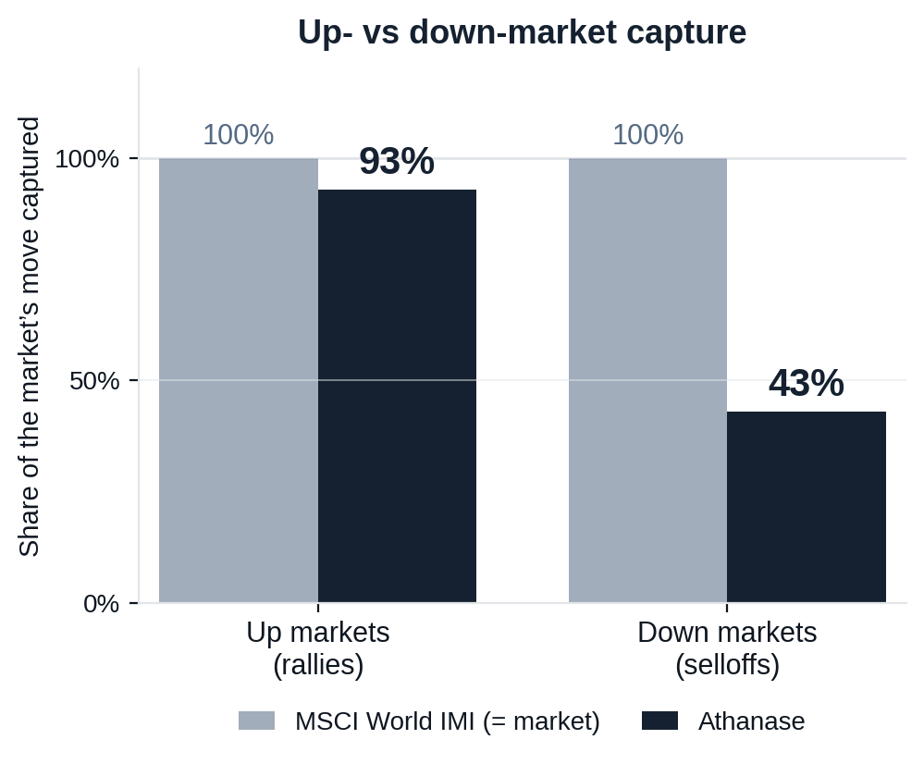
Risk-Adjusted Outcomes
Figure 7
A complement to global equities, not a duplicate
What a global-equity holder asks of a new manager: do you keep up in rallies, lose less in selloffs, and add something the index can’t?
CAPTURE ASYMMETRY
93% up / 43% down
Keeps pace with rallies but takes less than half of selloffs — the essence of the edge.
DIVERSIFICATION
correlation · 0.73 beta
Low correlation to your existing equity book — a genuine diversifier, not levered beta.
RELIABILITY OVER TIME
Beat MSCI in 90% of 5-yr and 100% of 7-yr windows
Over every rolling 7-year holding period in 20 years, Athanase out-returned the index.
Athanase captures 93% of the market’s upside but only 43% of its downside — at 0.44 correlation, it improves the whole portfolio, not just one line of it.
Strictly confidential 13
Source: monthly net returns, 235 months (2006–2025). Capture = compounded Athanase return in the market’s up/down months ÷ the market’s. Past performance is not indicative of future results.

Slide 14
Risk-Adjusted Outcomes
Table 16
Lower downside risk compounds into better outcomes
Athanase carries higher total volatility than the market — but its downside volatility is lower, which is what protects compounding.
ANNUALISED RETURN
TOTAL VOLATILITY
DOWNSIDE VOLATILITY
MSCI 6.2%
AIP 16.3%
MSCI 16.3%
AIP 27.0%
MSCI 11.5%
AIP 10.9%
↑ Athanase downside volatility is LOWER than the market’s.
EXPECTED VALUE OF 100 INVESTED, BY HOLDING PERIOD
years
years
years
years
Median outcome — MSCI
120
135
152
182
Median outcome — Athanase
157
213
287
452
Adverse case* — MSCI
99
105
114
129
Adverse case* — Athanase
133
172
223
335
Chance of a loss — MSCI
18%
11%
8%
4%
Chance of a loss — Athanase
0%
0%
0%
0%
Even in the adverse case, Athanase’s lower downside volatility leaves an investor ahead at every horizon — and the gap widens with time.
Strictly confidential 14
Source: monthly net returns, 235 months (2006–2025). *Adverse case = one downside-deviation outcome (≈1-in-6), narrowing with horizon as dd/√T. Illustrative; past performance is not indicative of future results.

Slide 15
Portfolio Impact
A drawdown you can actually defend
The fear is defending a halved position in a live crisis review. The arithmetic — and the down-capture — make this the line item you point to with relief, not apology.
WHY IT CUSHIONS, NOT AMPLIFIES
At 43% down-capture, in a macro selloff the sleeve falls roughly half as much as the equity book — it softens the crisis, it doesn’t add to it.
Down months average ~1.5% versus the market’s ~3.8%.
Daily marks and zero capital calls — no forced selling of good assets at the bottom (the denominator effect that traps PE allocators).
The two ~50% episodes were idiosyncratic and fully recovered (2010, 2020); Sortino 2.40.
THE FULL-FUND ARITHMETIC
≈ 1% of the fund
is what a 50% drawdown in a 2% sleeve costs at the total-fund level — inside a normal month’s equity noise.
≈ 1.5% at a 3% sleeve — recoverable, and small.
Sized so that no single name — and no sleeve-wide drawdown — can move the fund’s outcome. The position is liquid and daily-priced, so the committee can exit at will: it is never locked in defending it.
A 50% drawdown on a small, liquid, low-down-capture sleeve is a ~1% fund event you can exit at will — not a career-defining hole you are locked into. The PE alternative is also down ~50%, but invisible and illiquid.
Strictly confidential 15

Slide 16
Portfolio Impact
Figure 6
What it does to an allocator’s portfolio
Illustrative: redirecting a sleeve into Athanase rather than a long-only global fund or another activist.
Table 15. Annual uplift to TOTAL-portfolio return (bps), by sleeve size
Down-market year
523
Sleeve
vs Long-only
vs Other activist
3%
+31 bps
+23 bps
5%
+52 bps
+38 bps
8%
+83 bps
+60 bps
Athanase: holds
271
HOW THE PATH IS EARNED
Long-only: −19%
208
The smooth line is not won by chasing rallies. On average monthly returns (p.17), Athanase roughly matches the market up (1.2% vs 1.3%) but protects sharply down (+0.2% vs −1.7%).
Losing less in the down months — not winning more up — is what compounds the lines apart: a steadier path, not just a higher one.
Illustrative only; not a projection. Athanase 18% (headline net IRR); other activist 10.5%; long-only 7.6% (MSCI IMI). Uplift = sleeve × return spread; growth = annual compounding. Past performance ≠ future results.
Strictly confidential 16

Slide 17
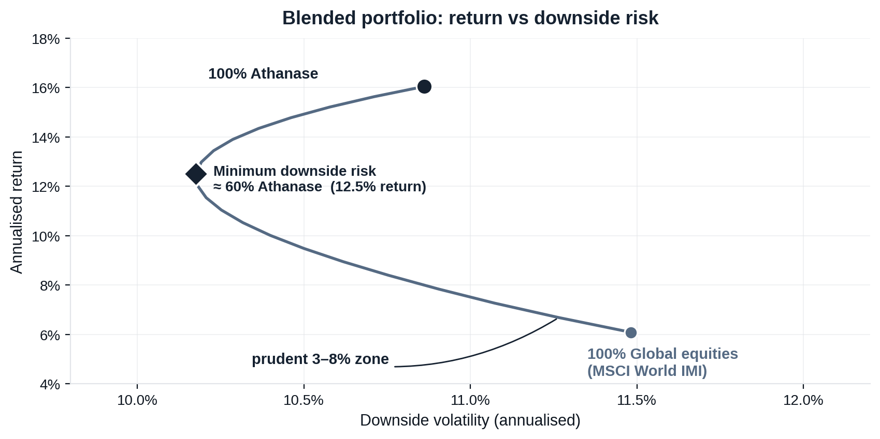
Risk-Adjusted Outcomes
Figure 8
What a blend does to the whole portfolio
Adding Athanase to a global-equity book moves the portfolio up and to the left — more return for less downside risk, thanks to low correlation.
ALL GLOBAL EQUITIES
6.1% return · 11.5% downside risk
100% MSCI World IMI
ADD A PRUDENT 8% SLEEVE
7.3% return · 11.1% downside risk
92% MSCI / 8% Athanase
HOW TO READ IT
Every blend on the curve beats holding equities alone, and the benefit keeps building until past half the portfolio (downside risk bottoms near 60%). That is a directional case to size up — within prudent limits — not a target: a 59% position would breach concentration, liquidity and the 3–8% sizing discipline. Even an 8% sleeve already moves the portfolio the right way.
The blend is not a trade-off: every allocation raises return and lowers downside risk — so to a committee this is a mathematical risk-reduction tool, not a risky bet, sized within prudent 3–8% limits.
Strictly confidential 17
Source: monthly net returns, 235 months (2006–2025), monthly rebalanced blends. The minimum-risk point is in-sample and shown for shape, not as advice. Illustrative; past performance is not indicative of future results.

Slide 18
Track Record
Figure 5
Proof: outperformance with downside protection
What downside protection means
In the market’s down months Athanase fell ~1.5% on average versus the market’s ~3.8% — losing less than half as much when it matters.
Positive when the market wasn’t
Across the six worst years for global equities, Athanase outperformed in five — and stayed positive in two: +9% in 2015 and +0.3% in 2022, while the market fell −6% and −20%.
Why it compounds
Losing less in drawdowns leaves more capital working in the recovery — the engine behind 18× growth of capital vs 3.2× for the market since 2006.
Strictly confidential 18

Slide 19
Track Record
Table 12
AIP Fund II — transactions (2015–present)
Each position shown against its benchmark; invested capital weighted MOIC of 2.2x.
Company
Holding
IRR
MOIC
vs Index
Bufab
2015-2025
35%
2.0x
+27%
DistIt
2015-2025
7%
1.2x
-1%
Ngex
2016-2025
69%
6.2x
+59%
Alcadon
2016-2025
74%
1.7x
+65%
Tempest
2018-2025
12%
1.2x
+3%
Zalaris
2018-2025
26%
1.5x
+16%
Zutec
2018-2025
38%
2.8x
+29%
Roko
2019-2025
28%
5.1x
+18%
Catella
2020-2025
12%
1.2x
+2%
AI
2020-2025
n.m.
5.4x
n.m.
Renold
2024-2025
220%
1.6x
+211%
Actic
2017-2023
-27%
0.4x
-33%
Haldex
2019-2022
36%
1.6x
+33%
Robit
2015-2020
14%
1.4x
+8%
Kitron
2016-2018
40%
1.5x
+16%
Sandvik
2015-2017
49%
1.6x
+43%
Transcom
2015-2016
80%
1.7x
+80%
deals · weighted MOIC 2.2x · ex best/worst IRR 41% vs index ~9% · 35 of 38 deals profitable since 2006
IRR/MOIC net of the position; “n.m.” where short holding periods make annualised figures not meaningful. Capital in SEK.
Strictly confidential 19

Slide 20
Independent Review
Independently validated: 20 years, net of every fee
A prospective LP’s investment committee reconciled the security-level (StatPro) data against the LP-level NET return series.
+1,743%
cumulative NET return
over 19.3 years
+16.3%
annualised NET
(net of all fees)
+10 pts
annualised alpha,
net, vs the market
5.8×
the relevant equity
benchmark
› Two full cycles, survived. Drawdowns of −52.8% (2008, recovered by 2010) and −45.9% (2017–2020, recovered by Sep 2020) — navigated live with the same philosophy, not back-tested.
› Top-tier downside-adjusted return. 20-year Sortino 1.54; AIPFII Sortino 2.40, with upside volatility 3.9× the downside.
› Realised cash, not marks. The largest contributors are realised LP cash — removing the mark-to-model objection.
Source: independent institutional due-diligence review, May 2026, on StatPro security-level data and LP-level NET monthly returns (2006–2026).
Strictly confidential 20

