Slide 1

Risk-Adjusted Outcomes
Figure 1
Lower downside risk compounds into better outcomes
Athanase carries higher total volatility than the market — but its downside volatility is lower, which is what protects compounding.
ANNUALISED RETURN
TOTAL VOLATILITY
DOWNSIDE VOLATILITY
MSCI 6.1%
AIP 16.0%
MSCI 16.3%
AIP 27.0%
MSCI 11.5%
AIP 10.9%
↑ Athanase downside volatility is LOWER than the market’s.
TABLE 1. EXPECTED VALUE OF 100 INVESTED, BY HOLDING PERIOD
3 years
5 years
7 years
10 years
Median outcome — MSCI
119
134
151
181
Median outcome — Athanase
156
210
283
443
Adverse case* — MSCI
98
105
113
128
Adverse case* — Athanase
132
170
220
328
Chance of a loss — MSCI
18%
12%
8%
5%
Chance of a loss — Athanase
1%
0%
0%
0%
Even in the adverse case, Athanase’s lower downside volatility leaves an investor ahead at every horizon — and the gap widens with time.
Source: monthly net returns, 235 months (2006–2025). Volatility annualised from monthly; downside volatility = annualised deviation of negative months (MAR 0). *Adverse case = one downside-deviation outcome (≈1-in-6), narrowing with horizon as dd/√T. Illustrative; past performance is not indicative of future results.

Slide 2
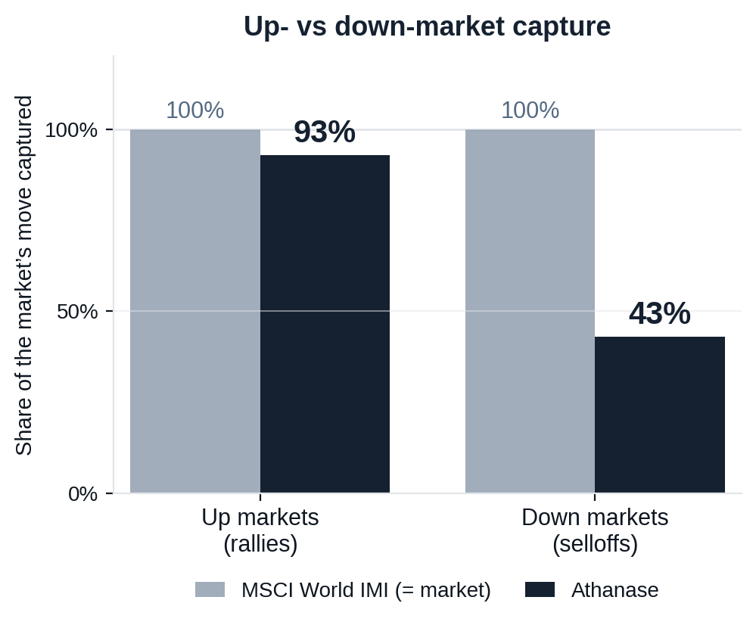
Risk-Adjusted Outcomes
Figure 2
A complement to global equities, not a duplicate
What a global-equity holder asks of a new manager: do you keep up in rallies, lose less in selloffs, and add something the index can’t?
CAPTURE ASYMMETRY
93% up / 43% down
Keeps pace with rallies but takes less than half of selloffs — the essence of the edge.
DIVERSIFICATION
0.44 correlation · 0.73 beta
Low correlation to your existing equity book — a genuine diversifier, not levered beta.
RELIABILITY OVER TIME
Beat MSCI in 90% of 5-yr and 100% of 7-yr windows
Over every rolling 7-year holding period in 20 years, Athanase out-returned the index.
Athanase captures 93% of the market’s upside but only 43% of its downside — at 0.44 correlation, it improves the whole portfolio, not just one line of it.
Source: monthly net returns, 235 months (2006–2025). Capture = compounded Athanase return in the market’s up/down months ÷ the market’s. Beta/correlation and rolling-window win rates from the same series. Past performance is not indicative of future results.

Slide 3
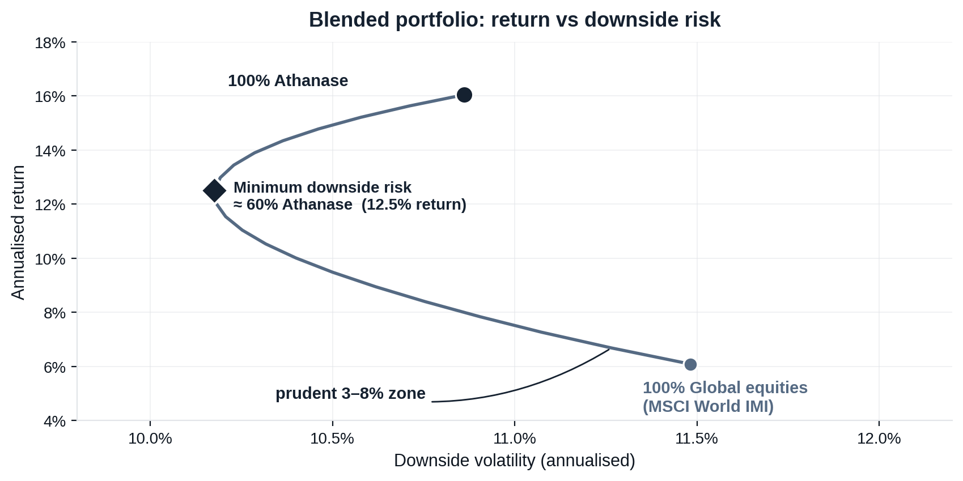
Risk-Adjusted Outcomes
Figure 3
What a blend does to the whole portfolio
Adding Athanase to a global-equity book moves the portfolio up and to the left — more return for less downside risk, thanks to low correlation.
ALL GLOBAL EQUITIES
6.1% return · 11.5% downside risk
100% MSCI World IMI
ADD A PRUDENT 8% SLEEVE
7.3% return · 11.1% downside risk
92% MSCI / 8% Athanase
HOW TO READ IT
Every blend on the curve beats holding equities alone, and the benefit keeps building until past half the portfolio (downside risk bottoms near 60%). That is a directional case to size up — within prudent limits — not a target: a 59% position would breach concentration, liquidity and the 3–8% sizing discipline. Even an 8% sleeve already moves the portfolio the right way.
The blend is not a trade-off — every allocation improves the portfolio, so the case is to size up within prudent 3–8% limits, not to chase the mathematical optimum.
Source: monthly net returns, 235 months (2006–2025), monthly rebalanced blends. Downside volatility = annualised deviation of negative months (MAR 0). The minimum-risk point is in-sample and shown for shape, not as advice. Illustrative; past performance is not indicative of future results.

