Slide 1
Predicting timely cancer diagnosis using demographic and societal drivers of healthcare inequities
Capstone II : Supervised Learning Project
Chari Cortez, Thinkful Data Science

Slide 2

WiDS
Women in Data Science (WiDS) Worldwide is on a mission to increase participation of women in data science to benefit societies worldwide
Equity in Healthcare
Healthcare inequity is a global challenge
→ Understand demographic and societal drivers of healthcare inequities
Task
Predict if patients received metastatic cancer diagnosis within 90 days of screening
https://www.kaggle.com/competitions/widsdatathon2024-challenge1

Slide 3
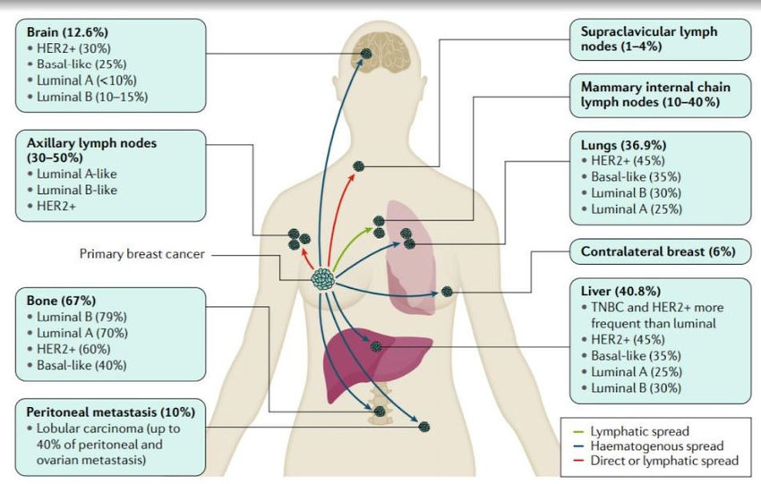
Metastatic TNBC requires most urgent and timely treatment
~10-40% of breast cancer tumors have metastasized
Most common metastatic sites for breast cancer
Bones
Liver
Lungs
Lymph nodes
Differences in wait time to get treatment is a good proxy for disparities in healthcare access
Drug Resistance in Metastatic Breast Cancer: Tumor Targeted Nanomedicine to the Rescue - Scientific Figure on ResearchGate. Available from: https://www.researchgate.net/figure/Illustration-of-common-metastatic-sites-in-breast-cancer-2-The-most-common-metastatic_fig2_351185404

Slide 4
The ”train” data set
12.9k
82
Binary
Records
Represents Patients and their…
Characteristics | Age, race, BMI, State
Geo | Zip-code level
Demographic | Income, education, rent, race, poverty, etc.
Toxic air quality data | Ozone, PM25, NO2; ties health outcomes to environmental conditions
Variables
Target

Slide 5
The purpose of this Capstone is to produce a supervised learning model that has
Good metrics
Good fit
Generalizability
Performs well on both test
and train datasets (low
error rate on training set
& low generalization gap)
Performs well at the
intersection between
overfitting (high
variance) and underfitting
(high bias)
Performs well on new,
unseen data with low bias
and low variance

Slide 6
The goal is to implement a reproducible, transparent model preparation process
Exploratory Data Analysis (EDA)
Data Cleaning
Feature Engineering
Raw Data
Clean, high quality data set suitable for modeling
I
II
III
Data Exploration

Slide 7
Data Cleaning
Data cleaning/munging/wrangling is the first step of EDA
Detect and eliminate problems in the dataset that would prevent further analysis
Deal with missing values
Handle categorical variables
Deal with outliers
Scale the features
Normalize the features (as much as possible)
I

Slide 8
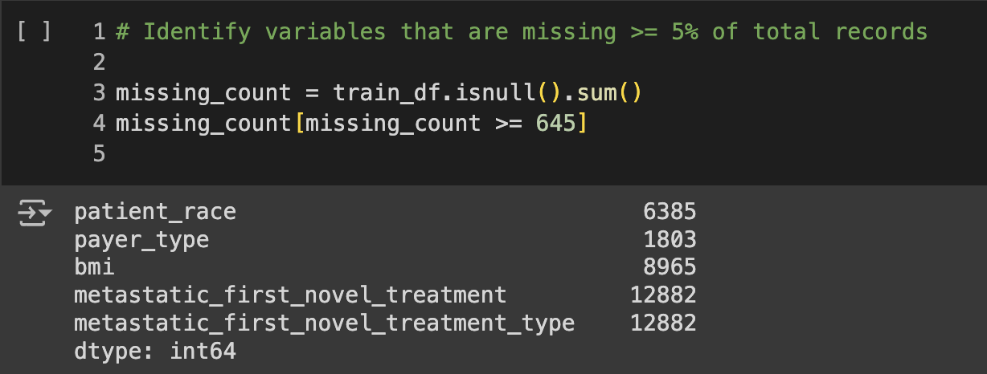
Data Cleaning
Deal with missing values
Variables that were missing 5% or more of total records were removed from the dataset to avoid introducing bias and gross inaccuracies
I

Slide 9
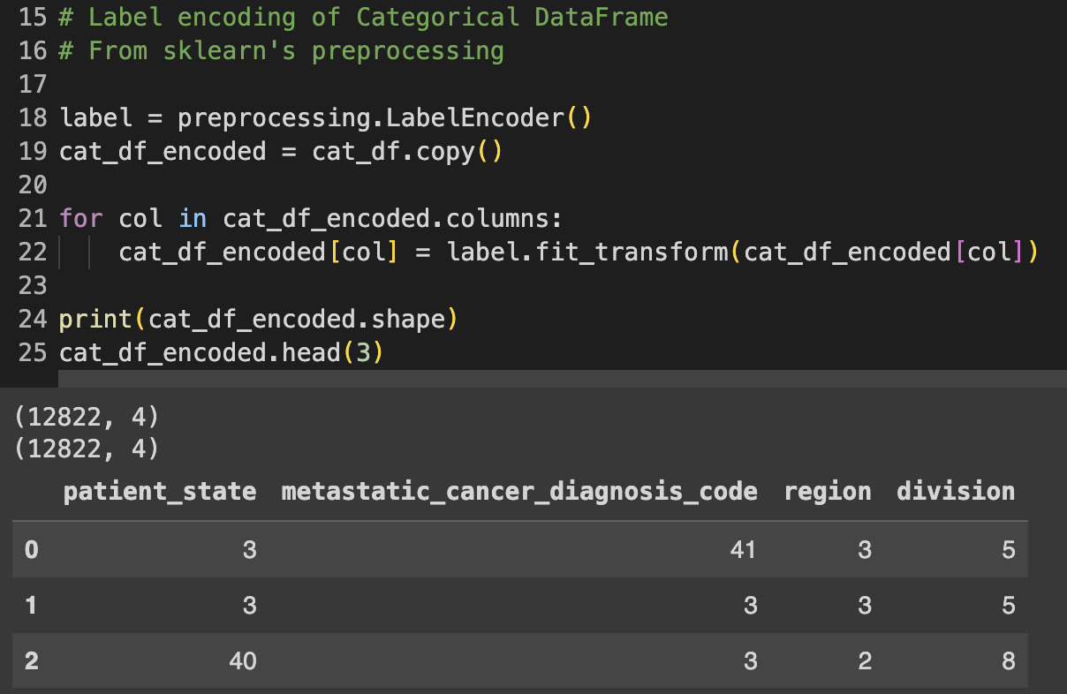
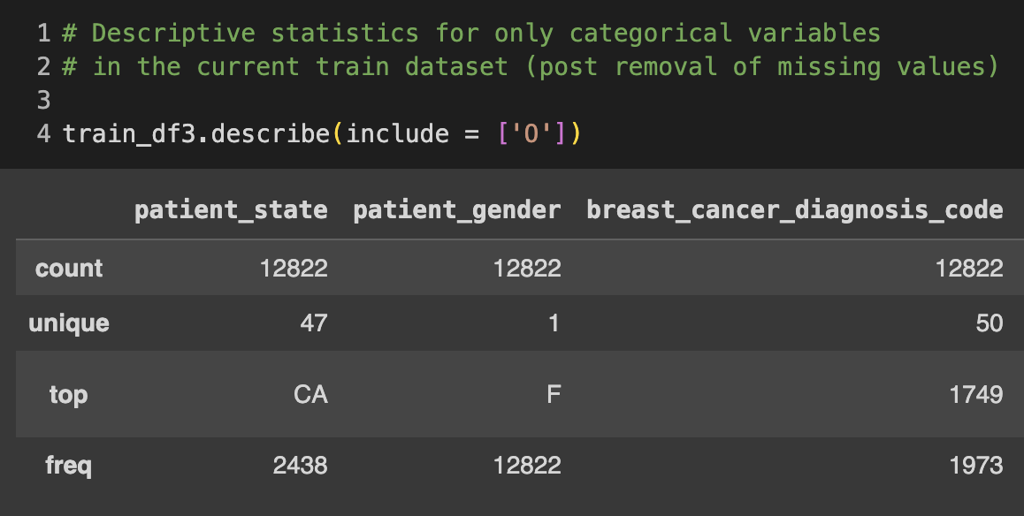
Data Cleaning
Handle Categorical Variables
Tautologous variables were dropped from the dataframe
Label encoding in lieu of get_dummies()
I
Label Encoding

Slide 10
Data Cleaning
Deal with outliers
I
Drop | Remove outliers from dataset | Easiest way, but dropping = loss of info Outliers stem from measurement or data-collection error
Cap | Cap the values by assigning them new values | “Cap” or “clip” extreme outliers to limit effect on analysis (Winsorization) Can introduce bias; question if variable is absolutely necessary
Transform | Transform outliers into something harmless | Usually apply monotonic transformations (log and square root) Can potentially obtain a normal distribution

Slide 11
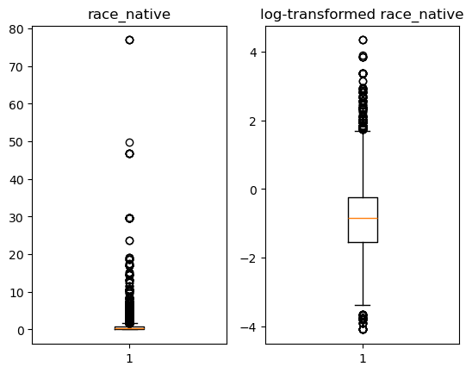
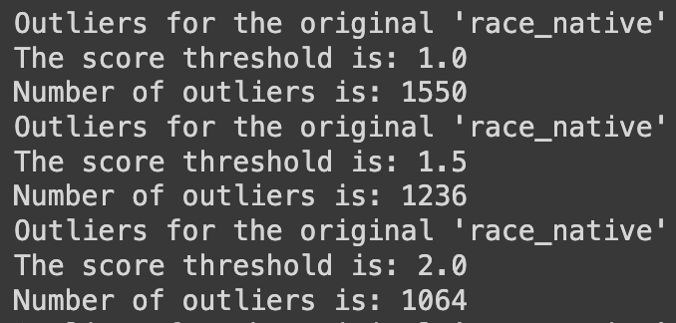
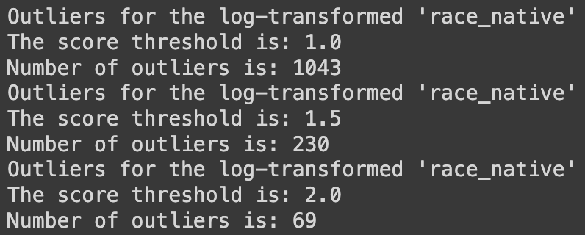
Log transformation resulted in a compressed range of values thus less extreme outliers
Number of outliers before transformation:
Number of outliers after transformation:

Slide 12
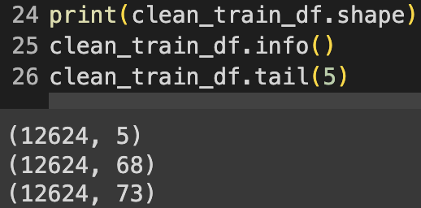
Data Cleaning
Scale the features
Standard Scaler was applied to continuous variables
No need to scale the categorical variables or the binary target
Normalize the features (as much as possible)
Shapiro test statistics
Yeo-Johnson Transformation
I
Data Cleaning produced a “clean” DataFrame used in Feature Engineering and modeling

Slide 13
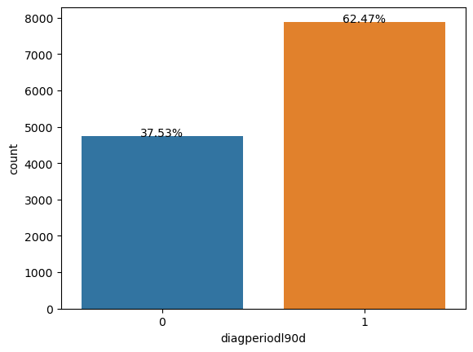
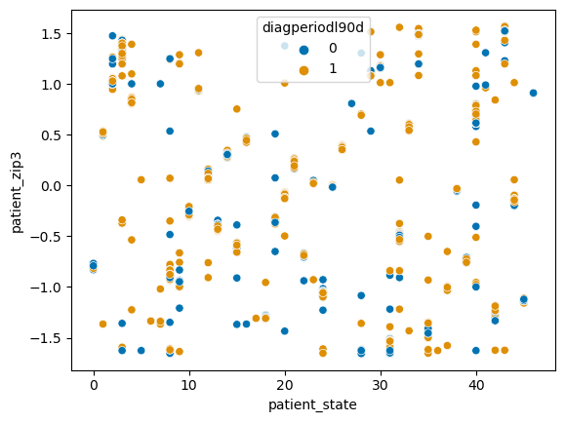
The target is class imbalanced and not linearly separable
II
Data Exploration

Slide 14
Nonparametric classification models are appropriate for this target
Model
Evaluation metric
Support Vector Machine (SVM) with non-linear kernel
K-nearest neighbors (KNN)
Decision Trees
Random Forest
Accuracy
Precision
Recall
F-score
Confusion Matrix
ROC-AUC curve
Precision-Recall curve
II
Data Exploration

Slide 15
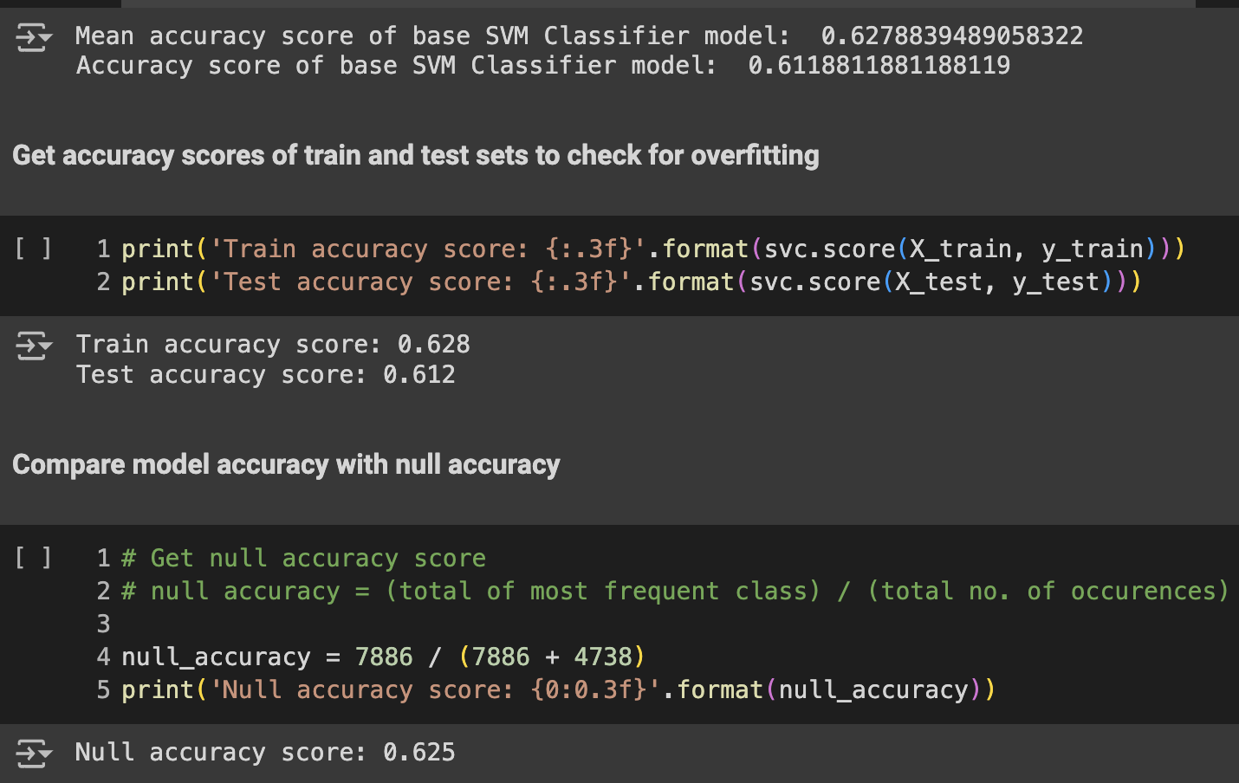
What’s my base?
Run all features in clean dataset
→ Establish base model and baseline performance metrics
II
Data Exploration

Slide 16
Feature Selection methods
Feature Engineering
III
Filter
Embedded
Wrapper
Point Biserial Correlation
Cramer's V function
Pearson’s Correlation Matrix
→ Identified 37 statistically significant features
(SVM cannot naturally embed a feature-selection process)
Backward Elimination (computationally expensive)
Recursive Feature Elimination (RFE; requires a linear kernal)

Slide 17
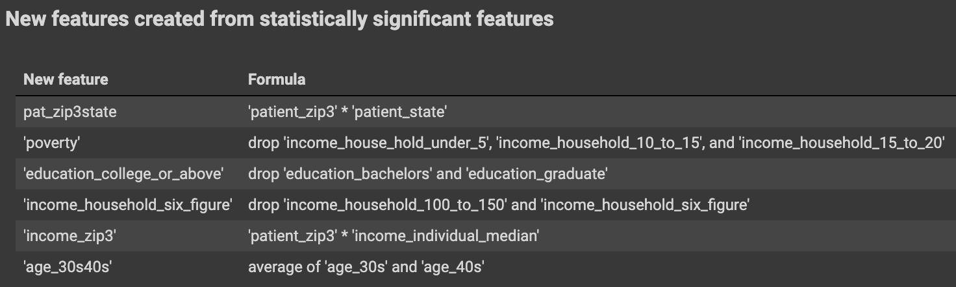
New features created following first-pass Filter methods
Feature Engineering
III
Increased Baseline Accuracy Score → greater than null accuracy

Slide 18
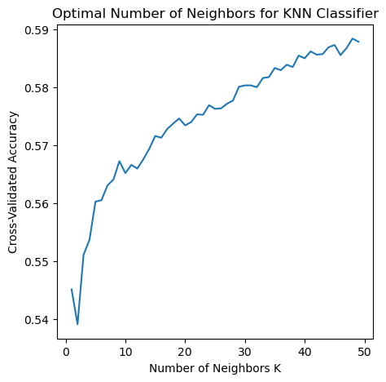
KNN accuracy scores with statistically significant feature set showed overfitting and poor predictive power
Weighted accuracy scores with 2 neighbors
Train data | 94.9%
Cross Validation Score | 54% (+/- 0.01)
Test data | 52.8%

Slide 19
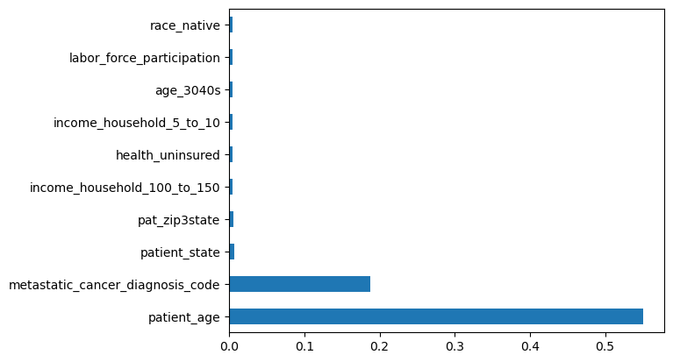
Feature importance data from KNN underscores importance and utility of feature engineering
The highest cross validation score obtained was 59%
Null hypothesis score was 62%
While predictive performance is relatively poor, the generated/engineered features were found to have a significant impact on the out-of-sample predictions

Slide 20
Random Forest models also had low accuracy scores and poor predictive power
Iteration (Feature Set) | Cross Validation Score
All 37 “statistically significant” features | 56% (+/- 0.03)
17 most important statistically significant features | 59% (+/- 0.01)
9 most important statistically significant features | 59% (+/- 0.01
All features in clean dataset | 56% (+/- 0.03)
8 most important features in clean dataset | 59% (+/- 0.01)

Slide 21
Gradient Boost Classification models showed the most potential
Iteration | Accuracy | Mean CV | Precision | Recall
1 | 63.4% | 64.0% | 64.1% | 91.4%
2 | 63.2% | 63.8% | 63.8% | 92.4%
3 | 63.9% | 64.1% | 64.2% | 92.4%
4 | 63.9% | 64.3% | 64.2% | 92.9%
5 | 63.8% | 64.3% | 64.0% | 93.5%

Slide 22
The Recall score was prioritized during optimization efforts
Tradeoff between Recall and Precision exists
Generally, a model doesn’t have high Recall and Precision
The target indicates whether or not a patient received a metastatic cancer diagnosis within 90 days of screening
A False Negative = Failure to diagnose
Serious consequences for metastatic TNBC

Slide 23
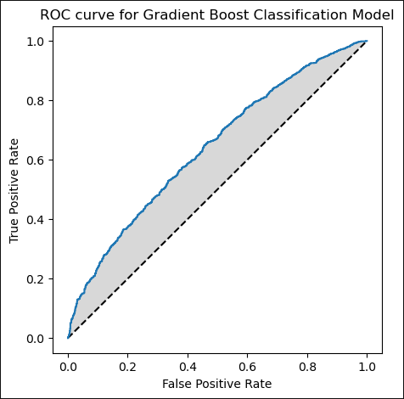
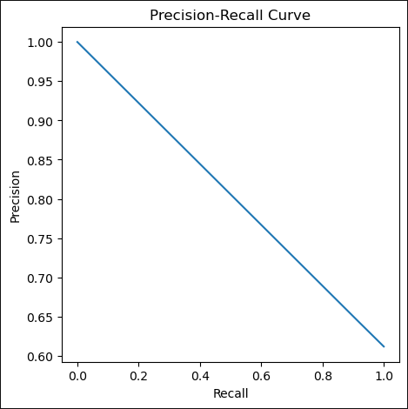
GridSearchCV identified optimal parameters and improved model performance
Accuracy | 67.8%
Mean CV | 64.2%
Precision | 64.3%
Recall | 91.9%
ROC-AUC | 0.640
* ‘pat_zip3state’ had 3rd highest Variable Importance

Slide 24
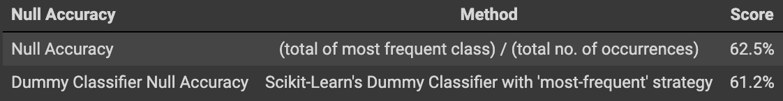
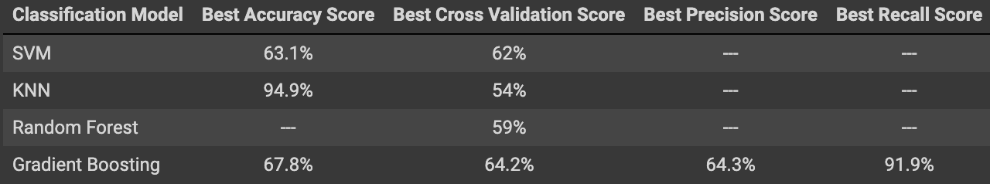
Gradient Boost Classification is the best model for this task

Slide 25
Conclusions
Gradient Boost Classifier was selected over SVM Classifier
Performed better than Dummy Classifier
Better performance metrics
Readily obtain feature importance data
The EDA process executed herein is clear, reproducible, and thorough
Feature Engineering was demonstrably useful
Real-world clinical data can be messy, complex, and tricky to navigate at times
Might need more records to increase predictive power
Medical diagnosis models can be particularly challenging

Slide 26
Next Steps
The best GB model can definitely be improved
The GB model built here had higher Accuracy and AUC-ROC scores than those in the ”WiDS Data Exploration | ML | Starter”
3rd highest-voted notebook; good sanity check during model development
Go back to Feature Engineering phase with feature importance data obtained during GB model optimization
Research new and different supervised learning Classification models
XGBoost, LightGBM, CatBoost, Extra Trees, Multilayer Perceptron
Try to obtain more samples
Clean dataset has 12, 624 records and a class-imbalanced target (0: 37.5% ; 1: 62.5%)

Slide 27
Thank you

