Slide 1
Attrition in IBM: Investigating the impact of employee work-life balance
Capstone I, Thinkful Data Science
Chari Cortez

Slide 2
Attrition impairs operational efficiency
Attrition is the reduction of the number of employees in a company
Achieve
goals
Knowledge
Skill sets
Fulfilled Work
Company
growth
High Attrition
Company
stagnates
Knowledge
gaps
Unfulfilled Work
Missing skill sets
Unmet
goals

Slide 3
Relevant stakeholders that should track attrition
Employees
Department
Leadership positions
Management roles
Establish workplace culture
Human Resources
Implement employee retention strategies

Slide 4
Data-driven approaches
“Help companies determine what’s causing employees to leave…Then, they can target those issues and really work to keep people around.”
Academy to Innovate HR

Slide 5
10%
An attrition rate exceeding 10% could be problematic for the company
Indeed, Business

Slide 6
Quantifying employee attrition and work-life balance
What is the size of the company and each of its departments?
Human Resources (HR), Research & Development (R&D), Sales
What is the overall attrition rate and attrition rate for each department?
What is the relationship between work-life balance and department?
Former and current employees
Is there a statistically significant difference in the work-life balance score between former and current employees?
Focus on R&D Department

Slide 7
A statistically significant difference in work-life balance scores is important
Improved work-life balance
Reduce employee attrition
Drive business forward
Improve employee retention
Maintain operational efficiency

Slide 8
Hypotheses
H₀
Hₐ
There is no statistically significant difference between the average work-life balance score between former R&D and current R&D employees
There is a statistically significant difference between the average work-life balance score between former R&D and current R&D employees

Slide 9
The Data
Field | Data | Data Type | Values
Department | Categorical | String | Human Resources Research and Development Sales
Attrition | Dichotomous | String | Yes No
worklifebalance | Ordinal | Integer | 1 = Bad 2 = Good 3 = Better 4 = Best
1,470 records, 35 variables
Clean
Not longitudinal

Slide 10
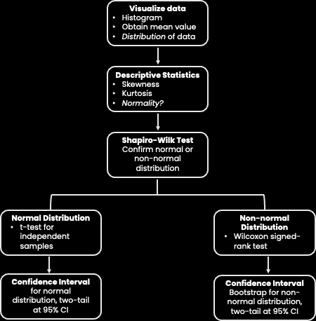
Methods
Form two dataframes based on attrition
Calculate overall attrition rate
Create sub-groups based on attrition and department
Calculate departmental attrition rate
Analyze work-life balance data
Determine statistical significance

Slide 11
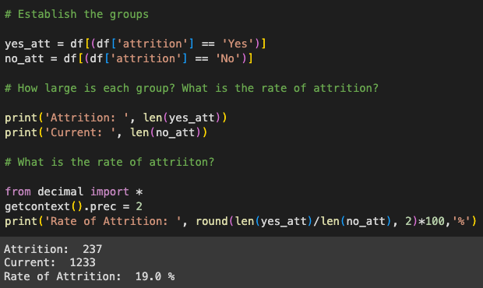
Establishing dataframes and calculating attrition
Number of Yes-attrition (Former)
100
Rate of attrition (%)
Number of No-attrition (Current)

Slide 12
All rates of attrition are > 10%
 | Former employees | Current employees | Rate of attrition (%)
Overall | 237 | 1233 | 19.0
HR | 12 | 51 | 24.0
R&D | 133 | 828 | 16.0
Sales | 92 | 354 | 26.0

Slide 13
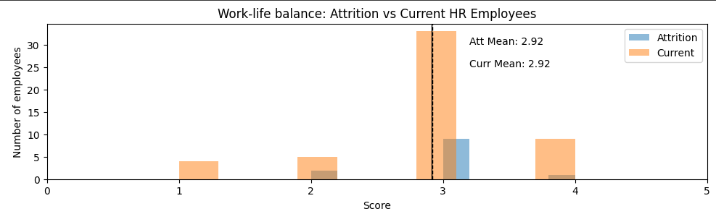
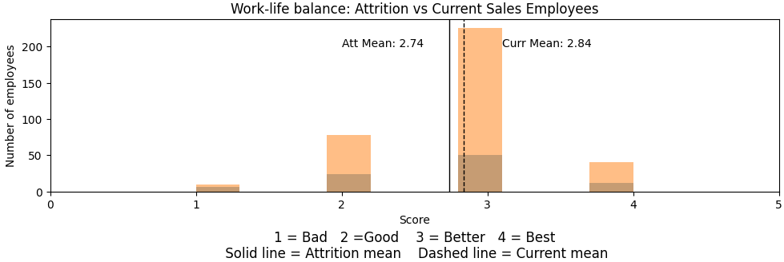
HR work-life balance data are not normally distributed; similar mean work-life balance score from current and former employees

Slide 14
Sales work-life balance data are not normally distributed; lower work-life balance score from former employees

Slide 15
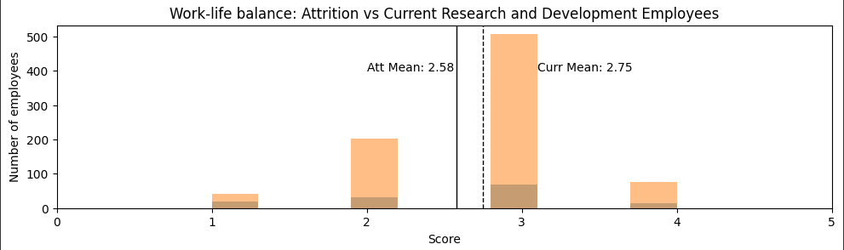
R&D Data are not normally distributed; lower mean work-life balance score from former employees

Slide 16
Kruskal-Wallis test to determine statistical significance
Dept | H-statistic | P-value (p <0.05)
HR | 0.13 | 0.72
R&D | 4.02 | 0.04
Sales | 1.14 | 0.28

Slide 17
2.58 vs 2.74
4.02
0.04
Reject the null hypothesis
Mean work-life balance score from Former vs Current R&D employees
H-statistic
There is a statistically significant difference between the average work-life balance score between former R&D and current R&D employees
p-value

Slide 18
Improving work-life balance in R&D will likely reduce attrition
Overall attrition rate is 19%
Nearly double the target rate of 10%
All departmental attrition rates exceeded 10%
R&D attrition accounts for 56.1% of overall attrition
Of the 237 employees that left the company, 133 of those employees were R&D
The difference in R&D work-life balance means is statistically significant
Strongly suggests that efforts to improve work-life balance in R&D will likely improve employee retention
 | Work-life balance score (mean)
 | Former | Current
HR | 2.92 | 2.92
R&D | 2.58 | 2.75
Sales | 2.74 | 2.84

Slide 19
Next Steps
Results of this study show that the company has problematic attrition rates that need to be addressed
This study has provided a more specific target for relevant stakeholders to address then implement improvements
Improve work-life balance → reduce attrition → maintain operational efficiency
Achieve
goals
Knowledge
Skill sets
Fulfilled Work
Company
growth

Slide 20
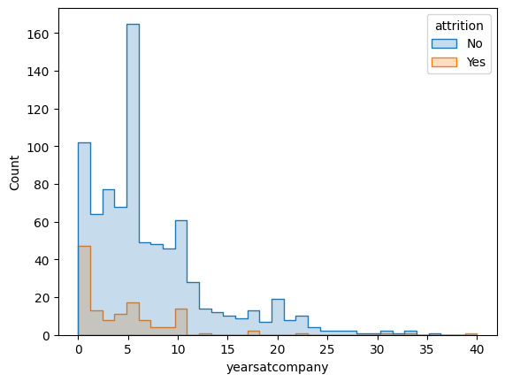
Next Steps
Follow-up studies to further characterize R&D attrition would be beneficial
The majority of R&D attrition occurs within the first year of employment
Equates to roughly $180,000 - $900,000 (not including salary and benefits) in immediate failed monetary investment (Indeed)
Improve critical hiring procedures = Improve employee retention

Slide 21
Thank you

