Slide 1
FREE PILOT · TRY BEFORE YOU BUY
ATLAS OT SCOUT
Know what is really on your OT segment —
then decide whether Atlas is worth keeping.
OFFLINE
ASSESSMENT
APPLIANCE
Atlas OT Scout is a guided, offline assessment appliance for water and wastewater teams. We deliver it, help you run a bounded pilot, leave it with you, and let your own experience decide the purchase.
Current state → guided evidence → desired state
NO CLOUD · PASSIVE FIRST · BOUNDED ACTIVE CHECKS
Notes:
Lead with the customer outcome and the low-friction commercial model. Do not open with technical architecture.

Slide 2
The customer problem is not “lack of a scanner.”
It is the gap between what the organization thinks is on the segment and what it can actually defend today.
01
Inventory exists
02
Visibility is fragmented
But it may be stale, incomplete or inconsistent across spreadsheets, diagrams and field reality.
Passive evidence, physical checks and device identity data live in different tools and notes.
03
OT cannot be treated like IT
04
The final decision is still manual
Broad discovery or uncontrolled probing can be inappropriate on a live process segment.
Teams must decide what is known, what changed, what matters and what is still missing.
CUSTOMER BENEFIT
The real need is a trustworthy operating picture, not a bigger packet count.
P0-WATER · bounded drinking-water / wastewater assessment

Slide 3
The desired state is simple: know, explain, act.
A good assessment leaves the customer with a defensible baseline and an explicit list of what still needs work.
CURRENT STATE
DESIRED STATE
Expected assets
Records and diagrams
Evidence-backed baseline
Expected ↔ observed ↔ confirmed
Observed reality
Partial / ad-hoc evidence
Known limitations
Visibility and confidence stay explicit
→
Unknowns
Mixed into analyst notes
Prioritized follow-up
Findings tied to evidence
Next action
Depends on who is reviewing
Repeatable method
The appliance stays available for the next case
CUSTOMER BENEFIT
Confidence improves because every conclusion stays connected to evidence, scope and review — and missing evidence stays visible.
P0-WATER · bounded drinking-water / wastewater assessment

Slide 4
You do not need to commit before you know whether the appliance helps.
Our commercial model is intentionally low-friction: use the capability first, then decide.
ATLAS OT SCOUT
1
We deliver
2
You use it
OFFLINE
ASSESSMENT
APPLIANCE
A configured Atlas appliance for the agreed pilot scope.
We guide the first bounded assessment, then leave the device with your team.
3
You decide
4
We support
Like the capability? Acquire it. Not useful? We pick it up.
Add consulting, onboarding, review or support packages only when needed.
CUSTOMER BENEFIT
The customer learns the value on its own network before making a purchase decision.
Commercial model · free pilot → acquire or return → optional consulting/support

Slide 5
Atlas guides the customer from uncertainty to a defensible decision.
The application is organized around the decisions the operator must make — not around a list of scanning features.
1
2
3
4
5
Scope
Collect
Review
Reason
Handoff
→
→
→
→
What exact site, process area and decision are we supporting?
What is the least intrusive evidence that can close the gap?
Which observations are strong enough to accept?
What changed, what conflicts and what needs follow-up?
What is ready to sign off — and what is still blocked?
CUSTOMER BENEFIT
The workflow tells the operator what to do next and why — while preserving scope, safety and analyst judgment.
P0-WATER · bounded drinking-water / wastewater assessment

Slide 6

Customer story: North Water Treatment Plant
The site has an expected inventory but one unresolved identity. The goal is to establish a current, defensible picture without broad discovery.
THE QUESTION
“Can we prove what is actually on this segment — and what still needs attention — without turning the assessment into a broad scan?”
Watch the same problem move through scope, passive evidence, review, one bounded identity check and report readiness.
Video is embedded in the PowerPoint.
Actual Android emulator user story · explanatory overlays added for the prospect narrative

Slide 7
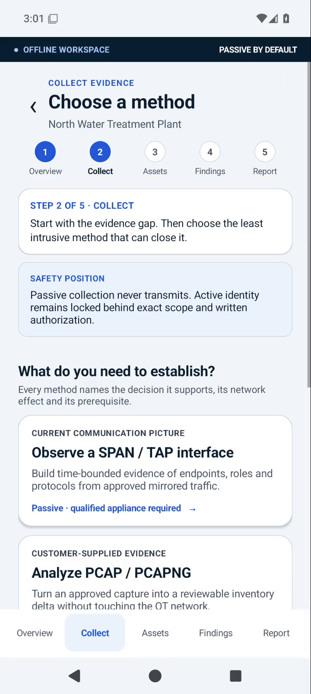
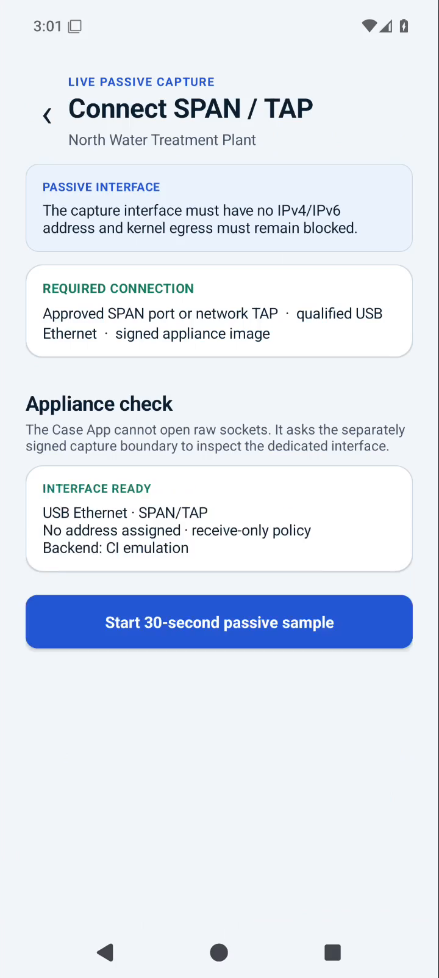
Step 1 — start passive and make the safest useful observation
Atlas guides the operator to the least intrusive evidence source before any active behavior is considered.
CUSTOMER PROBLEM
“I need a current communication picture, but I do not want a broad scan touching the process.”
The app explains which method answers which question.
SPAN / TAP is presented as the passive-first path.
The appliance verifies the dedicated capture boundary before starting.
CUSTOMER BENEFIT
The customer gets useful visibility without making broad discovery the default.
Choose the method
Verify receive-only capture
P0-WATER · bounded drinking-water / wastewater assessment

Slide 8
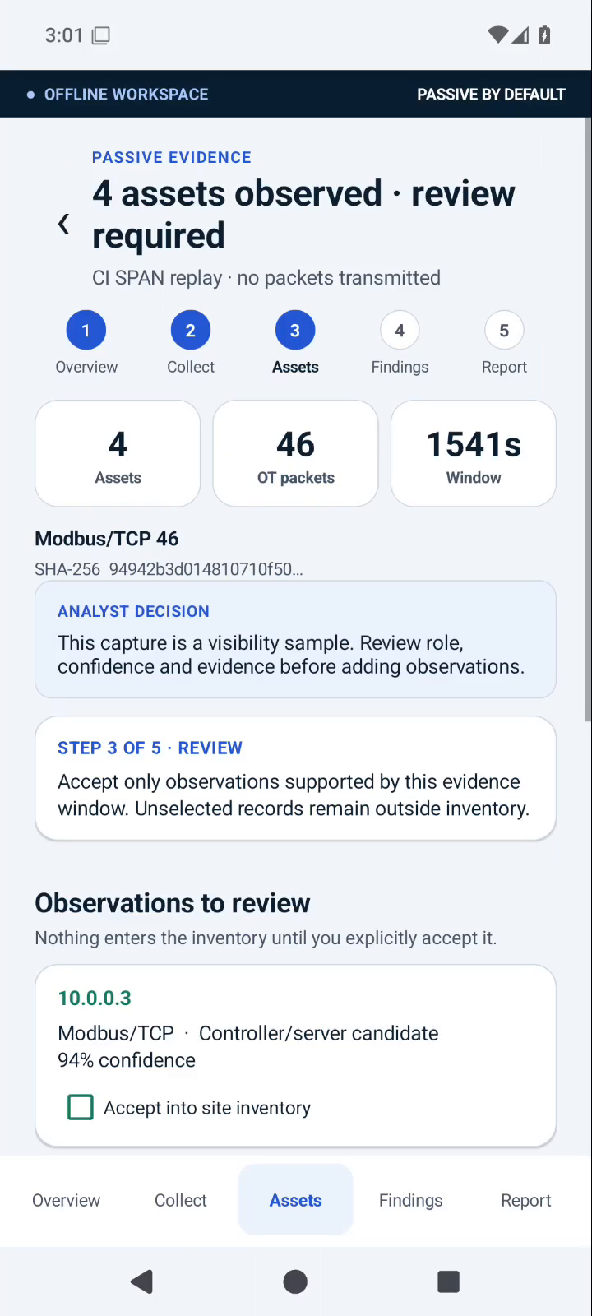
Step 2 — evidence is reviewed before it changes the inventory
The product separates “what was observed” from “what the customer is ready to accept as true.”
GUIDED REVIEW
The capture produced four observed assets. Atlas does not silently turn them into inventory records.
✓
Evidence stays attributable
Hash, capture window, packet counts and method remain visible.
✓
Confidence stays visible
Role / identity inference is shown as evidence, not certainty.
✓
The analyst decides
Only explicitly accepted observations can enter the reviewed inventory.
CUSTOMER BENEFIT
The customer reduces false assumptions because observations cannot silently become “truth.”
Passive evidence review
P0-WATER · bounded drinking-water / wastewater assessment

Slide 9
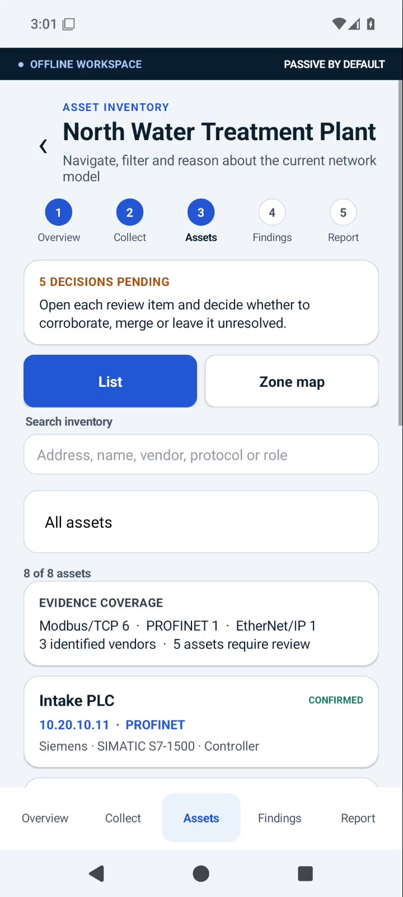
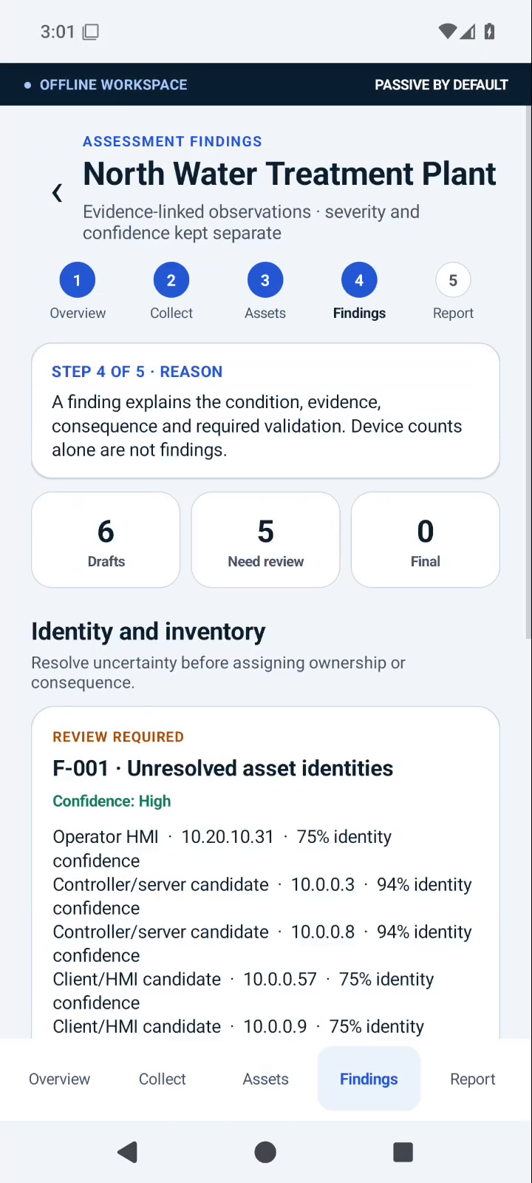
Step 3 — reconcile what was expected with what was actually observed
The customer is guided to the delta that matters: confirmed, missing, unexpected or conflicting identities.
FROM DATA TO DECISION
Atlas is not trying to maximize the number of discovered devices.
Known records stay visible alongside new evidence.
Unresolved identities stay visible instead of being guessed.
The next recommended action is tied to the remaining uncertainty.
CUSTOMER BENEFIT
The result is a current baseline the customer can explain to operations, security and management.
Reviewed inventory
Unresolved identity becomes work
P0-WATER · bounded drinking-water / wastewater assessment

Slide 10
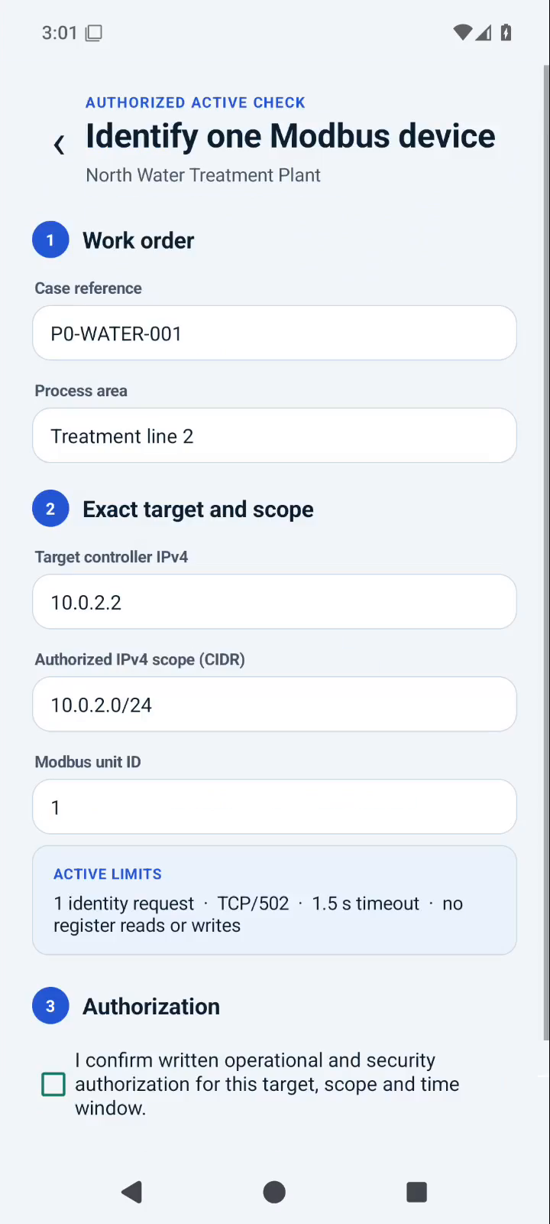
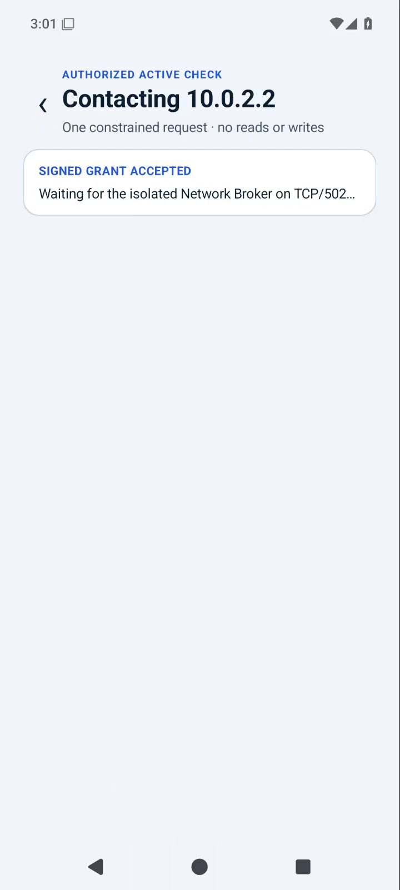
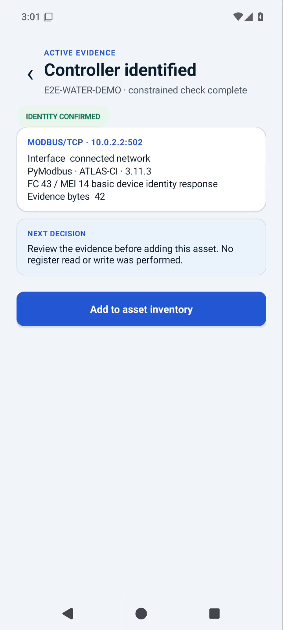
Step 4 — close one remaining gap without widening the scope
Active behavior is optional and exact. The workflow shows why the request is needed, what target is authorized and what is prohibited.
SAFETY AS A BENEFIT
The application guides the operator through a bounded identity check — and rejects a target that falls outside the authorized CIDR.
One exact target
One identity request
No scan · no write
CUSTOMER BENEFIT
The customer can resolve a specific uncertainty without turning the appliance into a general-purpose scanner.
Exact work order and target
Out-of-scope target blocked
One controller identified
P0-WATER · bounded drinking-water / wastewater assessment

Slide 11
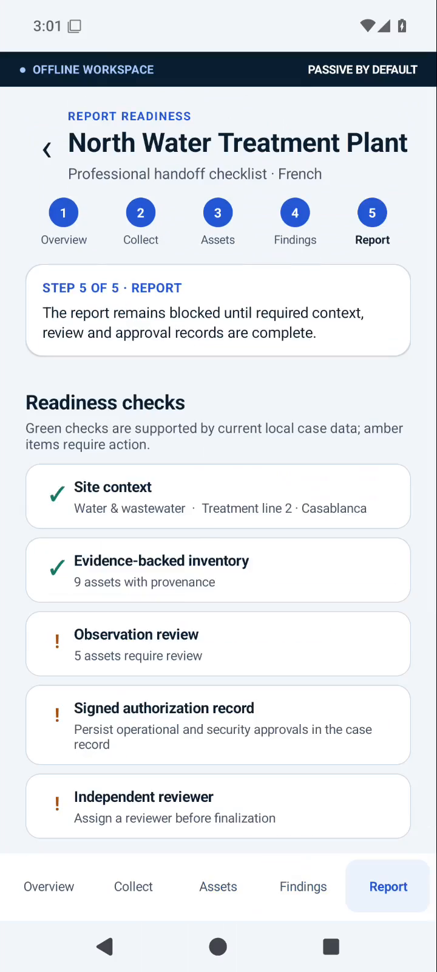
Step 5 — the handoff says what is ready and what is not
The assessment ends with evidence-linked findings and explicit readiness blockers — not an overconfident “all clear.”
HANDOFF
What we established
Reviewed inventory and evidence-backed identity claims.
What needs action
Findings with condition, evidence, confidence and recommendation.
What remains uncertain
Unreviewed evidence, incomplete approvals or visibility limitations.
CUSTOMER BENEFIT
The customer leaves with a defensible action list instead of a pile of scan output.
Evidence-linked finding
Report-readiness gate
P0-WATER · bounded drinking-water / wastewater assessment

Slide 12
What changes for the customer after the guided assessment
The benefit is not another tool in the toolbox. It is a better operating state that can be repeated.
BEFORE
WITH ATLAS
AFTER
“We have an inventory.”
“We can show the evidence.”
“We know what to do next.”
But confidence depends on age, spreadsheets and tribal knowledge.
Expected, observed and confirmed identities live in one guided review flow.
Unknowns, conflicts, findings and blockers remain explicit and reviewable.
uncertainty
defensible progress
defensible progress
CUSTOMER BENEFIT
Atlas helps the customer move from “inventory as a document” to “inventory as an evidence-backed operational picture.”
P0-WATER · bounded drinking-water / wastewater assessment

Slide 13
What exists today — and what the free pilot is meant to prove
We separate demonstrated software behavior from the field qualification that must happen with a real customer.
DEMONSTRATED TODAY
PROVED WITH THE PILOT
Guided Android workflow
Scope → collect → review → findings → report readiness
Physical field fit
Phone / appliance / USB-Ethernet / SPAN-TAP behavior in the customer environment
Passive capture/import
Bounded PCAP/PCAPNG analysis and receive-only capture path
Operational usefulness
Does the workflow reduce uncertainty for the customer’s real team?
Evidence reasoning
Provenance, confidence, conflicts and analyst acceptance
Evidence quality
Is the collected evidence sufficient for the chosen process segment?
Bounded active identity
One exact Modbus/TCP device-identification request
Handoff fit
Does the output support the customer’s review and remediation process?
CI proof
API 29/35 UI journeys and emulator / virtual-SPAN tests
Adoption decision
Is the appliance valuable enough to acquire and keep?
CUSTOMER BENEFIT
The free pilot is not a sales demo. It is the customer’s evidence for the acquisition decision.
No production qualification is claimed before the field pilot and release gates are completed

Slide 14
FREE PILOT
Start with one bounded segment.
Then decide from your own experience.
WHAT HAPPENS NEXT
1
We deliver and configure the appliance
What we ask from you
2
We guide the first assessment and leave it with you
One drinking-water or wastewater control segment
3
You use it and judge the value in your own environment
A named operational/security sponsor and an agreed collection window
Acquire it — or tell us to pick it up
4
Written scope, exclusions and stop conditions
5
Add consulting/support only where it helps
The next decision is only: which bounded segment should we use for the free pilot?
ATLAS OT SCOUT
Notes:
Close on the pilot, not on the acquisition. The acquisition decision comes after the customer has used the appliance.

