Slide 1
VNF = Virtual Network Function
Port
Device
Remote VNF
Local VNF
Cloud
Virtual Device
FW
IDS
OpenFlow
Controller
µNF
App
OpenFlow
Switch
OpenFlow-aware
Runtime Environment
Devices Binding
Charif.mahmoudi.us@gmail.com

Slide 2


VNF = Virtual Network Function ; SDN = Software-defined networking
Devices
Firewall
IDS
Fixed access
network
Broadband
Network
Gateway
Destination
network
Service Classification Function
SDN
Service Classification Function
Mobile access
network
Packet Data Network Gateway
VNF Platform
Current
Proposed
Virtual Device
Micro-Functions
Applications
Monitoring
MUD
control
Firewall
IDS
OpenFlow module
Broadband
Network
Gateway
Service Classification Function
SDN
Service Classification Function
Destination
network
Virtual Device
Micro-Functions
Applications
Monitoring
MUD
control
OpenFlow module
Packet Data Network Gateway
VNF Platform

Slide 3


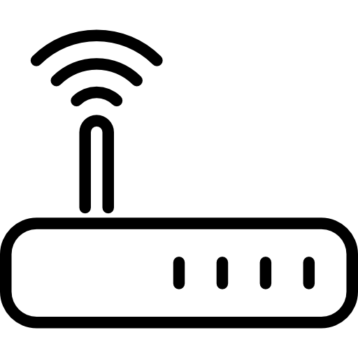
VNF = Virtual Network Function
Remote VNF
Local VNF
Cloud
Devices
Virtual Device
IDS
FW
IDS
Cloud
FW
Internet
IDS
NFz
Edge/Fog
NFy
NFx
NFx
Home Router
Cloudlet
NFy
End-devices
NFx
Charif.mahmoudi.us@gmail.com

Slide 4
Firewall
IDS
NAT
SDN
Source network
Destination network
Charif.mahmoudi.us@gmail.com

Slide 5
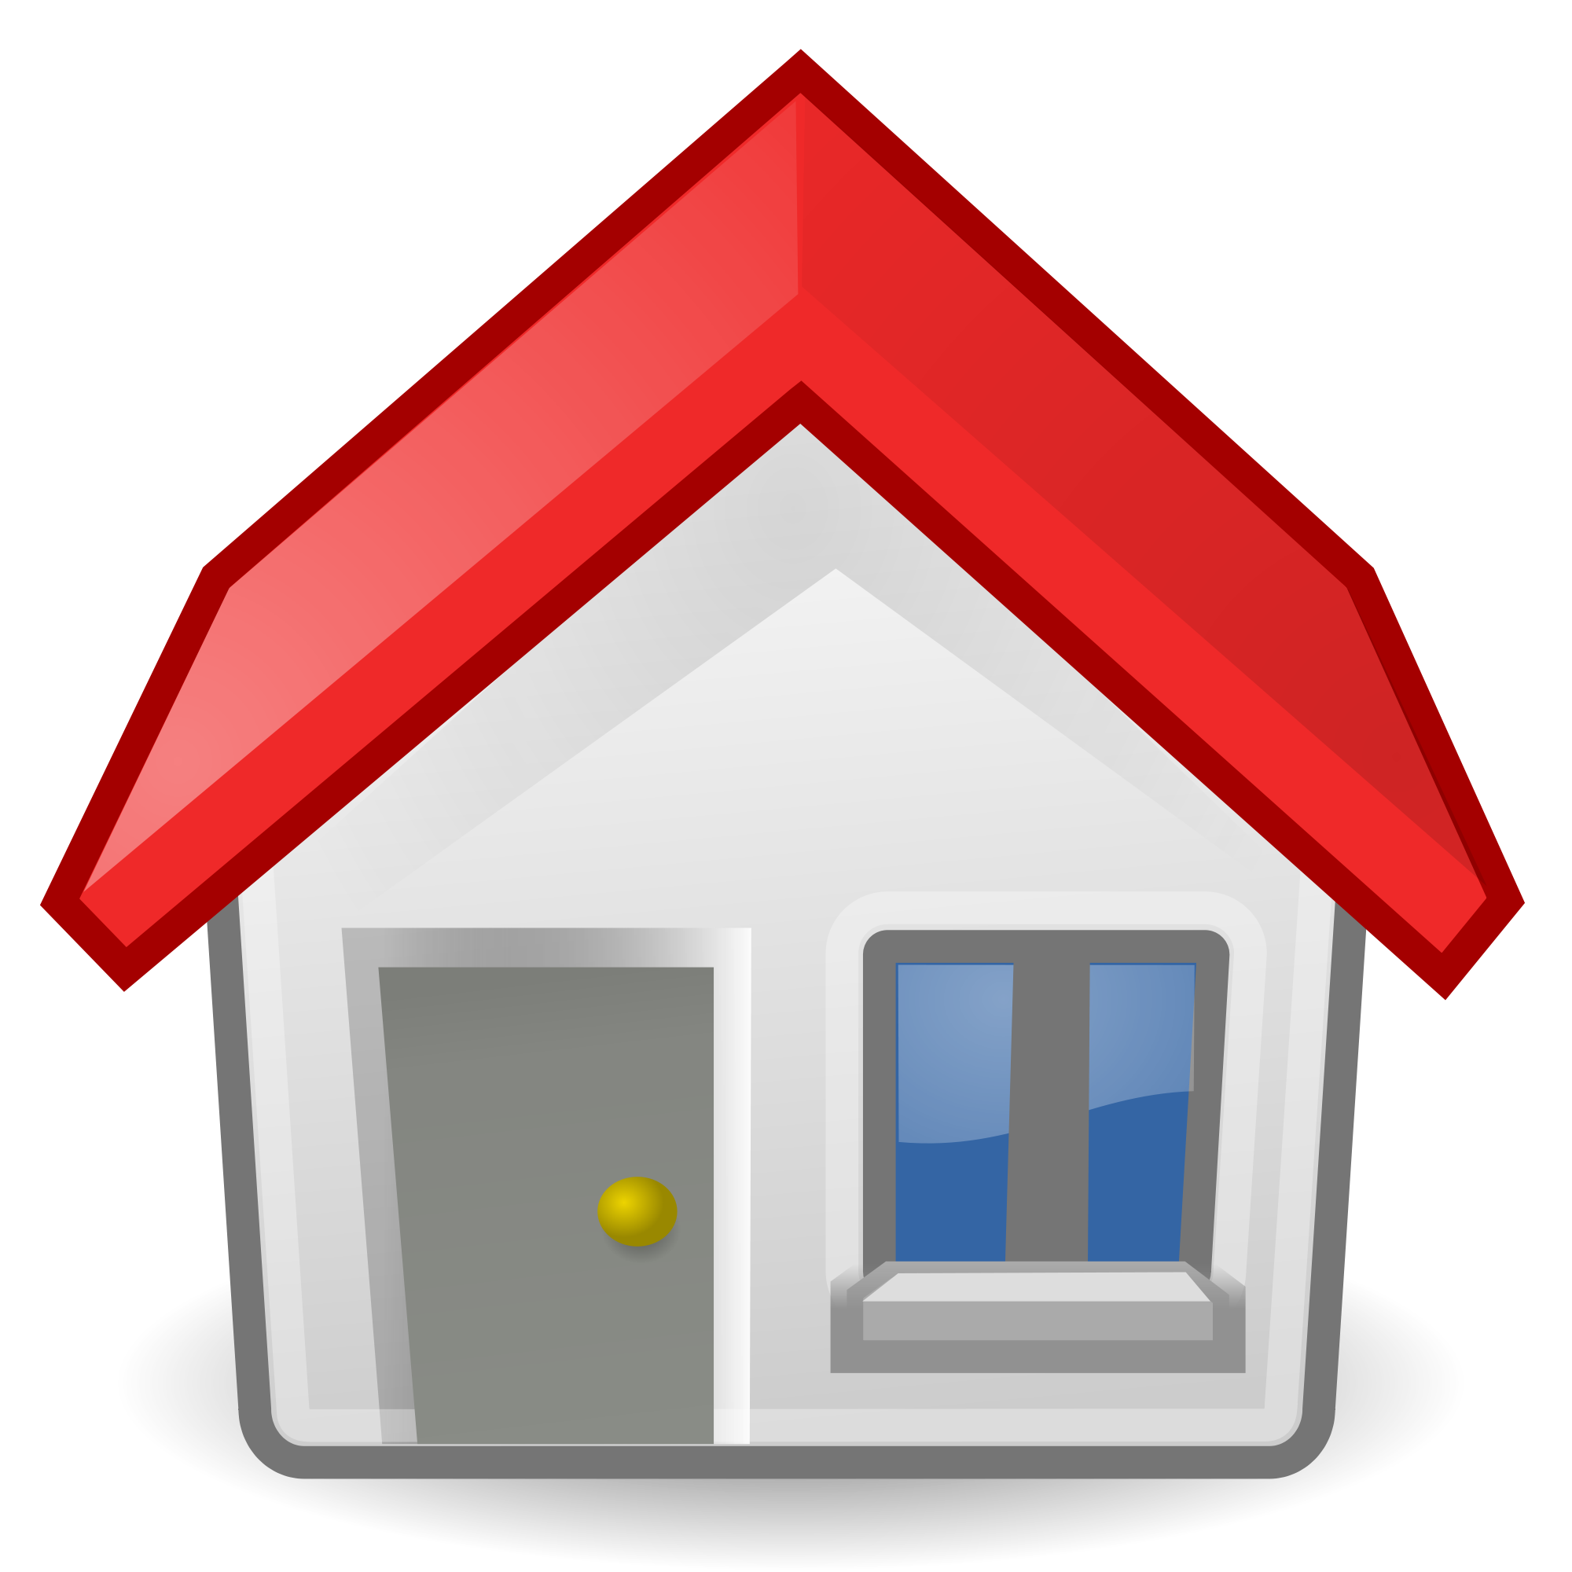
Destination network
Cloud
Firewall
IDS
WoT Servient
Remote facility
WoT Servient
SDN
WoT Servient
Cloudlet
Home
Router
WoT Servient
On-premises
Devices
Remote VNF
Local VNF
Charif.mahmoudi.us@gmail.com

Slide 6
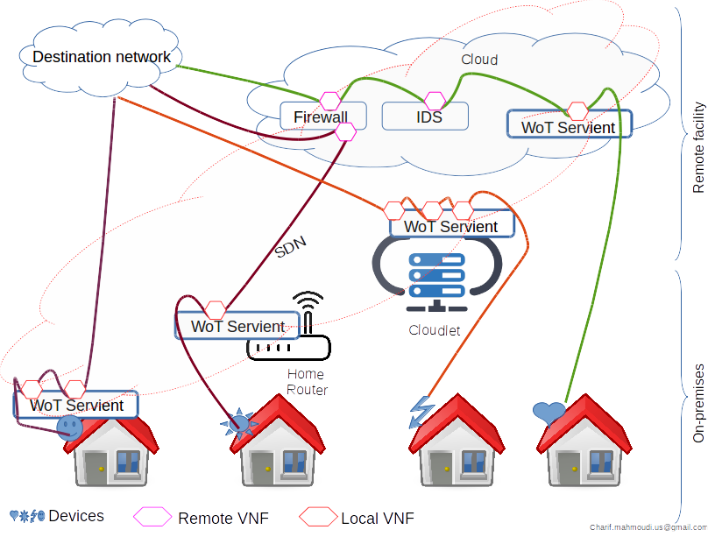

Slide 7
Destination network
Cloud
Firewall
IDS
WoT Servient
Remote facility
WoT Servient
SDN
Cloudlet
WoT Servient
Home
Router
WoT Servient
On-premises
Devices
Remote VNF
Local VNF

